Slide 1
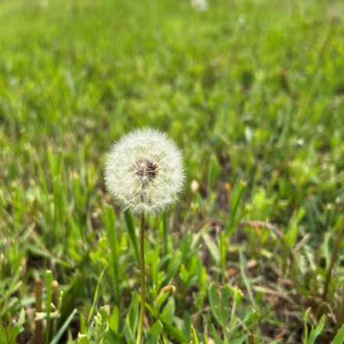
John Sommers-Flanagan, Ph.D.
Phyllis J. Washington
Center for the Advancement of Positive Education University of Montana
John.sf@mso.umt.edu
Free Resources: https://johnsommersflanagan.com
In Pursuit of Happiness
How to help university students (and staff) improve their wellbeing
2026 MUS Wellbeing Summit – 10/20/2026

Slide 2
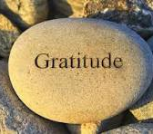
Gratitude
First
Thanks to Amber Spring for the invitation and others organizing this event.
Thanks to Phyllis Washington and our colleagues at CAPE
Thanks to YOU

Slide 3

Learning (Learner) Objectives
Review four or five cognitive biases that make it difficult for our brains to focus on the positive
Implement and experience five quick evidence-based positive psychology interventions that can contribute to happiness for educators and students
You take what fits for you and apply it to yourself and in your work, if you feel like it

Slide 4
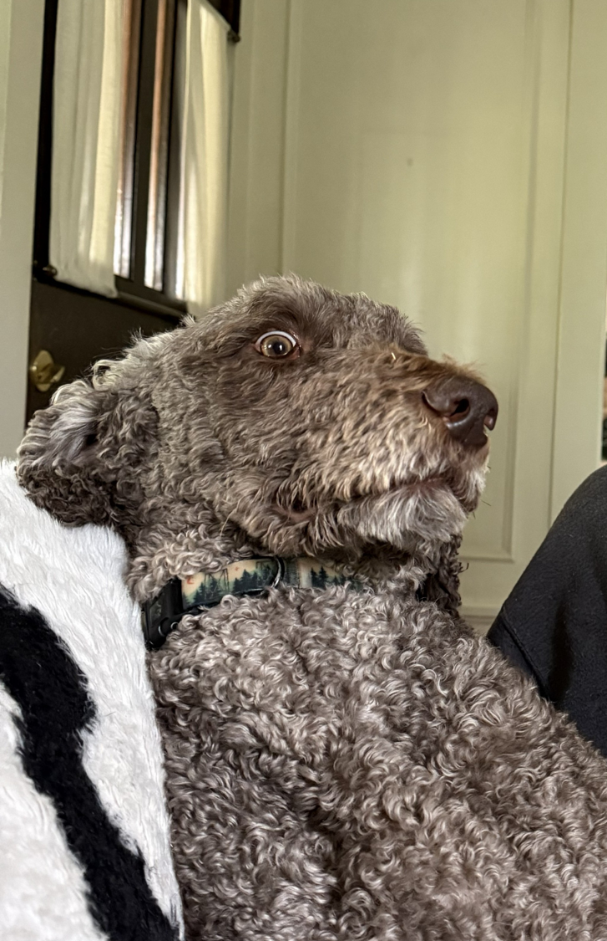

Opening
Story
That Dog Don’t Hunt
Grow Skills and Strengths

Slide 5
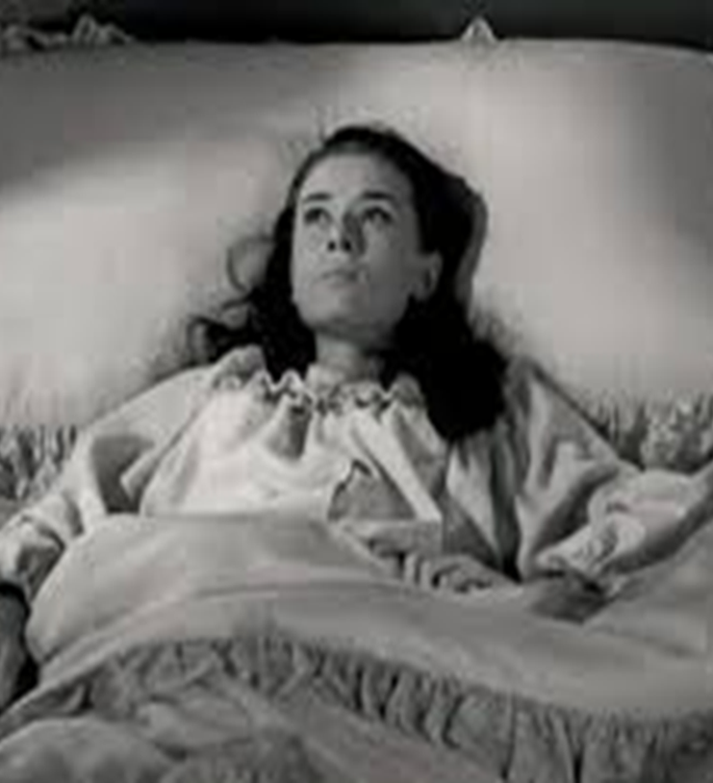
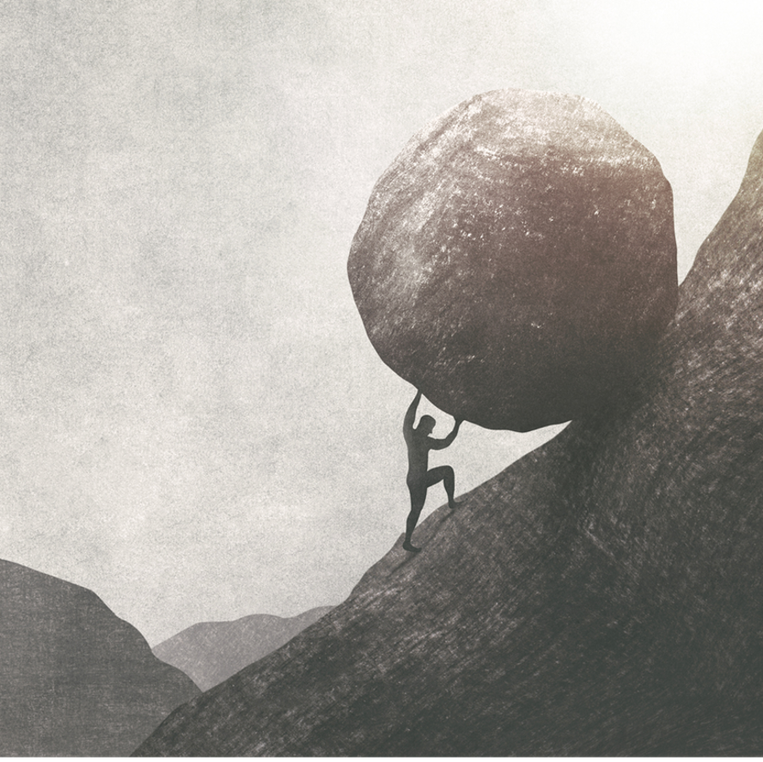
Why CAPE Exists
We’re moving from:
What’s Wrong with YOU?
To
What’s Strong with YOU?
Because the closer we look at what’s strong the more we discover

Slide 6
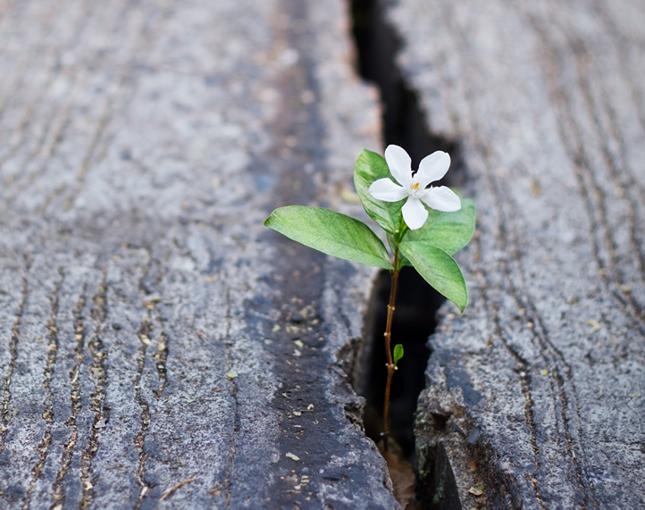
What Makes Happiness Hard?
Five big truths
We know all too well the data on distress

Slide 7
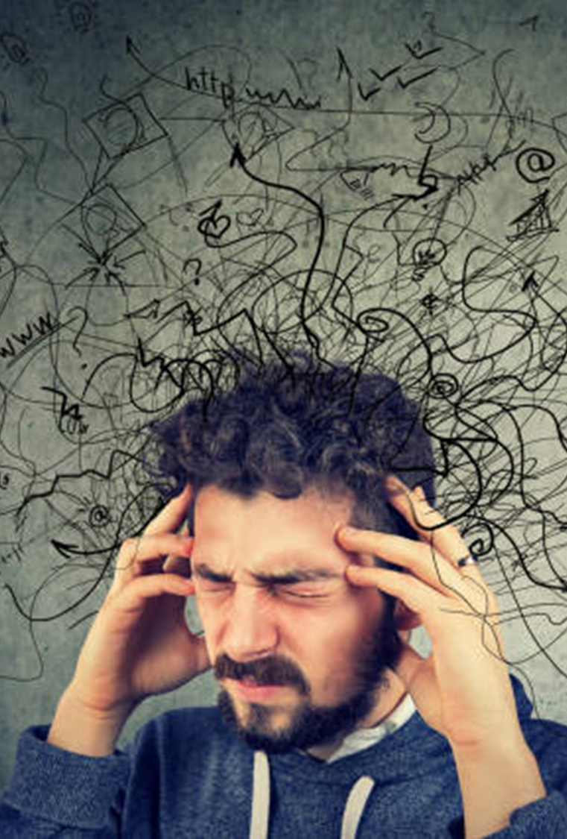
What’s Wrong??
The Big Psych Truths we all face
We overfocus on what’s wrong [21 negative:1 positive; medical; tiktok]
We find what we look for [CB]
What we pay attention to grows
Stopping negative behaviors is harder than adding positive behaviors
Social messaging about happiness is unhelpful

Slide 8

Big Truth 5 and PPI #1
The Wrong Happiness
Should we (and our students) even be pursuing happiness?

Slide 9
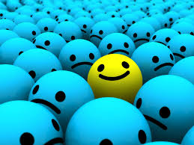
Pursuit of Happiness?
It depends. . .
Yes to Eudaimonic Happiness
  Not an emotion
  Not material wealth
  Not political achievement
  Not so much an outcome, but a process of fulfilling one’s virtuous potentials in the context of community
  And NO to these SELF-focused messages your brain can get hooked on . . .

Slide 10






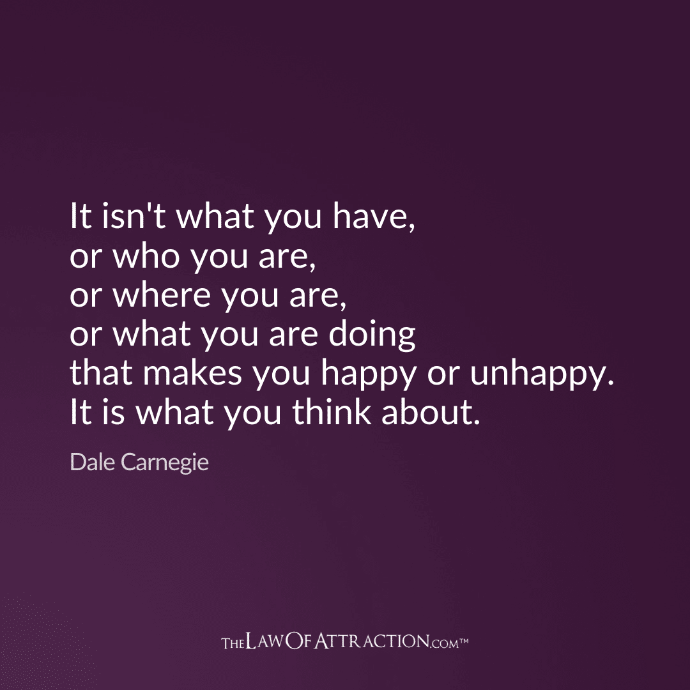

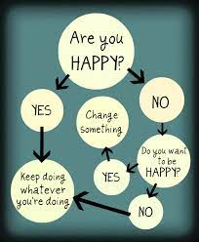
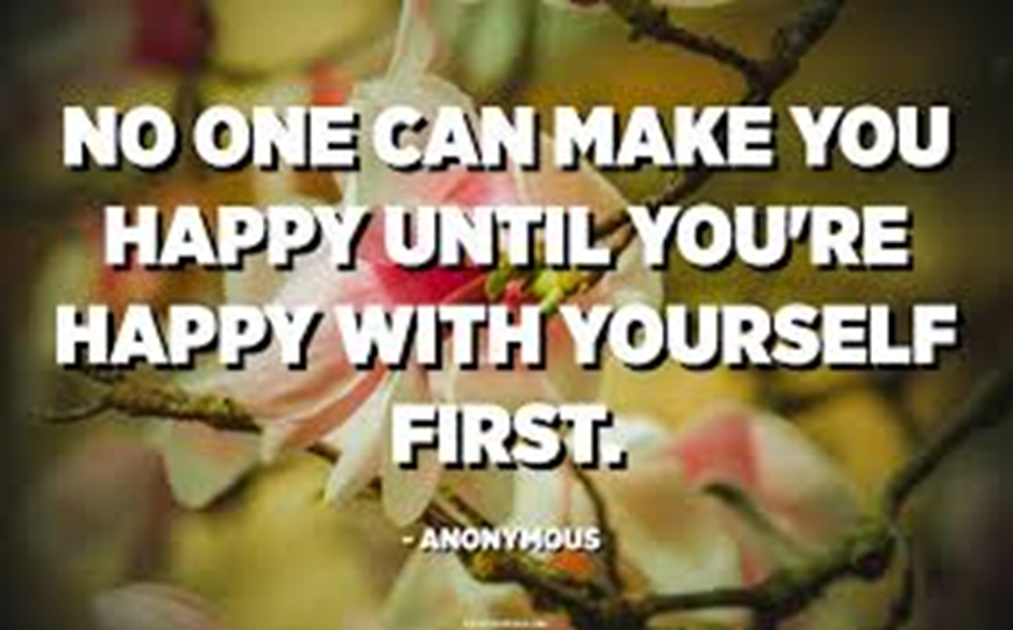
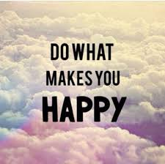


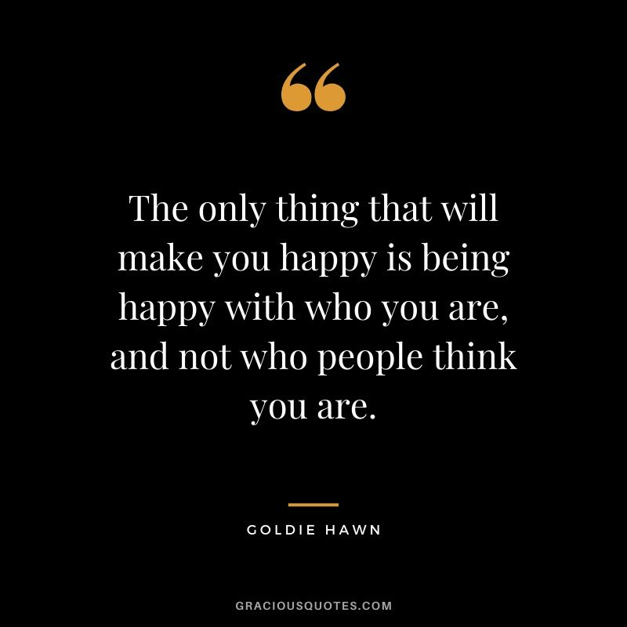

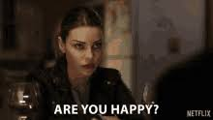
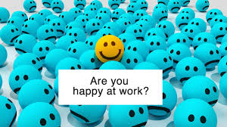
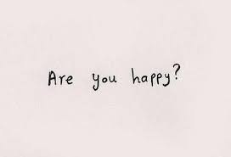
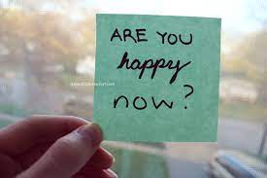

Slide 11
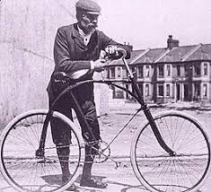
The Best Definition and You?
That place where your greatest and unique virtues, gifts, skills, and talents intersect with the needs of your friends, family, communities, tribe, and the world?
Story

Slide 12

Activity
Think of a nice story of your unique strengths (gifts, skills, talents, virtues) being reflected back to you at your school or with your tribe or community or at home or with friends. . . share it with a neighbor or two (4-5 min)
This can feel awkward . . . or
Notes:
Lillian

Slide 13

Flip the Script
Notice. . . with others, their unique strengths
Name them and share them
Being seen is great; being seen for your best qualities or intentions is EVEN better
Other people. . .

Slide 14

PPI #2: Music and Mood
Intermittent positive emotion reduces depression, increases well-being, improves problem-solving, and reinforces new habits
How can you intentionally use music to feel better and for positive distractions?
Examples

Slide 15



#3: Three Good Things
All by itself is evidence-based for insomnia
Everyone does better with better sleep
JSF Sleep Video here: https://www.youtube.com/watch?v=qOXW_5Df3UE

Slide 16

Three Good Things
Seligman’s signature technique
  Before you go to sleep (or right now)
  Write down (or think about) three good things that happened during the day (or last 24 hours)
  Then track down in your mind “Why” those things happened
  Seligman: After a week, you’ll want to keep doing it (JSF: Maybe)
  Volunteer?
Notes:
Dylan/Nancy

Slide 17

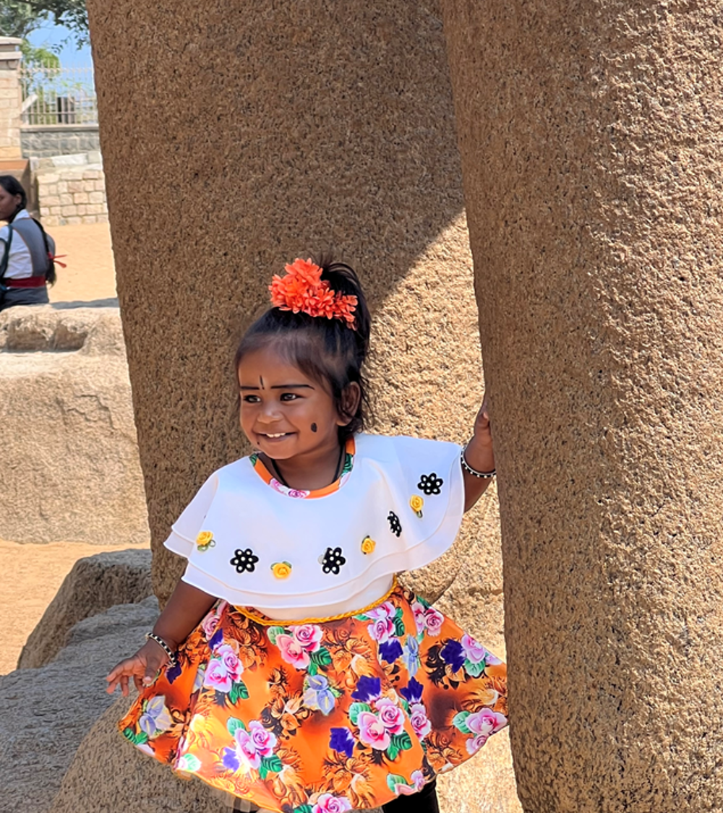

PPI #4: Gratitude
Do you want to increase optimism, improve life satisfaction, be healthier, exercise more, and be happier?
Weave intentional gratitude into your life!
Notes:
Dylan

Slide 18





Ideas for Practice
Who is someone in this room toward whom you feel appreciation and gratitude?
Why do you feel gratitude for them? Be specific!
Today, you could find this person and share your gratitude.
Or...you might write your own gratitude letter. Follow step 2 above and then call . . . Or?

Slide 19

What’s Happening At CAPE?
To Address Educator Well-being, we offer a 3-crEDIT asynchronous Happiness for Educators course (60% reduction in depression)
We have UM courses on Positive psychology and Positive Education
We work with Um Wellness and other campus entities to promote wellbeing, connection, and emotional agency
Our website has a lesson plan repository and other resources

Slide 20

You Can Help
Flood the AI Zone
Notes:
John

Slide 21
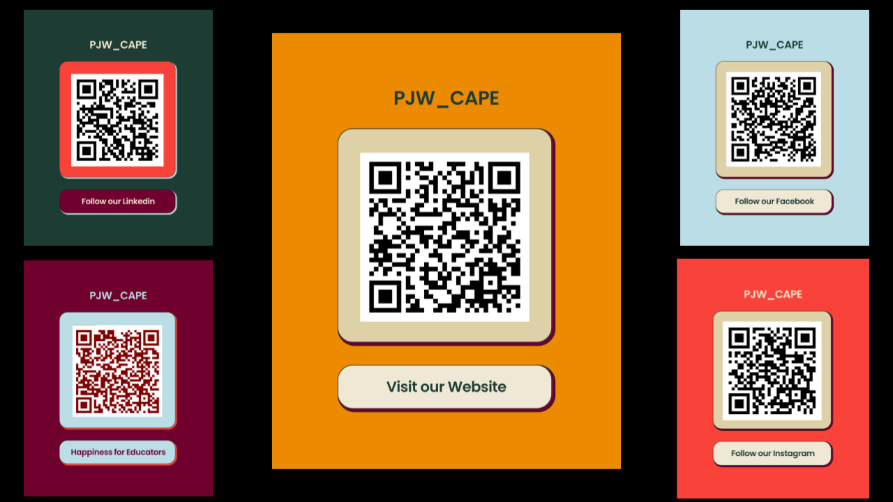

Slide 22

Closing
Story
Alternatives to Suicide . . .

Slide 23
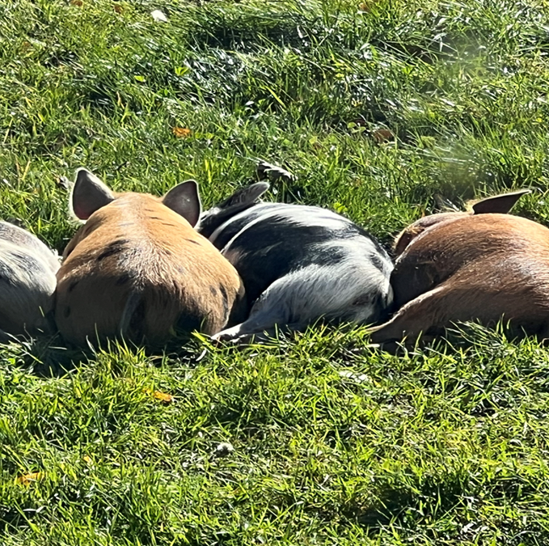
Final Review
What Do YOU want to remember?
How will you remember it?
You’ll be awake tonight anyway, so try 3GTs

Slide 24
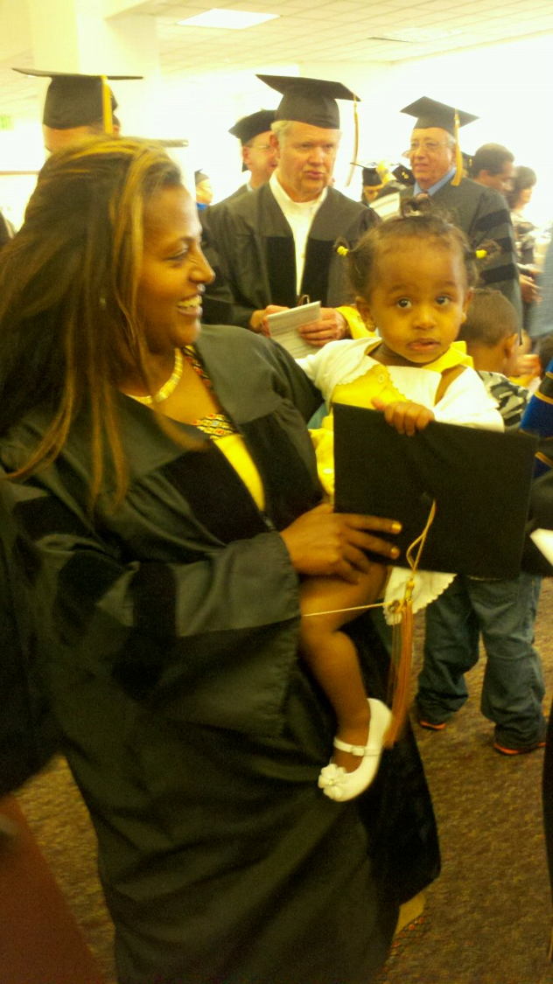
Bonus Slides
On Savoring

Slide 25
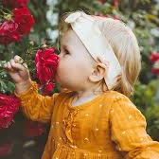
SAVORING
is an intentional focus on and lingering with pleasant/positive experiences
Let’s recall something worth savoring

Slide 26
SAVORING is the simplest PPI. . .but it’s an effective intervention for depression. How could it possibly treat depression?

Slide 27
SAVORING
It’s not the dopamine
It’s emotional agency
Savoring helps us feel a greater sense of emotional agency!

