Slide 1




Strengths Based Suicide Approach in Schools: Advantages and Challenges
Umut Arslan Ph.D.
John Sommers-Flanagan Ph.D.

Slide 2
Learning Objectives
Articulate key distinctions of collaborative, strengths-based approaches to suicide assessment
Identify and manage challenges to enhance the effectiveness of strengths-based suicide interventions
Understand the pros and cons of the contemporary emphasis on suicide screening tools in schools
Take whatever fits for you and your work

Slide 3
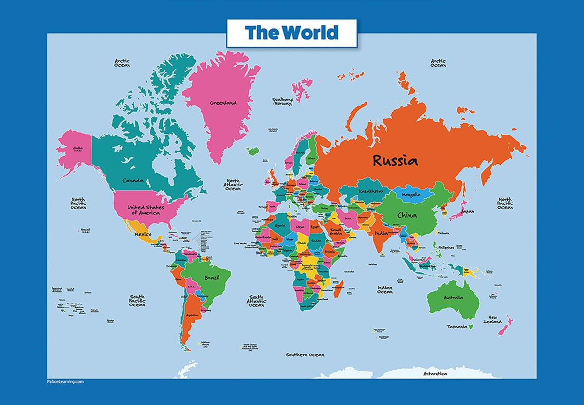
Understanding the Strengths-Based Approach: 5Ws + 1H
WHAT? | What is a strengths-based approach?
WHY? | Why strengths?
WHO? | Who has strengths?
WHERE? | Where are strengths found?
WHEN? | When do we look for strengths?
HOW? | How do we practice it?

Slide 4
Medical Model vs. Strengths-Based
[Let’s embrace both]
Positivistic Philosophy
Social Constructivist Philosophy
Suicidal thoughts and behaviors represent illness; we need to intervene
We are authority figures who know more about patient health than they do
The patient is a suicidal person
Suicidal thoughts and behaviors are a natural communication of pain
We collaborate on individualized safety plans
The patient is a whole person with strengths and resources

Slide 5
Medical Model vs. Strengths-Based
[Let’s embrace both]
Positivistic Philosophy
Social Constructivist Philosophy
We can predict* and prevent suicide
We use risk assessment procedures and questionnaires
We treat mental disorders
Suicide is mostly unpredictable*
We individualize risk factors and use collaborative and therapeutic assessment
We treat patient distress and suicidality

Slide 6
Collaborate, Elicit Strengths, and Focus on Hope
Use collaborative and therapeutic assessment
Start with empathy and compassion, NORMALIZE, and recognize that the problem may not be “in” the person [We acknowledge our legacy of pathologizing diversity].
Traditional approaches oriented toward psychopathology.
Explicitly value and ask about clients’ positive experiences, personal strengths and coping strategies.
Implement specific intervention strategies that target distress and suicidality. ​

Slide 7
Challenges: Normalize Distress and Assess Whole Person
Suicide = one of the most critical topics in counseling
Countertransference (Michaud et al., 2023)
Acutely suicidal patients (Joiner et al, 2018)
Common counselor reactions (Colson et al., 1986):

Slide 8
Challenges: Value Relationship Over Formulas
Competency is critical with suicidal clients
Only 45% of counseling students trained (Cureton & Sheesley, 2018)
Only 40–50% of graduate programs require suicide-specific training (Cho et al., 2024)
CACREP (2024): Suicide prevention referenced only twice
Ethical outcome: We can only expect what counselors are taught

Slide 9
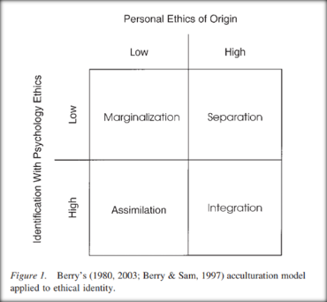
Challenges: Collaborate, Elicit Strengths and Focus on Hope
Cultural Barriers
Counselor Training
Insurance Systems
Training Models

Slide 10
Where to Start in Schools (ASCA)
The School Counselor's Role
School counselors have a legal and ethical responsibility to provide a holistic approach to student’s social/emotional well-being and comprehensive suicide prevention policies including prevention, intervention, and postvention components.
Prevention Components
1. Educate staff to recognize risk factors, warning signs, protective factors, response procedures, referrals, postvention and resources regarding youth suicide prevention

Slide 11
Where to Start in Schools (ASCA)
Prevention Components
2. Provide developmentally appropriate student instruction on the importance of safe and healthy choices and coping strategies focused on resiliency building and how to recognize risk factors and warning signs of mental health conditions and suicide in oneself and others (American Foundation for Suicide Prevention et al., 2019)

Slide 12
Where to Start in Schools (ASCA)
Prevention Components
3. Use data from universal screeners to proactively identify and address students’ academic, career and social/emotional needs while ensuring appropriate supports are in place to respond to students’ immediate needs (ASCA, 2023)

Slide 13
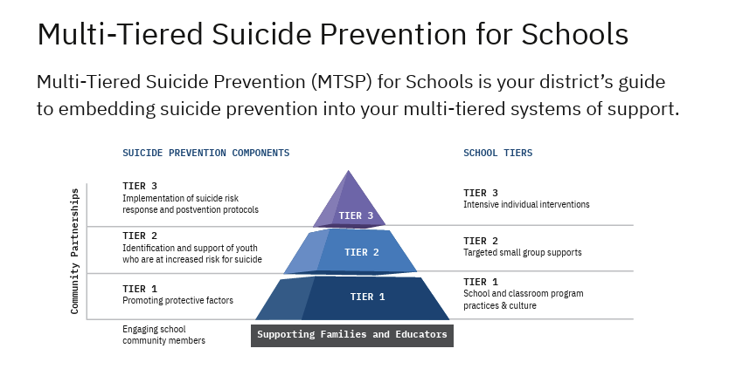

Slide 14
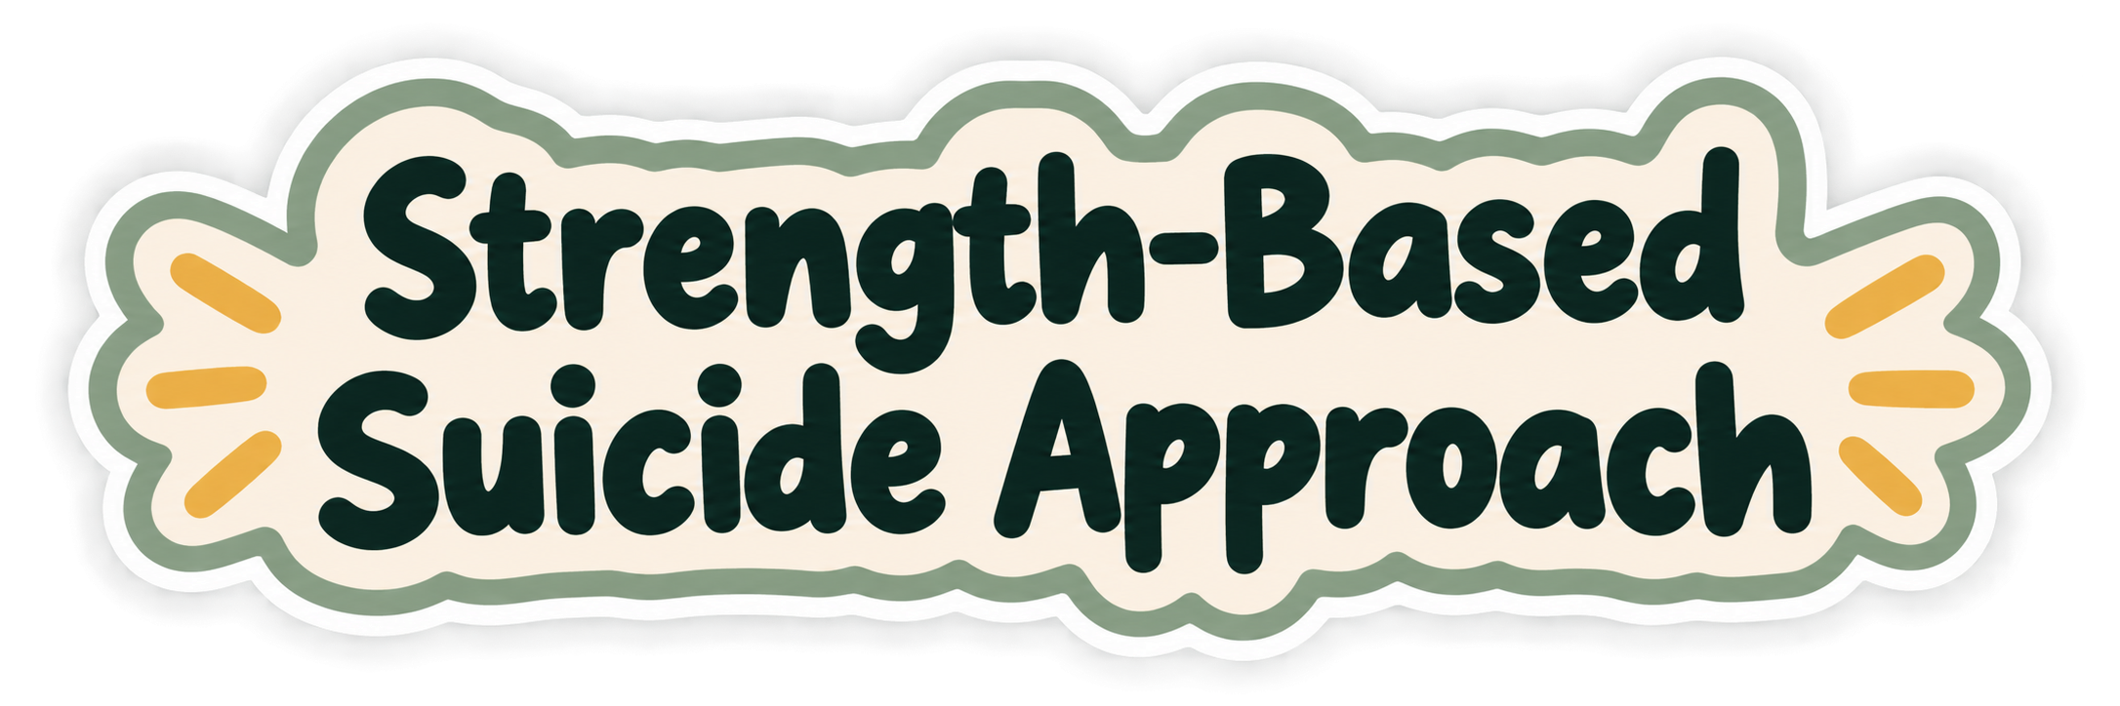
Tier 1- Universal prevention for ALL students
Individual Strengths: Character strengths & well-being (White & Waters, 2015)
Resilience: Coping skills & psychological resources (Dray et al., 2017)
School Connectedness “I belong here.” “People care about me.” (Wilkins et al., 2023)
Culturally Relevant Protective Factors: Family • Cultural identity • Hope • Future orientation • Spirituality (Brooks Stephens et al., 2026)
Strengths Systemically: The Good School (White & Walker, 2015)
Build
Notes:
White, M. A., & Waters, L. E. (2015). A case study of 'The Good School:' Examples of the use of Peterson's strengths-based approach with students. The journal of positive psychology, 10(1), 69–76. https://doi.org/10.1080/17439760.2014.920408
1. Wilkins NJ, Krause KH, Verlenden JV, et al. School Connectedness and Risk Behaviors and Experiences Among High School Students — Youth Risk Behavior Survey, United States, 2021. MMWR Suppl 2023;72(Suppl-1):13–21. DOI: http://dx.doi.org/10.15585/mmwr.su7201a2
2. Brooks Stephens, J. R., Murphy, E. R., Robinson, T. A., Arnold, E., & Mims, L. C. (2026). A strengths-based approach to suicide prevention among Black youth: Advancing the Black youth thriving framework through a systematic review. Psychological trauma : theory, research, practice and policy, 10.1037/tra0002141. Advance online publication. https://doi.org/10.1037/tra0002141
3. Dray, J., Bowman, J., Campbell, E., Freund, M., Wolfenden, L., Hodder, R. K., McElwaine, K., Tremain, D., Bartlem, K., Bailey, J., Small, T., Palazzi, K., Oldmeadow, C., & Wiggers, J. (2017). Systematic Review of Universal Resilience-Focused Interventions Targeting Child and Adolescent Mental Health in the School Setting. Journal of the American Academy of Child and Adolescent Psychiatry, 56(10), 813–824. https://doi.org/10.1016/j.jaac.2017.07.780

Slide 15
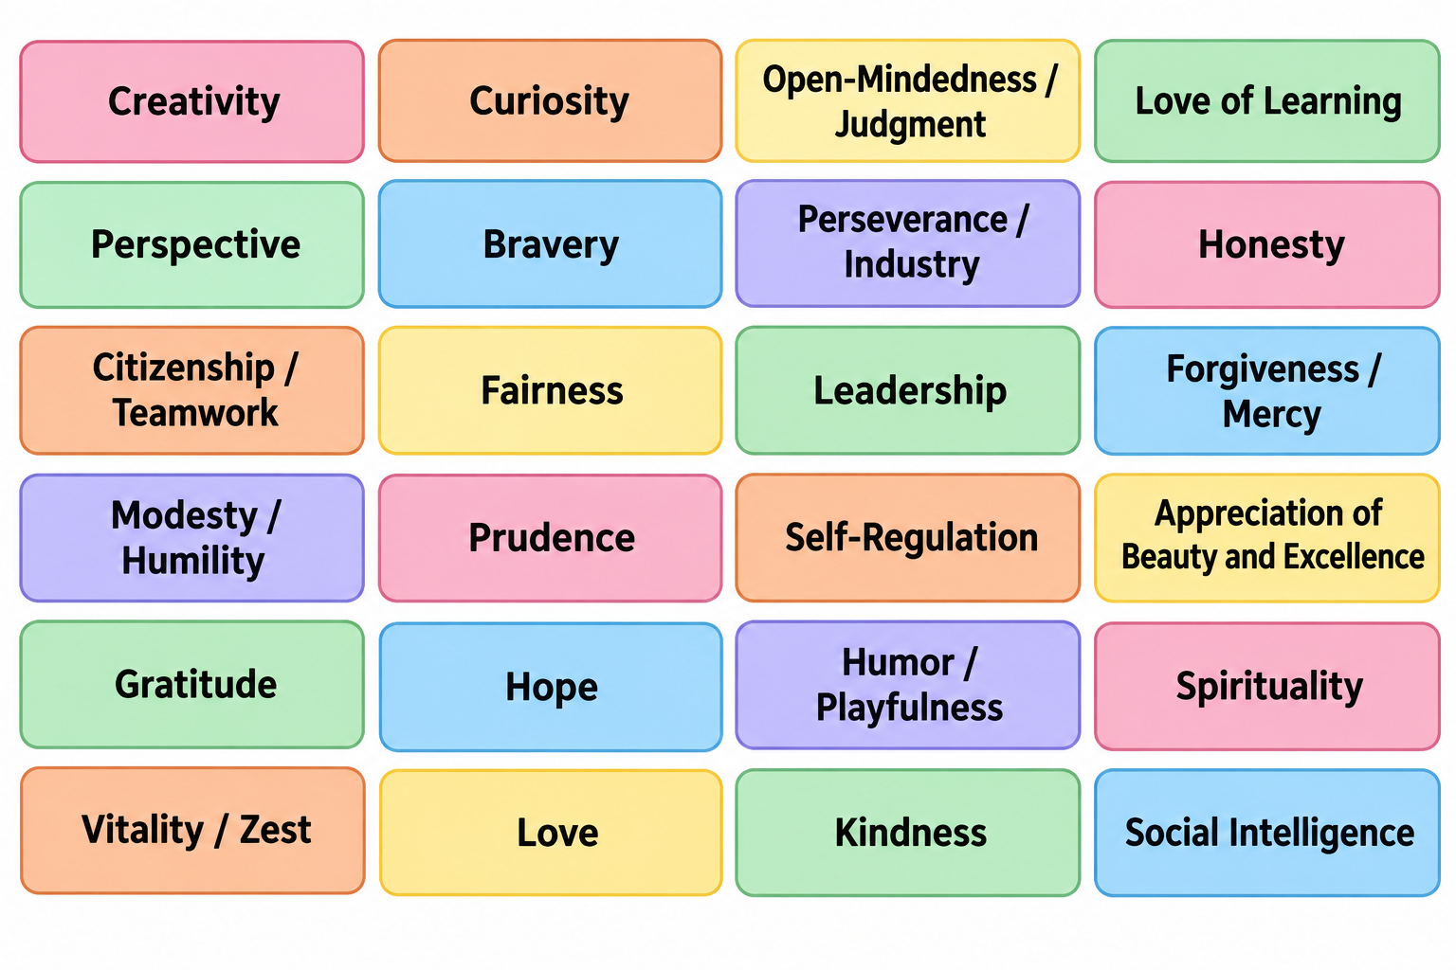

Tier 2 – Identification and Support
Peterson, C. (2006b). The values in action VIA classification of strengths. In M. Csikszentmihalyi & I. Csikszentmihalyi (Eds.), A life worth living: Contributions to positive psychology (pp. 29–48). Oxford: New York, NY.
Notes:
Peterson, C. (2006b). The values in action VIA classification of strengths. In M. Csikszentmihalyi & I. Csikszentmihalyi (Eds.), A life worth living: Contributions to positive psychology (pp. 29–48). Oxford: New York, NY.

Slide 16
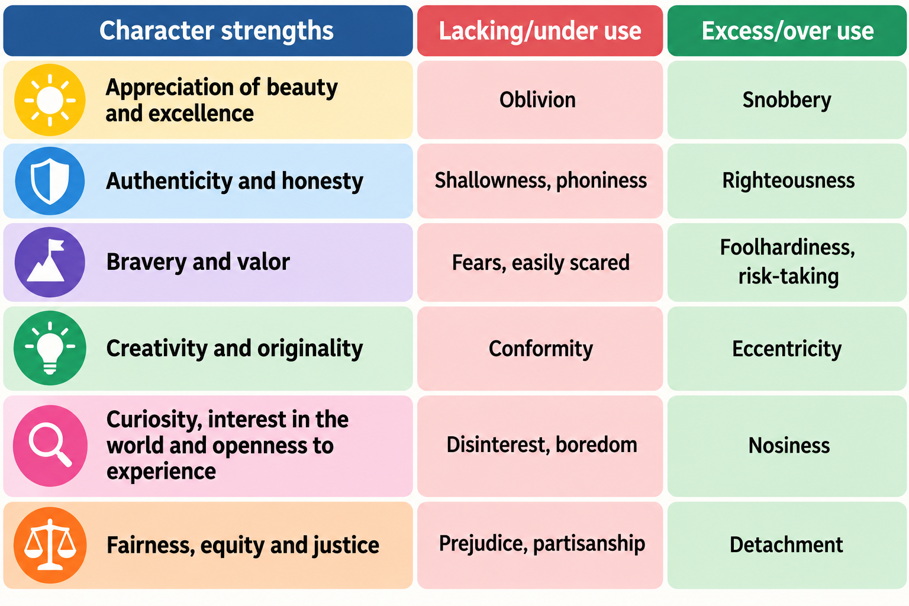
Tier 2 – Identification and Support
Rashid, T. (2015). Positive psychotherapy: A strength-based approach. The Journal of Positive Psychology, 10(1), 25–40. https://doi-org.unk.idm.oclc.org/10.1080/17439760.2014.920411
Notes:
Rashid, T. (2015). Positive psychotherapy: A strength-based approach. The Journal of Positive Psychology, 10(1), 25–40. https://doi-org.unk.idm.oclc.org/10.1080/17439760.2014.920411

Slide 17
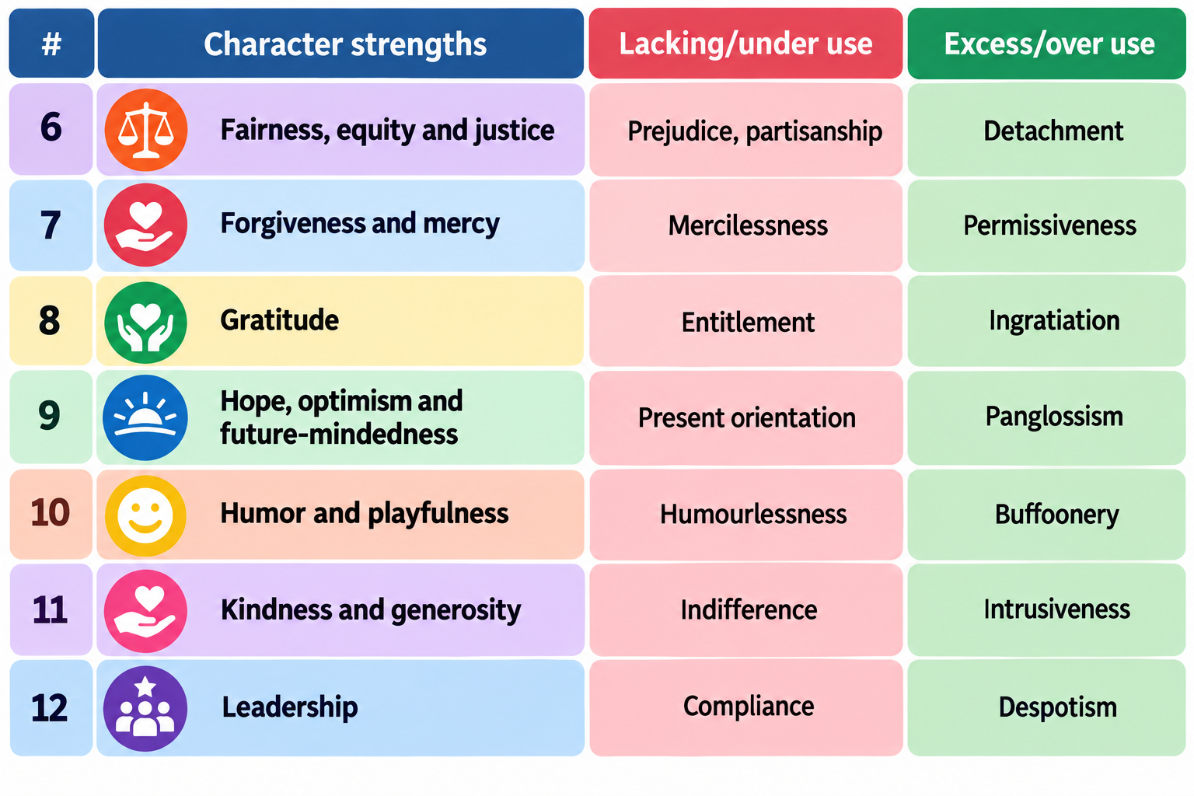
Tier 2 – Identification and Support
Rashid, T. (2015). Positive psychotherapy: A strength-based approach. The Journal of Positive Psychology, 10(1), 25–40. https://doi-org.unk.idm.oclc.org/10.1080/17439760.2014.920411
Notes:
Rashid, T. (2015). Positive psychotherapy: A strength-based approach. The Journal of Positive Psychology, 10(1), 25–40. https://doi-org.unk.idm.oclc.org/10.1080/17439760.2014.920411

Slide 18
Tier 3 - Individualized suicide interventions
  Emotional – Separate emotional pain from the self
  Cognitive – Managing activated core beliefs
  Interpersonal – The social universe

Slide 19
Research-Based Suicide Interventions
Stanley and Brown’s collaborative safety planning (JSF video demo: https://www.youtube.com/watch?v=jd7PM9HFDO4)
Motivational interviewing and goal-setting with youth in emergency departments – especially with a call-back.
Craig Byran’s Crisis Response Plan- RCT found
  Veterans in ER 76% less likely to attempt in next 6 months when asked to discuss reasons for living.
  Less likely to be hospitalized (Bryan et al., 2017)
  Experience significant increases in positive emotions (Bryan et al., 2017)
  Experience increased optimism (Rozek et al., 2018).

Slide 20
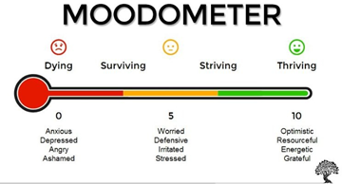
Mood Scaling Demo (if time)
Strengths-based questions:
What’s the best (or least low) mood you’ve ever had this week?
What was happening that helped you have such a high mood?

Slide 21
Resources
https://montanahappinessproject.com/​
https://johnsommersflanagan.com/
https://www.umt.edu/education/specunits/cape/

Slide 22
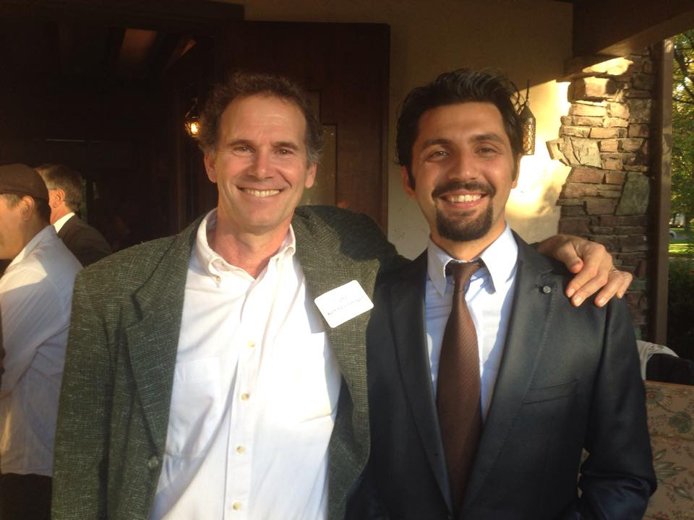
Questions & Discussion

