Slide 1



The Future of Counseling is Counseling for Happiness
John Sommers-Flanagan, Ph.D.
Center for the Advancement of Positive Education
John.sf@mso.umt.edu

Slide 2
You Can Download and Read these PPTs over and over again by going to: https://johnsommersflanagan.com/

Slide 3
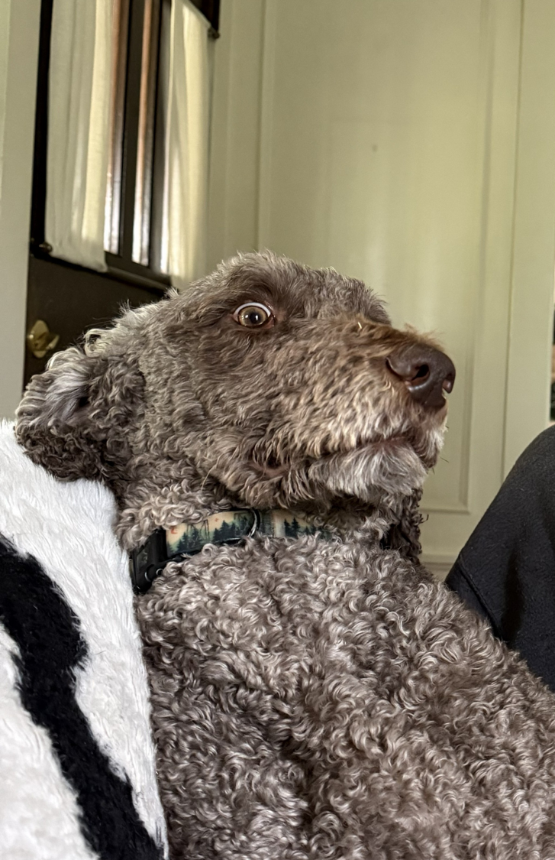
Opening Story
That Dog Don’t Hunt

Slide 4
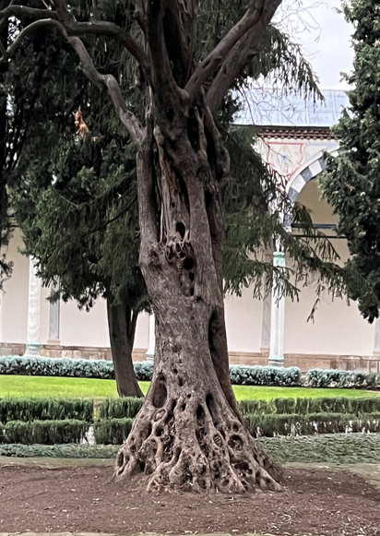
Trigger and Strength Warnings
Trigger Warning: I will be talking about happiness
The research on trigger warnings
Strength Warning
I

Slide 5


Remember . . .
Trigger warnings are suggestions about what you might not be able to handle
Strength warnings are suggestions about how learning new knowledge and gaining experiences can make you STRONGER

Slide 6
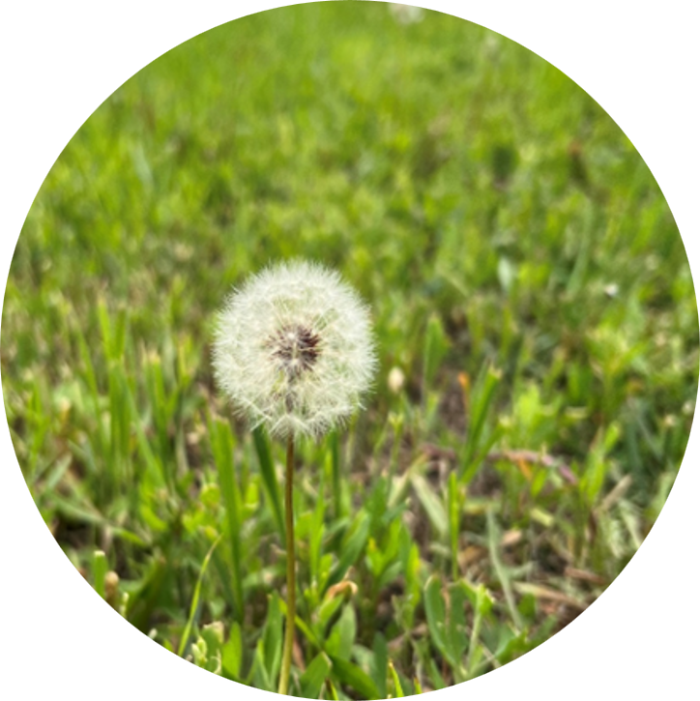
Learning (Learner) Objectives
You come with YOUR knowledge, experience, and expectations – You come with YOUR WHY and PURPOSE
I offer ideas about happiness and ideas for how to move toward wellbeing
You take what fits for you and apply it to yourself and in your work, if you feel like it

Slide 7
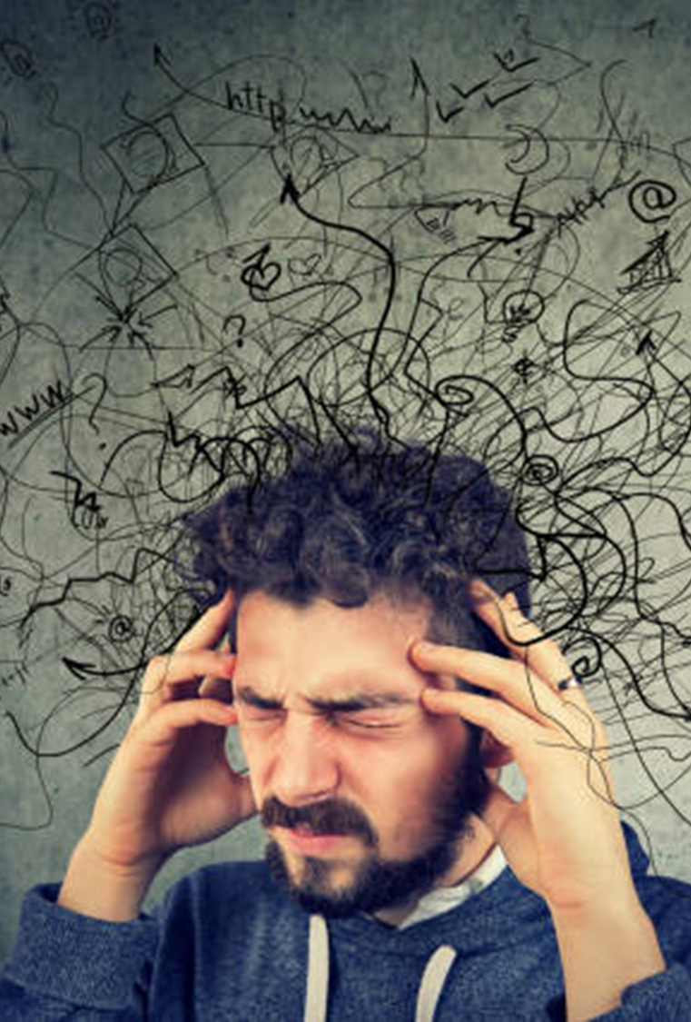
Let’s Do Diagnosis
We have more mental health literacy, more evidence-based MH treatments, more prevention programs
And. . .we have more diagnoses
How does that work?
Nosophobia and Medical Student Syndrome and Hyperdiagnosis
What’s wrong with you?

Slide 8
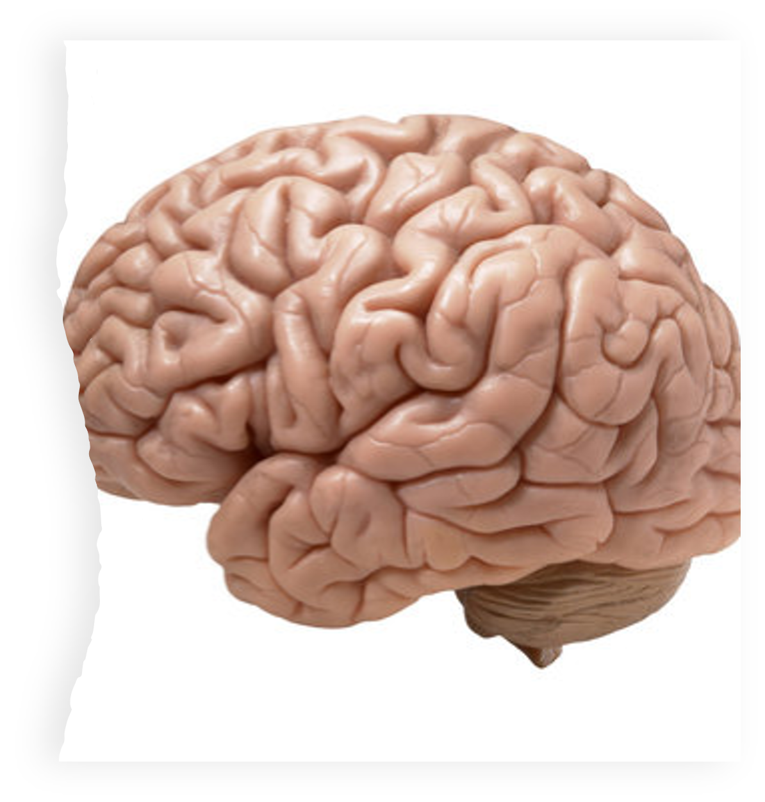
What is Mental Health?
Trick question: What is mental health prevention?
Do we really want to prevent mental health?
What is mental health?
Mental health is a state of mental well-being that enables people to cope with the stresses of life, realize their abilities, learn and work well, and contribute to their community. (W.H.O.)

Slide 9

Fight-or-Flight
We pathologize fear, sadness, grief, etc.
The origins of fight-or-flight??
Shall we run from distress or approach wellbeing?
If we’re counselors, we should approach wellbeing
How do we help clients, students, and ourselves approach and embrace wellbeing?

Slide 10
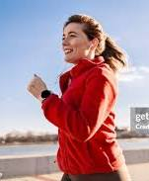
The Pursuit of Happiness
If we chase happiness, we’ll never catch it, because it’s so damn fast
If we chase the wrong happiness, we’ll never fill ourselves with meaning and connection
If we chase the right happiness and realize it’s the chase and not the catching, we have a tolerably good chance to FEEL BETTER about life and ourselves

Slide 11

The Wrong Happiness
Should we (and our students and clients) even be pursuing happiness?

Slide 12
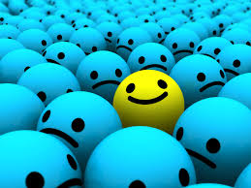
Pursuit of Happiness?
It depends. . .
Yes to Eudaimonic Happiness
  Not an emotion
  Not material wealth
  Not political achievement
  Not so much an outcome, but a process of fulfilling one’s virtuous potentials in the context of community
  And NO to these SELF-focused messages . . .

Slide 13



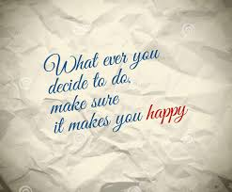
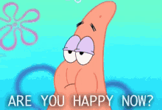

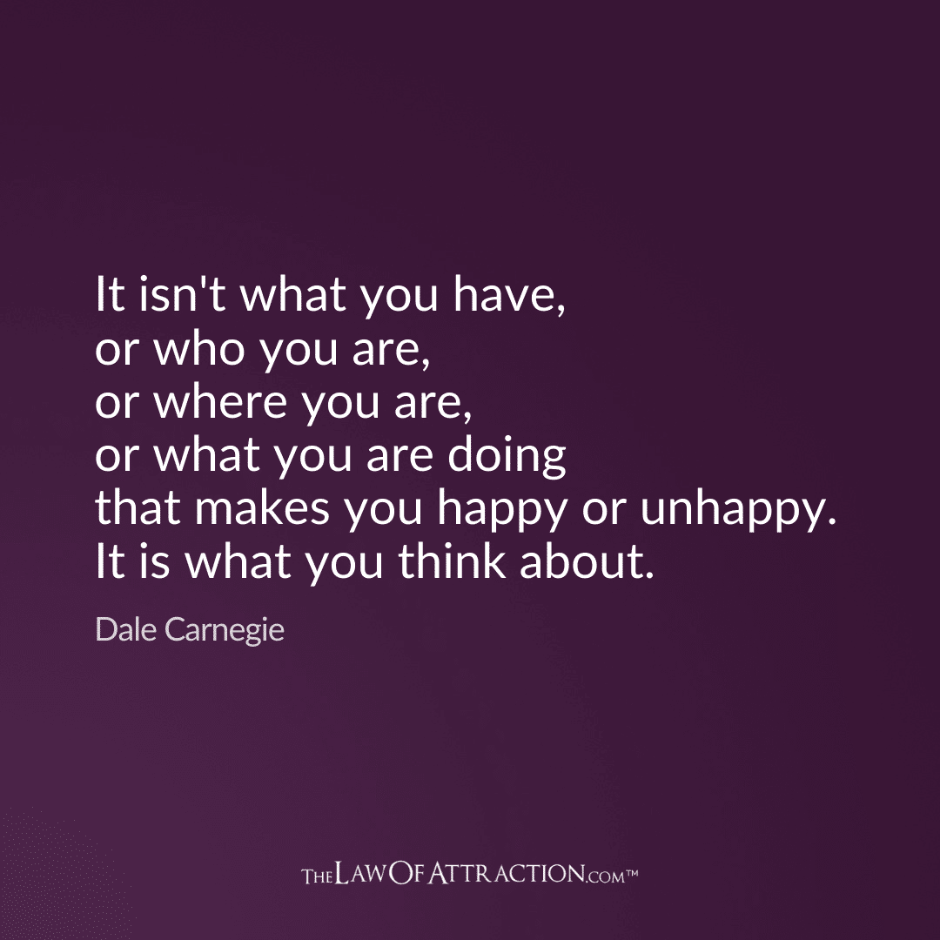

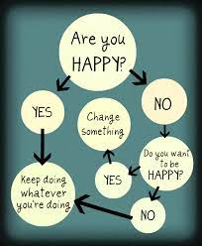
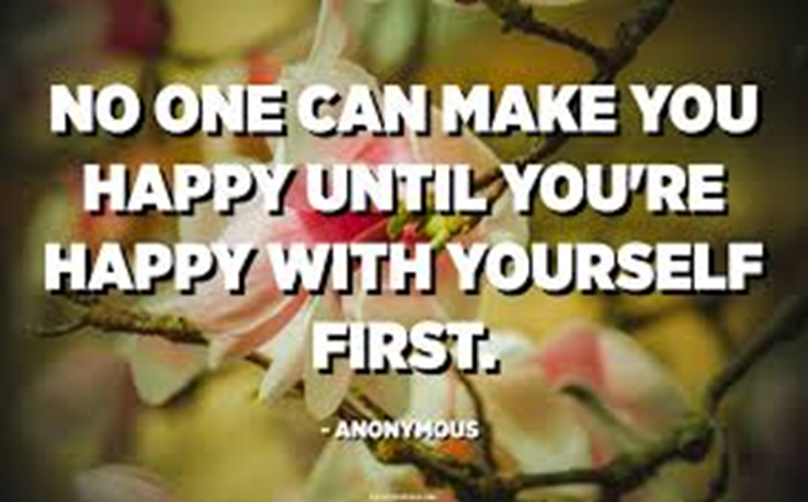
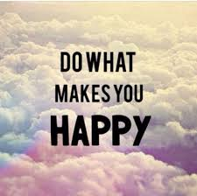

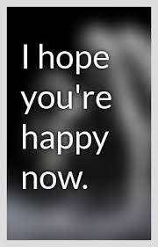
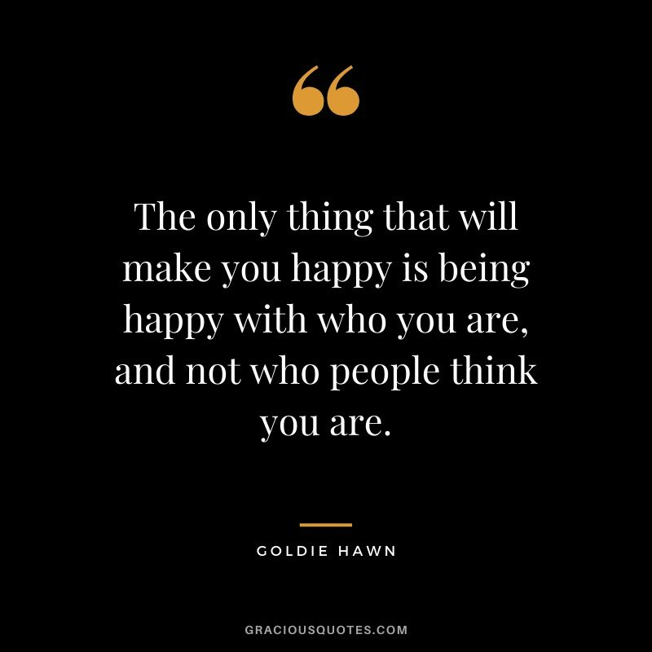
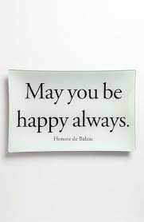
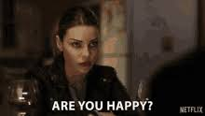
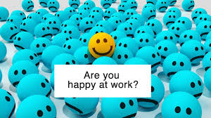
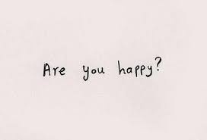
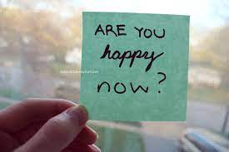

Slide 14
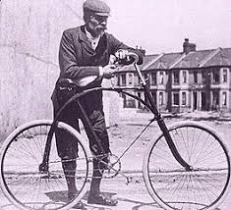
The Best Definition and You?
That place where your greatest and unique virtues, gifts, skills, and talents intersect with the needs of your friends, family, communities, tribe, and the world?
JSF – Biking story

Slide 15

Activity
Think of a nice story of your unique strengths (gifts, skills, talents, virtues) being seen at your school or with your tribe or community or at home or with friends. . . share it with a neighbor or two (5-7 min)
This can feel awkward . . . Or***
Notes:
Lillian

Slide 16

Flip the Happiness
Notice. . . with others, their unique strengths
Name them and share them
Being seen is great; being seen for your best qualities is better
Other people. . .

Slide 17
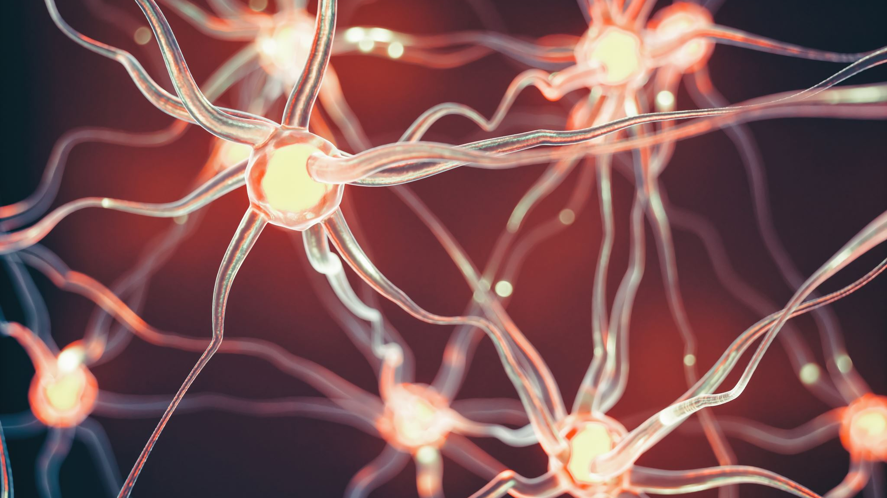
The Muscle Metaphor in Counseling
Neurons that fire together, wire together (Hebb)

Slide 18
Three Good Things – An Experiment
Seligman’s signature technique
Evidence-based for depression and insomnia
Over the past day. . .identify three “good” things that happened and why they happened
VOLUNTEER and process commentary opportunities

Slide 19

Just Say No to Toxic Positivity

Slide 20
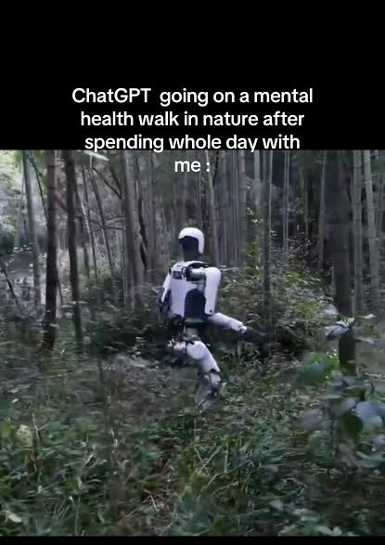
AI Bot or Human Counselor?
AI Bots will know more than we do
So. . .what can we offer?
It’s the relationship, dummy (real-time, process-based, with feedback, mutual empathy, and REAL practice for developing relationships outside the counseling context)
It doesn’t get any better or more practical than that

Slide 21
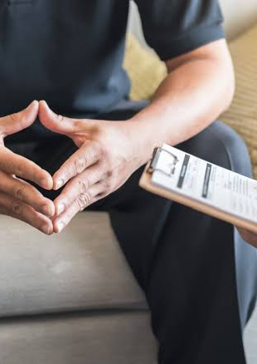
How About Strengths-Based Screenings?
What we pay attention to grows
We’ve been paying attention to and growing mental disorders – quite efficiently
What if we look at everything we do through a strengths-based lens?
What if we build the SB muscle and process the pain and judgments as needed?

Slide 22
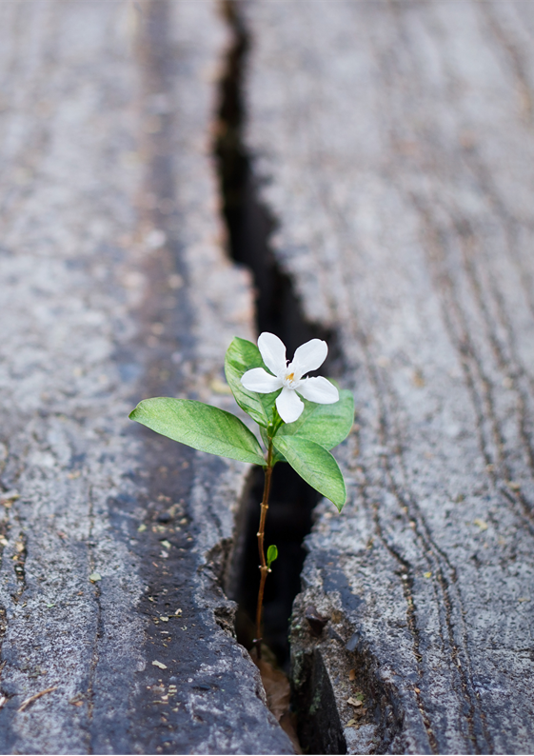
Let’s Do Gratitude
Look around
Look inside
Identify a person, a place, an experience, a choice, or anything else that you feel grateful for

Slide 23
Closing Story
Eight Warts

Slide 24

Closing Comments and Your Summary
Counseling is the original wellness-oriented approach to mental health
Let’s keep our roots and emphasize strengths and growing strengths, skills, virtues, and resources
What do you want to remember or take with you?

