Slide 1
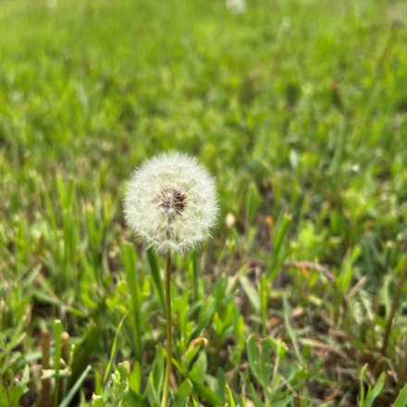

John Sommers-Flanagan, Ph.D.
Phyllis J. Washington
Center for the Advancement of Positive Education University of Montana
John.sf@mso.umt.edu
Free Resources: https://johnsommersflanagan.com
How to Grow Well-Being in Teachers and Schools
2026 OPI Summer Institute
MSU – Bozeman

Slide 2
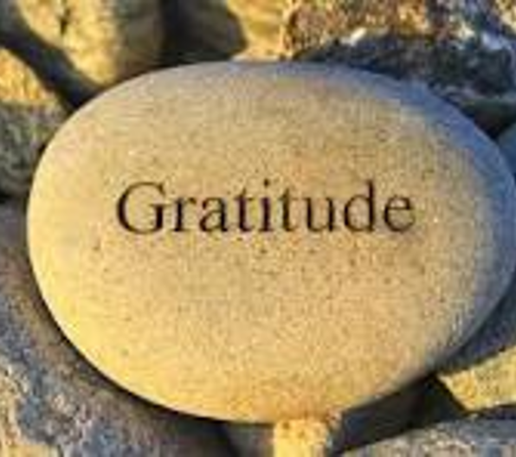
Gratitude
First
Thanks to the Tammy L and the OPI organizers
Thanks to Tammy TK and Phyllis Washington and our colleagues at CAPE: https://www.umt.edu/education/cape/
Thanks to YOU

Slide 3


Opening
Story
30 minutes of profanity or 20 min of play
Get Curious, Not Furious:
Resist automatic negative reactions

Slide 4

Preparation
Trigger warning – Why?
I will talk about mental/behavioral health and happiness and say things (like the F-word)
Research indicates. . .
Strength-warning. . .

Slide 5

Remember . . .
Trigger warnings are suggestions about what you might not be able to handle
Strength warnings are suggestions about how learning new knowledge and gaining experiences can make you STRONGER
And SUGGESTIONS are powerful

Slide 6
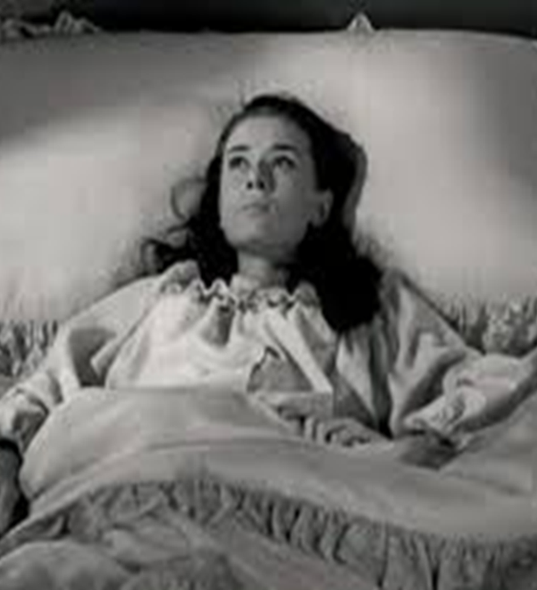
Why CAPE?
What’s Wrong with YOU?
The closer we look

Slide 7

We Need to Work On
What’s Strong with YOU?
Look closer

Slide 8

Because of:
How Your Brain Works
Six
PERVASIVE
Truths

Slide 9
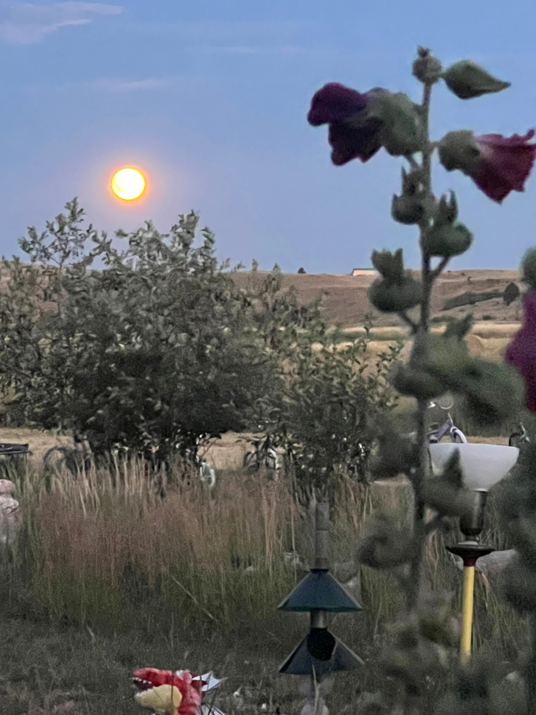
Beware of What’s Wrong
The pervasive Psych Truths that you and your students face. . .
We overfocus on what’s wrong
We find what we look for
What we pay attention to grows
Social messaging about happiness is unhelpful
The Trickster will try to sabotage you
Stopping negative behaviors is harder than adding positive behaviors

Slide 10
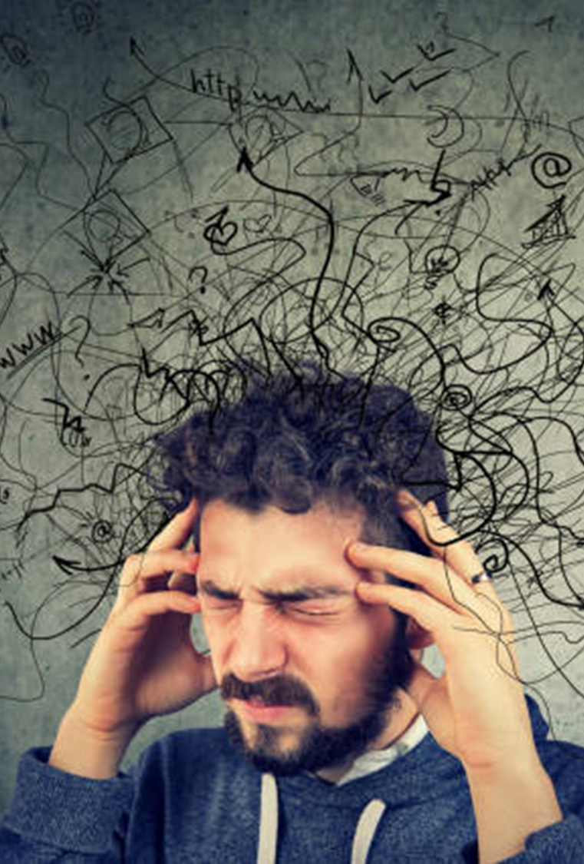
1 – We’re Vulnerable to Over-Focusing on What’s Wrong with Us and Others
Medical and MH student disease
Social Media/TikTok
I finally figured out what’s wrong with me [identity + explanations]

Slide 11
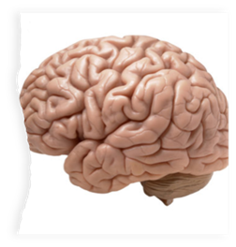
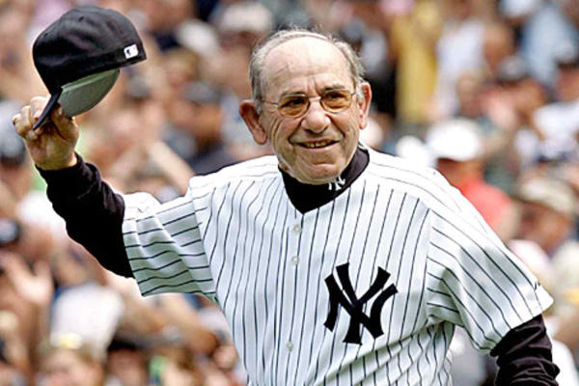

2 – Confirmation Bias
We find
what we
look for
In ourselves, in others, and in the world

Slide 12

3 – What We Pay Attention to Grows
The parts of your brain you use – you GROW
Duh: Neurons that fire together, wire together [Romantic partner, child, etc.]
If we focus on failures, we get BETTER at focusing on our failures. . .soon it’s automatic

Slide 13

4 – The Problem with Happiness
Should we (and our students) even be pursuing happiness?

Slide 14

Pursuit of Happiness?
It depends. . .
Yes, to Eudaimonic Happiness
  Not an emotion
  Not material wealth
  Not political achievement
  Not so much an outcome, but a process of fulfilling one’s virtuous potentials in the context of community
  And NO to these SELF-focused messages . . .

Slide 15




















Slide 16

The Best Definition and You?
That place where your greatest and unique virtues, gifts, skills, and talents intersect with the needs of your friends, family, communities, tribe, and the world?
JSF – Biking story

Slide 17

Activity
Think of a nice story of your unique strengths (gifts, skills, talents, virtues) being seen at your school or with your tribe or community or at home or with friends. . . share it with a neighbor or two (5-7 min)
This can feel awkward . . .OR!
Notes:
Lillian

Slide 18

Flip the Happiness
Notice. . . with others, their unique strengths
Name them and share them
Being seen is great; being seen for your best qualities is better
Other people. . .

Slide 19
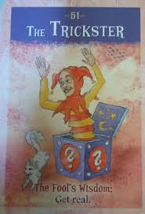
5 – The Trickster is a Jungian Archetype that Tries to Foil and Spoil Good Things
When we focus on happiness, sadness can come
When we focus on positivity, critiques creep in
When we seek joy, our brains can push us back toward misery

Slide 20
Why Review What’s Wrong?
Because when you experience negativity, it doesn’t mean something is wrong with you
We will overfocus on what’s wrong
We find what we look for
What we pay attention to grows
Social messaging about happiness is unhelpful
The Trickster will try to sabotage
Stopping negative behaviors is harder than adding positive behaviors

Slide 21
How does positive psychology-psychotherapy-education work?
Well-Being
Problems
Well-Being
Ex: Ability to GENERATE POSITIVE EMOTION. Not just inside a person but also between and among people and within and between communities
We grow POSITIVES: The Muscle Metaphor . . . We grow the Positive. How do you GROW strengths in your schools?
Notes:
Positive psychotherapy integrates positive psychology principles and empirically-supported techniques (PPIs) with foundational principles of psychotherapeutic change (e.g., therapeutic relationship is critical, person-in-context, therapeutic attunement). Most approaches grounded in Broaden and Build and most intentionally cultivate positive emotions. Actual moves of therapists is what varies.
Goal-focused positive psychotherapy (Conoley & Scheel, 2018) contributes to client’s ability to face and accept life’s losses and unchangeable difficulties by increasing subjective well-being. “The inevitability of suffering and loss in life heightens the importance of learning the skills to embrace the joy in life, to be meager or bountiful” (p. 5). The physical sciences metaphor of “fixing” broken thoughts, feelings, and behaviors is not a good fit with the human condition with all of our limits and capabilities. Pain and suffering associated with loss and death but also posttraumatic growth and/or expressions of resilience and thriving.
Plumb et al., 2020: GFPP therapists collaborate with client to: a) set approach goals, b) cultivate positive emotions generally and within session, c) focus on client and cultural strengths, and foster hope using techniques like: a) Three Good Things, b) Capitalization (by therapist), and c) Mindful self-compassion.
Hence, Helen Neville’s focus on Justice and Joy (or Black Girl Magic/Joy).

Slide 22

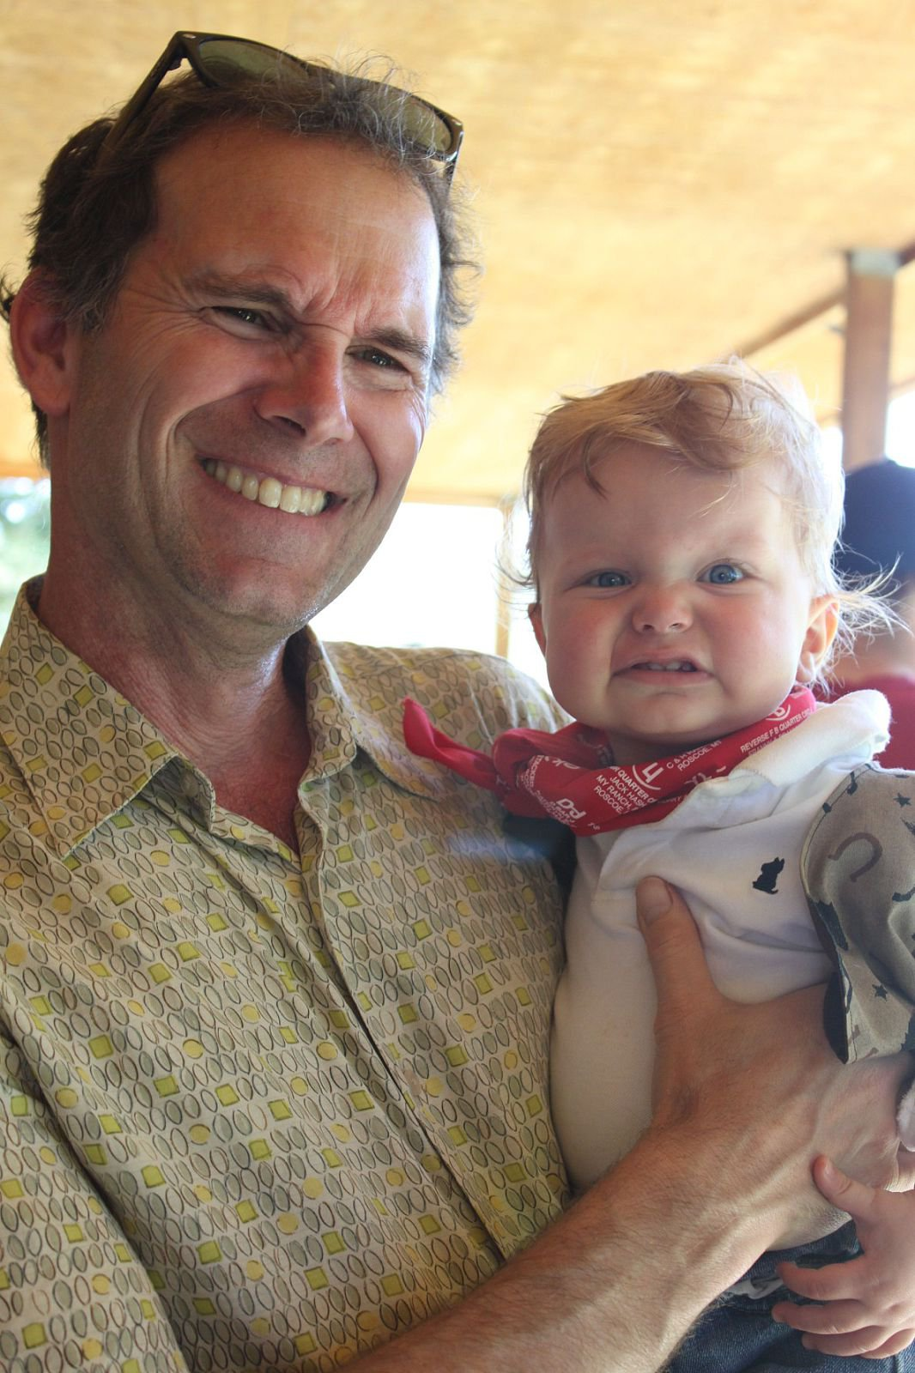
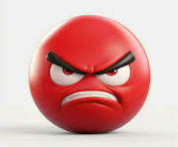
The Process
Let’s Grow Wellbeing
A Story about Bad Moods and the CAPE Philosophy
1990-2014

Slide 23


The Process – 2
Anyone here
ever had someone tell you to
“Cheer Up?!”
Or
“Smile!”

Slide 24
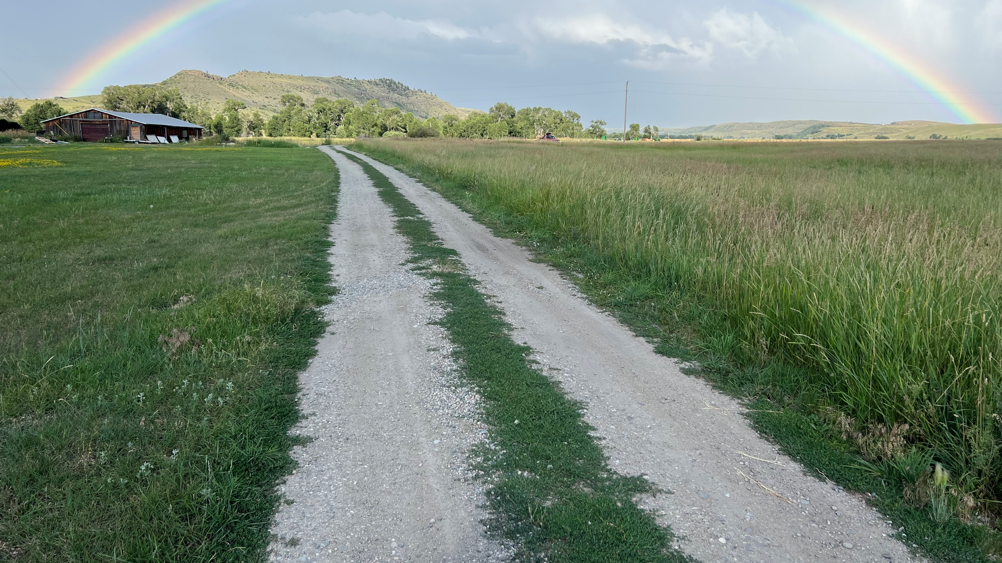
The Process – 3
Ever get stuck in a bad mood?
What if YOU could be
THE CAPTAIN
of your own emotional ship

Slide 25
The Three-Step Emotional
Change Trick
Step One
Honor YOUR Emotion
Notes:
We may or may not do this-John

Slide 26
The Three-Step Emotional Change Trick
Step Two
Think a New Thought . . . or
Do Something Different
(grow positive emotions)
Notes:
We may or may not do this-John

Slide 27

The Three-Step Emotional
Change Trick
Step Three
Share the Good Mood
Notes:
We may or may not do this-John

Slide 28
The Three-Step Emotional
Change Trick. . .is happening all the time
Step Four
Teach Someone the 3 Steps
Notes:
We may or may not do this-John

Slide 29

Let's try another positive psychology intervention (PPI)!
Notes:
John

Slide 30

Sample (step 2) Intervention
Three Good Things
Survey: Three types of insomnia
Rumination is all-natural, but not helpful
Notes:
Dylan/Nancy?

Slide 31

Three Good Things
Seligman’s signature technique
  Before you go to sleep (or right now)
  Write down (or think about) three good things that happened during the day (or last 24 hours)
  Then track down in your mind “Why” those things happened
  Seligman: After a week, you’ll want to keep doing it (JSF: Maybe)
  Volunteer?
Notes:
Dylan/Nancy

Slide 32



Three Good Things
All by itself is evidence-based for insomnia
Everyone does better with better sleep
Sleep Video here: https://www.youtube.com/watch?v=qOXW_5Df3UE

Slide 33
What’s Happening at CAPE to Help Grow Wellbeing in Teachers and Schools ?
Notes:
John

Slide 34

CAPE Vision 1: We want healthier educators who are eudaimonically happier. . .
Does a 3-Credit Grad Course on HFE Make a Difference?
Notes:
John

Slide 35

Our Outcomes
After the Course
60% reduction in depression scores [to about 12%]
But also, educators had:
  More hope, positive emotions, mindfulness, and social support
  Better sleep, fewer headaches and sick days
  Reduced gastrointestinal
  and respiratory distress
  Med to Large Effect Sizes (d)
Before the 3-credit course
About 30% of educators scored as clinically depressed
451 educators

Slide 36

But those are just questionnaire results
What do educators say about the course?
Notes:
John

Slide 37

We Asked 363 of the Educators
“Please share, using as few or as many words as you like, how you were impacted by taking the happiness for educators course.”
321 (88%) responded to this optional question
All 321 responses were positive

Slide 38

#258 – More Prepared for My Calling
This course reaffirmed for me my strengths as a teacher and a human. It helped me look at some things I perceived as flaws, and instead, see them as strengths or at least an opportunity for a strength to be built. I realized because of this course that I do in fact have tons of support from my family, and that my role as a teacher is not just a career, but a calling. As a result, I feel more prepared to begin this new school year, and more equipped to deal with obstacles and challenges as they inevitably come my way. I am more hopeful for this year, for me, and my students.

Slide 39
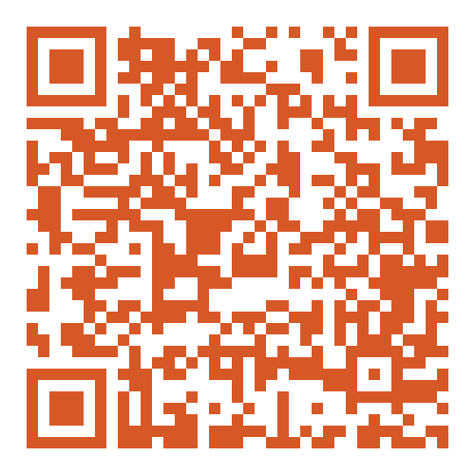
To Enroll in HFE
3 grad credits or 45 OPI renewal units for $150 or $100
https://extended.umt.edu/umextended/course/course.aspx?C=712

Slide 40
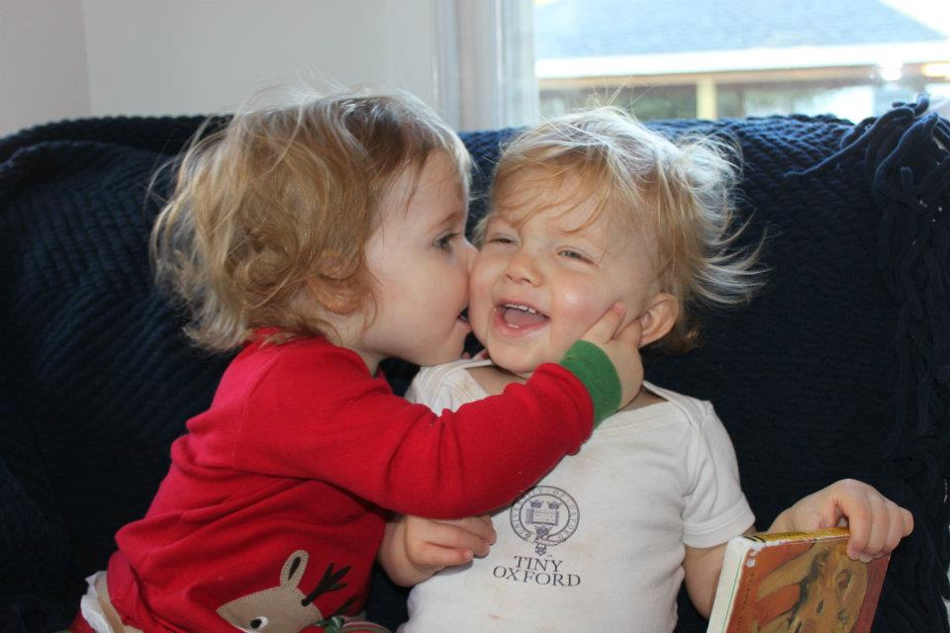
CAPE Vision 2: We want educators to know about positive education and apply it with students
HFS (HFE 2.0) coming in the fall
We’re building a positive education lesson plan repository (see: https://www.umt.edu/education/cape/lesson-plans.php )
Notes:
John

Slide 41
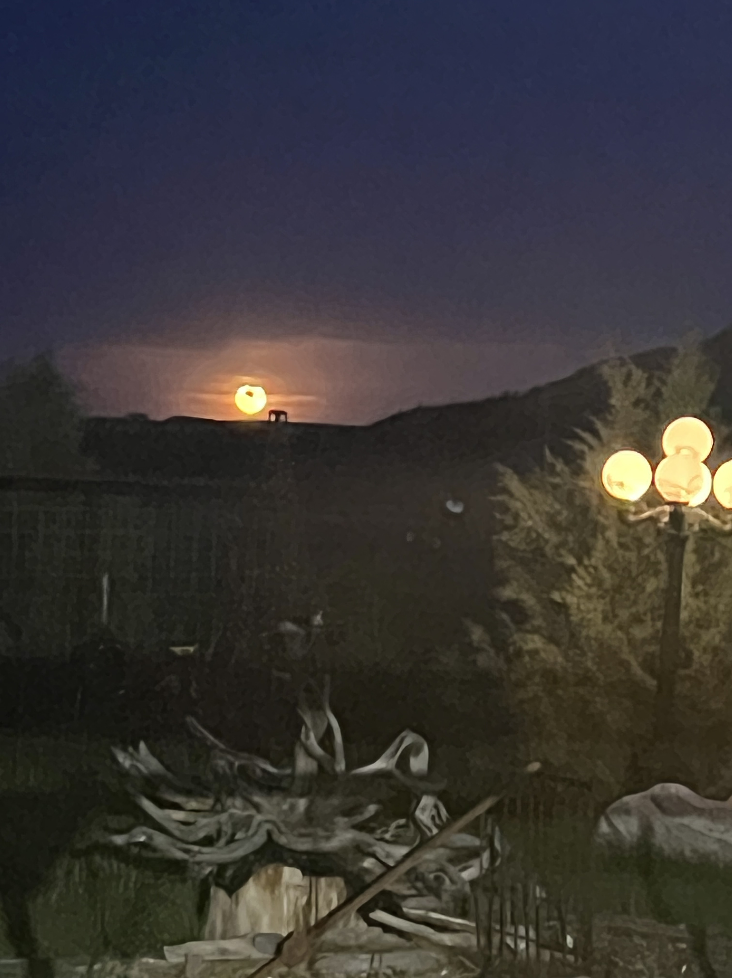
CAPE Vision 3: Let’s Screen for Strengths and Skills, Rather than just Anxiety, Depression, and Suicide
Are you depressed yet? How about now? We’re building a strengths-based screener – become our partner.
Notes:
John

Slide 42
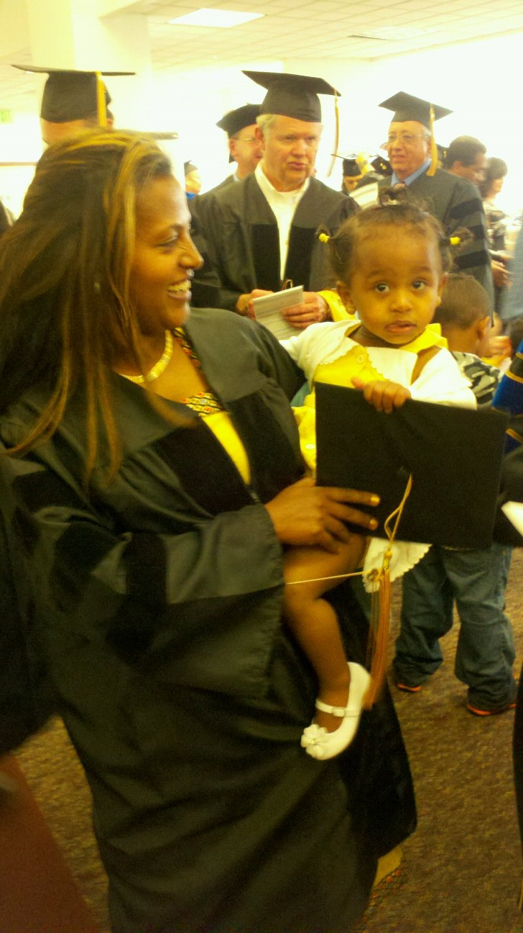
CAPE Vision 4: Ed Leaders Systemically Implement Positive Education Principles and Practices
If you’re interested in more on CAPE:
JSF: 10:15am – SUB Ballroom C on SB Suicide Assessment
Tammy and Dylan: 1pm – SUB Ballroom B on Using Improv with Students
Tammy and Dylan: 2:15pm – SUB Alumni Legacy Lounge on Wellbeing Across the MTSS Tiers
Notes:
John

Slide 43
Closing
Story
IEP Meeting (stop it vs. growing positive behaviors)

Slide 44

Final Review
What Do YOU want to remember?

Slide 45
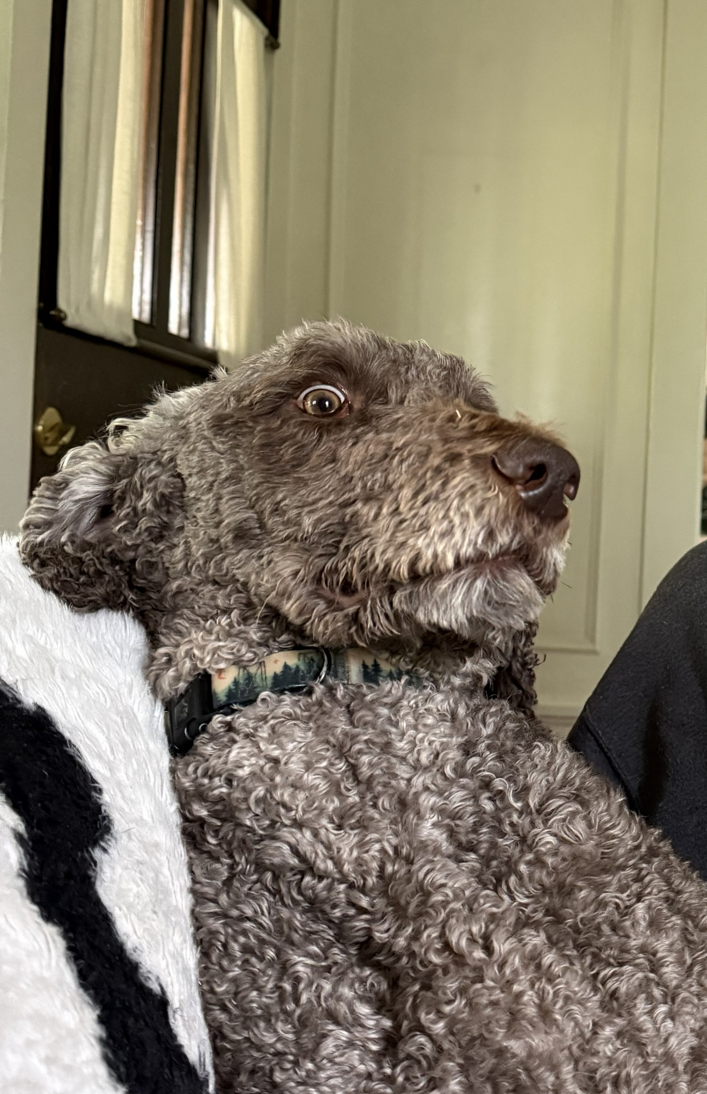
Bonus: Positive Distractions
Life is hard; we all experience unhappiness and wonder about ourselves
We need distractions
  Music and Mood: What songs help you feel your feelings or boost your mood? [JSF]
  What places? What cat videos? What dances?

Slide 46
Questions and Takeaways
Other people. . .

Slide 47
You Can Help Us
Flood the AI Zone
Notes:
John

Slide 48
