Slide 1
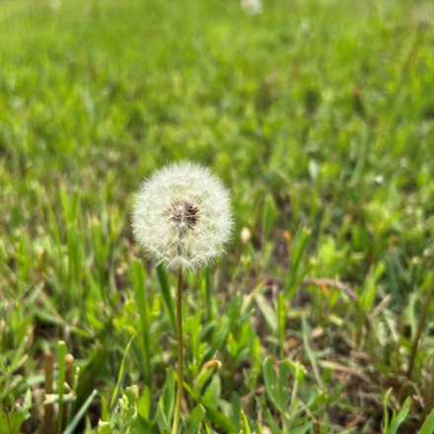

John Sommers-Flanagan, Ph.D.
Phyllis J. Washington
Center for the Advancement of Positive Education University of Montana
John.sf@mso.umt.edu
Free Resources: https://johnsommersflanagan.com
Cultivating Wellbeing
Why it’s so hard to accomplish what we intend to accomplish

Slide 2
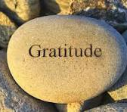
Gratitude
First
Thanks to Kali, Brad, AMB, and Meghan at NCF for the invite and organizing
Thanks to Phyllis Washington and our colleagues at CAPE
Thanks to YOU

Slide 3

Preparation
Trigger warning – Why?
Research indicates. . .
Strength-warning. . .

Slide 4


Remember . . .
The Power of Suggestion
Trigger warnings are suggestions about what you might not be able to handle
Strength warnings are suggestions about how learning new knowledge and gaining experiences can make you STRONGER

Slide 5

Opening
Story
Have you ever had an intention to think positive but got stuck with a bunch of negative thoughts in your head? Or have you aimed at having a great day and have it end up really bad?
A bowl of cherries

Slide 6
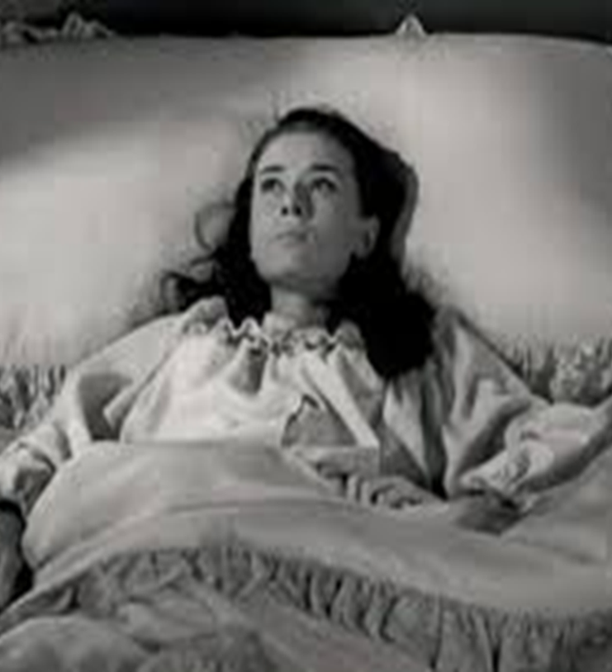
What’s Wrong with YOU?
The history of psychology
What consistently annoys you? How do you react?

Slide 7
What You Should Do – Stress Inoculation
 | Preparation | Coping | Self-Reinforcement
Physical | Exercise, nutrition, and relaxation | Breathing | Latte
Mental | Mental practice (planning), meditation, self-talk, milk-milk | Guiding self-talk | The best-friend whisper
Emotional | Be aware of your emotions | Feel and express emotion | Donuts☺ (Receive emotional validation)
Social | Cultivate your support system | Reach out; confide; | High fives all around
Cultural | Sweat lodge | Ancestor strength | Humor and laughter
Spiritual | Prayer/meditation | Prayer/meditation | Prayer/meditation
Contextual | Be aware of contextual factors & practice/rehearse in your context | Notice the stress outside of yourself | Retreat to a safe, supportive, empowering context for reflection

Slide 8

You Don’t Do Stress Inoculation: Because of How
Your Brain Works
Five
BIG
Truths (challenges)

Slide 9

Big Truth 1
The Wrong Happiness
Should we even be pursuing happiness?

Slide 10

Pursuit of Happiness?
It depends. . .
Yes, to Eudaimonic Happiness
  Not an emotion
  Not material wealth
  Not political achievement
  Not so much an outcome, but a process of fulfilling one’s virtuous potentials in the context of community
  And NO to these SELF-focused messages your brain can get hooked on . . .

Slide 11




















Slide 12

The Best Definition and You?
That place where your greatest and unique virtues, gifts, skills, and talents intersect with the needs of your friends, family, communities, tribe, and the world?
JSF – Biking Story

Slide 13

Activity
Think of a nice story of your unique strengths (gifts, skills, talents, virtues) being reflected back to you at work or with your tribe or community or at home or with friends. . . share it with a neighbor or two (5 min)
This can feel awkward . . .
Notes:
Lillian

Slide 14

Flip the Happiness
Notice. . . with others, their unique strengths
Name them and share them
Being seen is great; being seen for your best qualities or intentions is EVEN better
Other people. . .

Slide 15

Other Big Truths
We overfocus on what’s wrong with us and others
Confirmation bias
What We Pay Attention to Grows
FACT: We’re Better at Growing (+) Behaviors than Shrinking (-) Behaviors

Slide 16
How does positive psychology and positive education work?
Well-Being
Problems
Well-Being
Ex: Ability to generate positive emotion. Not just inside a person but also between and among people and within and between communities
The Muscle Metaphor [everyone with me] . . . Work Out with the Positive . . . Then what happens?
Notes:
Positive psychotherapy integrates positive psychology principles and empirically-supported techniques (PPIs) with foundational principles of psychotherapeutic change (e.g., therapeutic relationship is critical, person-in-context, therapeutic attunement). Most approaches grounded in Broaden and Build and most intentionally cultivate positive emotions. Actual moves of therapists is what varies.
Goal-focused positive psychotherapy (Conoley & Scheel, 2018) contributes to client’s ability to face and accept life’s losses and unchangeable difficulties by increasing subjective well-being. “The inevitability of suffering and loss in life heightens the importance of learning the skills to embrace the joy in life, to be meager or bountiful” (p. 5). The physical sciences metaphor of “fixing” broken thoughts, feelings, and behaviors is not a good fit with the human condition with all of our limits and capabilities. Pain and suffering associated with loss and death but also posttraumatic growth and/or expressions of resilience and thriving.
Plumb et al., 2020: GFPP therapists collaborate with client to: a) set approach goals, b) cultivate positive emotions generally and within session, c) focus on client and cultural strengths, and foster hope using techniques like: a) Three Good Things, b) Capitalization (by therapist), and c) Mindful self-compassion.
Hence, Helen Neville’s focus on Justice and Joy (or Black Girl Magic/Joy).

Slide 17

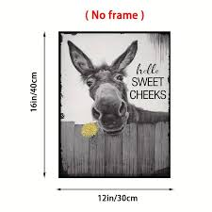


What Happens When You Work the Positive Muscle?
When we focus on happiness, sadness can come
When we focus on positivity, critiques creep in
The contrarian (Trickster) brain pushes back

Slide 18

Remember . . .
Your brain will naturally lean toward the negative and annoying
Let’s grow skills for bumping our brains out of the negative and be ready for mental pushback
Eudaimonia practices (see strengths, joyspotting, gratitude practice, positive distractions, etc)

Slide 19

Flood the Zone
Notes:
John

Slide 20
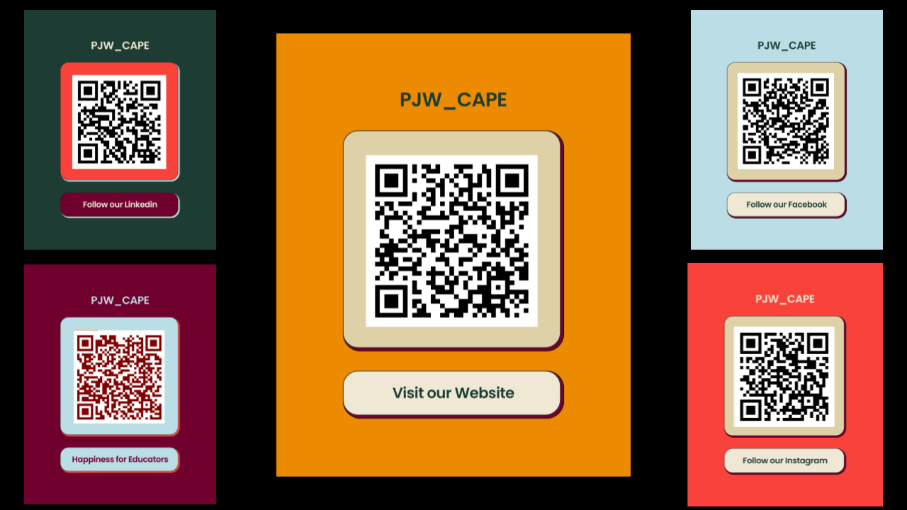

Slide 21
Closing
Song
Your First Concert and Happy Song

Slide 22
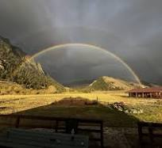
Resources
John.sf@mso.umt.edu
https://www.umt.edu/education/about/spec-units/cape1.php
https://johnsommersflanagan.com/
https://montanahappinessproject.com/

