Slide 1
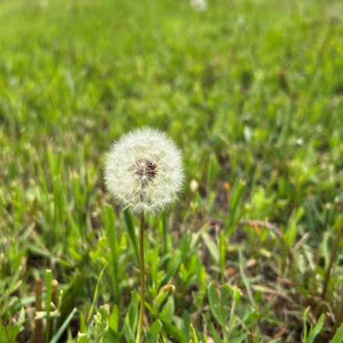

John Sommers-Flanagan, Ph.D.
Tamara Tolleson Knee, M.S.W., Ed.S.
Phyllis J. Washington
Center for the Advancement of Positive Education University of Montana
John.sf@mso.umt.edu
Tamara.TollesonKnee@mso.umt.edu>
Free Resources: https://johnsommersflanagan.com
In Pursuit of Happiness
For Educators and Schools

Slide 2
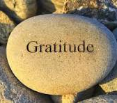
Gratitude
First
Thanks to Crissy, Kristina, and LaRonda for the invite and organizing
Thanks to Phyllis Washington and our colleagues at CAPE
JSF’s Platform
Thanks to YOU

Slide 3
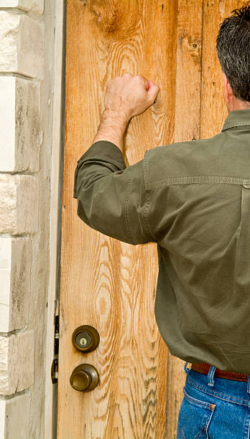

Opening
Story
Ambivalence
You make the case for change

Slide 4

Preparation
Trigger warning – Why?
I will talk about why mental health and happiness are so elusive, and say contrary things
Research indicates. . .
Strength-warning. . .

Slide 5

Remember . . .
Trigger warnings are suggestions about what you might not be able to handle
Strength warnings are suggestions about how learning new knowledge and gaining experiences can make you STRONGER

Slide 6

Learning (Learner) Objectives
You come with YOUR knowledge, experience, and expectations – You come with YOUR WHY and PURPOSE
We offer a few ideas about the brain, MH, happiness and YOUR well-being
You take what fits for you and apply it to yourself and in your work, if you feel like it

Slide 7
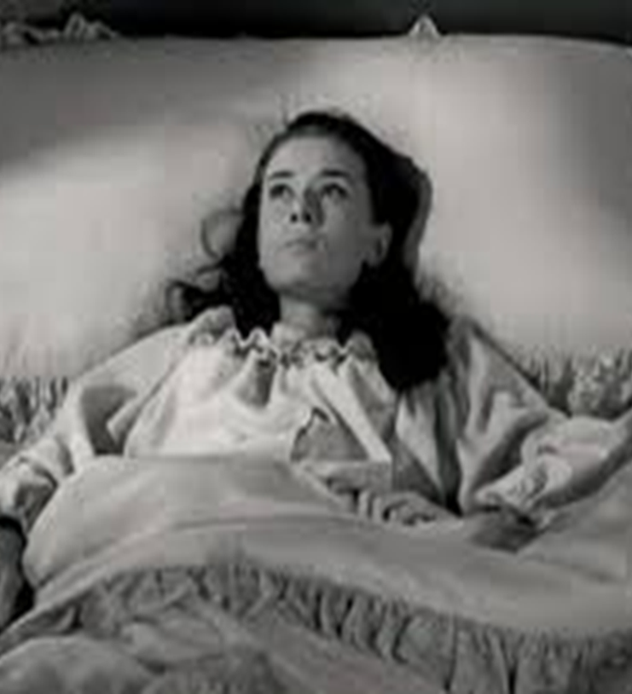
What’s Wrong with YOU?
The closer we look

Slide 8
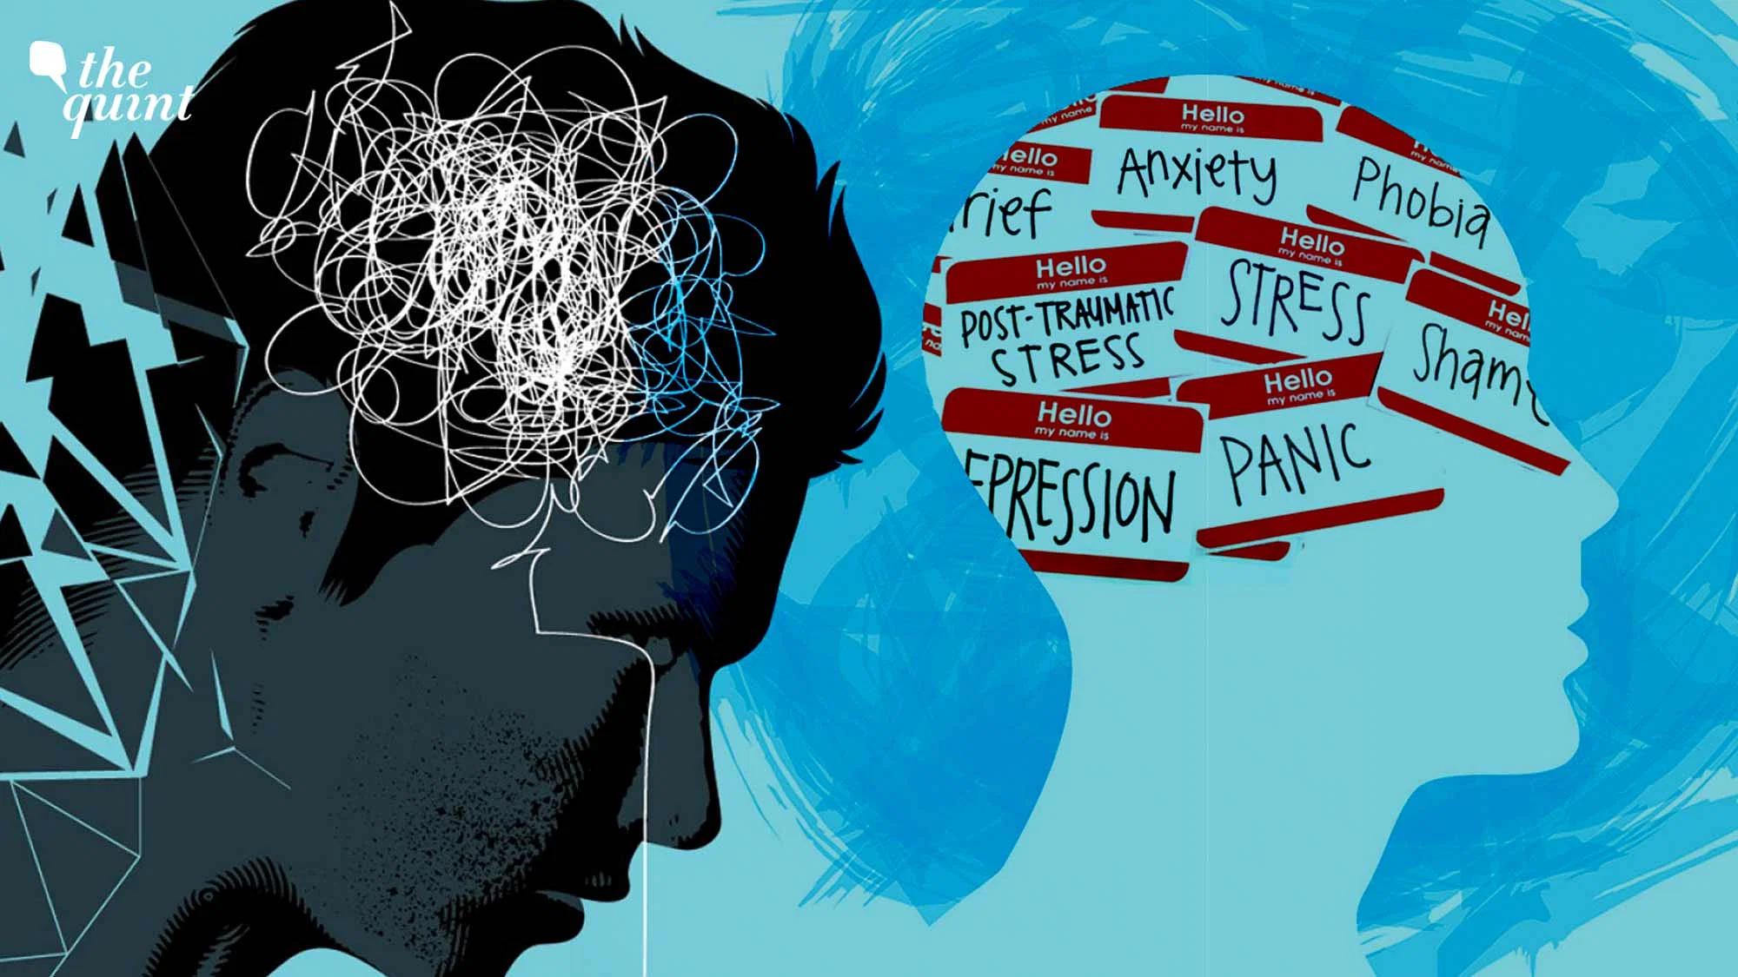
The Problem is Extra large
Nearly
Every Year
1981-2025 in the face of more treatments

Slide 9

How Your Brain Works
Five
BIG
Truths

Slide 10
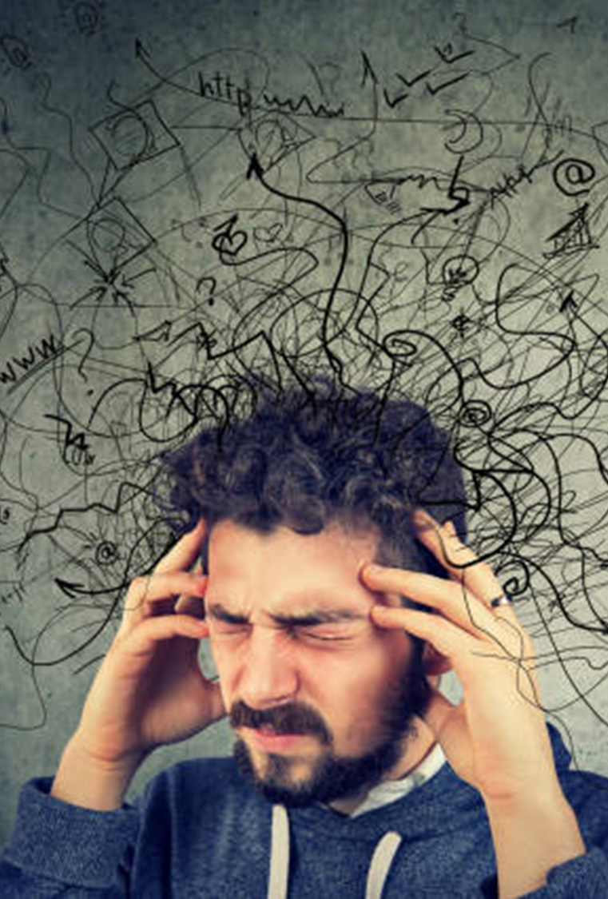
1 – We’re Vulnerable to Over-focusing on What’s Wrong with Us and Others
Medical and MH student disease
Social Media/TikTok
I found out my BF has autism spectrum disorder or DID [identity + explanations]

Slide 11
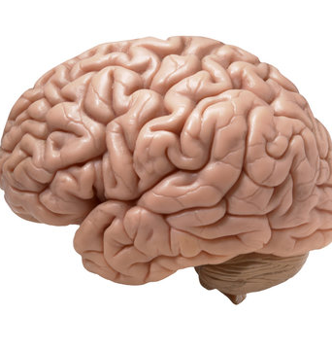
The Amazing Brain
Activity
Mindful moments

Slide 12
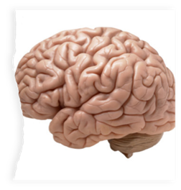
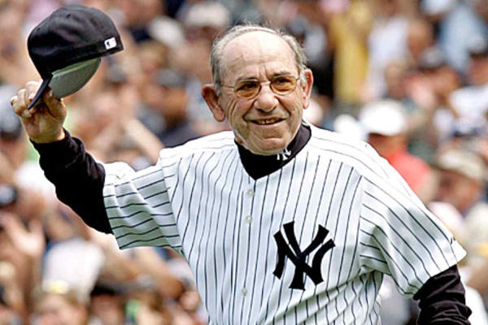

2 – Confirmation Bias
We find
what we
look for
Ex: 6th to 7th grade transition meeting

Slide 13
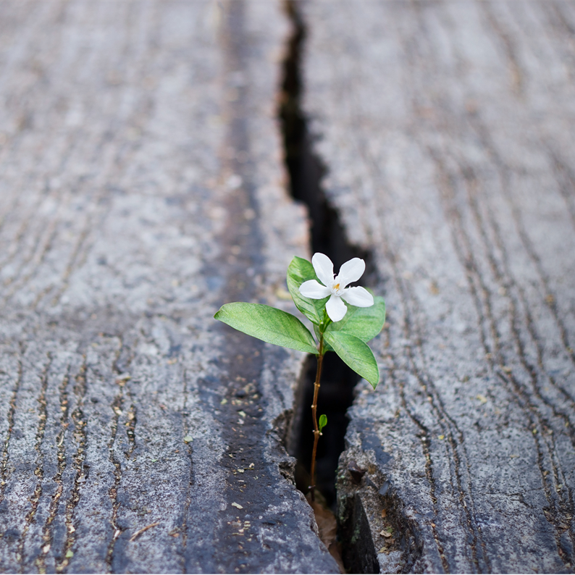
3 – What We Pay Attention to Grows
The parts of your brain you use – you GROW
Duh: Neurons that fire together, wire together [Romantic partner, child, etc.]
If we focus on failures, we get BETTER at focusing on our failures. . .and there are MANY

Slide 14

4 – The Problem with Happiness
Should we (and our students) even be pursuing happiness?

Slide 15

Pursuit of Happiness?
It depends. . .
Yes to Eudaimonic Happiness
  Not an emotion
  Not material wealth
  Not political achievement
  Not so much an outcome, but a process of fulfilling one’s virtuous potentials in the context of community
  And NO to these SELF-focused messages . . .

Slide 16





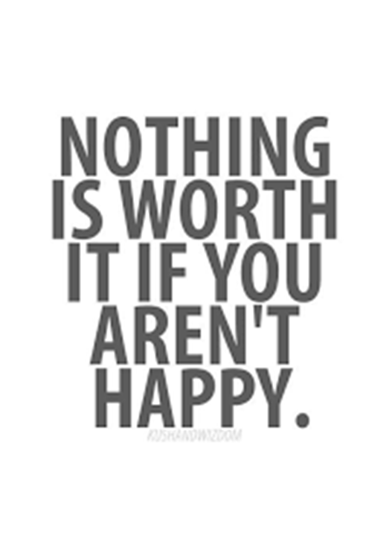














Slide 17

The Best Definition and You?
That place where your greatest and unique virtues, gifts, skills, and talents intersect with the needs of your friends, family, communities, tribe, and the world?
JSF – Biking story

Slide 18

Activity
Think of a nice story of your unique strengths (gifts, skills, talents, virtues) being seen at your school or with your tribe or community or at home or with friends. . . share it with a neighbor or two (5-7 min)
This can feel awkward . . .
Notes:
Lillian

Slide 19
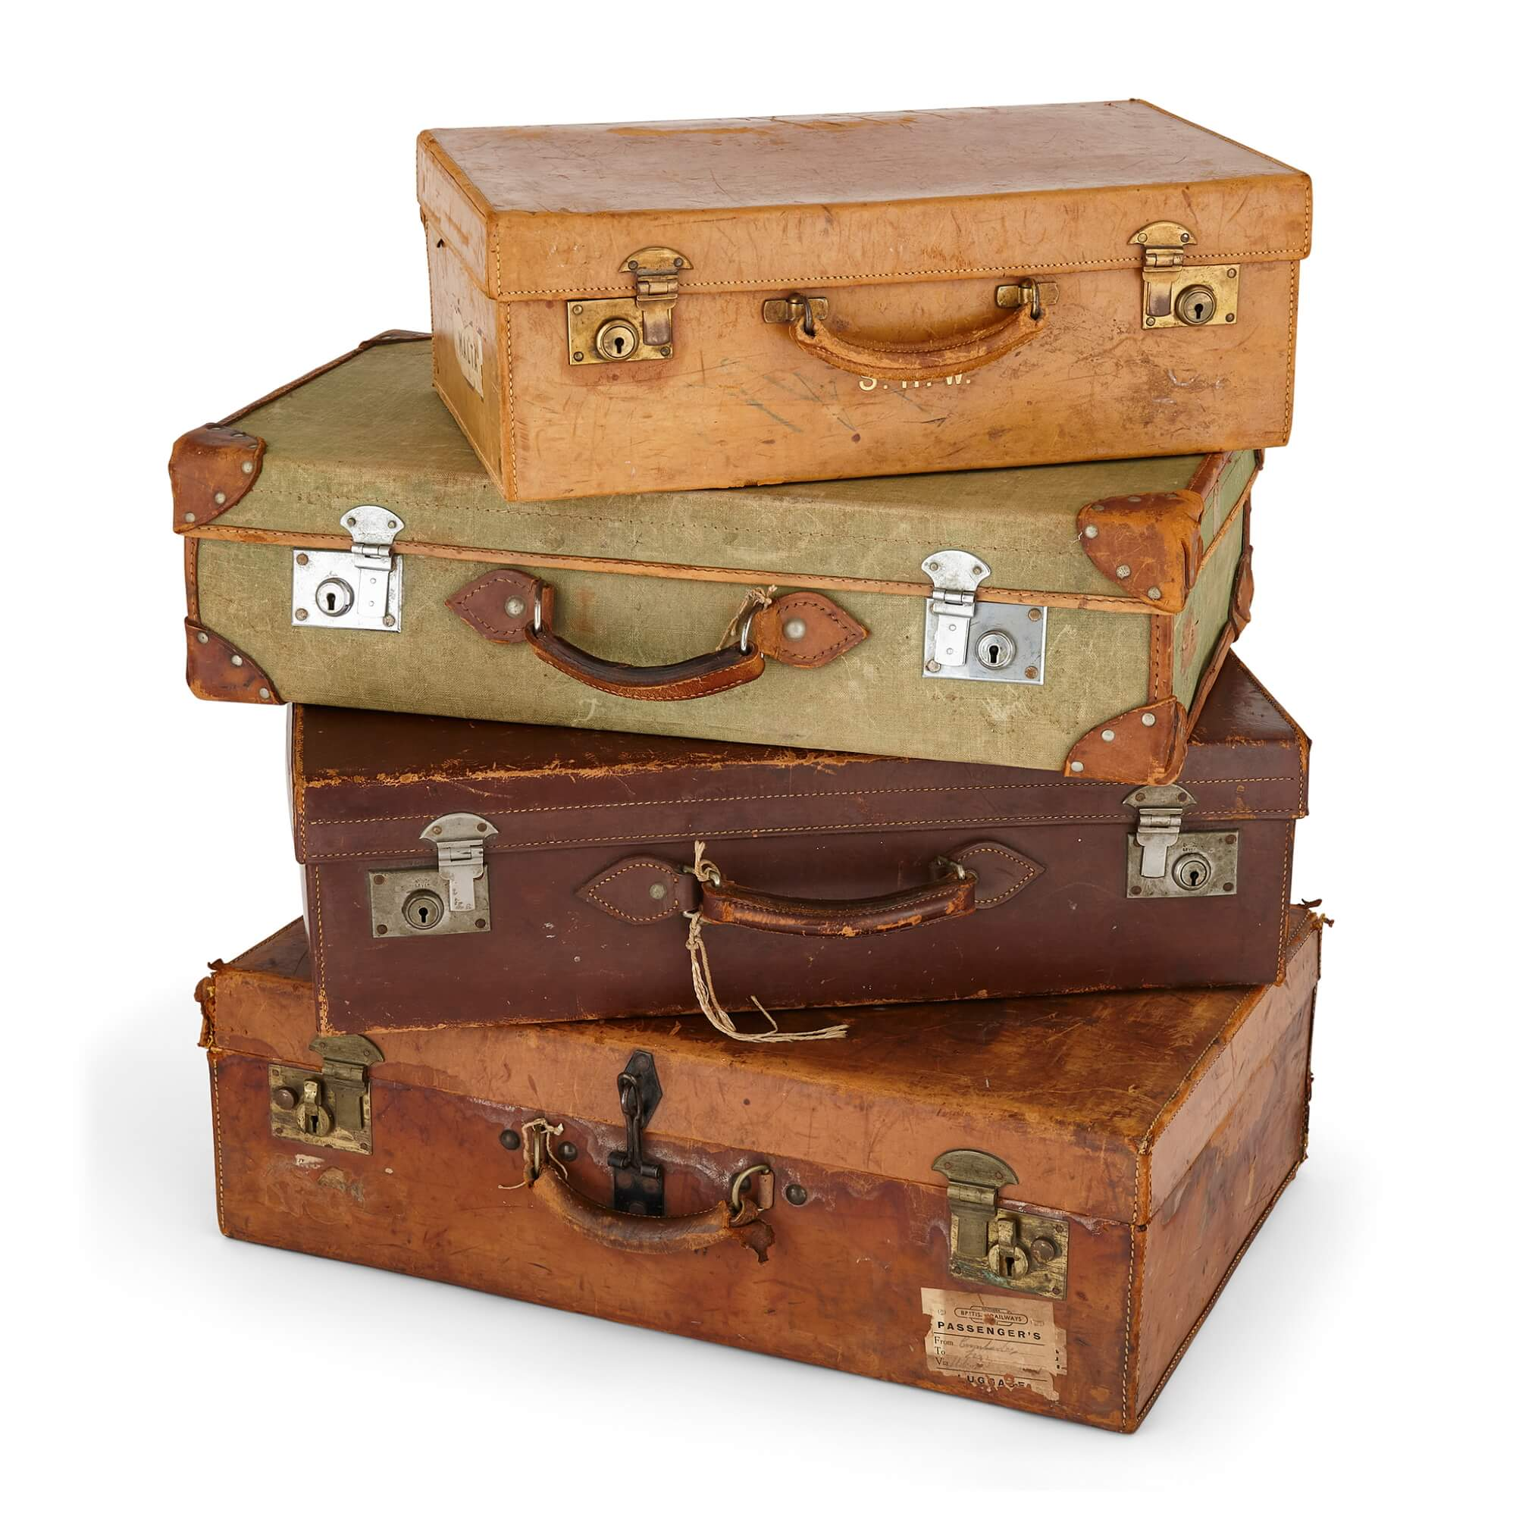
Flip the Happiness
Notice. . . with others, their unique strengths
Name them and share them
Being seen is great; being seen for your best qualities is better
Other people. . .

Slide 20
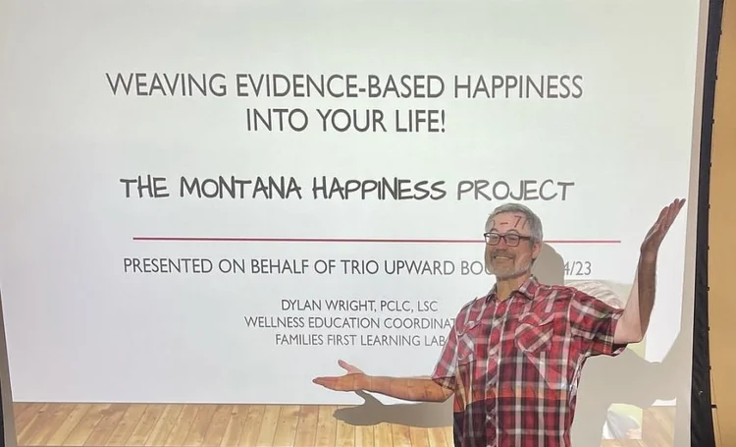
5 – The Contrarian Brain
When we focus on happiness, sadness can come
When we focus on positivity, critiques creep in
When we seek joy, our brains sometimes push us back toward misery

Slide 21
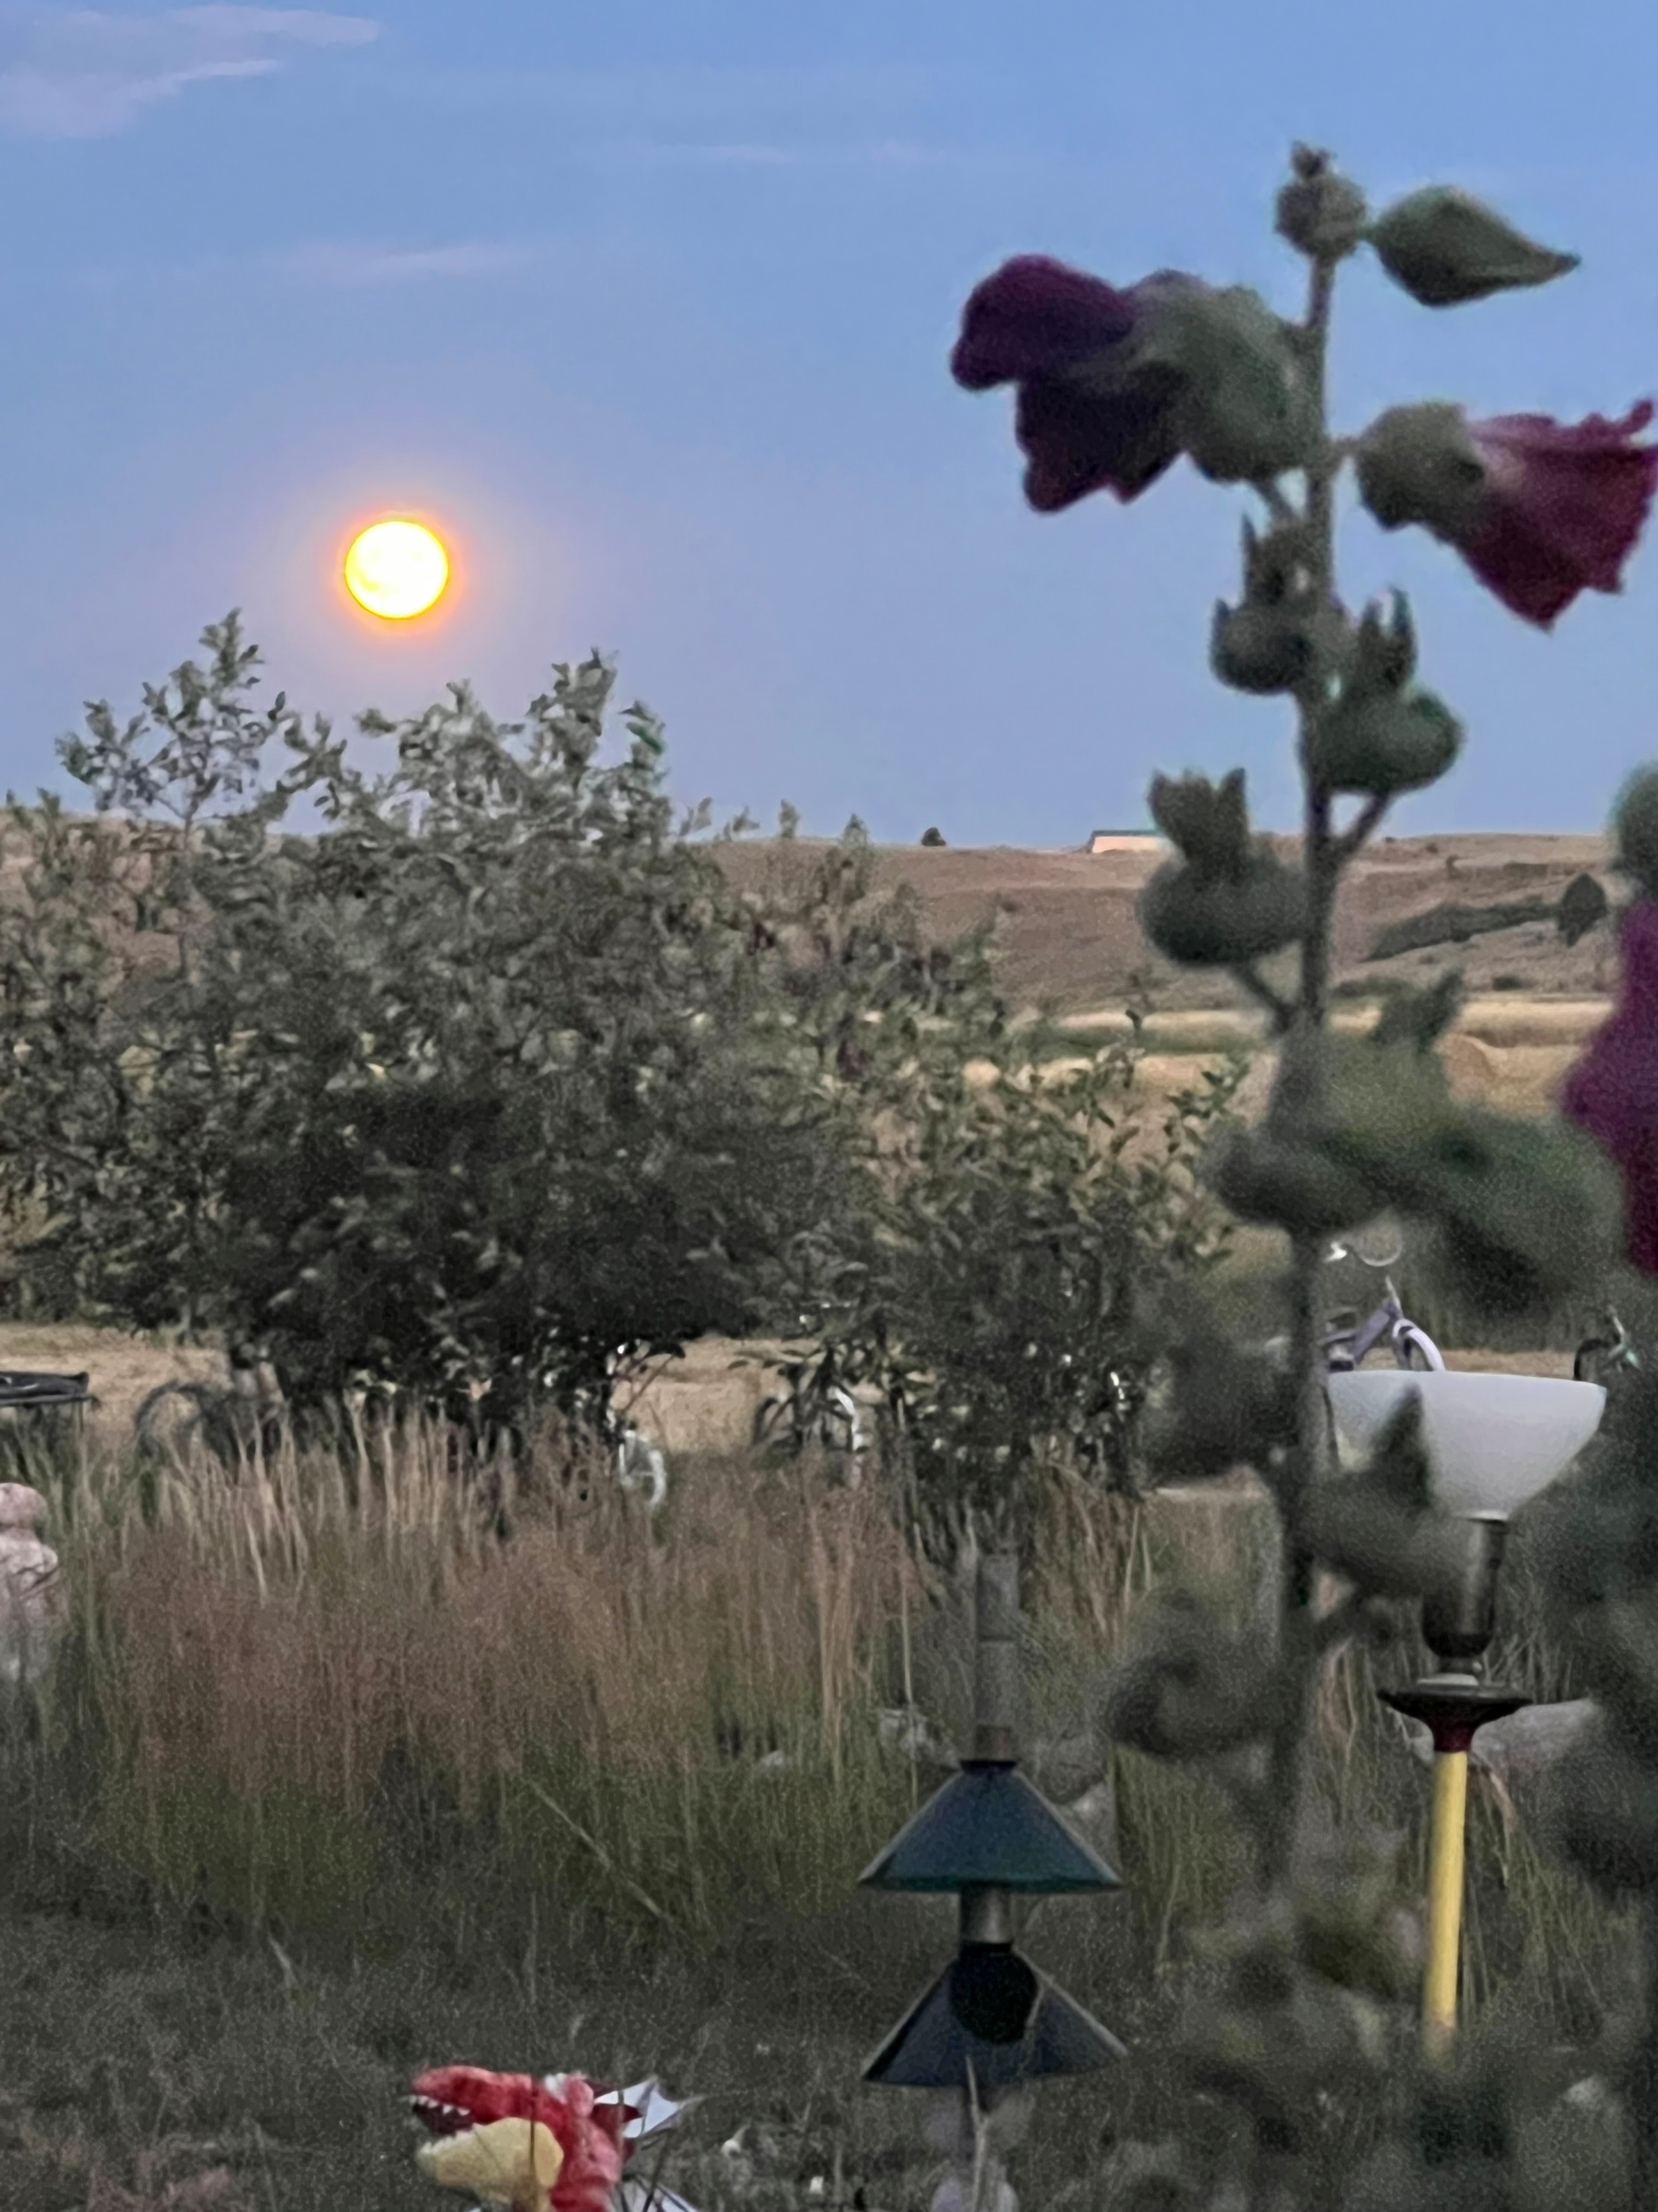
What’s Wrong??
The Big Psych Truths that you and your clients must face. . .
We overfocus on what’s wrong [21 negative:1 positive]
We find what we look for
What we pay attention to grows
Social messaging about happiness is unhelpful
Our brains are often contrary-spoilers

Slide 22
How does positive psychology/psychotherapy work?
Well-Being
Problems
Well-Being
Ex: Ability to generate positive emotion. Not just inside a person but also between and among people and within and between communities
The Muscle Metaphor [everyone with me] . . . Work Out with the Positive . . . Then what happens?
Notes:
Positive psychotherapy integrates positive psychology principles and empirically-supported techniques (PPIs) with foundational principles of psychotherapeutic change (e.g., therapeutic relationship is critical, person-in-context, therapeutic attunement). Most approaches grounded in Broaden and Build and most intentionally cultivate positive emotions. Actual moves of therapists is what varies.
Goal-focused positive psychotherapy (Conoley & Scheel, 2018) contributes to client’s ability to face and accept life’s losses and unchangeable difficulties by increasing subjective well-being. “The inevitability of suffering and loss in life heightens the importance of learning the skills to embrace the joy in life, to be meager or bountiful” (p. 5). The physical sciences metaphor of “fixing” broken thoughts, feelings, and behaviors is not a good fit with the human condition with all of our limits and capabilities. Pain and suffering associated with loss and death but also posttraumatic growth and/or expressions of resilience and thriving.
Plumb et al., 2020: GFPP therapists collaborate with client to: a) set approach goals, b) cultivate positive emotions generally and within session, c) focus on client and cultural strengths, and foster hope using techniques like: a) Three Good Things, b) Capitalization (by therapist), and c) Mindful self-compassion.
Hence, Helen Neville’s focus on Justice and Joy (or Black Girl Magic/Joy).

Slide 23



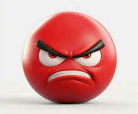
Bad Moods
Let’s Grow Wellbeing
A Story about Bad Moods and our CAPE Philosophy
1990-2014

Slide 24
Bad Moods – 2
Anyone here
ever had someone tell you to
“Cheer Up?!”
Or
“Smile!”

Slide 25
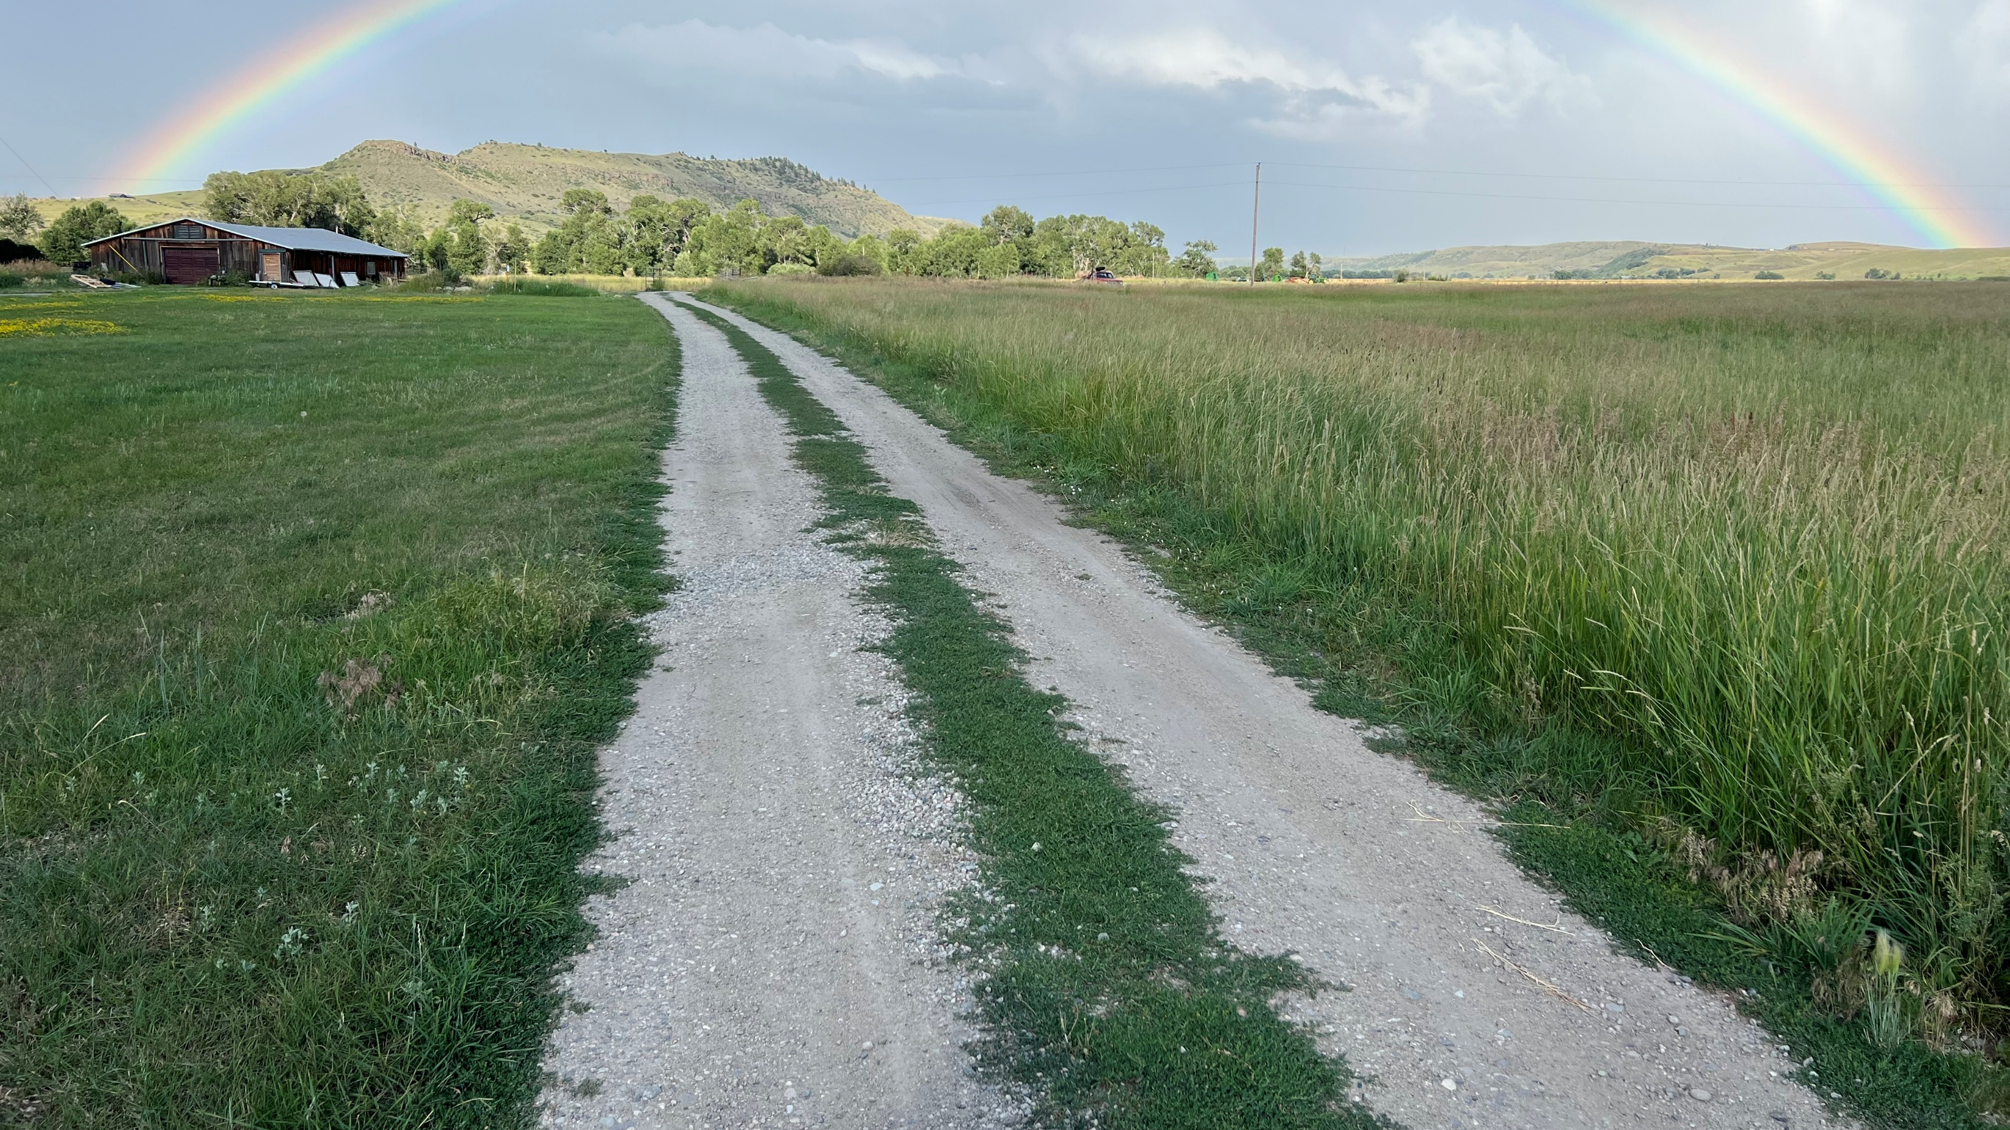
Bad Moods – 3
Ever feel stuck in a bad mood?
What if YOU could be
THE CAPTAIN
of your own emotional ship

Slide 26
The Three-Step Emotional
Change Trick
Step One
Honor YOUR Emotion
Notes:
We may or may not do this-John

Slide 27
The Three-Step Emotional Change Trick
Step Two
Think a New Thought . . . or
Do Something Different
Notes:
We may or may not do this-John

Slide 28

The Three-Step Emotional
Change Trick
Step Three
Share the Good Mood
Notes:
We may or may not do this-John

Slide 29
The Three-Step Emotional
Change Trick
Step Four
Teach Someone the 3 Steps
Notes:
We may or may not do this-John

Slide 30

Let's try a positive psychology intervention (PPI)!
Notes:
John

Slide 31

Sample (step 2) Intervention
Three Good Things
Survey: Three types of insomnia
Rumination is all-natural, but not helpful
Notes:
Dylan/Nancy?

Slide 32
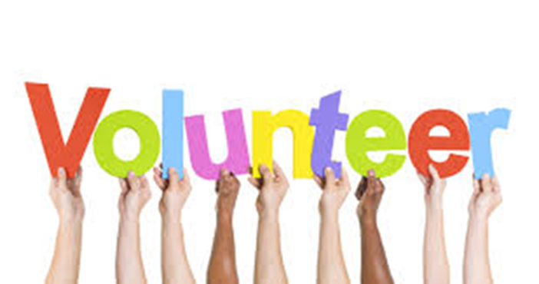
Three Good Things
Seligman’s signature technique
  Before you go to sleep (or right now)
  Write down (or think about) three good things that happened during the day (or last 24 hours)
  Then track down in your mind “Why” those things happened
  Seligman: After a week, you’ll want to keep doing it (JSF: Maybe)
  Volunteer?
Notes:
Dylan/Nancy

Slide 33
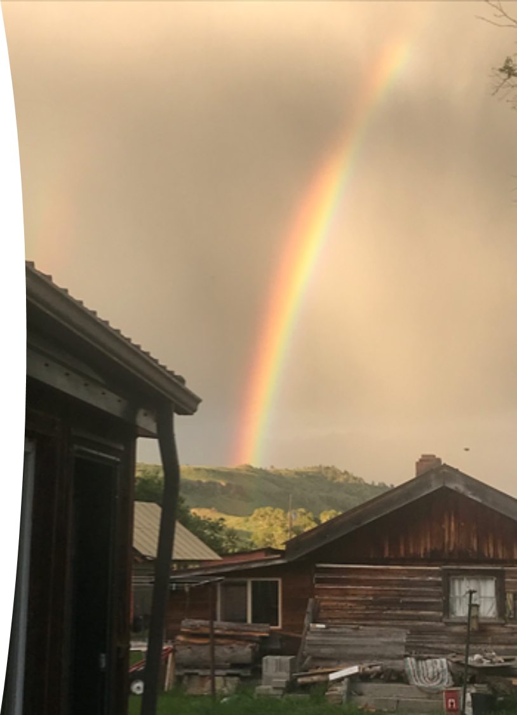
Why Three Good Things Works
When you go to bed, you NATURALLY embark on a negative (depressive) review or anticipatory (anxiety) preview
Three good things shifts your focus
Identifying “Why” those things happened activates a brain search toward positive attributions

Slide 34
Evidence-Based Happiness for Educators
One MHP, AMBFF, and CAPE project at the University of Montana
Notes:
John

Slide 35
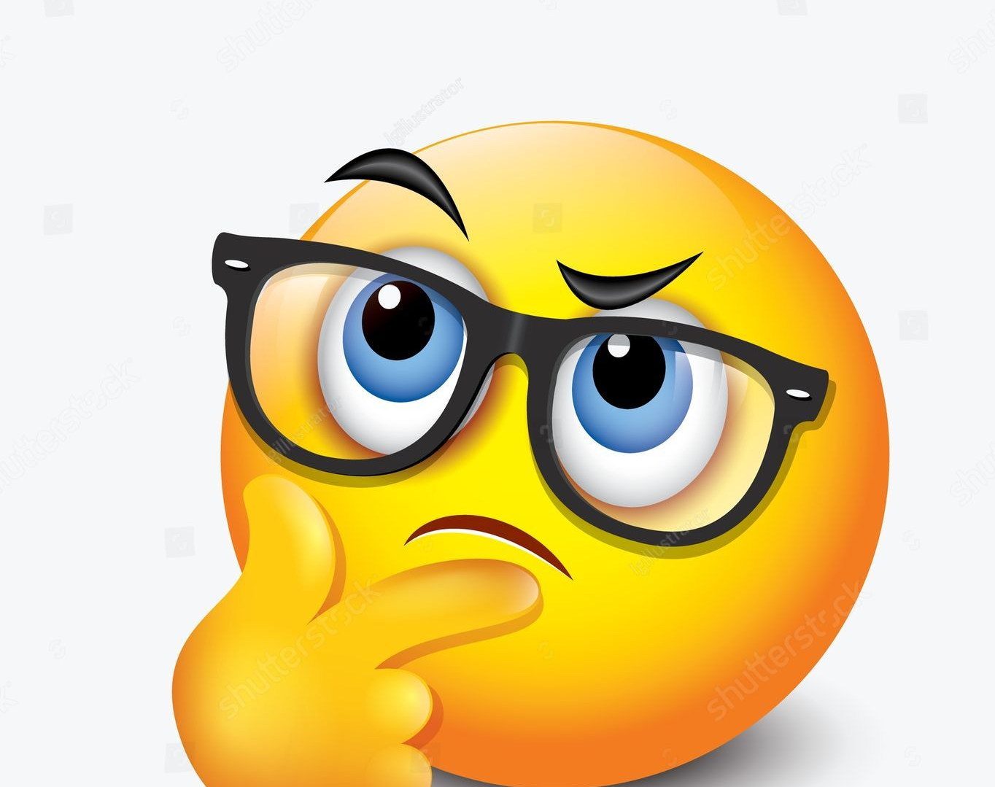
Does a 3-Credit Grad Course on HFE Make a Difference?
In the beginning. . .
Notes:
John

Slide 36
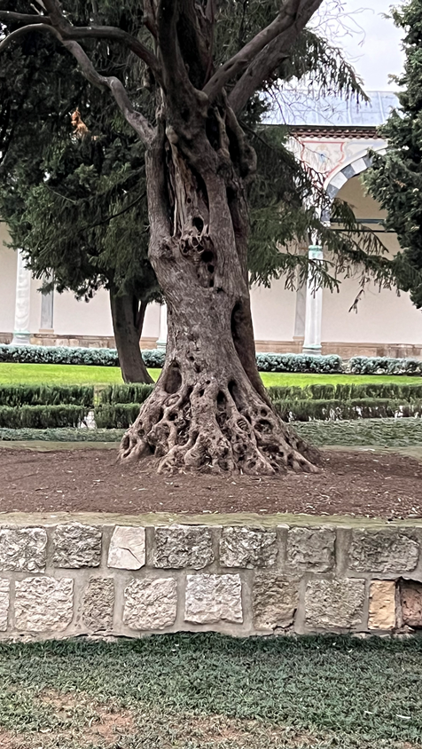
What We’ve Done: With the Arthur M. Blank Family Foundation’s Support
Created and Delivered a 3 Grad Credit Happiness for Educators Online Async Course
Pilot – Winter 2022/2023 = 19 (Browning only)
Cohort 1 – Summer 2023 = 44
Cohort 2 – Spring 2024 = 54
Cohort 3 – Summer 2024 = 71
Cohort 4 – Fall 2024 = 27
Cohort 5 – Spring 2025 = 89
Cohort 6 – Summer 2025 = 130
Cohort 7 – Fall 2025 = 42 [451 completed]

Slide 37

Cultural Convergence
Integrating Indigenous Resilience
Lakota elder, James Clairmont:
The closest translation of “resilience” is a sacred word that means “resistance” . . . resisting bad thoughts, bad behaviors. We accept what life gives us, good and bad, as gifts from the Creator. We try to get through hard times, stressful times, with a good heart. The gift [of adversity] is the lesson we learn from overcoming it.
Notes:
Lillian

Slide 38
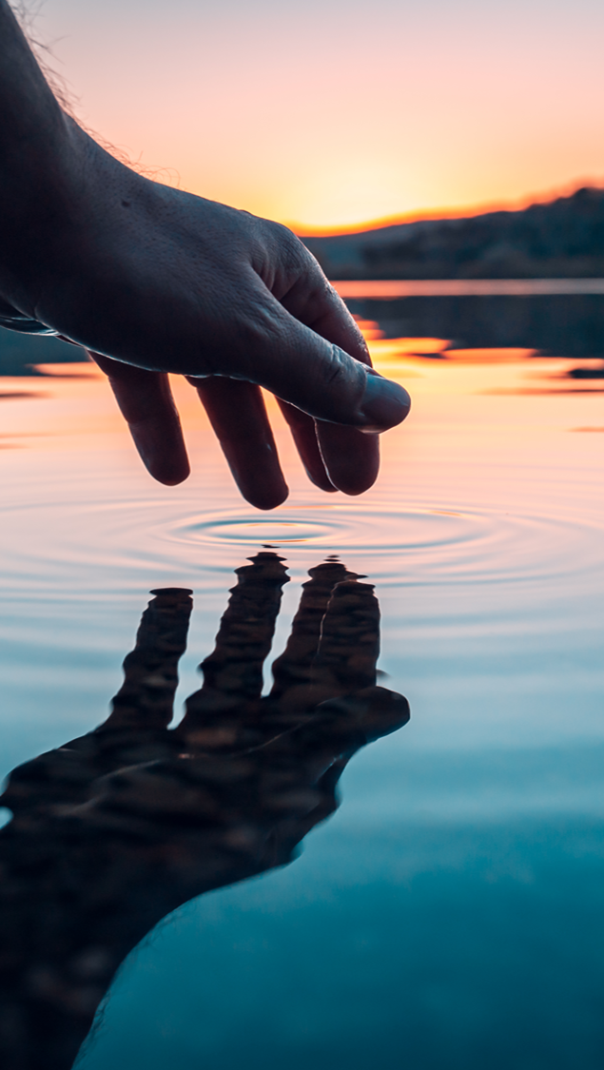
Our Outcomes
After the Course
60% reduction in depression scores [about 12%]
But also, educators had:
  More hope, positive emotions, mindfulness, and social support
  Better sleep, fewer headaches and sick days
  Reduced gastrointestinal
  and respiratory distress
  Med to Large Effect Sizes (d)
Before the 3-credit course
About 30% of educators scored as clinically depressed
451 educators

Slide 39

But those are just questionnaire results
What do the educators themselves say about the course?
Notes:
John

Slide 40

We Asked 363 of the Educators
“Please share, using as few or as many words as you like, how you were impacted by taking the happiness for educators course.”
321 (88%) responded to this optional question
All 321 responses were positive

Slide 41
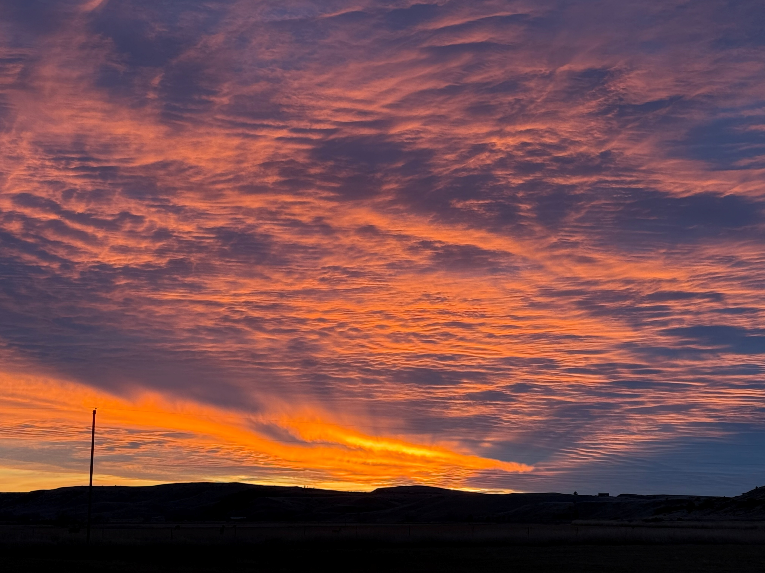
#258 – More Prepared for My Calling
This course reaffirmed for me my strengths as a teacher and a human. It helped me look at some things I perceived as flaws, and instead, see them as strengths or at least an opportunity for a strength to be built. I realized because of this course that I do in fact have tons of support from my family, and that my role as a teacher is not just a career, but a calling. As a result, I feel more prepared to begin this new school year, and more equipped to deal with obstacles and challenges as they inevitably come my way. I am more hopeful for this year, for me, and my students.

Slide 42
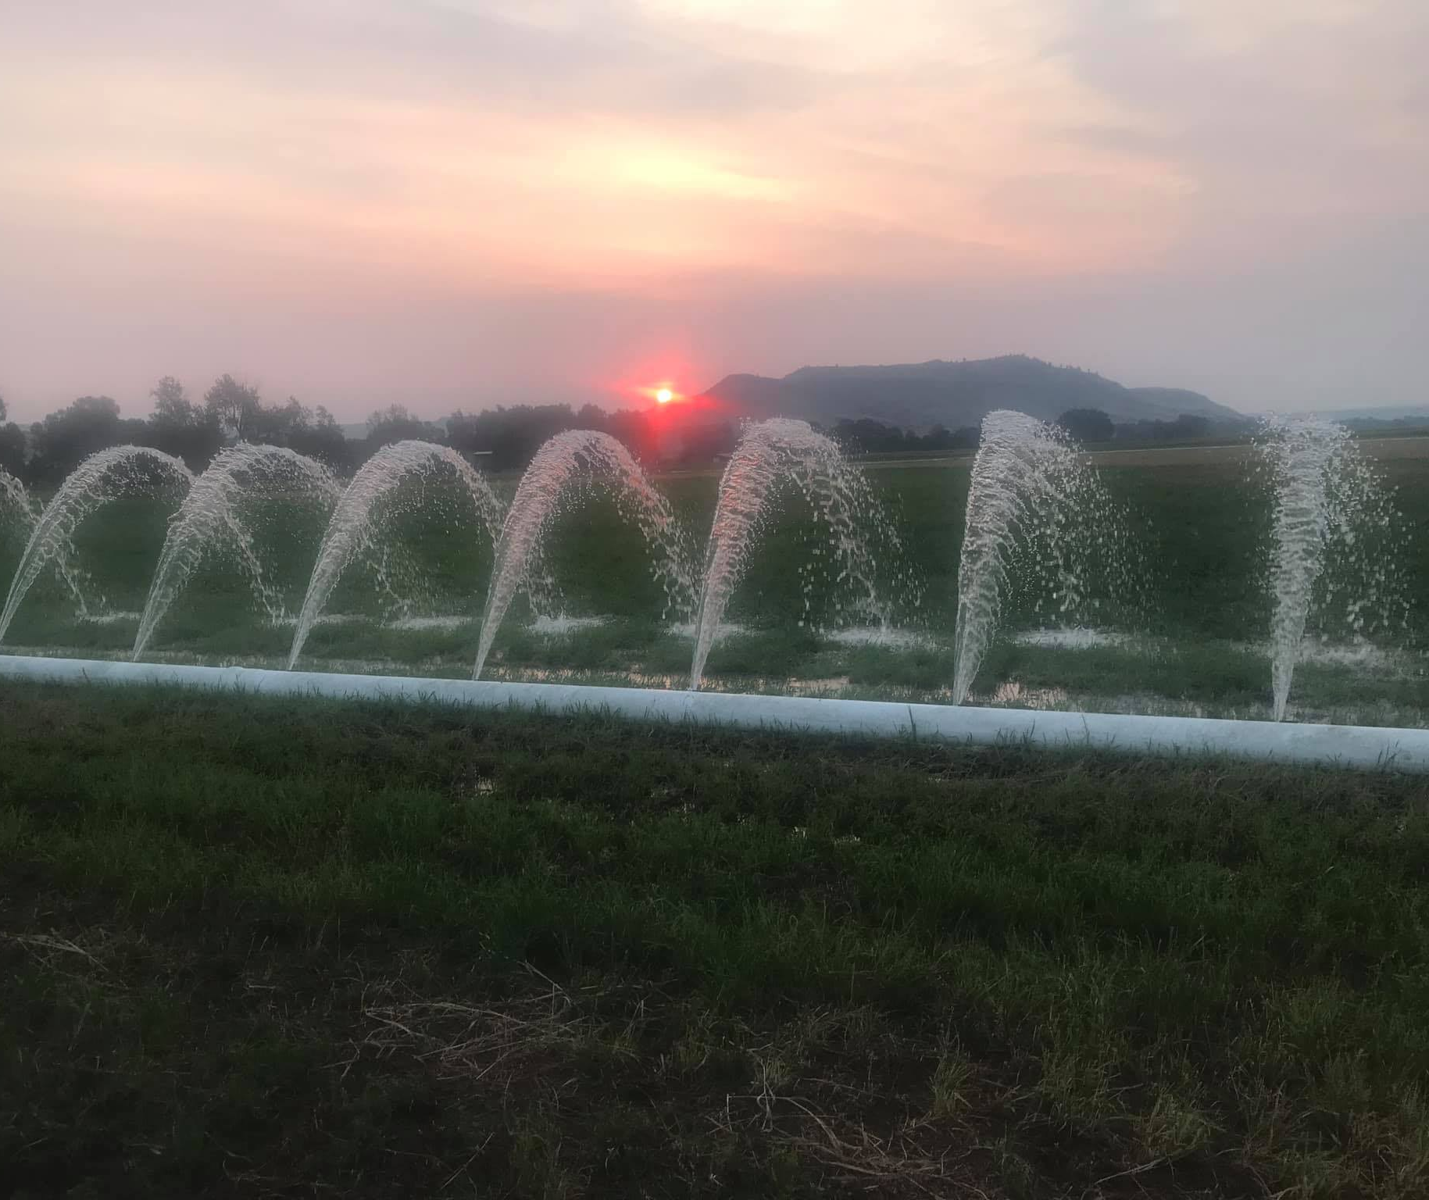
#259 – Inexpensive 5 Star Therapy
The Happiness for Educators Course was one of the best courses I have ever participated in! I looked forward to working on it every day, it was very well-organized, and very informative. It almost felt like very inexpensive therapy! ;) I really do feel "happier" after taking this course. Thank you so much for offering it and making it so accessible! 5 stars! :)

Slide 43
Closing
Story
IEP Meeting

Slide 44
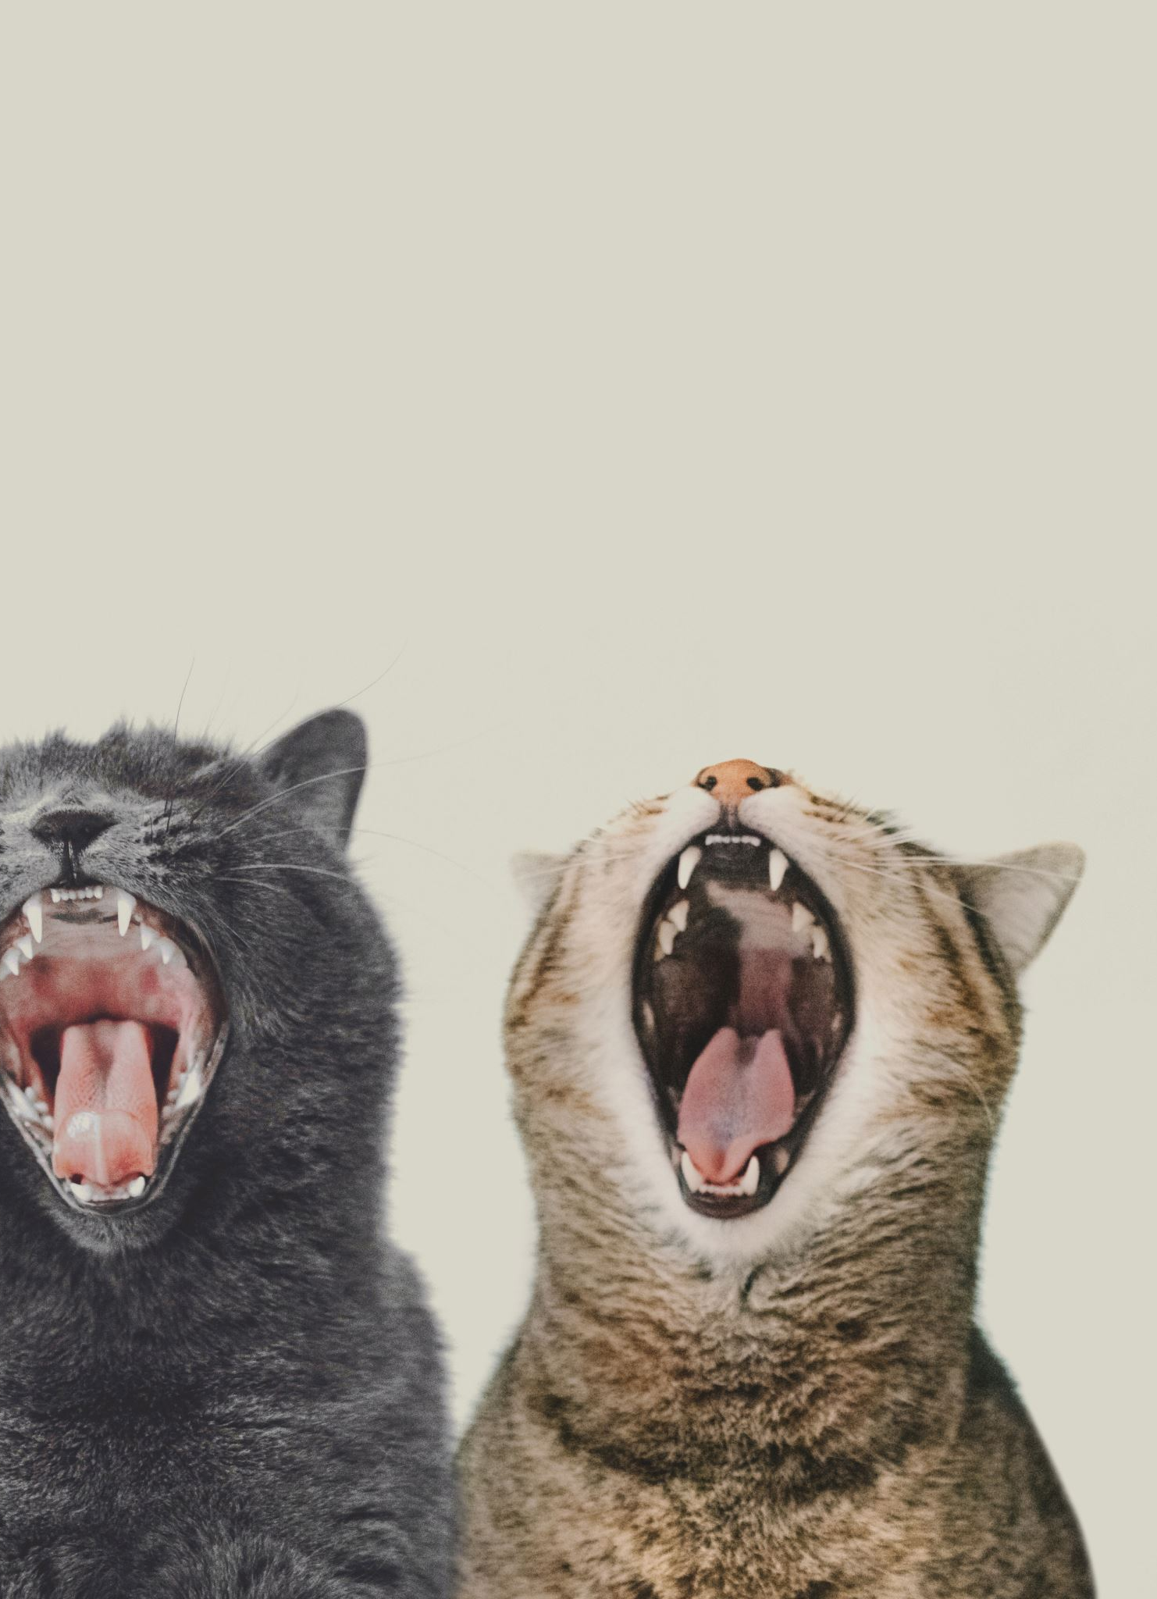
Bonus 1: Positive Distractions
Life is hard; we all experience unhappiness and wonder about ourselves
We need distractions
  Music and Mood: What songs help you feel your feelings or boost your mood? [JSF]
  What places? What cat videos? What dances?

Slide 45

Final Review
Five big psychological ideas
Your unique talents, strengths, and virtues
Let’s grow wellbeing
3-step emotional change trick
Three Good Things
EB happiness in Montana
Cultural convergence: Resilience
Positive distractions
Bonus: Anxiety and gratitude

Slide 46

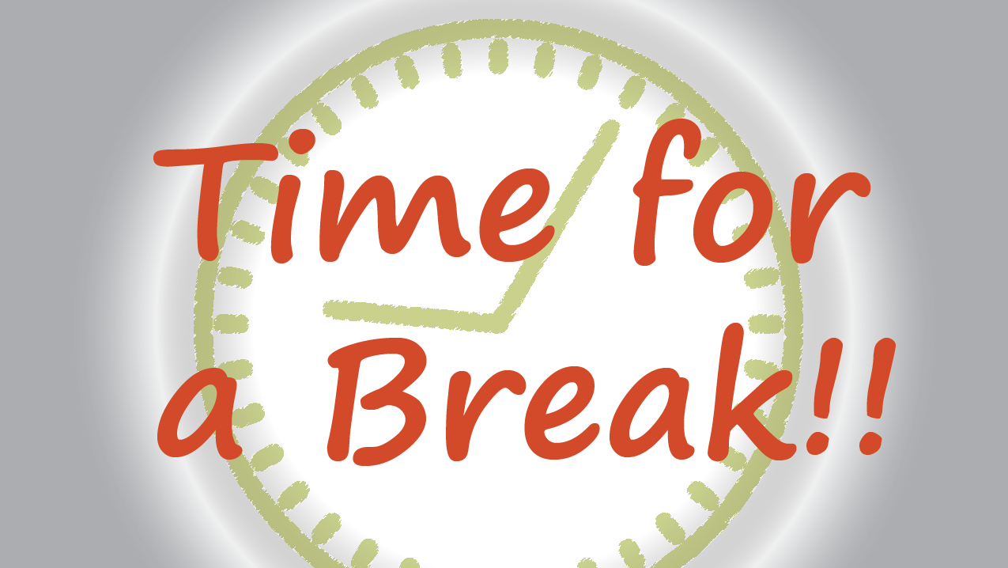

Slide 47

For Break
Savor your BREAK TIME
Meet and converse about how YOU might infuse some of these ideas into your work
Return with ideas to share and ready to learn more PPIs

Slide 48

And we’re back! – Part 2 of Pursuit of Happiness
If you like, post something on JSF’s blog or share an application idea with the group

Slide 49

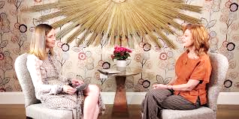

Slide 50

Strategies to grow well-being, boost happiness, and buoy you during life's hard times

Slide 51
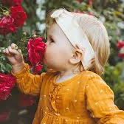
SAVORING

Slide 52
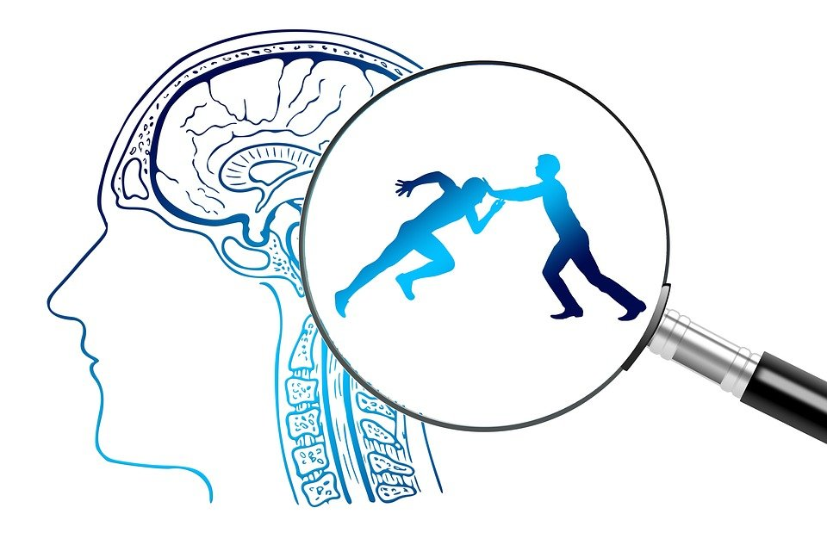
THE BENEFITS
Enhances Resilience
Decreases Depression
Increases Happiness
Increases Optimism

Slide 53
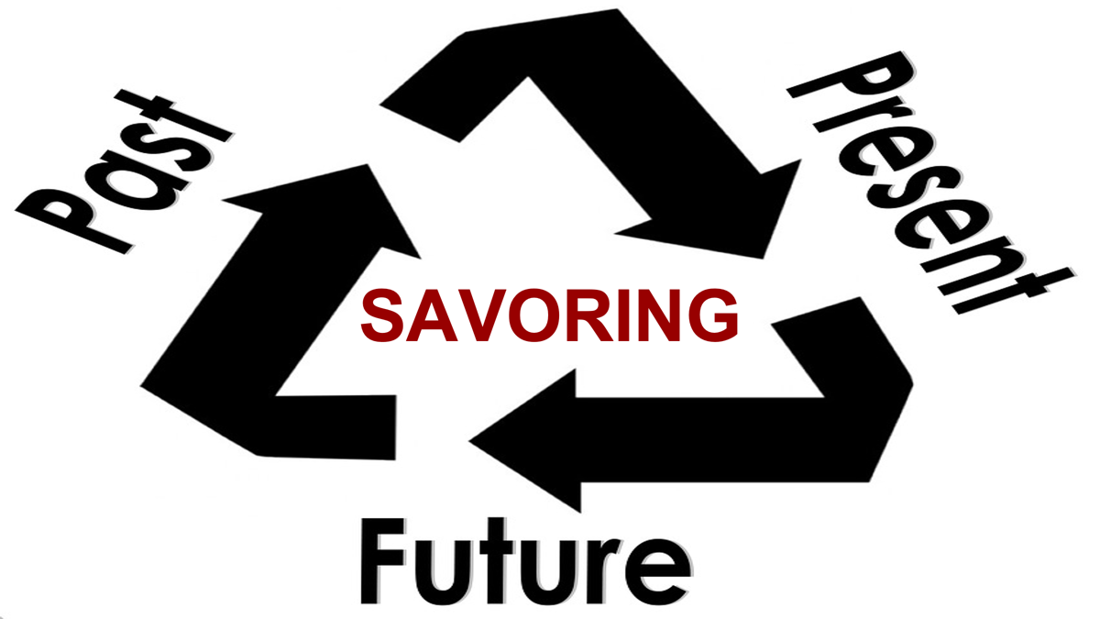
Three Practices

Slide 54

SAVORING
Joyful anticipation!
Gaining pleasure from looking forward and imagining future happy events.
Anticipating and fantasizing about upcoming positive events.
Likely to experience intense emotions.
Be more optimistic.

Slide 55
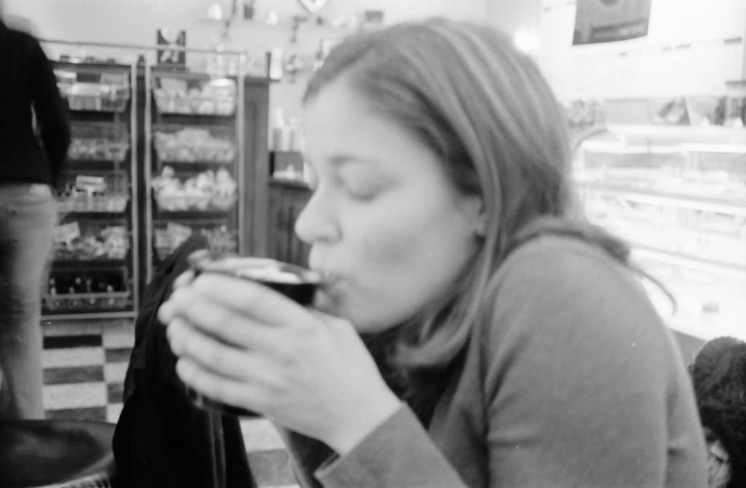
PRESENT SAVORING
Hanging on to the good feelings right now.
Gratitude, Flow, Mindfulness.
Less likely to experience stress, guilt, depression, and shame.

Slide 56
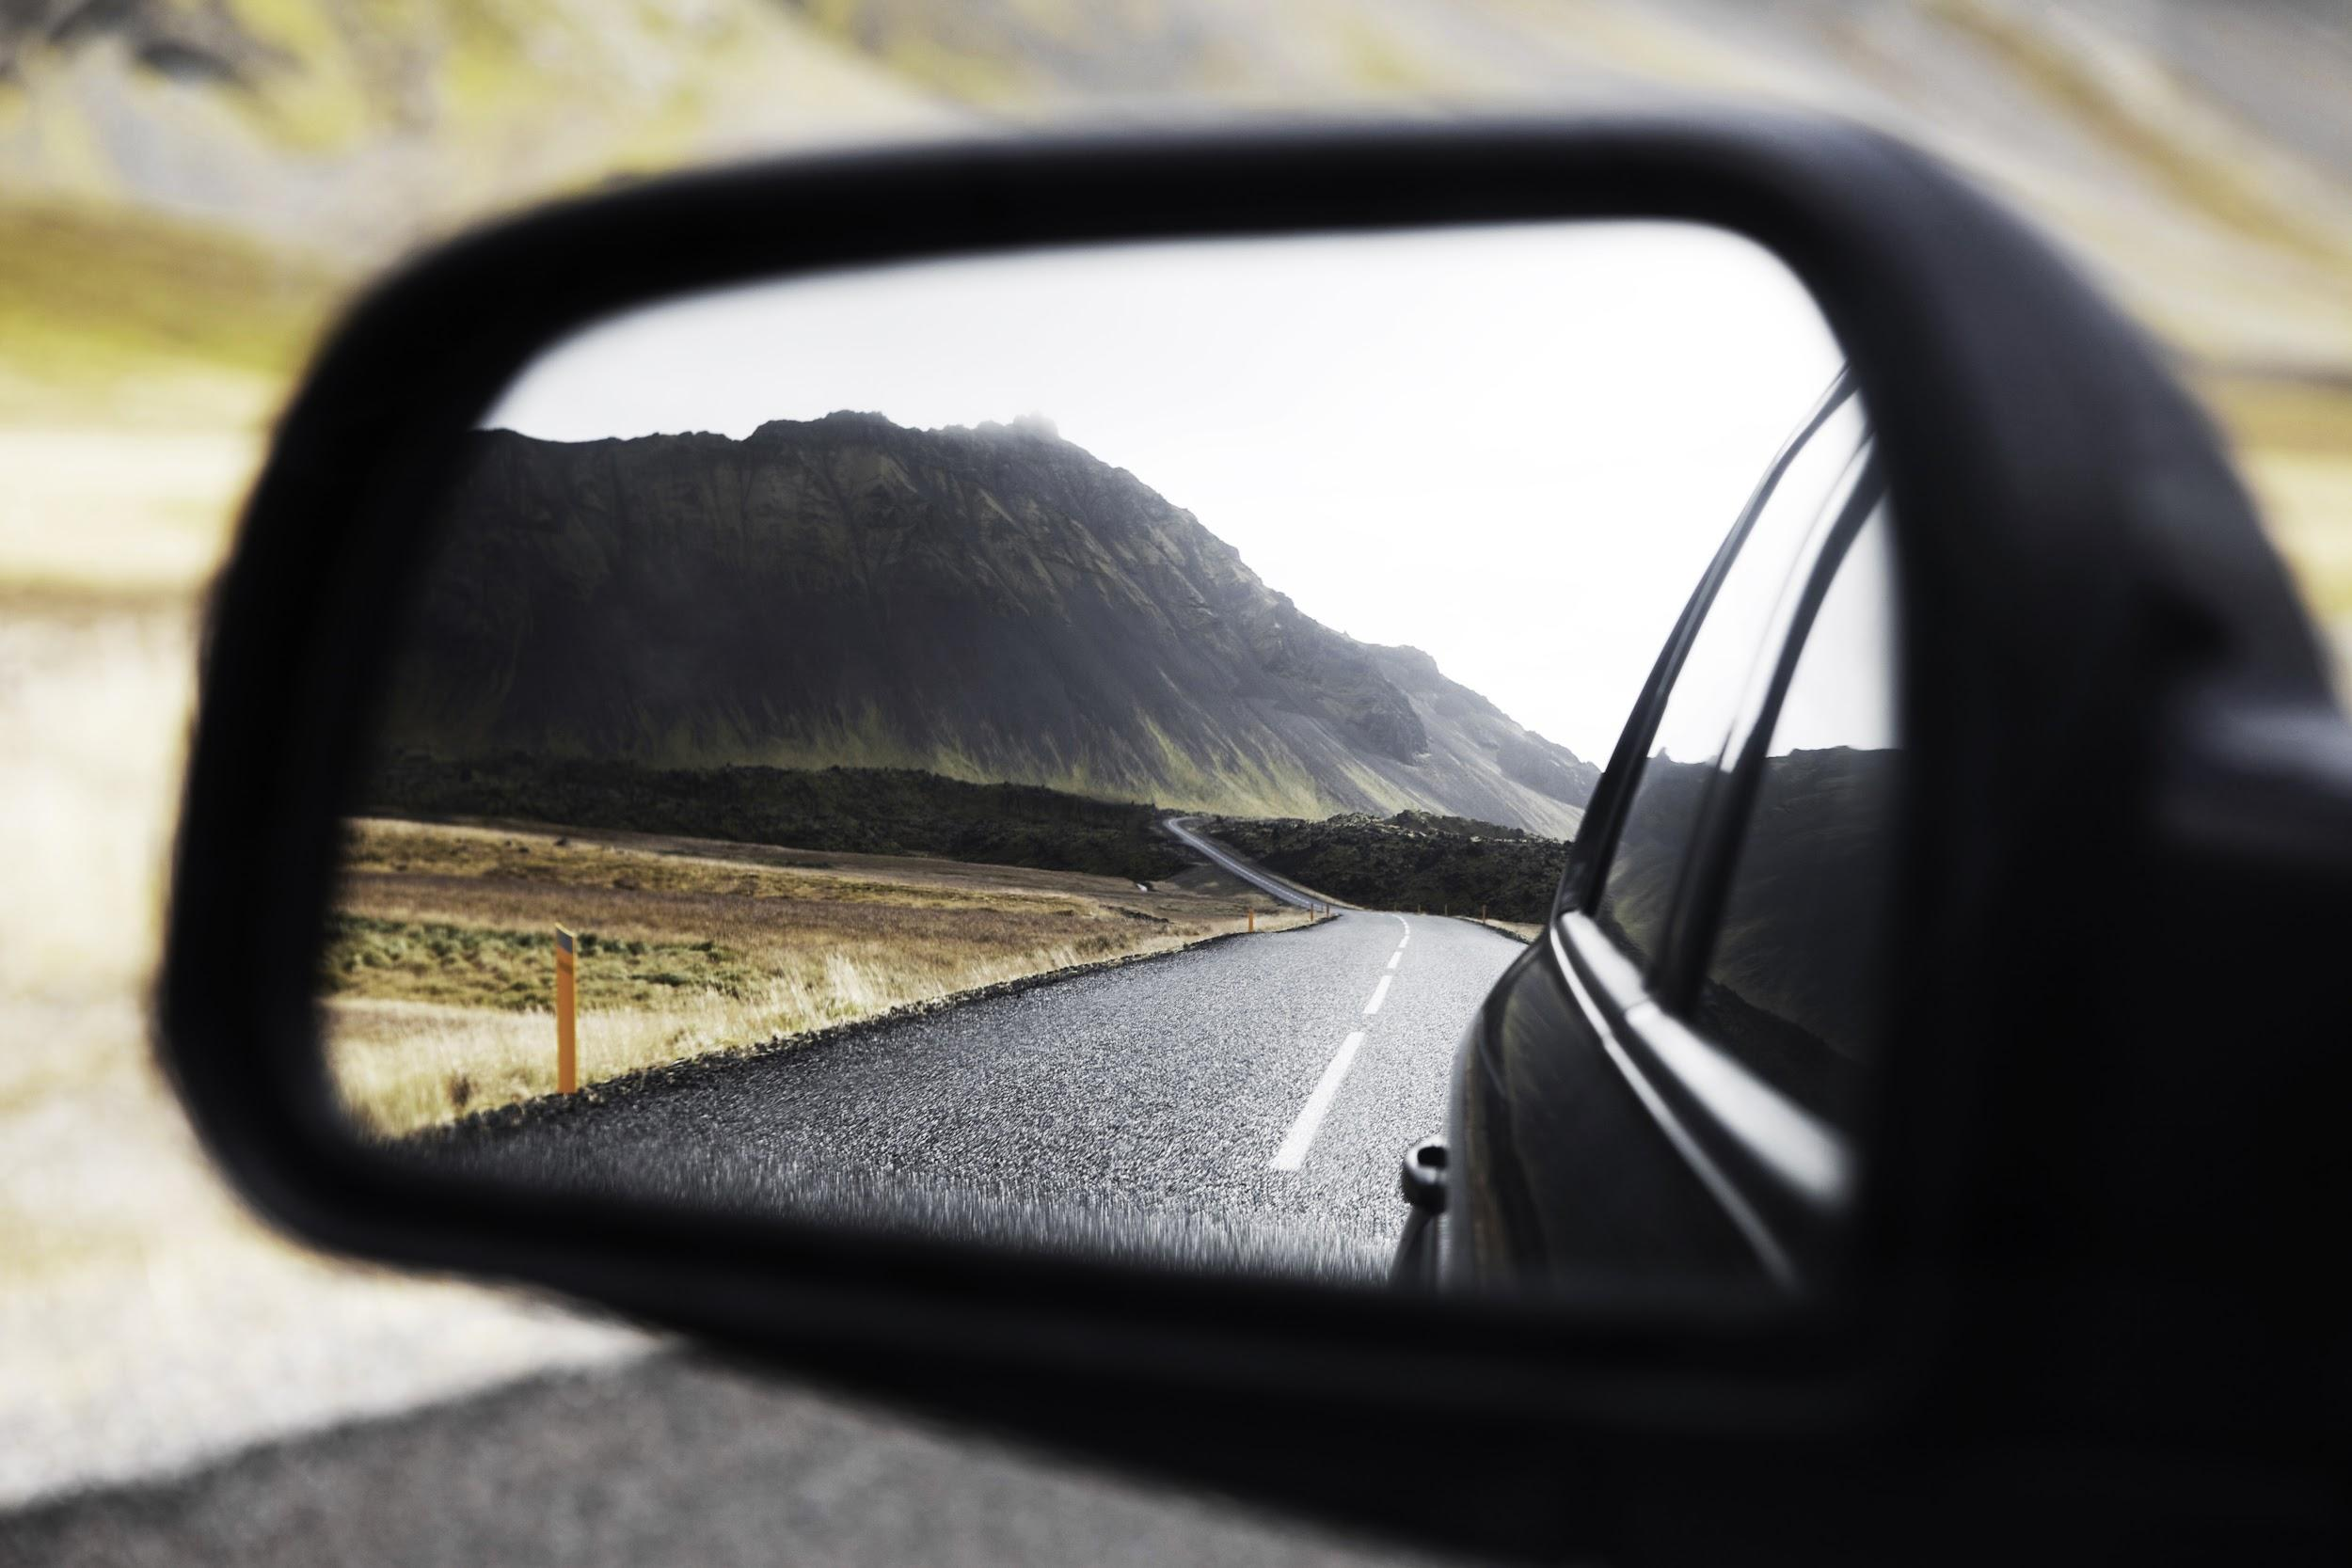
PAST SAVORING
(looking back on happy times)
-good at buffering stress-
-brings up positive feelings-
-creates connections-
Mutual Reminiscing

Slide 57
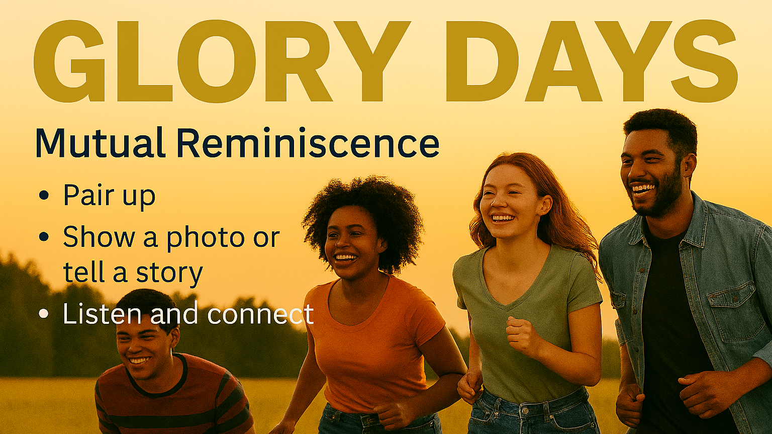

Slide 58

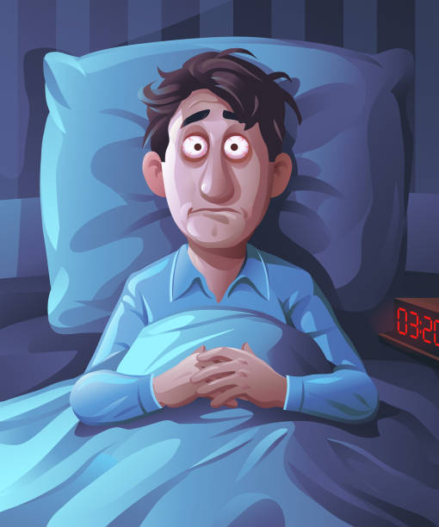
The costs of insomnia
Bono, Ch 4: “What’s the most important thing for students who want to be successful in college?”
[We could substitute Adults and life in that question]
The answer: “That’s easy, Sleep.”
Accidents, illness, lower achievement, depression, irritability, suicidality, etc!

Slide 59
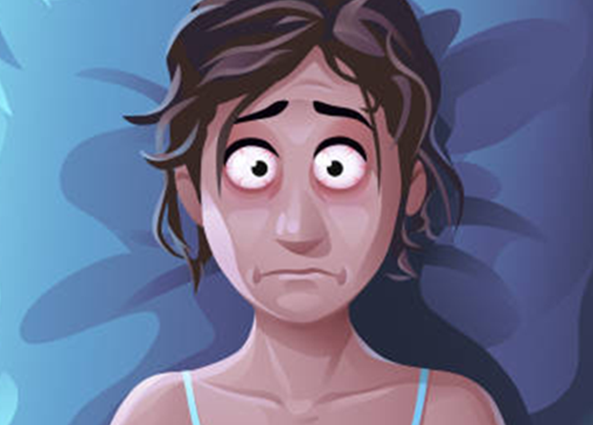
We can All Agree
Let’s talk about
Problems
Strategies
Solutions
and secrets
for sleeping well – Because Knowledge is Power

Slide 60

sleep (and anxiety) problems
Sleep Insomnia role play – Pretend
What disrupts sleep? – The insomnias
What disrupts sleep? – awakenings (children, nightmares, pets, chainsaws, light/screens)
What disrupts sleep? – cognitions and behaviors [Expectations and poor sleep hygiene]
Sleep paralysis Story

Slide 61
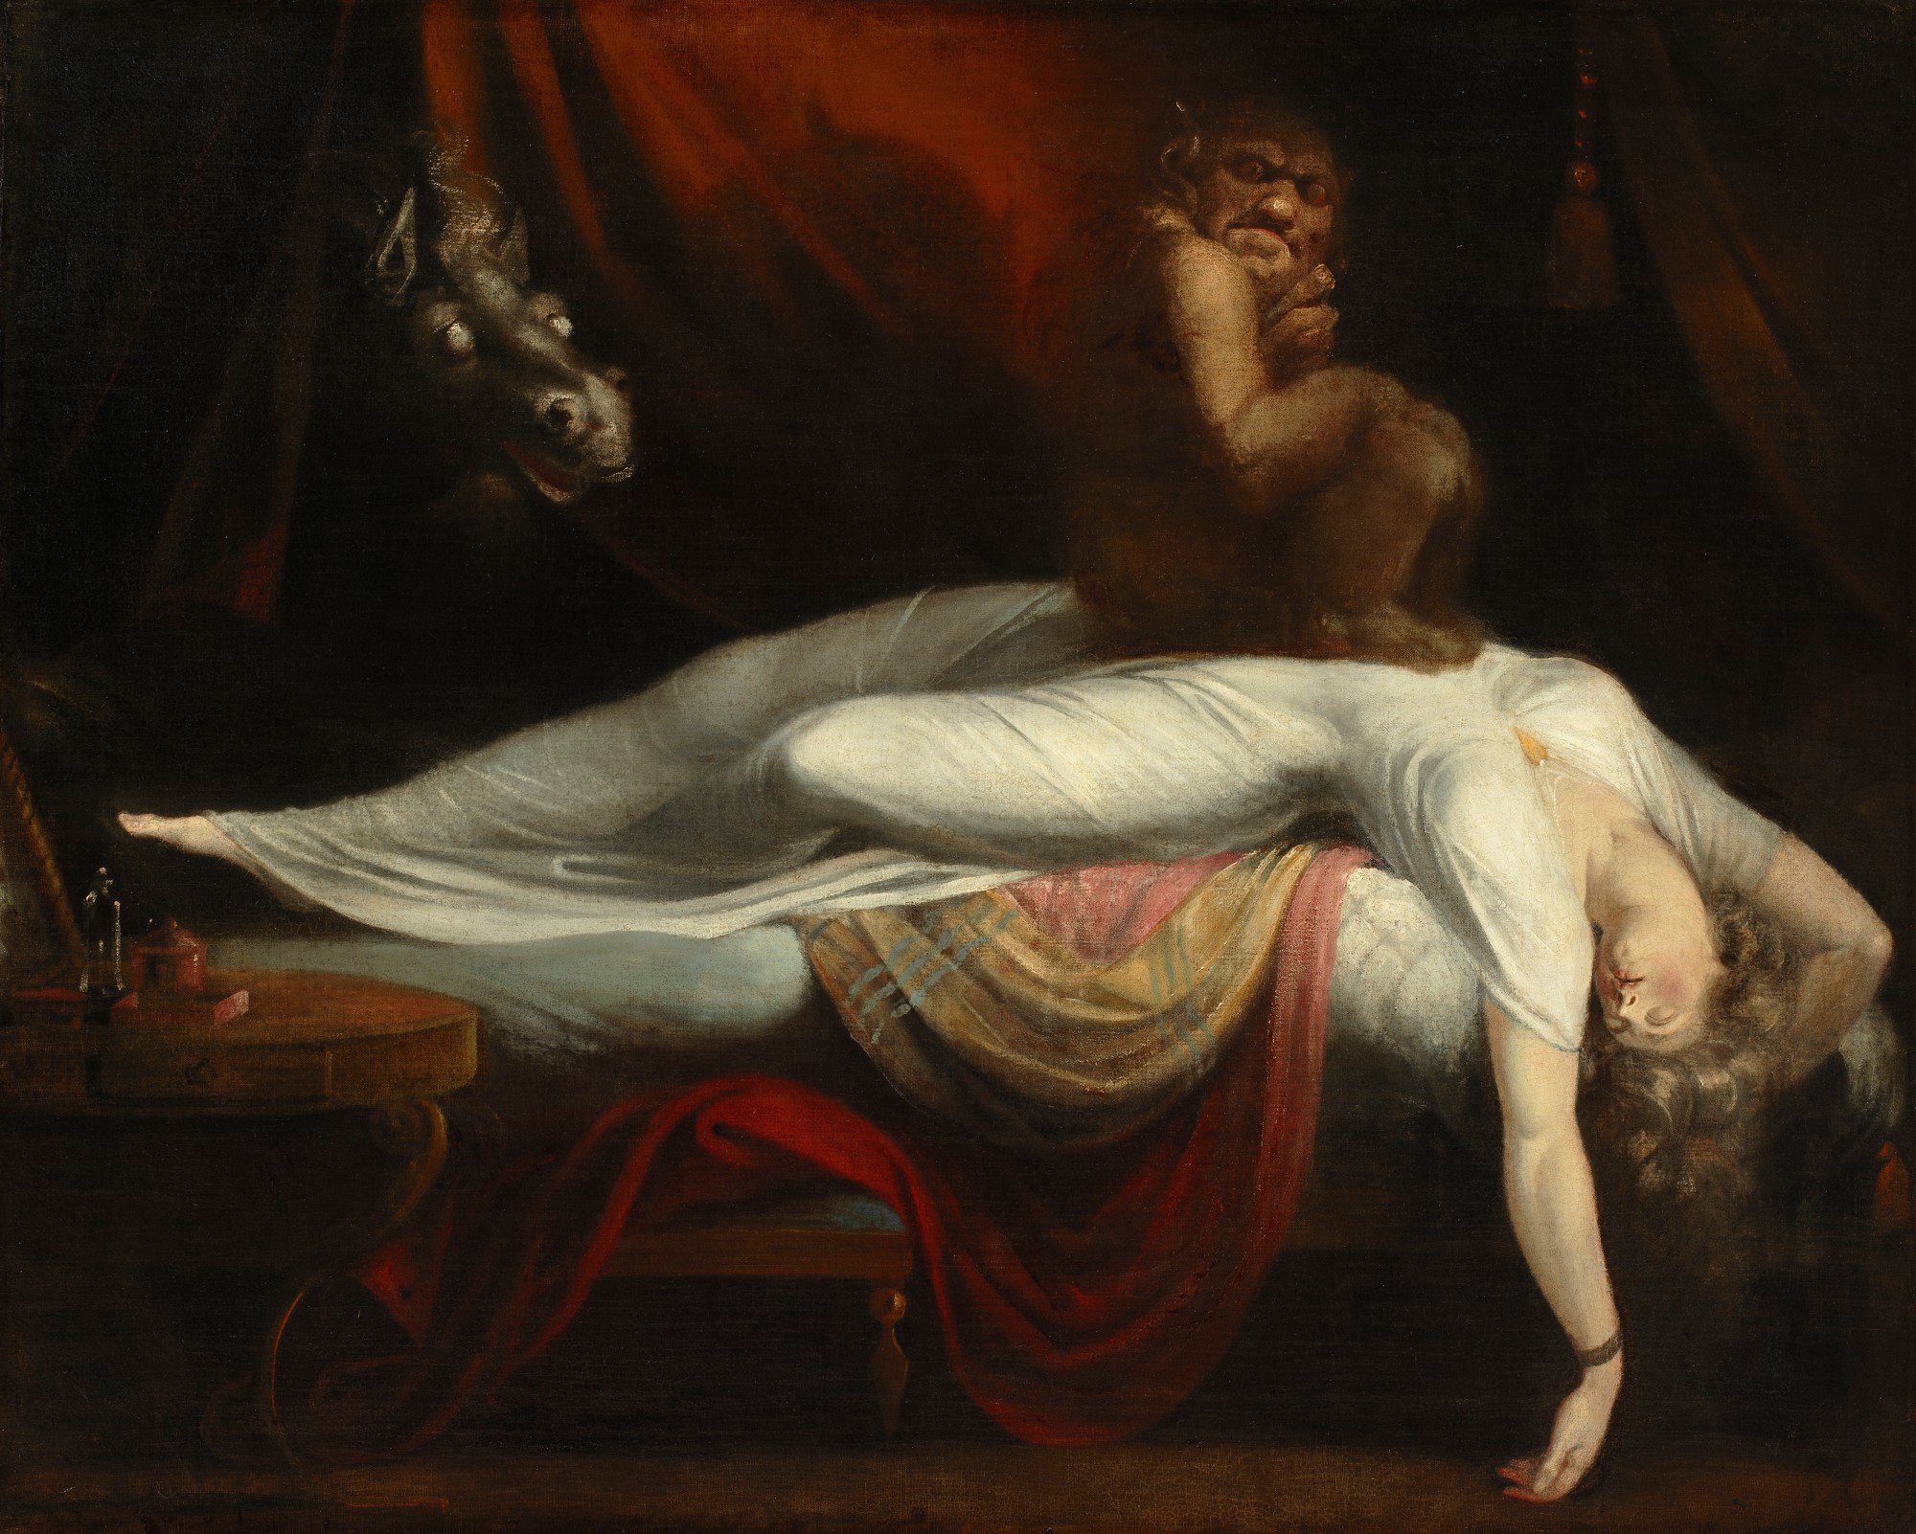
IMHO
Omg

Slide 62

Three Good Things
All by itself is evidence-based for insomnia
Cognition focus (cognitive shuffling – tiktok)
not for everyone

Slide 63
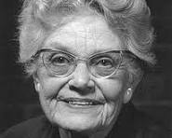
Only One Method:
Mary Cover Jones
1924 – Little peter
https://johnsommersflanagan.com/2017/07/17/brain-science-may-be-shiny-but-exposure-therapy-is-pure-gold/
The method is a soothing/comforting stimulus

Slide 64

Many Paths to the one true method
Measure your calmness-tension 0-100
Deep breathing
Progressive muscle relaxation
Visual imagery
Autogenic training
Yoga, weight-Lifting, or cardio, followed by one or more of the above
Find your comforting stimulus
3Gt, cognitive shuffling, whatever

Slide 65
Sleep Hygiene (Not just showering)
Routines – times, worry journal, etc.
Daily exercise (30 min sunshine)
Caffeine curfews [alcohol!]
Light and dark and sound and comfort
Beds are for sleeping
Limit naps to less than 30 min [coffee naps]
Avoid certain foods (meds? Melatonin?)
The temperature decline (Bath or shower)
Screen light exposure and Tech in the bedroom? (the research?)
Have a plan for dealing with troubling thoughts and dreams [3 Good Things; mindfulness meditation]

Slide 66

Bonus: How Anxiety Works
Anxiety is mostly driven by thoughts
Ever hear of: Fight or Flight or Freeze?
Male rats
What about female rats?
What about humans?
Amygdala hijack and brain shutdown?
Adolescent brains?
All research says. . . Fear of fear

Slide 67
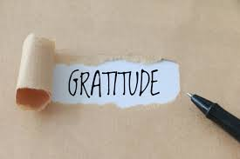

Slide 68

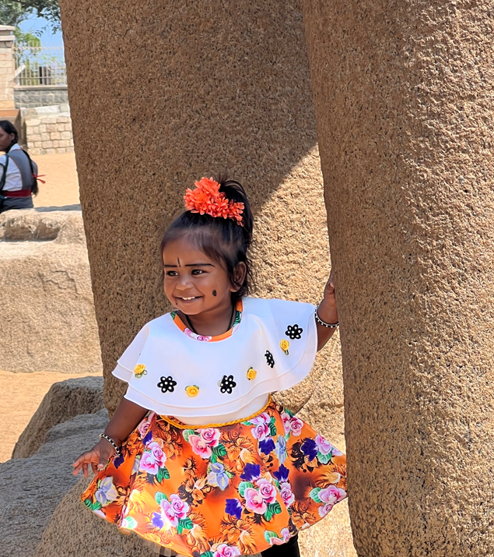
Do you want to increase optimism, improve life satisfaction, be healthier, exercise more, and be happier?
Weave intentional gratitude into your life!
Notes:
Dylan

Slide 69
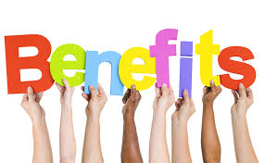
Internal
Happier
More energetic
Hopeful
Experience MORE positive experiences!
Physical
More likely to exercise
Less headaches
Less nausea
Less body aches
Less acne

Slide 70
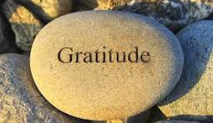
Gratitude Practices
Gratitude Journaling
Gratitude Jar
Gratitude Photography
Gratitude Tree or Wall
Reverse Gratitude (Bad to Good)
Gratitude Letter Writing
Notes:
Dylan

Slide 71


Slide 72





Ideas for practice
Who is someone in this room toward whom you feel appreciation and gratitude?
Why do you feel gratitude for them? Be specific!
Over the lunch break, find this person and share your gratitude!
Or...you make want to write your own gratitude letter. Follow step 2 above and then call your recipient and read it!

Slide 73
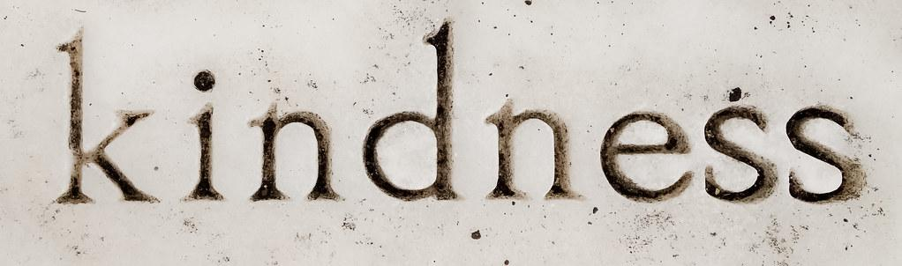
Notes:
When we talk about Kindness we can also talk about social connection.
Random Acts of Kindness - Intention Acts of Kindness
What does kindness look like? Why is kindness important to you? To society? What are the benefits of being kind?

Slide 74
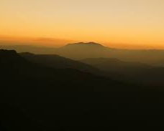
Other
People
Matter
Dr. Christopher Peterson
Notes:
Chris Peterson - PP can be summed in 3 simple words
Investing in social relationships is a powerful practice on the road to happiness.
2 ways to do this through kindness and nurturing relationships. Today we are going to focus on Kindness

Slide 75
Relationships constitute the single most important factor responsible for the survival of homo sapiens
-Ellen Berscheid

Slide 76
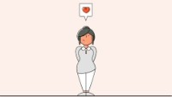
Notes:
2:30

Slide 77
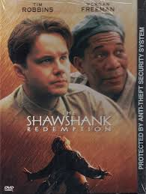



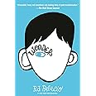

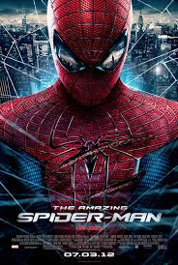
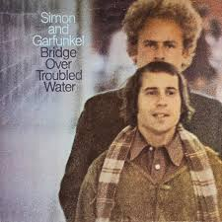

Kindness Begets Kindness Evermore
-Sophocles
Notes:
“Hurt people, hurt people.” “Kindness, begets Kindness” - impacted by giving, receiving, witnessing
A major theme in Philosophy, literature, religion, music, movies, TV, comedy, poetry, spirituality etc - for centuries

Slide 78
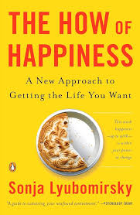
1. Kindness Boosts Happiness
positive emotions, sense of connection, life satisfaction
2. Timing and Variety Matter
a “kindness burst” (several acts in one day) is more effective than spreading them out, and varying acts keeps the benefits strong.
3. Intentional Kindness Is Most Effective
freely chosen acts have a greater impact than those that feel forced or obligatory.
Dr. Sonja Lyubomirsky’s (and other’s) research
Notes:
Kindness - perceive others as more positive and charitable, fosters heightened sense of interdependence and coopeeratiton in community, relieves built, distress over other’s hardships and gives sense of awareness of gratitude, self-perception and positive social consequences. -
Lyubomirsky, S. (2007). The How of Happiness: A New Approach to Getting the Life You Want. Penguin Press.
Lyubomirsky, S., Sheldon, K. M., & Schkade, D. (2005). Pursuing happiness: The architecture of sustainable change. Review of General Psychology, 9(2), 111–131. https://doi.org/10.1037/1089-2680.9.2.111
Lyubomirsky, S., Tkach, C., & Yelverton, J. (2007). Pursuing sustained happiness through random acts of kindness and counting one’s blessings: Tests of two six-week interventions. Unpublished manuscript, University of California, Riverside.
Otake, K., Shimai, S., Tanaka-Matsumi, J., Otsui, K., & Fredrickson, B. L. (2006). Happy people become happier through kindness: A counting kindnesses intervention. Journal of Happiness Studies, 7(3), 361–375. https://doi.org/10.1007/s10902-005-3650-z

Slide 79
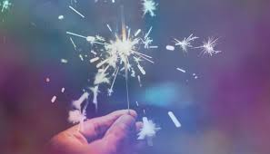
WHO
Choose the recipient
WHAT
Consider their unique needs
ACT
Describe how you’ll give your time, energy, skills, or resources.
Share the Plan

Slide 80
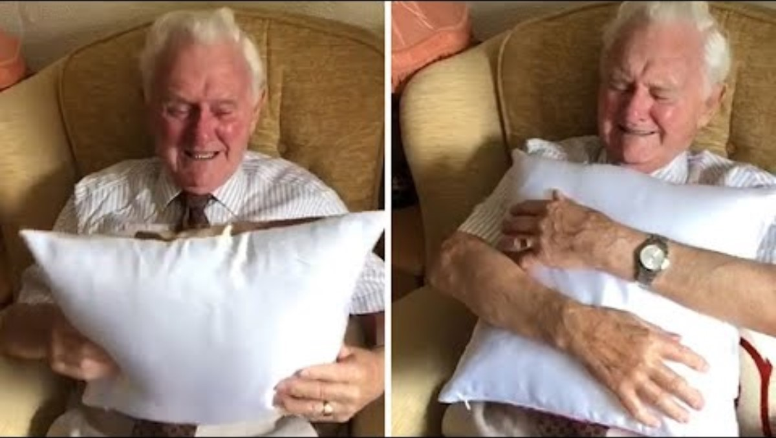

Slide 81


SAMPLE LEARNING ACTIVITIES
Option 1: The Chain Effect of Kindness
Option 2: At Home, At School, In the World
Notes:
Chain Effect of Kindness:
Break into three groups
Group 1: “At home”
Group 2: “In the real world” (e.g. restaurant, grocery store, movie, the street, neighborhood)
Group 3: “At school”
Choose a writer
Choose two presenters
On the paper provided write as many ways to show kindness as you can, as it pertains to your group’s location (home, real world, school).
You have 5 minutes!

Slide 82


Slide 83
Free Resources
https://montanahappinessproject.com/
https://johnsommersflanagan.com/

Slide 84
Bonus Slides
Flood the Zone
Notes:
John

Slide 85


Slide 86
Closing
Story
Educators

Slide 87

What do you want to remember?

Slide 88

Resources
John.sf@mso.umt.edu
Tamara.tollesonknee@mso.umt.edu
https://www.umt.edu/education/about/spec-units/cape1.php
https://johnsommersflanagan.com/
https://montanahappinessproject.com/

Slide 89

Therapeutic Writing

