Slide 1
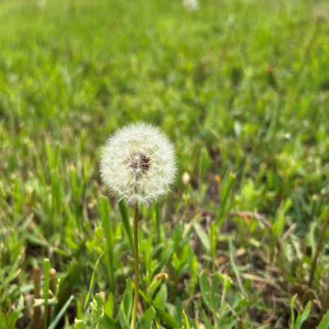

John Sommers-Flanagan, Ph.D.
Phyllis J. Washington Center for the Advancement of Positive Education, University of Montana
John.sf@mso.umt.edu
Free Resources: https://johnsommersflanagan.com/
In Pursuit of Happiness
For Educators and Schools

Slide 2
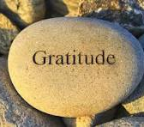
Gratitude
First
Thanks to Dr Amy Geinert, Zach McCormick, and Grand Forks for the invite and for organizing
Thanks to Phyllis Washington and our colleagues at CAPE
JSF’s Platform
Thanks to YOU

Slide 3

Opening Story
10 Min of Play

Slide 4

Preparation
Trigger warning – Why?
I will talk about why mental health and happiness are so elusive, and say contrary things
Research indicates. . .
Strength-warning. . .

Slide 5


Remember . . .
Trigger warnings are suggestions about what you might not be able to handle
Strength warnings are suggestions about how learning new knowledge and gaining experiences can make you STRONGER

Slide 6

Learning (Learner) Objectives
You come with YOUR knowledge, experience, and expectations – You come with YOUR WHY and PURPOSE
I offer a few ideas about the brain, MH, happiness and YOUR well-being
You take what fits for you and apply it to yourself and in your work, if you feel like it [Get out!]

Slide 7
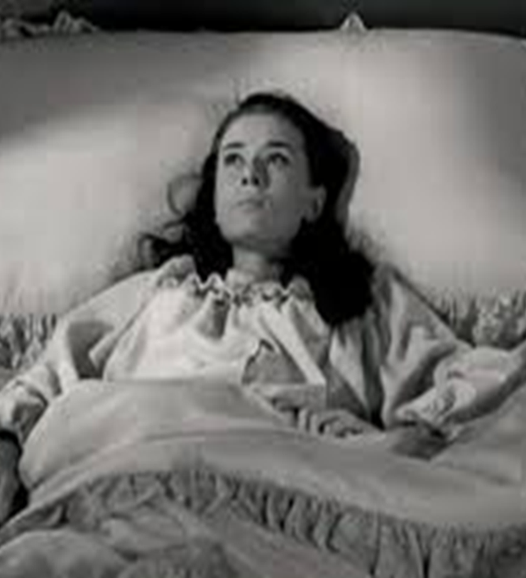
What’s Wrong with YOU?
The closer we look

Slide 8
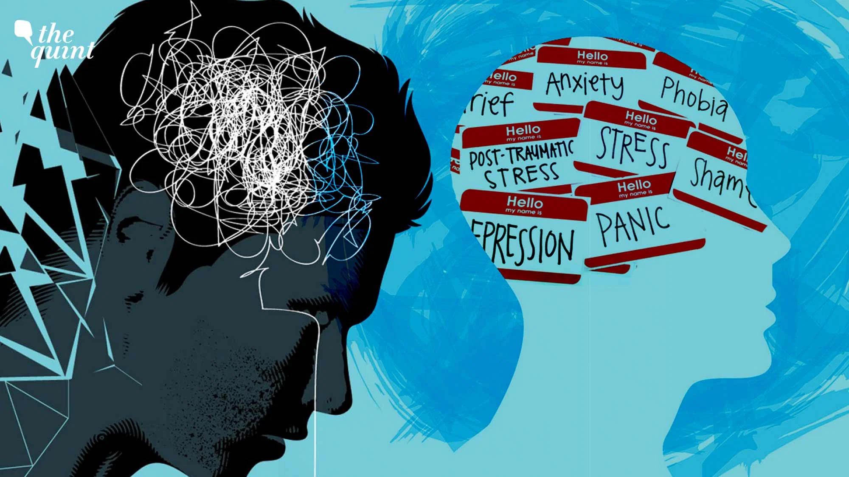
The Problem is Extra large
From 1980 to 2025 problems have just gotten worse in the face of more treatments. Why??

Slide 9

How Our Brains Work
Five
BIG
Truths

Slide 10
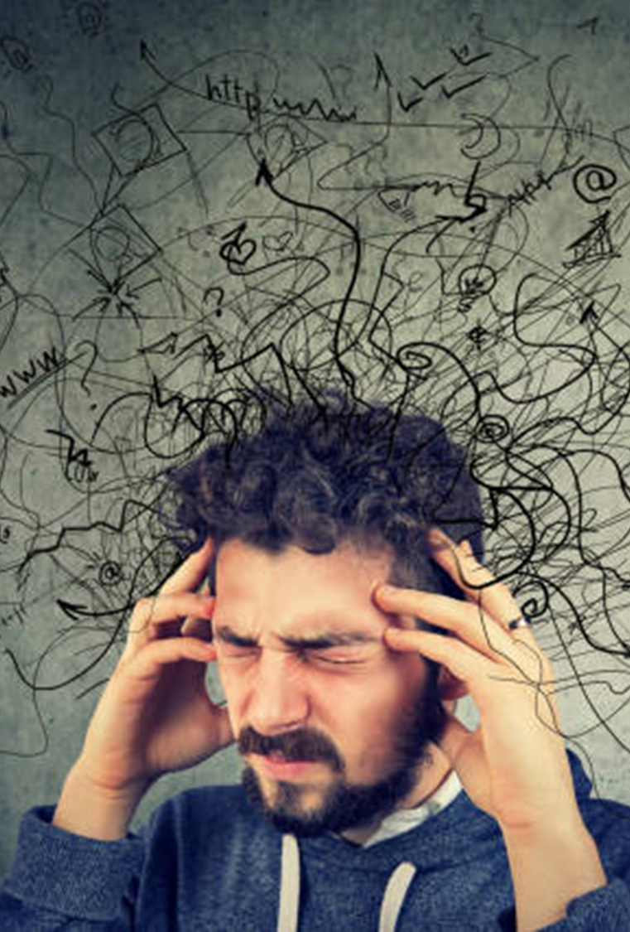
1 – We’re Vulnerable to Over-focusing on What’s Wrong with Us and Others
Medical and MH student disease
Social Media/TikTok

Slide 11
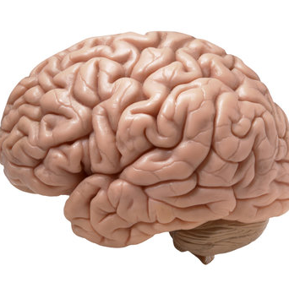
The Amazing Brain
Activity
Mindful moments

Slide 12
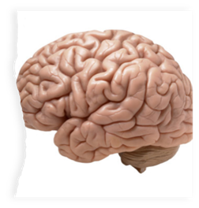
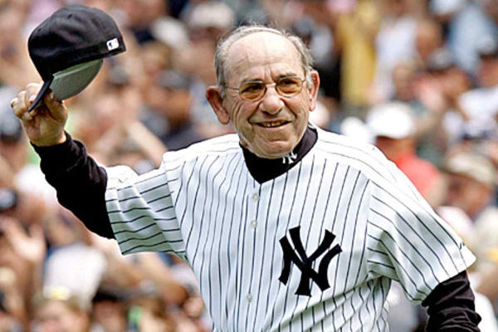

2 – Confirmation Bias
We find
what we
look for
Ex: 6th to 7th grade transition meeting

Slide 13
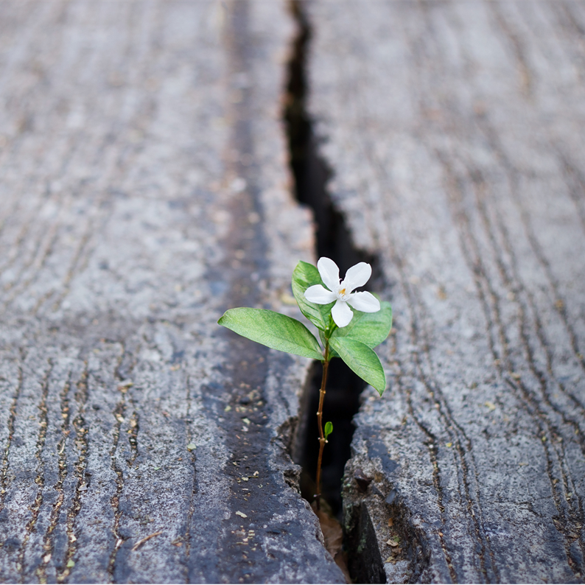
3 – What We Pay Attention to Grows
The parts of your brain you use – you GROW
Duh: Neurons that fire together, wire together [Romantic partner, child, etc.]
If we focus on failures, we get BETTER at focusing on our failures. . .and there are MANY

Slide 14

4 – The Problem with Happiness
Should we (and our students) even be pursuing happiness?

Slide 15

Pursuit of Happiness?
No and yes
Yes, to Eudaimonic Happiness
  Not an emotion
  Not material wealth
  Not political achievement
  Not so much an outcome, but a process of fulfilling one’s virtuous potentials in the context of community
  And NO to these SELF-focused messages . . .

Slide 16





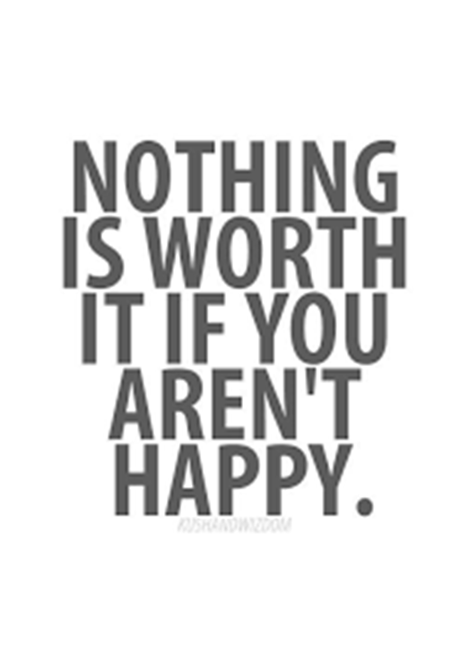














Slide 17

The Best Definition and You?
That place where your greatest and unique virtues, gifts, skills, and talents intersect with the needs of your friends, family, communities, tribe, and the world?
JSF – Biking story

Slide 18

Activity
Think of a nice story of your unique strengths (gifts, skills, talents, virtues) being seen at your school or with your tribe or community or at home or with friends. . . share it with a neighbor or two (5-7 min)
This can feel awkward . . .
Notes:
Lillian

Slide 19

Flip the Happiness
Notice. . . with others, their unique strengths
Name them and share them
Being seen is great; being seen for your best qualities is better
Other people. . .

Slide 20
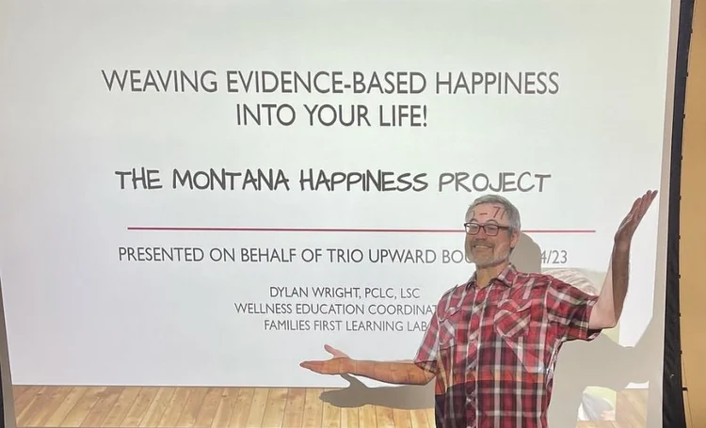
5 – The Contrarian Brain
When we focus on happiness, sadness can come
When we focus on positivity, critiques creep in
When we seek joy, our brains sometimes push us back toward misery

Slide 21
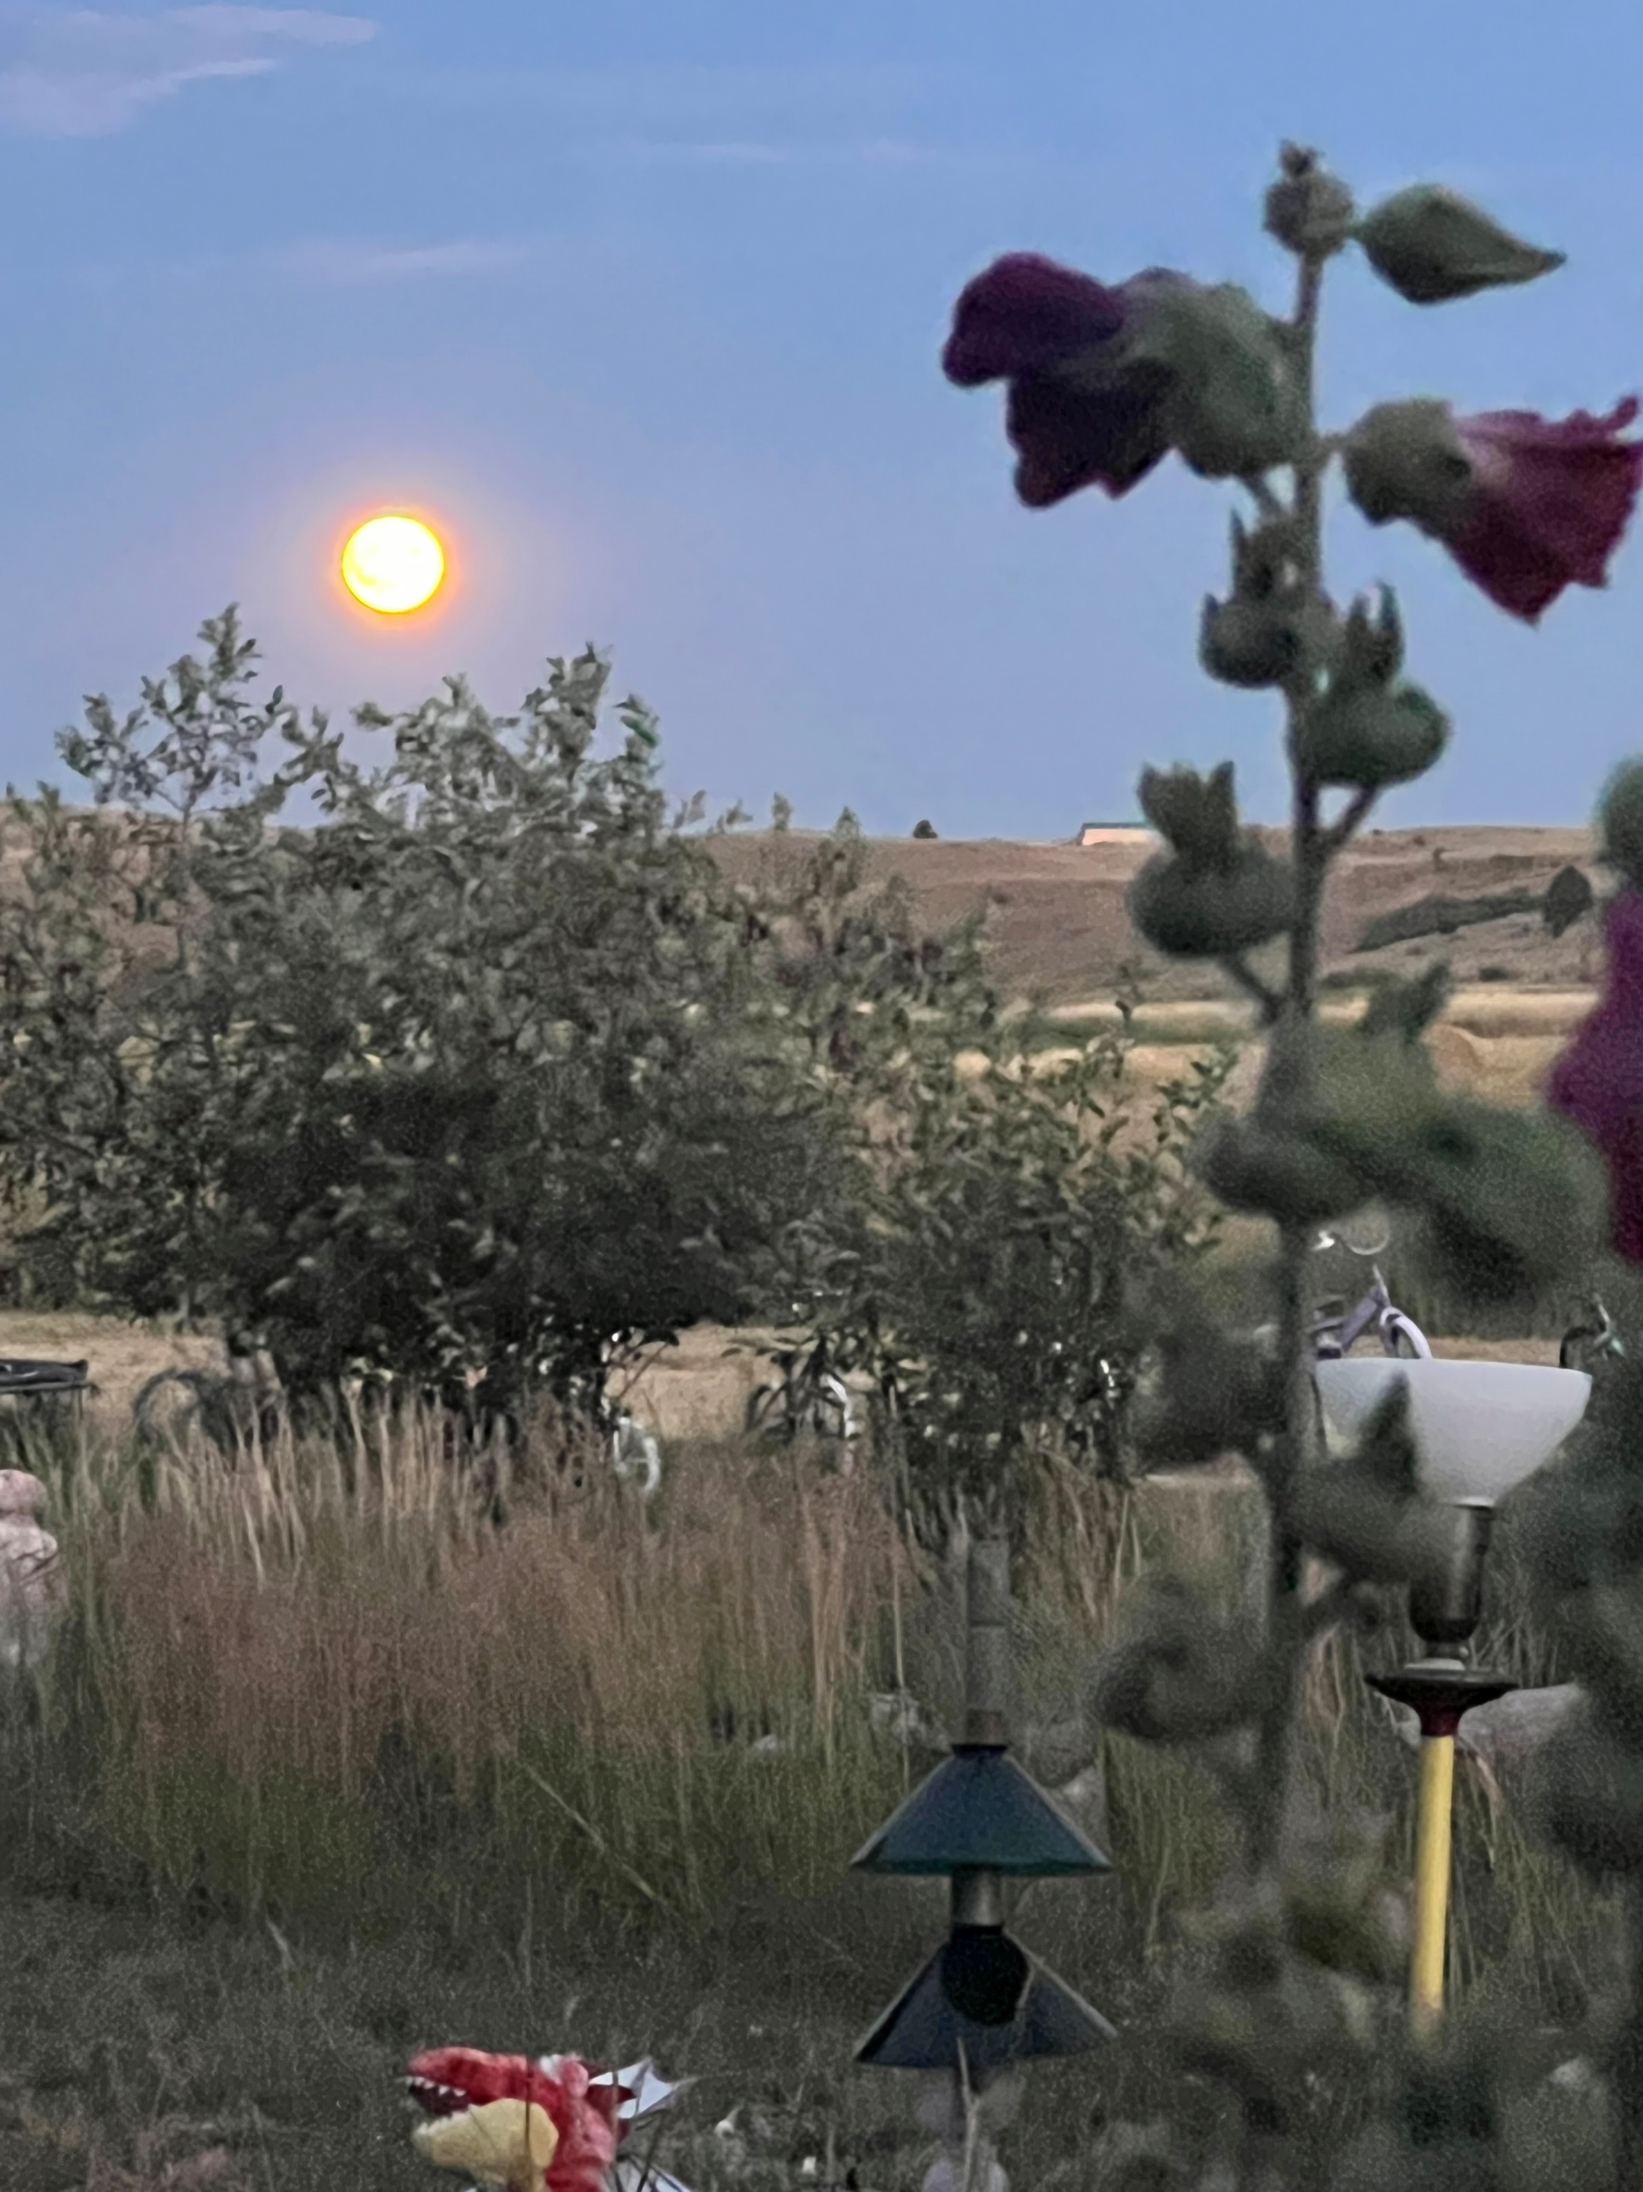
What’s Wrong??
The Big Psych Truths that you and your students must face. . .
We overfocus on what’s wrong [21 negative:1 positive]
We find what we look for
What we pay attention to grows
Social messaging about happiness is unhelpful
Our brains are often contrary-spoilers

Slide 22
How does positive psychology/psychotherapy work?
Well-Being
Problems
Well-Being
Ex: Ability to generate positive emotion. Not just inside a person but also between and among people and within and between communities
The Muscle Metaphor [everyone with me] . . . Work Out with the Positive . . . Then what happens? What about ACES?
Notes:
Positive psychotherapy integrates positive psychology principles and empirically-supported techniques (PPIs) with foundational principles of psychotherapeutic change (e.g., therapeutic relationship is critical, person-in-context, therapeutic attunement). Most approaches grounded in Broaden and Build and most intentionally cultivate positive emotions. Actual moves of therapists is what varies.
Goal-focused positive psychotherapy (Conoley & Scheel, 2018) contributes to client’s ability to face and accept life’s losses and unchangeable difficulties by increasing subjective well-being. “The inevitability of suffering and loss in life heightens the importance of learning the skills to embrace the joy in life, to be meager or bountiful” (p. 5). The physical sciences metaphor of “fixing” broken thoughts, feelings, and behaviors is not a good fit with the human condition with all of our limits and capabilities. Pain and suffering associated with loss and death but also posttraumatic growth and/or expressions of resilience and thriving.
Plumb et al., 2020: GFPP therapists collaborate with client to: a) set approach goals, b) cultivate positive emotions generally and within session, c) focus on client and cultural strengths, and foster hope using techniques like: a) Three Good Things, b) Capitalization (by therapist), and c) Mindful self-compassion.
Hence, Helen Neville’s focus on Justice and Joy (or Black Girl Magic/Joy).

Slide 23



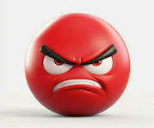
Bad Moods
Let’s Grow Wellbeing
A Story about Bad Moods and our CAPE Philosophy
1990-2014

Slide 24
Bad Moods – 2
Anyone here
ever had someone tell you to
“Cheer Up?!”
Or
“Smile!”

Slide 25
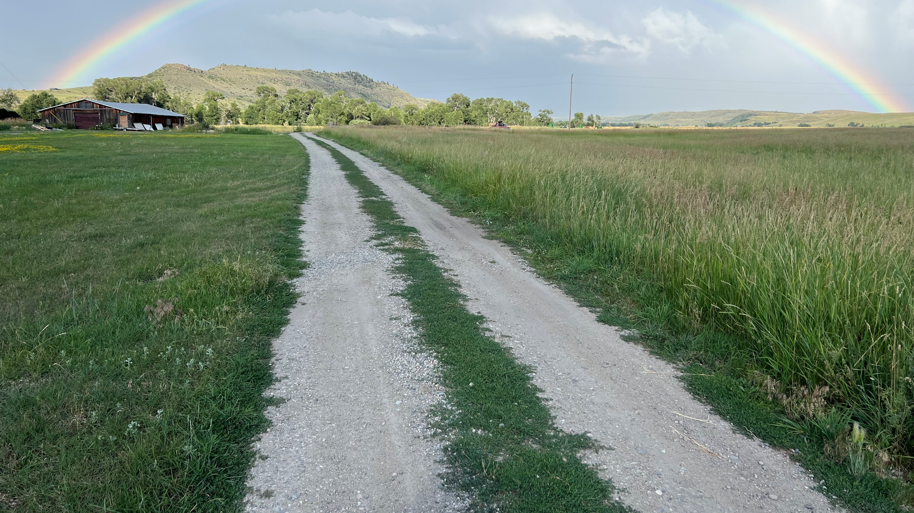
Bad Moods – 3
Ever feel stuck in a bad mood?
What if YOU could be
THE CAPTAIN
of your own emotional ship

Slide 26
The Three-Step Emotional
Change Trick
Step One
Honor YOUR Emotion
Notes:
We may or may not do this-John

Slide 27
The Three-Step Emotional Change Trick
Step Two
Think a New Thought . . . or
Do Something Different
(ACEs may pull you back)
Notes:
We may or may not do this-John

Slide 28

The Three-Step Emotional
Change Trick
Step Three
Share the Good Mood
Notes:
We may or may not do this-John

Slide 29
The Three-Step Emotional
Change Trick
Step Four
Teach Someone the 3 Steps
Notes:
We may or may not do this-John

Slide 30

Sample (step 2) Intervention
Three Good Things
Sleep survey
Rumination is all-natural, but not helpful
Notes:
Dylan/Nancy?

Slide 31

Three Good Things
Seligman’s signature technique
  Before you go to sleep (or right now)
  Write down (or think about) three good things that happened during the day (or last 24 hours)
  Then track down in your mind “Why” those things happened
  Seligman: After a week, you’ll want to keep doing it (JSF: Maybe)
  Volunteer? And practice.
Notes:
Dylan/Nancy

Slide 32
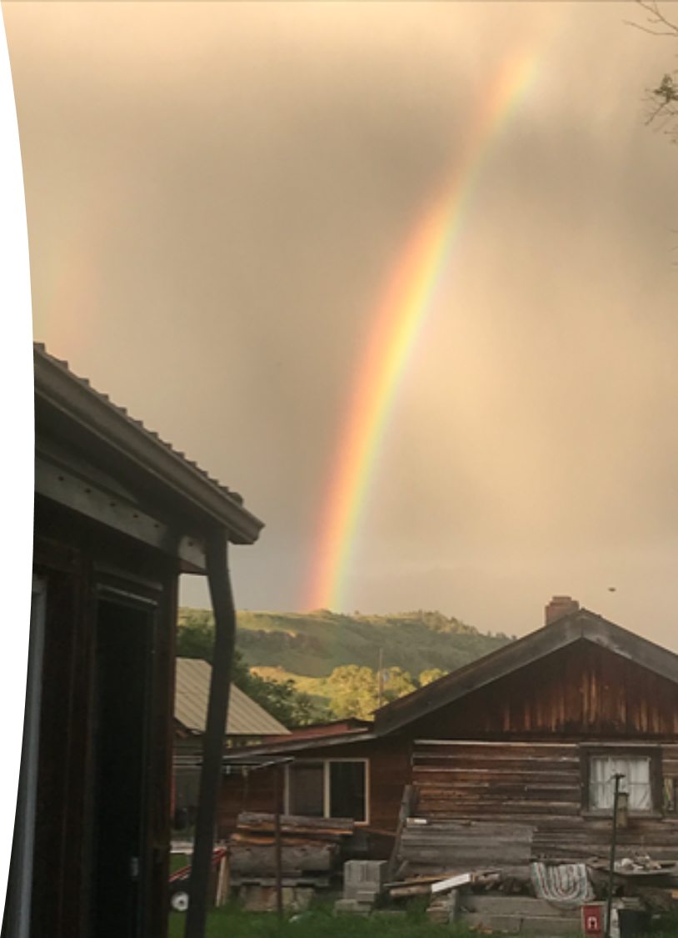
Why Three Good Things Works
When you go to bed, you NATURALLY embark on a negative (depressive) review or anticipatory (anxiety) preview
Three good things shifts your focus
Identifying “Why” those things happened activates a brain search toward positive attributions
Sleep problems and solutions

Slide 33

Evidence-Based Happiness for Educators
One MHP, AMBFF, and CAPE project at the University of Montana
Notes:
John

Slide 34
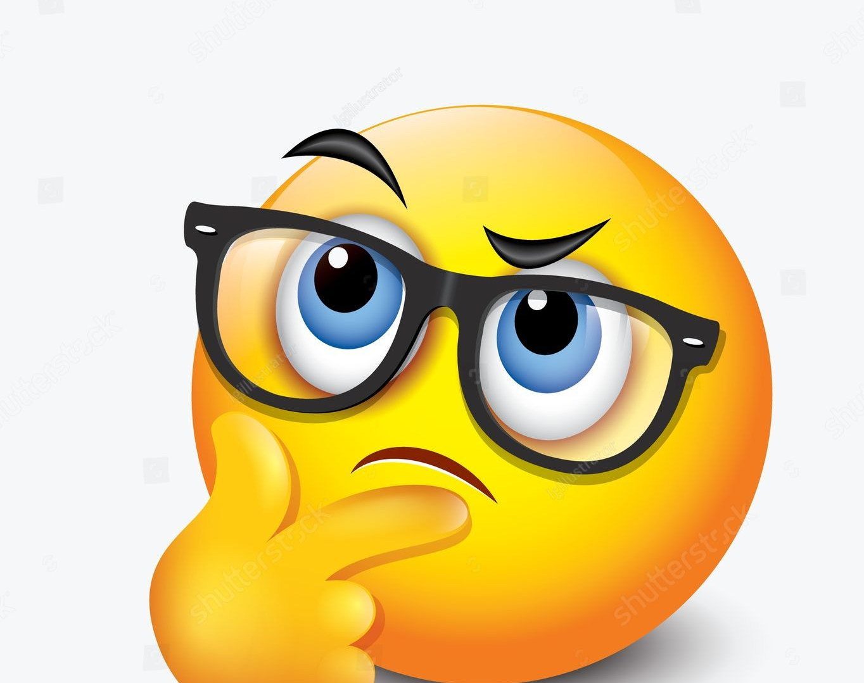
Does a 3-Credit Grad Course on HFE Make a Difference?
In the beginning. . .
Notes:
John

Slide 35
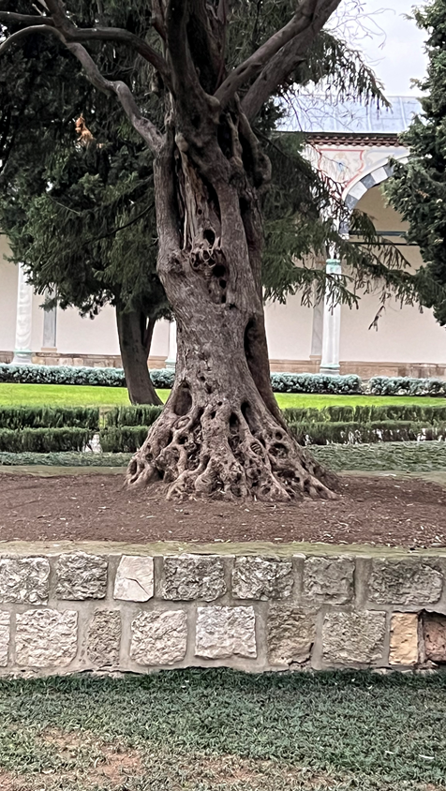
What We’ve Done: With the Arthur M. Blank Family Foundation’s Support
Created and Delivered a 3 Grad Credit Happiness for Educators Online Async Course
Pilot – Winter 2022/2023 = 19 (Browning only)
Cohort 1 – Summer 2023 = 44
Cohort 2 – Spring 2024 = 54
Cohort 3 – Summer 2024 = 71
Cohort 4 – Fall 2024 = 27
Cohort 5 – Spring 2025 = 89
Cohort 6 – Summer 2025 = 130
Cohort 7 – Fall 2025 = 42 [451 completed]

Slide 36

Cultural Convergence
Integrating Indigenous Resilience
Lakota elder, James Clairmont:
The closest translation of “resilience” is a sacred word that means “resistance” . . . resisting bad thoughts, bad behaviors. We accept what life gives us, good and bad, as gifts from the Creator. We try to get through hard times, stressful times, with a good heart. The gift [of adversity] is the lesson we learn from overcoming it.
Notes:
Lillian

Slide 37
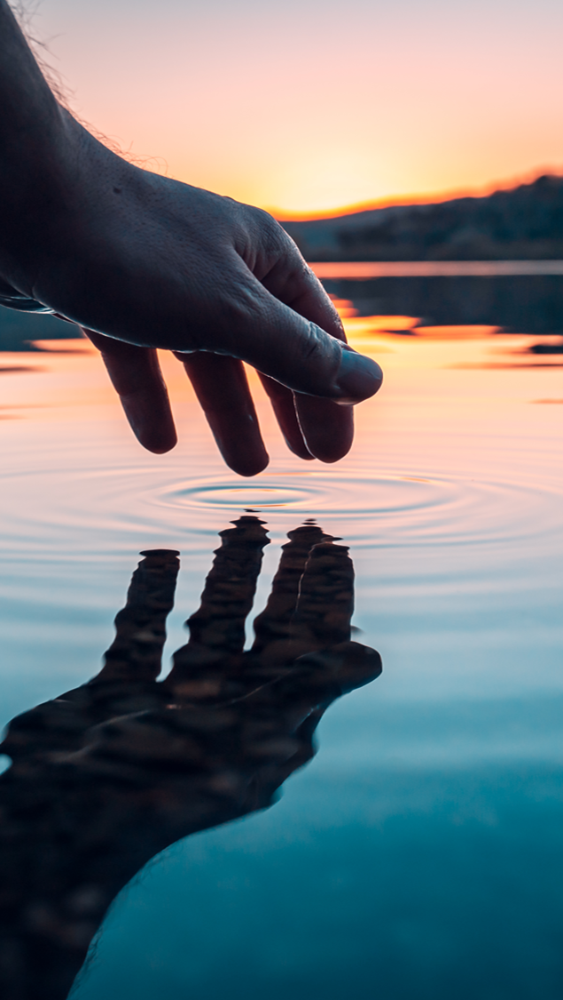
Our Outcomes
After the Course
60% reduction in depression scores [about 12%]
But also, educators had:
  More hope, positive emotions, mindfulness, and social support
  Better sleep, fewer headaches and sick days
  Reduced gastrointestinal
  and respiratory distress
  Med to Large Effect Sizes (d)
Before the 3-credit course
About 30% of educators scored as clinically depressed
451 educators

Slide 38

But those are just questionnaire results
What do the educators themselves say about the course?
Notes:
John

Slide 39

We Asked 363 of the Educators
“Please share, using as few or as many words as you like, how you were impacted by taking the happiness for educators course.”
321 responded
All responses were positive

Slide 40
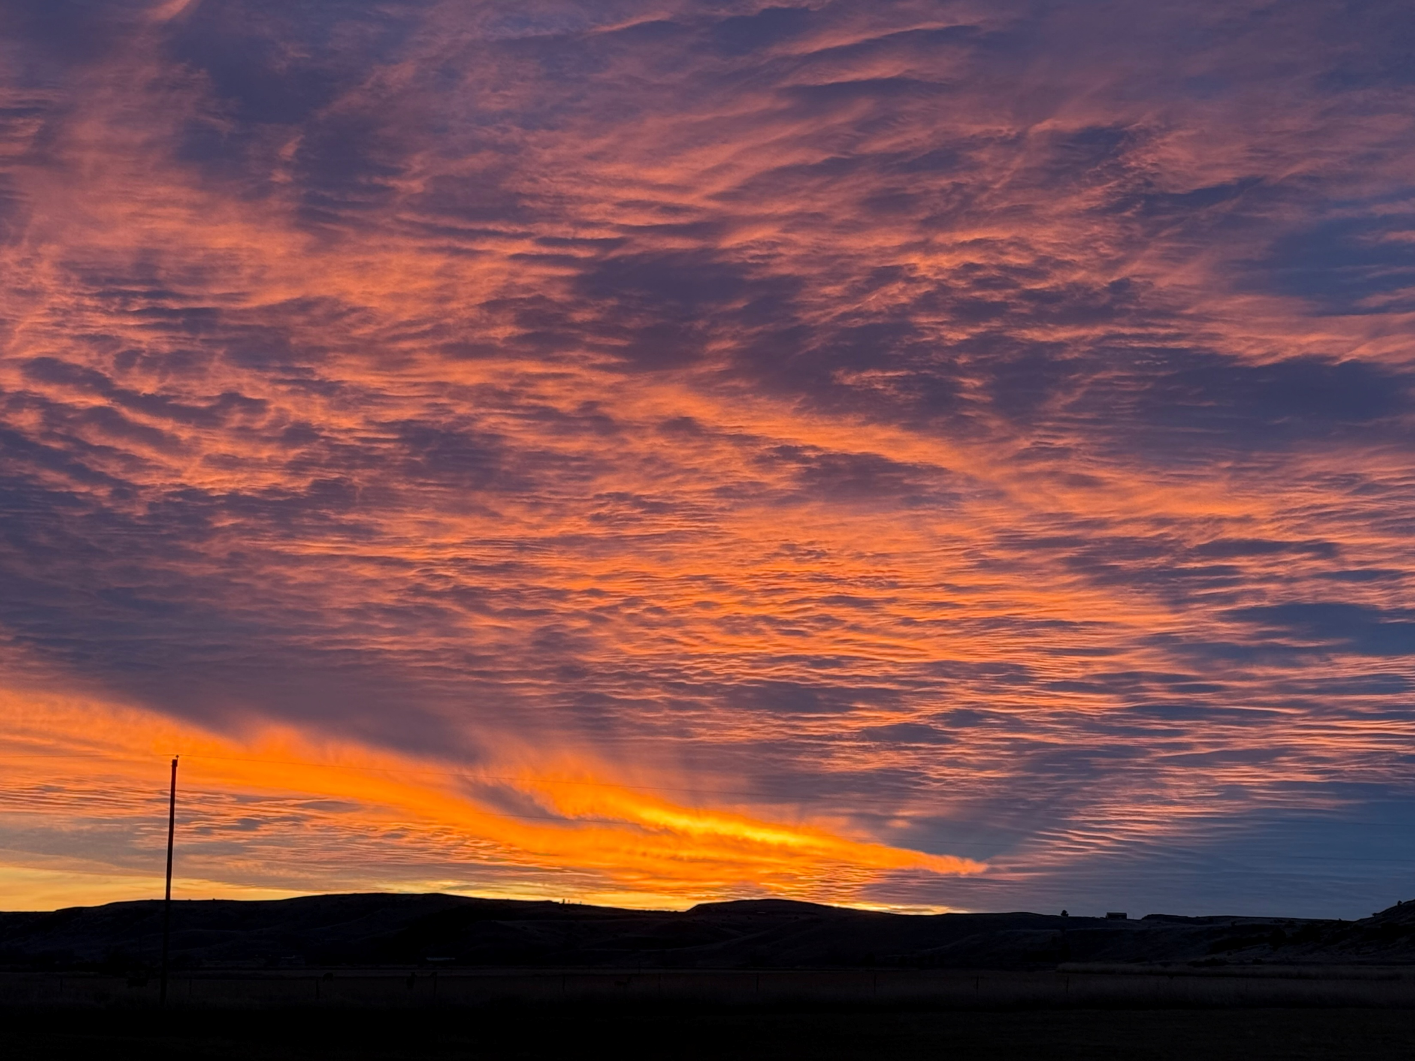
#258 – More Prepared for My Calling
This course reaffirmed for me my strengths as a teacher and a human. It helped me look at some things I perceived as flaws, and instead, see them as strengths or at least an opportunity for a strength to be built. I realized because of this course that I do in fact have tons of support from my family, and that my role as a teacher is not just a career, but a calling. As a result, I feel more prepared to begin this new school year, and more equipped to deal with obstacles and challenges as they inevitably come my way. I am more hopeful for this year, for me, and my students.

Slide 41
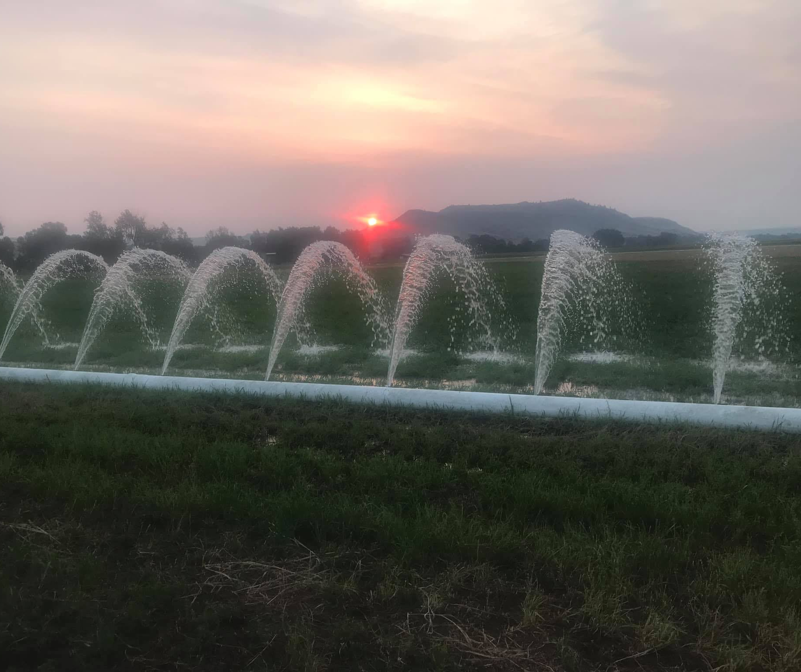
#259 – Inexpensive 5 Star Therapy
The Happiness for Educators Course was one of the best courses I have ever participated in! I looked forward to working on it every day, it was very well-organized, and very informative. It almost felt like very inexpensive therapy! ;) I really do feel "happier" after taking this course. Thank you so much for offering it and making it so accessible! 5 stars! :)

Slide 42
Closing
Story
IEP Meeting

Slide 43

Bonus 1: Positive Distractions
Life is hard; we all experience unhappiness and wonder about ourselves
We need distractions
  What songs help you feel your feelings or boost your mood? [JSF]
  What places? What cat videos? What dances?

Slide 44

Final Review
Five big psychological ideas
Your unique talents, strengths, and virtues
Let’s grow wellbeing
3-step emotional change trick
Three Good Things
EB happiness in Montana
Cultural convergence: Resilience
Positive distractions
Bonus: Anxiety and gratitude

Slide 45

In Closing
What do you want to remember?
What can you implement soon?
Thanks for being you . . .
Monitor and take care of yourself and your colleagues

Slide 46
Free Resources
https://montanahappinessproject.com/
https://johnsommersflanagan.com/

Slide 47
Bonus Slides
Notes:
John

Slide 48

Bonus: How Anxiety Works
Anxiety is mostly driven by thoughts
Ever hear of: Fight or Flight or Freeze?
Male rats
What about female rats?
What about humans?
Amygdala hijack and brain shutdown?
Adolescent brains?
All research says. . . Fear of fear

Slide 49
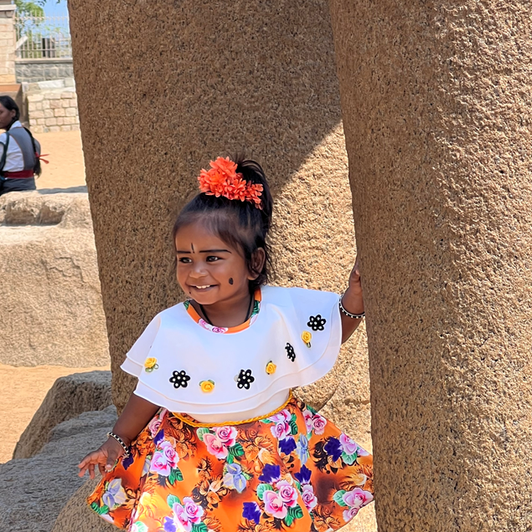
Intervention
Gratitude
Do you want to increase optimism, improve life satisfaction, be healthier, and exercise more?
Weave intentional gratitude into your life

Slide 50
Gratitude PRACTICE
Take a moment to think of one thing you’re thankful for.
Examples include a person, an event, something you’re good at, goals you have achieved, where you live, or opportunities.

Slide 51

Gratitude – Homework
Toward whom do you want to express gratitude?
Write a postcard or letter or email or text or IM of gratitude to a person you value
Or . . . Tell the person directly
Results?? Not about the response.

