Slide 1
Integrating Strengths Based Suicide Assessment into Traditional Approaches

Slide 2
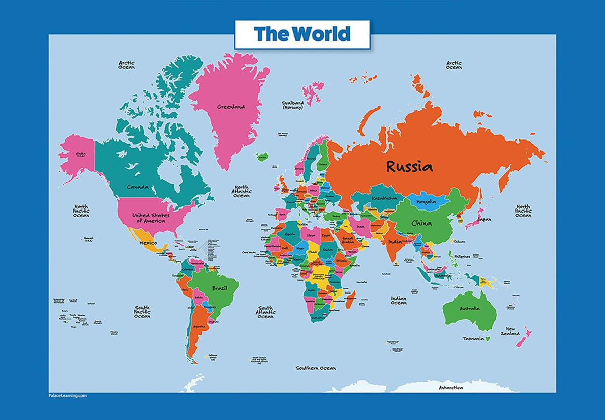
Why a Strengths-Based Approach?
People who feel suicidal need to be seen, accepted, respected, and valued – not dismissed or reduced to a stereotype or told they should or shouldn’t feel particular ways.
This is especially true for people with identities that have been historically and are currently marginalized.

Slide 3
Medical Model vs. Strengths-Based
[Let’s embrace both]
Positivistic Philosophy
Social Constructivist Philosophy
Suicidal thoughts and behaviors represent illness; we need to intervene
We are authority figures who know more about patient health than they do
The patient is a suicidal person
We can predict* and prevent suicide
We use risk assessment procedures and questionnaires
We treat mental disorders
Suicidal thoughts and behaviors are a natural communication of pain
We collaborate on individualized safety plans
The patient is a whole person with strengths and resources
Suicide is mostly unpredictable*
We individualize risk factors and use collaborative and therapeutic assessment
We treat patient distress and suicidality

Slide 4
Strengths-Based Principles – I
De-pathologize: Suicide Ideation is a normal communication of pain, that stems from difficult environmental circumstances and emotional pain.
Disclosure offers an opportunity to offer compassionate help.
The narrow pursuit of psychopathology causes clinicians to neglect a more complete assessment and case formulation of the whole person. Focus on whole-person with unique strengths and capabilities (7 dimensions).
Avoid an over-focus on suicide.
Normalize Distress and Assess Whole Person
Notes:
Edwin Shneidman was an American clinical psychologist and suicidologist, known as the "father of contemporary suicidology" for his pioneering work in the field. He dedicated his career to studying the psychological and social factors behind suicide, developing groundbreaking concepts that profoundly shaped modern suicide prevention and research.
Worked to redefine suicidality.
History of being viewed as a crime
Instead of illness it is a sign of psychological pain, seeing no other options to relieve the pain

Slide 5
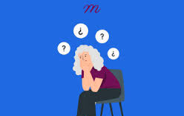
Strengths-Based Principles – I
Challenges: Normalize Distress and Assess Whole Person
Suicide = one of the most critical topics in counseling
  Triggers strong emotions, especially for counselors with personal trauma
Countertransference (Michaud et al., 2023)
  Counselor’s history resurfaces during sessions
  Balancing emotions becomes harder with suicide cases
Acutely suicidal patients (Joiner et al, 2018)
  Intense emotions: hopelessness, self-hate, irritation, entrapment
  Risk of “emotional contagion” → patient’s emotions absorbed by clinician
Common counselor reactions (Colson et al., 1986):
  Anger / provocation, Positive engagement, Fear, Helplessness / confusion, Protectiveness
Notes:
Suicide is one of the most critical topics in counseling—arguably the most important, alongside homicide. When these issues surface in a counseling session, they often stir strong emotions in counselors. This is especially true for those who have experienced trauma, suicide, homicide, or other difficult events in their own lives. Such encounters can trigger flashbacks and intensify feelings of anxiety or overwhelm.
This challenge is closely tied to countertransference, the phenomenon where a counselor’s personal history resurfaces during therapeutic work. The difficulty is twofold: the inherent gravity of suicide as a subject, and the emotional weight of the counselor’s own countertransference. Research shows that many people enter the counseling profession because of personal experiences and a genuine desire to help others. Yet, those same personal histories may make it harder to maintain balanced attention when addressing suicide, adding to the complexity of this work.
Moreover, patients who are acutely suicidal often experience intense emotions such as hopelessness, self-hatred, irritation, and a profound sense of entrapment. Studies demonstrate that these emotions can spill over onto healthcare professionals, almost like an “emotional contagion.” In other words, the patient’s negative emotions may be absorbed by the clinician (Joiner et al., 2018). Scholars such as Joiner and Stanley have even explained this phenomenon through biological processes.
Importantly, countertransference is not merely a theoretical concept. As Michaud and colleagues (2023) emphasize, it is a very real and significant factor in every clinical encounter with patients—even in a single, brief meeting. Supporting this, Colson and colleagues (1986) identified five common emotional responses that mental health workers often experience when working with suicidal patients: Anger or provocation, Positive engagement, Fear, Helplessness or confusion, A sense of protectiveness

Slide 6
“I’ve read that more than half of teenagers have thought about suicide. Has that ever been true for you?”
“The pain you’re describing is immense, and it’s understandable that you feel desperate for it to stop. Many people who feel that level of distress start to think about suicide. Have you ever had thoughts like that?”
"Besides how you're feeling emotionally, let's look at the bigger picture. How are your relationships, your sleep, or your connection to your culture/community right now (or how they have helped in the past)?”
Notes:
Someone our own fears keep us from asking the question or we ask in a way that doesn't make it safe to someone to give an honest answer "You are not thinking about suicide are you?"

Slide 7

Strengths-Based Principles – 2
Value Relationship Over Formulas
Trust, empathy and collaboration will improve utility of data.
Recognize the limits of risk/protective factor assessment (because mostly it doesn’t work; 50-year meta-analysis; cultural variability).
We are transparent, build trust and collaborate to develop individualized safety plans and decrease personal distress.
Sometimes in a strengths-based model you may need to be directive, you may need to initiate protective action, and you may need to be the voice of authority and rational decision-making in the room.
Notes:
What we pay attention to grows – focus on the whole person – not toxic positivity

Slide 8
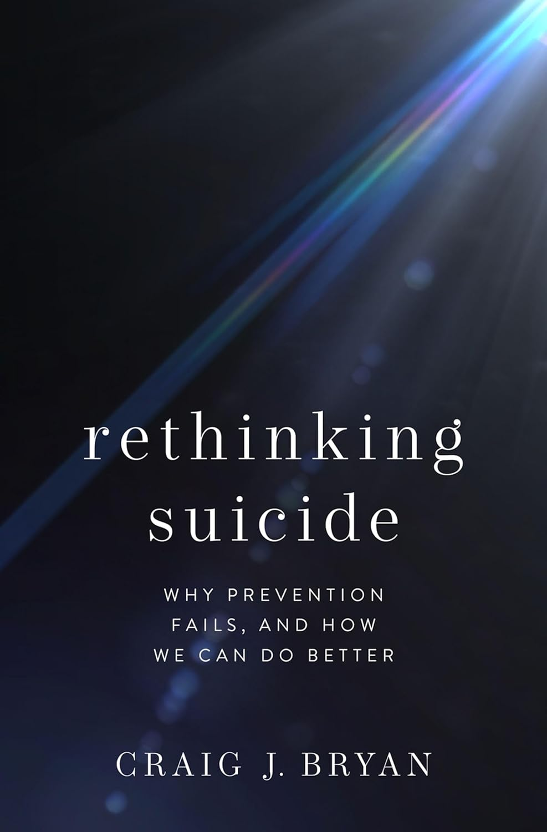
*Predicting Suicide
“The majority of patients who die by suicide screen negative for suicidal ideation. If you are a MH professional/agency who uses decision trees that designate negative screens as ‘low risk,’ you should consider discontinuing that practice. This is especially applicable to clinicians/agencies that use the C-SSRS’s red/orange/yellow scoring system. The C-SSRS will ‘miss’ most patients who kill themselves.” [False negatives]
  Craig Bryan, Ph.D., Feb 7, 2024 – LinkedIn post
Notes:
Bryan also talks about our only goal can't be to keep someone from suicide it has to also include building hope and easing pain.

Slide 9
More Directive
Building Collaborative Discussions
“We’ve been talking about how to keep you safe, and we’ve made a safety plan, but I hear you saying you’re not interested in enacting the plan. I’d like to talk with you about another alternative.”
"I'm required to document some information, but please know I value what we talk about here much more than what I check on a list. You are my greatest source of information.”
“What we need to do is keep you safe until your big wave of suicidal feelings gets smaller.”

Slide 10

Strengths-Based Principles – II
Challenges: Value Relationship Over Formulas
Competency is critical with suicidal clients
Only 45% of counseling students trained (Cureton & Sheesley, 2018)
Only 40–50% of graduate programs require suicide-specific training (Cho et al., 2024)
CACREP (2024): Suicide prevention referenced only twice
Ethical outcome: We can only expect what counselors are taught
Notes:
The biggest challenge we face when it comes to being more directive while still building cooperative discussions with clients is competency. Competency is always important in any counseling session, but it becomes absolutely critical when we are working with clients experiencing suicidal thoughts.
This raises a pressing question: how well-prepared are counselors, through their graduate training, to address suicide risk?
Research shows some concerning gaps. For example, Cureton and Sheesley (2018) found that only 45 percent of counseling students reported receiving training in suicide risk assessment as part of their graduate programs. And despite the crucial role graduate education plays in preparing counselors for suicide-specific interventions, only about 40 to 50 percent of graduate curricula in clinical psychology, mental health counseling, and social work require formalized instruction in suicide risk assessment and response procedures (Cho and colleagues, 2024).
Even more concerning, the CACREP Standards reference suicide prevention in only two instances—and those are limited to counselor practices and ethical responsibilities toward clients (CACREP, 2024).
So, as you can see, there is a clear gap between what is needed in practice and what is formally required in training programs. And one of the biggest ethical outcomes we must recognize is this: we can only expect from counselors what they have been taught.

Slide 11

Strengths-Based Principles – 3
Collaborate, Elicit Strengths and Focus on Hope
Use collaborative and therapeutic assessment
Start with empathy and compassion, NORMALIZE, and recognize that the problem may not be “in” the person [We acknowledge our legacy of pathologizing diversity].
Traditional approaches oriented toward psychopathology.
Explicitly value and ask about clients’ positive experiences, personal strengths and coping strategies.
Implement specific intervention strategies that target distress and suicidality. ​
Interventions Can Stimulate Hope.
Notes:
Not "to" or "for" someone – we assess "with" someone. We establish this norm with the client by beginning with empathy and normalizing

Slide 12
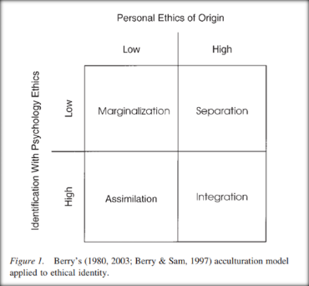
Strengths-Based Principles – III
Challenges: Collaborate, Elicit Strengths and Focus on Hope
Cultural Barriers
Counselor Training
Insurance Systems
Training Models
Notes:
It is very challenging for counselors to normalize suicide in conversations with clients, and there are several reasons for this.
The first reason is cultural. In many cultures—whether shaped by ethnicity, religion, or other micro- and macro-level influences—suicide is still a strong taboo. It is often considered forbidden, something people simply do not talk about. And while suicide is always a serious matter, in some cultures it becomes nearly impossible to even discuss, normalize, or empathize with openly.
The second reason is tied to our training in counselor education. From the very beginning, we are taught to focus on problems. We are trained to diagnose, to pathologize, and to use frameworks like the DSM-5 or ICD-11. This orientation makes normalization even more difficult.
A third factor is insurance systems. Insurance companies require a diagnosis and a treatment plan based on a problem—not on hope, not on relationship building. To get approval for services, counselors must document pathology, not strengths.
Finally, these challenges shape how we train our students in counseling programs. Barry developed a model describing how ethics training can lead us to feel marginalized, separated, assimilated, or integrated. Strength-based suicide training might have similar outcomes. Ideally, we seek integration—an understanding of our own culture and training, while also meeting the needs of our clients. But reaching integration is not easy.

Slide 13
Build Hope from the Bottom up
Craig Byran’s Crisis Response Plan- RCT found
Veteran’s in the ER 76% less likely to attempt in next 6 months when asked to discuss reasons for living.
Less likely to be hospitalized (Bryan et al., 2017)
Experience significant increases in positive emotions (Bryan et al., 2017)
Experience increased optimism (Rozek et al., 2018).
Notes:
RCT – randomized control trial
Help clients see there is time and space to make different choices
Implement specific interventions that target distress and suicidality.
Interventions can stimulate HOPE – defined by client

Slide 14
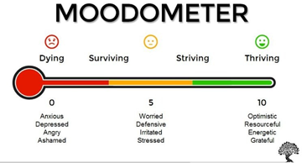
Mood Scaling
Strengths-based questions:
What’s the best (or least low) mood you’ve ever had this week?
What was happening that helped you have such a high mood?
Notes:
When are you least likely to feel distress? When are you least likely to think about suicide?
Often provides helpful information for an intervention and safety plan.

Slide 15

Magic Wand Assessment
What’s the one thing that would reduce your risk of suicide?
Some of the answers won’t be attainable… They still guide treatment and intervention focus.

Slide 16

Strengths-Based Principles – 4
Prioritize Counselor Well-being
Recognizing the immense stress we carry in this role, we practice excellent self-care, including evidence-based happiness activities.
We support each other.
We acknowledge and talk about our own emotional challenges.
We use the skills we teach.
Notes:
Well-being of the provider

Slide 17
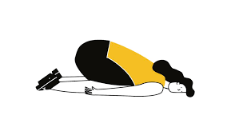
Strengths-Based Principles – 4
Challenges: Prioritize Counselor Well-being
Burnout
Notes:
One important discussion of Prioritize Counselor Well-being relates to the research on burnout. Studies consistently show high rates of burnout among counselors and school counselors. This reminds us that focusing on our own well-being and self-care is not just a personal choice—it is actually a professional and ethical responsibility. Yet, despite this, it is still not easy to practice. What is particularly interesting is that some studies reveal counselors often do not even recognize their own burnout symptoms. They may be experiencing them without realizing it. When we consider the larger context—heavy workloads, economic challenges, entering the field, keep stayin in the field, the demands of the field, and the pressure to maintain professional standards—it becomes clear: this is not an easy job. That is why it is essential for us to find and create systems of support, both individually and collectively, to sustain ourselves and continue serving our clients effectively.

Slide 18
Resources
https://montanahappinessproject.com/​
https://johnsommersflanagan.com/
https://www.umt.edu/education/specunits/cape/

