Slide 1

Ten Things Everyone Should Know About Children’s Mental Health and Happiness
John Sommers-Flanagan, Ph.D.
Center for the Advancement
of Positive Education
University of Montana
For free resources: https://johnsommersflanagan.com/
https://montanahappinessproject.com/

Slide 2

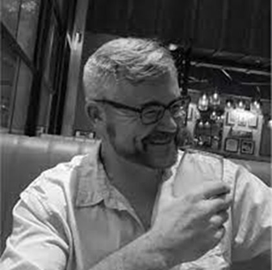

Gratitude
Thanks to Elizabeth, April, and Montana CASA for organizing
Thanks to all the scientists . . .
Thanks to the PJW-CAPE team
Thanks for being YOU and being here

Slide 3

Preparation
Trigger Warnings
I will talk about mental health and happiness
I may say contrary things
Research indicates. . .
And now—Your very own strength-warning

Slide 4


Remember . . .
Trigger warnings are suggestions about what you might not be able to handle
Strengths warnings are suggestions about how learning new knowledge and gaining experiences can make you STRONGER

Slide 5

Learning (Learner) Objectives
You come with YOUR knowledge, experience, and expectations – You come with YOUR WHY and PURPOSE
I offer a few ideas about the brain and MH and happiness
You take what fits for you and apply it to yourself if you feel like it

Slide 6
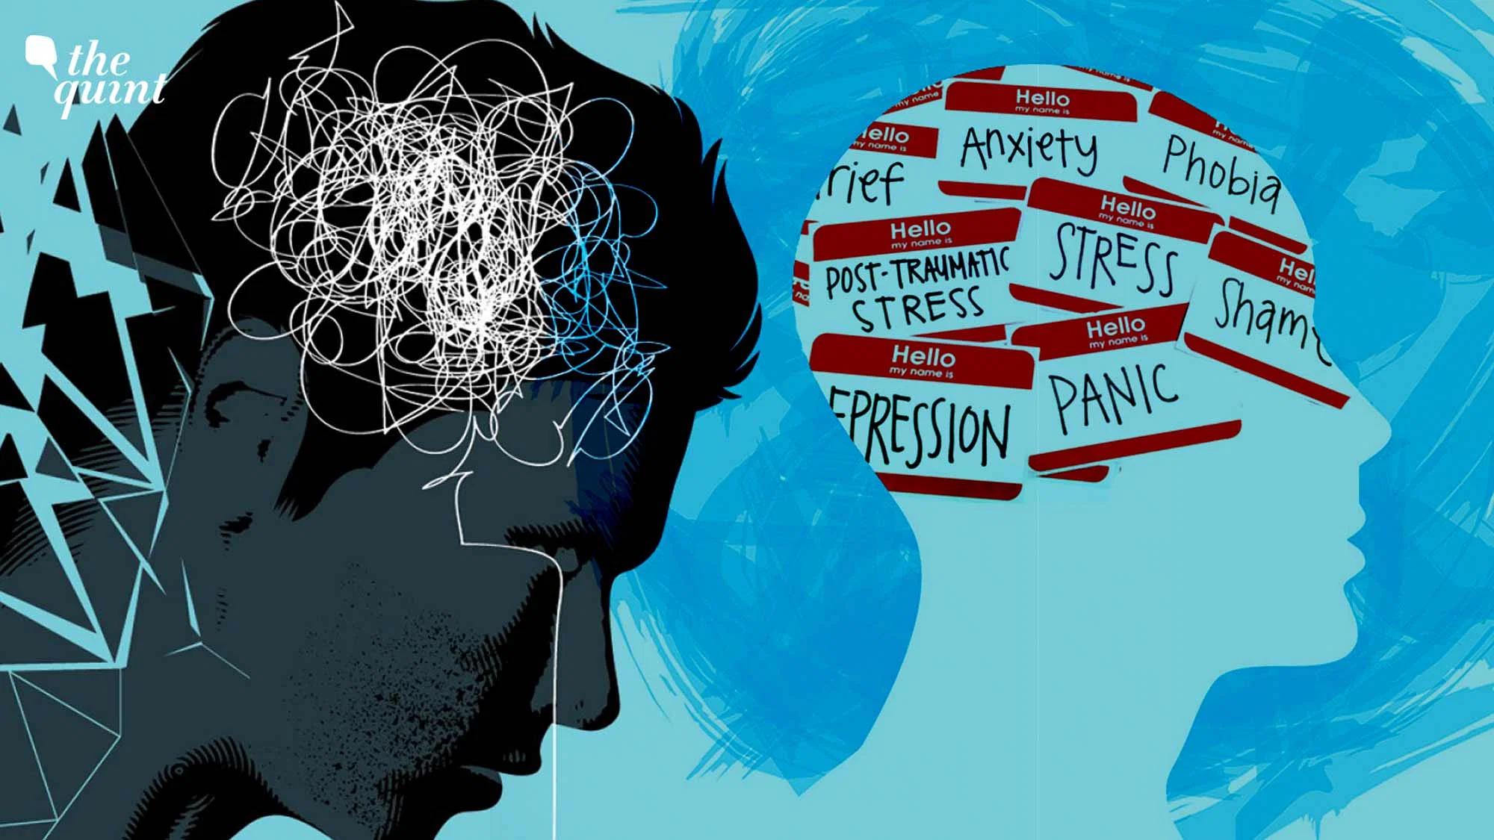
The
Problem is Very large
Nearly Every Year
1981-2025
More treatments
More problems
Why?

Slide 7

#1 – Mental Health and Happiness are wicked problems
Wicked problems are not linear
Multidimensional, Multiple individual, group, and cultural perspectives, formulations, and emotional reactions
Not testable; Efforts to solve can backfire [Happiness Party example]

Slide 8
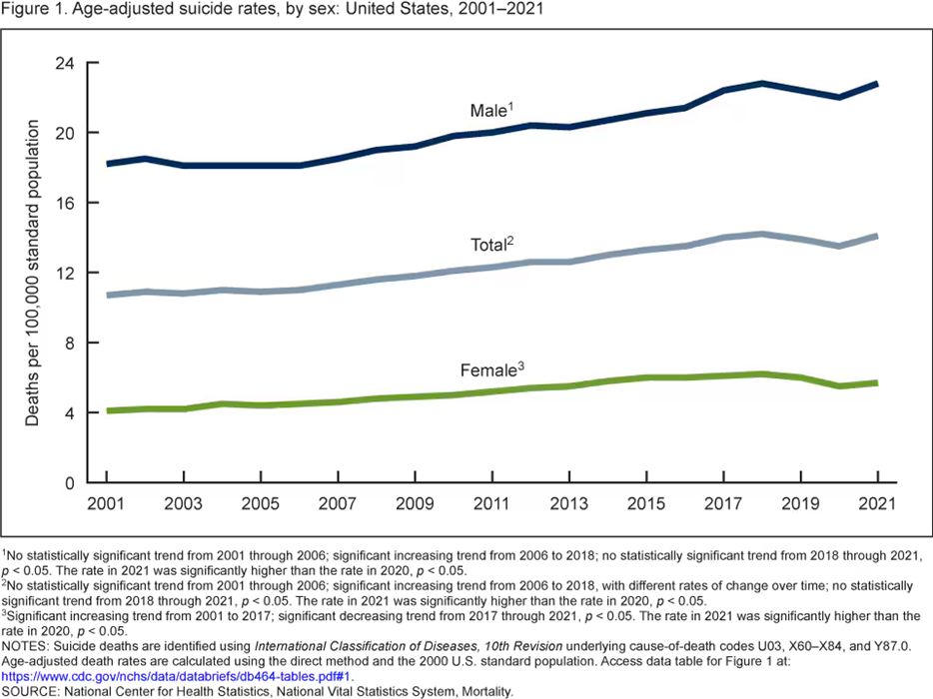
Wicked Problems are why. . .
Everything is worse
GAD, Panic, MDD, PTSD, ADHD, SUDs, ODD, CD, etc.
Trigger warnings backfire
Suicide is up 40-80% over 20 years . . . Despite big efforts (National and Tribal strategies; 2001/2017)

Slide 9

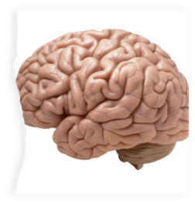
#2
Three Ways Your Brain Works
Notes:
John

Slide 10
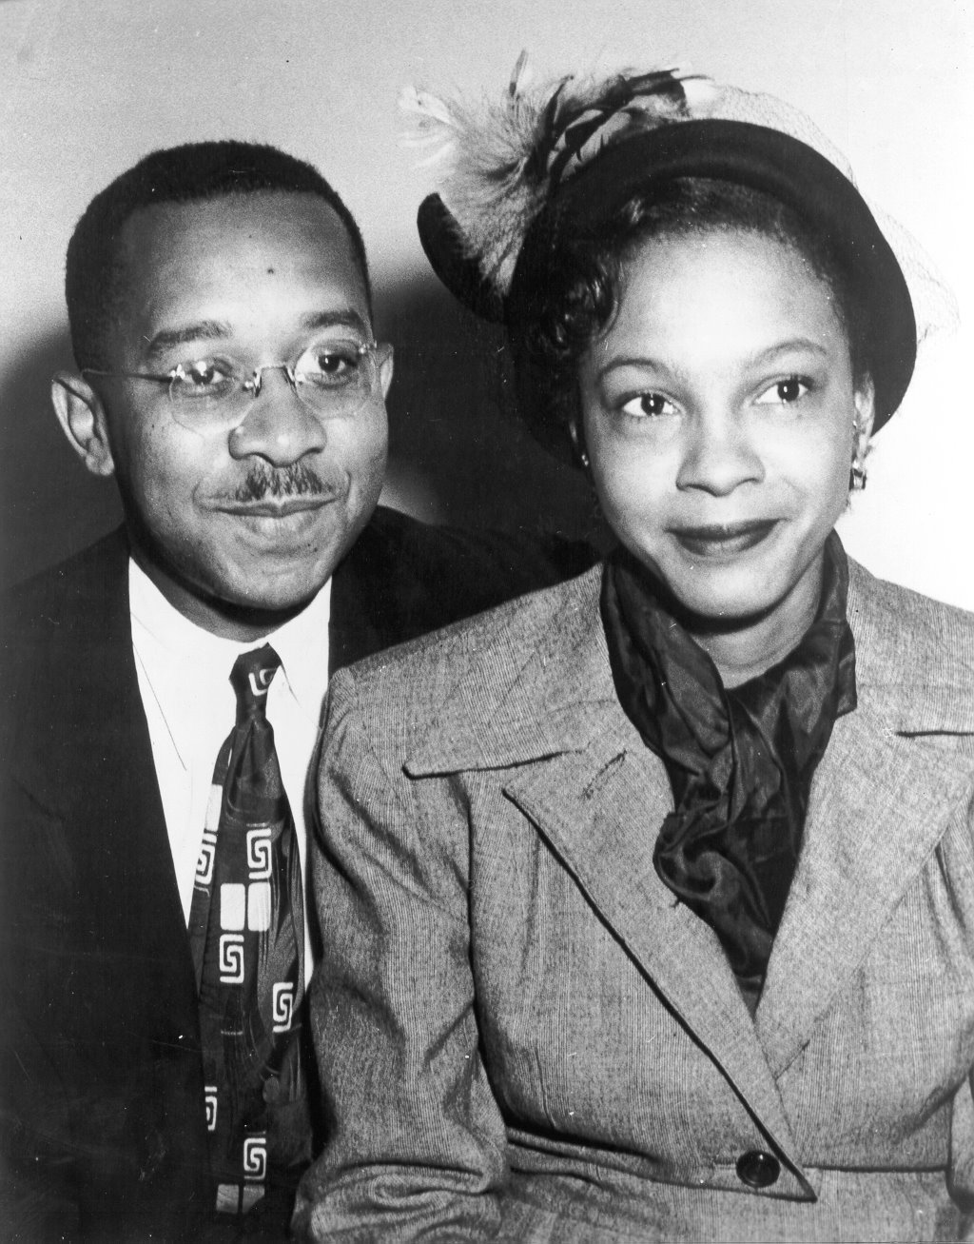

2A. We Naturally Look for What’s Wrong [Children and Teens are Especially Vulnerable]
Medical student disease
Mental health student disease
TikToc
Kenneth and Mamie Clark

Slide 11
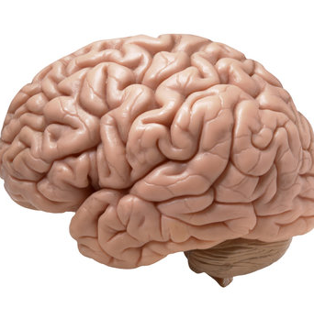
Exploring Brain Science
Activity: Mindful moments
Notes:
John

Slide 12
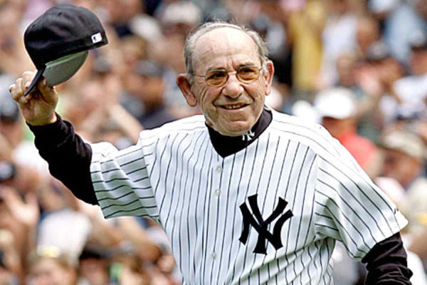
2B. Confirmation Bias
We find
what we
look for

Slide 13

2C. What We Pay Attention to Grows
15-20% of youth are depressed.
Are you depressed yet?
How about now?
Maybe you’re depressed now?
Let’s keep checking because you may notice depression symptoms and then you’ll be depressed
80-85% of youth are NOT depressed!

Slide 14

Remember Those Three Science-Based Ideas
QUIZ
1 2 3

Slide 15

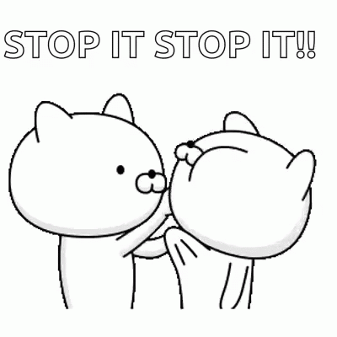
#3: We’re NOT GOOD at
Shrinking NEGATIVE Behaviors
Negative behaviors and problems are VERY difficult to stop
Why don’t you “Just chill” dude?

Slide 16


#4: We’re Better at Growing
POSITIVE Behaviors
Growing positive behaviors to cope with and crowd out negative behaviors works better than trying to get people to stop the negative

Slide 17
How Positive Psychotherapy Works
What Shall We Grow?
Well-Being
Problems
Well-Being
Not just inside a person but also between and among people and within and between communities
Conoley, C. W., & Scheel, M.J. (2018). Goal focused positive psychotherapy: A strengths-based approach. Oxford University Press.
Notes:
Positive psychotherapy integrates positive psychology principles and empirically-supported techniques (PPIs) with foundational principles of psychotherapeutic change (e.g., therapeutic relationship is critical, person-in-context, therapeutic attunement). Most approaches grounded in Broaden and Build and most intentionally cultivate positive emotions. Actual moves of therapists is what varies.
Goal-focused positive psychotherapy (Conoley & Scheel, 2018) contributes to client’s ability to face and accept life’s losses and unchangeable difficulties by increasing subjective well-being. “The inevitability of suffering and loss in life heightens the importance of learning the skills to embrace the joy in life, to be meager or bountiful” (p. 5). The physical sciences metaphor of “fixing” broken thoughts, feelings, and behaviors is not a good fit with the human condition with all of our limits and capabilities. Pain and suffering associated with loss and death but also posttraumatic growth and/or expressions of resilience and thriving.
Plumb et al., 2020: GFPP therapists collaborate with client to: a) set approach goals, b) cultivate positive emotions generally and within session, c) focus on client and cultural strengths, and foster hope using techniques like: a) Three Good Things, b) Capitalization (by therapist), and c) Mindful self-compassion.
Hence, Helen Neville’s focus on Justice and Joy (or Black Girl Magic/Joy).

Slide 18

Should we focus on happiness?
#5 – Nope. Thinking too much about whether we’re happy has a backward effect
Are YOU happy?
Preoccupation with whether you’re happy will, in most cases, make you feel worse
Notes:
Lillian

Slide 19
#6
A Flashback: What is Happiness?
Aristotle and Happiness
  Not an emotion
  Not material wealth
  Not political achievement
  Not so much an outcome, but a process of fulfilling one’s virtuous potentials in the context of community
  And NOT this . . .
Notes:
John

Slide 20

















Notes:
John

Slide 21

The Best Definition?
Aristotle’s idea (and others) – That place where the flowering of your greatest (and unique) virtues, gifts, skills, and talents intersect (over time) with the needs of the world [aka family/community].
Notes:
Tammy what is the best definition?

Slide 22

The Best Definition and You?
How do you match your gifts with the needs of your friends, family, communities, tribe, and the world?
JSF – Biking story
Notes:
John

Slide 23

Reflection
Activity
In your mind:
Think of a nice story of the manifestation of your unique strengths (gifts, skills, talents, virtues) coming out in your CASA work or at home or with friends. . .
This can feel awkward . . .
Notes:
Lillian

Slide 24

#7
Flip the Happiness
Notice. . .in the youth you work with (and others) their unique strengths
And share them
Being seen is great; being seen for your best qualities is better

Slide 25
#8
Just Say No. . .
To Toxic Positivity
Notes:
We may or may not do this-John

Slide 26
#8 - Continued
The Three-Step Emotional
Change Trick
Step One
Honor YOUR Emotion
Notes:
We may or may not do this-John

Slide 27
The Three-Step Emotional Change Trick
Step Two
Think a New Thought . . . or
Do Something Different
Notes:
We may or may not do this-John

Slide 28

The Three-Step Emotional
Change Trick
Step Three
Share the Good Mood
Notes:
We may or may not do this-John

Slide 29

The Three-Step Emotional Change Trick
Step Four
Teach Someone the 3 Steps
Notes:
We may or may not do this-John

Slide 30

One Volunteer
Please
This will be SO MUCH fun!
Notes:
John

Slide 31

#9
Automatic Thoughts Aren’t All That Positive
Internalizing
They don’t like me. . . Something wrong with me. . . I’m stupid, ugly, awkward, yada, yada
Externalizing
That jerk! What an _________. I’ll get them back one way or another.

Slide 32
How to Deal with ATs
Mindful Acceptance – Notice them. Accept them. Recognize “My thoughts aren’t facts.” Let them go. . .
Rational Countering – What’s the evidence? Can I find a middle-ground explanation/thought? Replace it!

Slide 33

#10
How Anxiety Works
Fight or Flight or Freeze?
Male rats
What about female rats?
What about all humans?
Amygdala hijack?
Brain shutdown?
Adolescent brains?
Anxiety is mostly driven by your thoughts
Notes:
Lillian

Slide 34
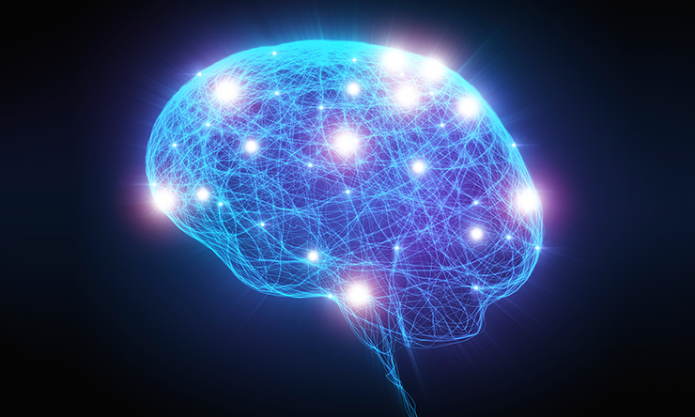
Five Steps to Being Calmer
Find your calming thing – And practice
Manage your thoughts about yourself and your triggers
When you feel anxious—and you will—Make a plan for how do you WANT to deal with it.
Your brain may be compromised, but with pre-planning, you can keep it functioning.
Use your values to face down anxiety

Slide 35
The Magic of Intentionality
  We will lean toward seeing what we believe, overfocusing on the negative, and growing the negative, unless:
  We practice intentional positivity – BUT NEVER toxic positivity
Notes:
Lillian

Slide 36

#11 – Let’s Really Focus on Mental Health
What’s Wrong with You?
What’s Right with You?
Diagnosis
Go deep
Deal with pain, trauma, social injustice
Focus on strengths
Nurture and grow skills, strengths, and resources
Externalize the problems (injustice is not what’s wrong with you)

Slide 37

What If. . .?
We could reduce depression by 60%?
We could improve physical health?
We could increase hope and positive emotions?
We could improve mindfulness
We could improve feelings of social support?
We did this with 267 Montana Educators

Slide 38

Final Review
MH+ are wicked problems
Three big psychological ideas pervade everything: What’s wrong with you; we find what we look for; what we pay attention to grows.
We’re not good at shrinking negative symptoms
We’re better at growing skills and strengths
We shouldn’t focus directly on happiness
Eudaimonic happiness is what to pursue
You can flip the happiness script and SEE youth strengths
Just say no to toxic positivity (and yes to the 3-step emotional change trick)
Automatic thoughts aren’t all that positive
How anxiety works
Let’s REALLY focus on mental health

Slide 39

What do you want to remember?

Slide 40


Thanks for listening: YES!
Please take good care of yourselves
Resources . . .
John Sommers-Flanagan, Ph.D.
Department of Counseling
University of Montana
John.sf@mso.umt.edu or
https://johnsommersflanagan.com/ and
https://montanahappinessproject.com/
for resources

