Slide 1

Tools for Living your best life
A happiness Primer
John Sommers-Flanagan, Ph.D.
Center for the Advancement
of Positive Education
University of Montana
For free resources: https://johnsommersflanagan.com/
https://montanahappinessproject.com/

Slide 2

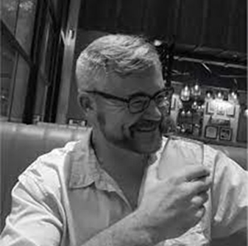

Gratitude
Thanks to Stacey, Rita, Richelle, Jan, and The Cobb for organizing
Thanks to all the scientists . . .
Thanks to the PJW-CAPE team
Thanks for being YOU and being here

Slide 3

Preparation
Trigger Warnings
I will talk about mental health and happiness
I may say contrary things
Research indicates. . .
And now—Your very own strength-warning

Slide 4


Remember . . .
Trigger warnings are suggestions about what you might not be able to handle
Strengths warnings are suggestions about how learning new knowledge and gaining experiences can make you STRONGER

Slide 5
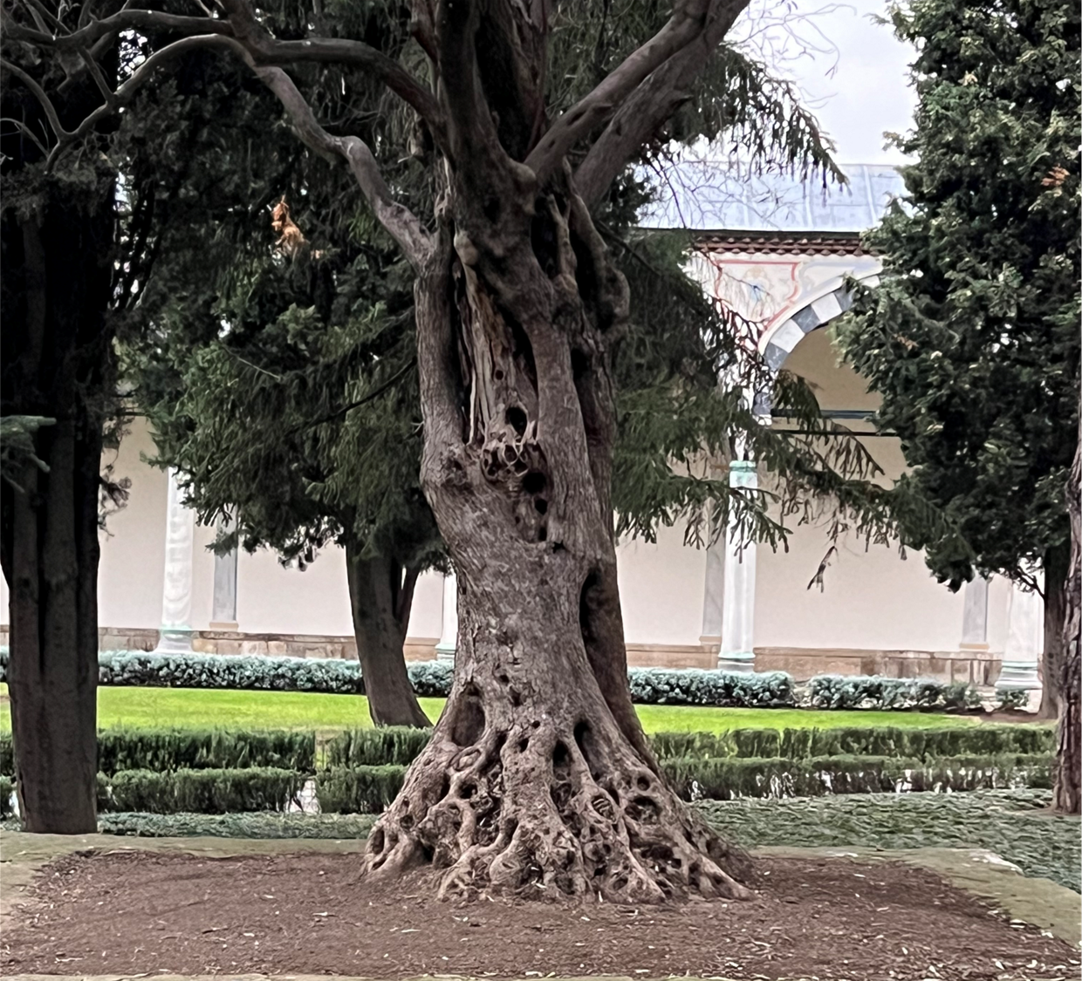
Part One
Knowledge is Power

Slide 6
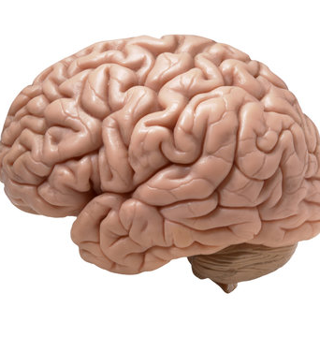
Let’s Explore Brain Science
Activity: Mindful Moments
Notes:
John

Slide 7

Four Big
Principles in Psychology
We find what we look for
We overfocus on “What’s wrong”
What we pay attention to grows
Our brains are contrarians

Slide 8

What is Happiness?
Aristotle and Happiness
  Not an emotion
  Not material wealth
  Not political achievement
  Not so much an outcome, but a process of fulfilling one’s virtuous potentials in the context of community
  And NOT this . . .
Notes:
John

Slide 9

















Notes:
John

Slide 10

The Best Definition?
Aristotle’s idea (and others) – That place where the flowering of your greatest (and unique) virtues, gifts, skills, and talents intersect (over time) with the needs of the world [aka family/community].
Notes:
Tammy what is the best definition?

Slide 11

The Best Definition and You?
How do you match your gifts with the needs of your friends, family, communities, tribe, and the world?
JSF – Biking story
Notes:
John

Slide 12

Activity
Think of a nice story of your unique strengths (gifts, skills, talents, virtues) coming out in your work or at home or with friends. . .
This can feel awkward . . .
Notes:
Lillian

Slide 13

Flip the Happiness
Notice. . . with others, their unique strengths
Name them and share them
Being seen is great; being seen for your best qualities is better

Slide 14
Part Two
Emotional Education and Managing Emotions

Slide 15
Just Say No. . .
To Toxic Positivity
Notes:
We may or may not do this-John

Slide 16
The Three-Step Emotional Change Technique
[We do not do toxic positivity]
Step 1: Honor the emotion
Notes:
We may or may not do this-John

Slide 17
The Three-Step Emotional Change Technique
Step 2: Think or do something different
Notes:
We may or may not do this-John

Slide 18
The Three-Step Emotional Change Technique
Step Three: Share the good mood
Notes:
We may or may not do this-John

Slide 19
The Three-Step Emotional Change Technique
Step Four: Teach someone the 3 steps
Notes:
We may or may not do this-John

Slide 20
Part Three
Happiness Tools

Slide 21

Tool #1: Three Good Things
Survey
Rumination is all-natural, but not helpful
Notes:
Dylan/Nancy?

Slide 22

Why?
This seems to be the way our brains are built
Notes:
Dylan/Nancy

Slide 23

Three Good Things
Seligman’s signature technique
  Before you go to sleep (right now)
  Write down (or think about) three good things that happened during the day (or last 24 hours)
  Then track down “Why” those things happened
  Seligman: After a week, you’ll want to keep doing it (JSF: Maybe)
  Volunteer?

Slide 24
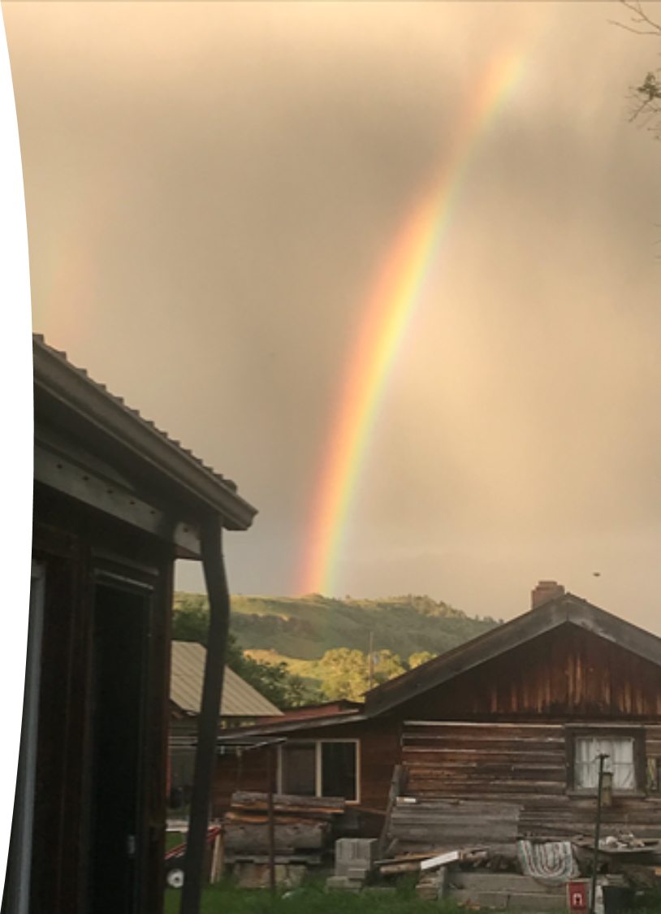
Why Three Good Things Works
When you go to bed, you NATURALLY embark on a negative (depressive) review or anticipatory (anxiety) preview
Three good things shifts your focus
Identifying “Why” those things happened activates a brain search toward positive and empowering attributions

Slide 25







Tool #2
What is Savoring?
Notes:
Dylan

Slide 26
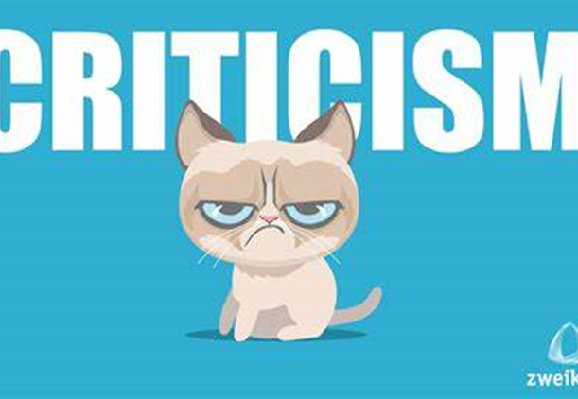
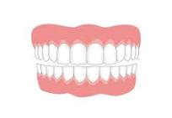
The Opposite of Savoring
We dampen or spoil good experiences, while chewing on our mistakes
Anybody ever get stuck chewing on the negative or spoiling the positives?

Slide 27
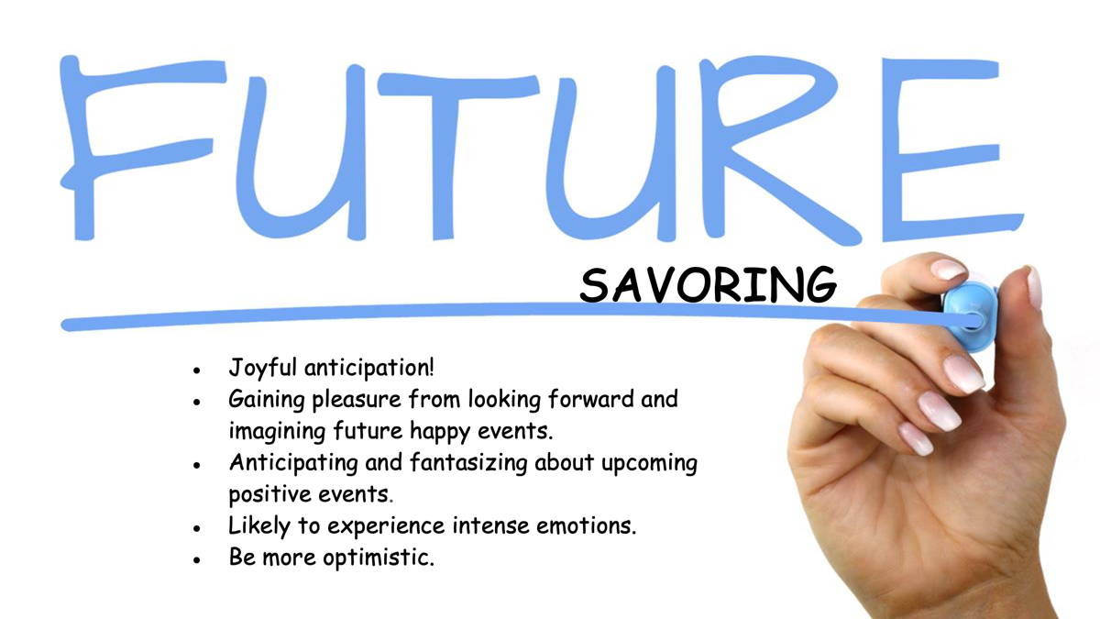

Slide 28
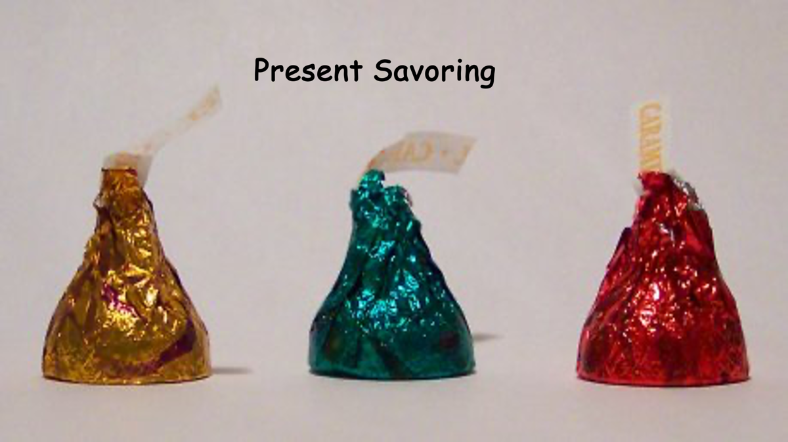

Slide 29

Tool #3 Sleeping Well
Sleep may be the most important thing of all for health, mental health, and success
  Why? Sleep disruption is linked to accidents, illness, lower achievement, depression, irritability, worse MH, suicidality, etc!
  Sleep paralysis, MHCC and the DSM – Wait a minute☺

Slide 30

Understanding Sleep Problems
Advice is cheap; but knowledge is POWER
What disrupts sleep?
  The three insomnias
  Awakenings (nightmares)
  Cognitions and behaviors [Expectations]

Slide 31

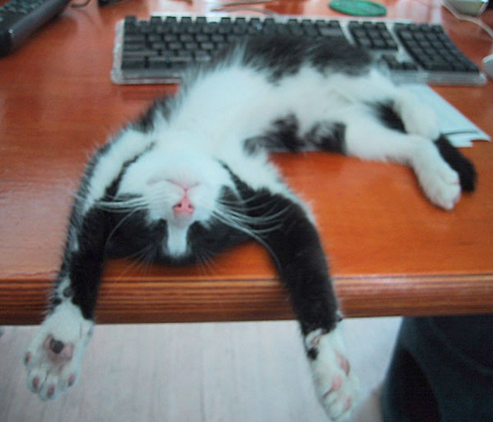
Many Paths to Almost Sleep
(aka Relaxation)
Deep breathing
Progressive muscle relaxation
Visual imagery
Autogenic training
Cognitive shuffle
Yoga, weight-lifting, or cardio, followed by one or more of the preceding
Find YOUR calming stimulus
Plan for expectations and troubling thoughts [3 Good Things; mindfulness meditation; sleep hygiene]

Slide 32

Tool #4: Coping with Triggers
What situations and people tend to activate negative thoughts or unpleasant emotions
Plan your “best” response in advance
Practice the response
Don’t expect perfection
Notes:
Dylan

Slide 33

One Volunteer
Please
This will be SO MUCH fun!
Notes:
John

Slide 34

Automatic Thoughts Aren’t All That Positive
Internalizing
They don’t like me. . . Something wrong with me. . . I’m stupid, ugly, awkward, yada, yada
Externalizing
That jerk! What an _________. I’ll get them back one way or another.

Slide 35
Be Ready for Your ATs
Use Mindful Acceptance – Notice them. Accept them. Recognize “My thoughts aren’t facts.” Let them go. . .
Use Rational Countering – What’s the evidence? Can I find a middle-ground explanation/thought? Replace it!

Slide 36

Bonus 1: Positive Distractions
Life is hard; we all experience unhappiness and wonder about ourselves
We need distractions
  What songs help you feel your feelings or boost your mood? [JSF]
  What places? What cat videos? What dances?
  Auctioning?

Slide 37

Conclusion:
The Magic of Intentionality
  We will lean toward seeing what we believe, overfocusing on the negative, and growing the negative, unless:
  We practice intentional positivity – BUT NEVER toxic positivity
Notes:
Lillian

Slide 38

Final Review
Watch out for strengths
Four big psychological ideas
Happiness is . . .
3-step emotional change trick
Three Good Things
Savoring
Sleeping well
Dealing with triggers
Positive distractions
Intentionality

Slide 39

What do you want to remember and Try?

Slide 40

Bonus Tool
Gratitude
Do you want to increase optimism, improve life satisfaction, be healthier, exercise more, and be happier?
Weave intentional gratitude into your life
Notes:
Dylan

Slide 41

Gratitude Practices
Gratitude List
Gratitude Jar
Gratitude Photography
Gratitude Tree or Wall
Reverse Gratitude
Gratitude Letter Writing
Notes:
Dylan

Slide 42
How Anxiety Works
Fight or Flight or Freeze?
Male rats
What about female rats?
What about all humans?
Amygdala hijack?
Brain shutdown?
Adolescent brains?
Anxiety is mostly driven by your thoughts
Notes:
Lillian

Slide 43
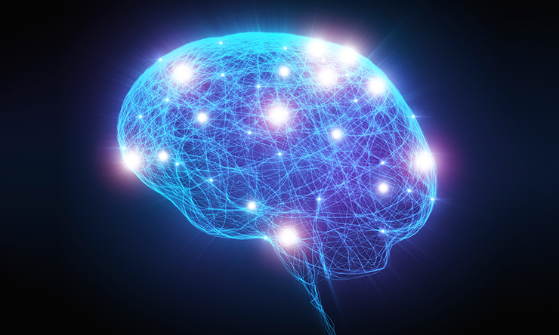
Five Steps to Being Calmer
Find your calming thing – And practice
Manage your thoughts about yourself and your triggers
When you feel anxious—and you will—Make a plan for how do you WANT to deal with it.
Your brain may be compromised, but with pre-planning, you can keep it functioning.
Use your values to face down anxiety

Slide 44
How Positive Psychotherapy Works
What Shall We Grow?
Well-Being
Problems
Well-Being
Not just inside a person but also between and among people and within and between communities
Conoley, C. W., & Scheel, M.J. (2018). Goal focused positive psychotherapy: A strengths-based approach. Oxford University Press.
Notes:
Positive psychotherapy integrates positive psychology principles and empirically-supported techniques (PPIs) with foundational principles of psychotherapeutic change (e.g., therapeutic relationship is critical, person-in-context, therapeutic attunement). Most approaches grounded in Broaden and Build and most intentionally cultivate positive emotions. Actual moves of therapists is what varies.
Goal-focused positive psychotherapy (Conoley & Scheel, 2018) contributes to client’s ability to face and accept life’s losses and unchangeable difficulties by increasing subjective well-being. “The inevitability of suffering and loss in life heightens the importance of learning the skills to embrace the joy in life, to be meager or bountiful” (p. 5). The physical sciences metaphor of “fixing” broken thoughts, feelings, and behaviors is not a good fit with the human condition with all of our limits and capabilities. Pain and suffering associated with loss and death but also posttraumatic growth and/or expressions of resilience and thriving.
Plumb et al., 2020: GFPP therapists collaborate with client to: a) set approach goals, b) cultivate positive emotions generally and within session, c) focus on client and cultural strengths, and foster hope using techniques like: a) Three Good Things, b) Capitalization (by therapist), and c) Mindful self-compassion.
Hence, Helen Neville’s focus on Justice and Joy (or Black Girl Magic/Joy).

