Slide 1

Ten Things Everyone Should Know About Mental Health, Suicide, and Happiness
John Sommers-Flanagan, Ph.D.
Department of Counseling
University of Montana
For free resources: https://johnsommersflanagan.com/
https://montanahappinessproject.com/

Slide 2
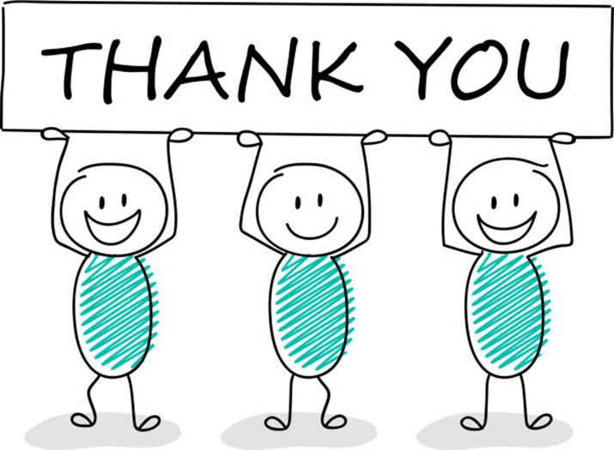


Gratitude
Thanks to Kelci for the organizing
Thanks to all the scientists . . .
Thanks for being YOU and being here

Slide 3


Preparation
Trigger Warnings
I will be talking about happiness
I will be saying contrary things
I will be talking about suicide and mental health
Research
Strength-warning

Slide 4
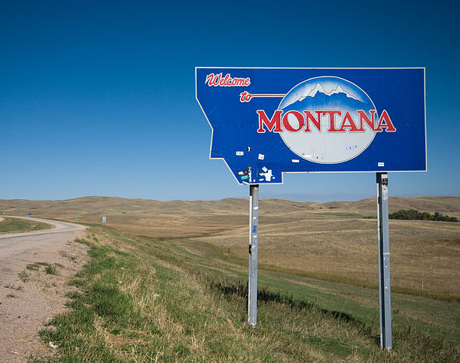
Goals
My goals, your goals, our goals
Gain new knowledge, insights, and perspectives on mental health, suicide, and happiness

Slide 5

#1 – Suicide, Mental Health, and Happiness are wicked problems
not linear
Multidimensional, Multiple individual, group, and cultural perspectives, formulations, and emotional reactions
Not testable; Efforts to solve can backfire

Slide 6

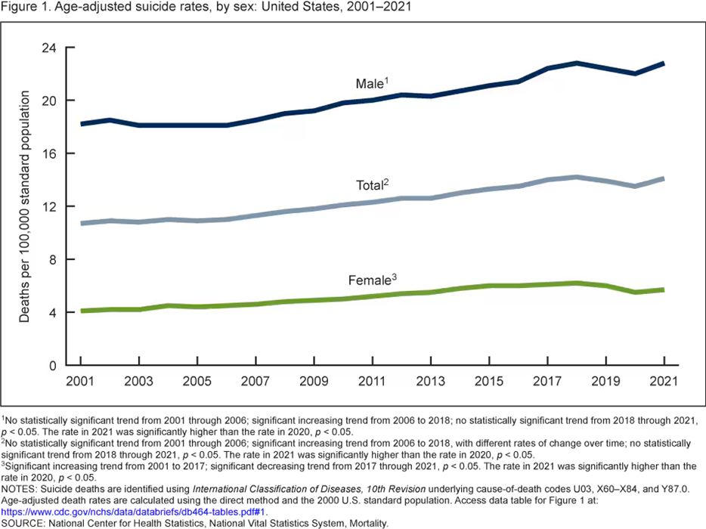
Wicked Problems are why. . .
Everything is worse
Anxiety, depression, intergenerational trauma, ADHD, narcissism, addiction, etc.
Trigger warnings backfire
And suicide is up 40-80% over 20 years . . . (National and Tribal strategies; 2001/2017)

Slide 7
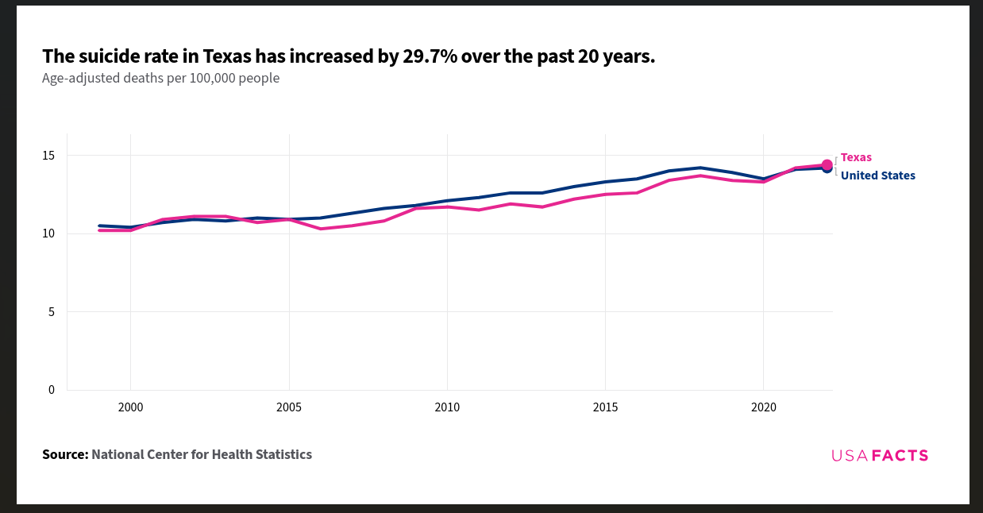

Slide 8

#2 – We’re Not Good at Predicting Suicide
Imagine Darrell K Royal-Texas Memorial Stadium on 1/1/25 – Capacity about 100K
It’s filled with Texans
By Dec 31, 14 or 15 of those 100K Texans will die by suicide.
Your job: Identify and intervene to prevent suicide?

Slide 9

Predicting Suicide II
We could screen for depression and suicidal ideation
With depression, we’ll cut our number from 100K to about 15K (but which 14 or 15 of the 15K?)
If we screen for suicidal ideation, we’ll cut our numbers to about 10K (but which 14-15 of the 10K?)

Slide 10

Predicting Suicide III
But, if we dismiss the people who screen negative, we’ll miss about ½ of those who will die by suicide because they won’t report SI or depression
If we screen for so-called “Mental Illness” we’ll do even worse

Slide 11
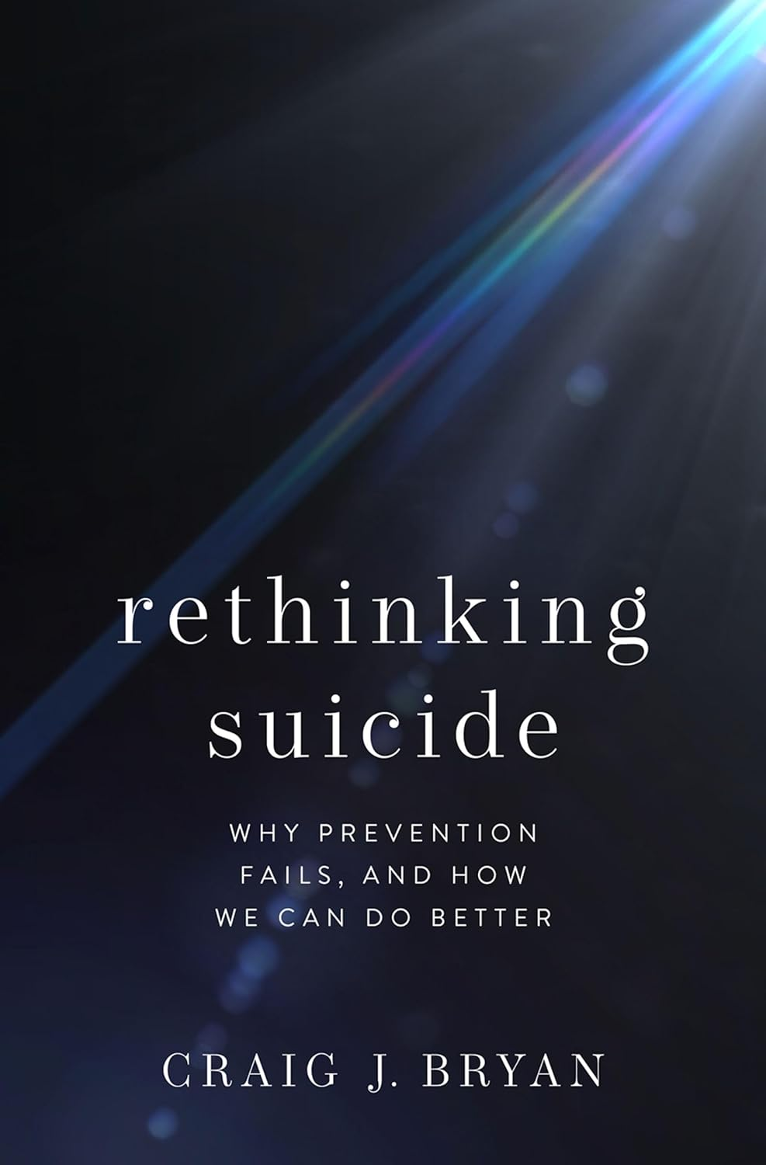
Predicting Suicide IV
“The majority of patients who die by suicide screen negative for suicidal ideation. If you are a MH professional/agency who uses decision trees that designate negative screens as ‘low risk,’ you should consider discontinuing that practice. This is especially applicable to clinicians/agencies that use the C-SSRS’s red/orange/yellow scoring system. The C-SSRS will ‘miss’ most patients who kill themselves.” [False negatives]
  Craig Bryan, Ph.D., Feb 7, 2024 – LinkedIn post

Slide 12

#3 – We’re ALSO Not Good at Preventing Suicide
Here’s a Typical* Suicide Prevention Message
Suicide rates for at-risk youth can be substantially reduced by:
  Knowing the signs. Four out of five suicide deaths are preceded by warning signs such as suicidal threats, previous suicide attempts, preoccupation or obsession with death, depression, and final arrangements.
  *From: https://www.americashealthrankings.org/explore/health-of-women-and-children/measure/teen_suicide/state/MT

Slide 13
Time Out for Reflection
Why am I saying these things?
I think we should DO EVERYTHING WE CAN to prevent suicide . . . AND
I think we should be REALISTIC . . .
Because if we assume suicide is predictable and preventable . . . We will feel EVEN MORE GUILTY when students die by suicide

Slide 14

#4 – Suicidal Ideation is not an Illness, Mental Disorder, Sin (or even a good predictor of suicide)
#5 – Suicidal ideation is a natural human response to disturbing, painful, stressful circumstances, over which we feel little control. Think historical trauma. Think systemic oppression and discrimination.
High rates of suicidal ideation means people are living lives of internal and/or external despair and experiencing hopelessness

Slide 15


The Wickedness of the Problem
From 1999-2022 we did more suicide prevention than ever before (National Strategy, 2001; 2012; 2024).
And suicide rates went up every year except two. . . Usually by 2-3% each year. Per capita up 40%
Which years did they go down? Why did they go down? [Wicked Problem]
The raw number of suicides have increased by about 60%.

Slide 16

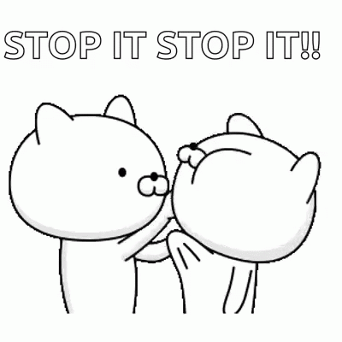
#6: We’re Better at Growing (+) Behaviors than Shrinking (-) Behaviors
Negative behaviors and problems are VERY difficult to stop [“Just chill”]
Growing positive behaviors and crowding out negative behaviors works better than trying to get people to stop the negative

Slide 17
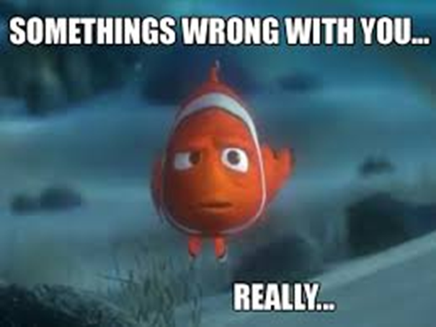

We naturally focus on WHAT’S WRONG
What’s your problem? Are you okay? Is there something wrong with your brain?
Self-awareness is NOT just awareness of what’s wrong with us.

Slide 18
How Positive Psychotherapy Works
What Shall We Grow?
Well-Being
Problems
Well-Being
Not just inside a person but also between and among people and within and between communities
Conoley, C. W., & Scheel, M.J. (2018). Goal focused positive psychotherapy: A strengths-based approach. Oxford University Press.
Notes:
Positive psychotherapy integrates positive psychology principles and empirically-supported techniques (PPIs) with foundational principles of psychotherapeutic change (e.g., therapeutic relationship is critical, person-in-context, therapeutic attunement). Most approaches grounded in Broaden and Build and most intentionally cultivate positive emotions. Actual moves of therapists is what varies.
Goal-focused positive psychotherapy (Conoley & Scheel, 2018) contributes to client’s ability to face and accept life’s losses and unchangeable difficulties by increasing subjective well-being. “The inevitability of suffering and loss in life heightens the importance of learning the skills to embrace the joy in life, to be meager or bountiful” (p. 5). The physical sciences metaphor of “fixing” broken thoughts, feelings, and behaviors is not a good fit with the human condition with all of our limits and capabilities. Pain and suffering associated with loss and death but also posttraumatic growth and/or expressions of resilience and thriving.
Plumb et al., 2020: GFPP therapists collaborate with client to: a) set approach goals, b) cultivate positive emotions generally and within session, c) focus on client and cultural strengths, and foster hope using techniques like: a) Three Good Things, b) Capitalization (by therapist), and c) Mindful self-compassion.
Hence, Helen Neville’s focus on Justice and Joy (or Black Girl Magic/Joy).

Slide 19

Maybe we should focus on happiness?
Are YOU happy?
#7 – Nope. Thinking too much about whether we’re happy has a backward effect
Preoccupation with whether you’re happy will, in most cases, make you feel worse
Notes:
Lillian

Slide 20
So. . . #8. . . What Shall We Pursue, if not Happiness?
Aristotle and Eudaimonic Happiness
  Not an emotion
  Not material wealth
  Not political achievement
  Not so much an outcome, but a process of fulfilling one’s virtuous potentials in the context of community
  And NOT SELF-focused messages . . .
Notes:
Lillian

Slide 21


The Best Definition?
Aristotle – That place where the flowering of your greatest (and unique) virtues, gifts, skills, and talents intersect with the needs of the world.
Notes:
Lillian

Slide 22

The Best Definition and You?
How do you match your gifts with the needs of your friends, family, communities, and the world?
JSF – Biking story
Notes:
John

Slide 23

Reflection Activity
In your mind:
Think of a nice story of the manifestation of your unique strengths (gifts, skills, talents, virtues) coming out in your work or teaching or research or . . .
This can feel awkward . . .
Notes:
Lillian

Slide 24

#9 – White Cultural Solutions
Will not necessarily translate across cultures
Besides, when it comes to “Wicked Problems,” White cultural solutions don’t even work for White people.
What to do?

Slide 25
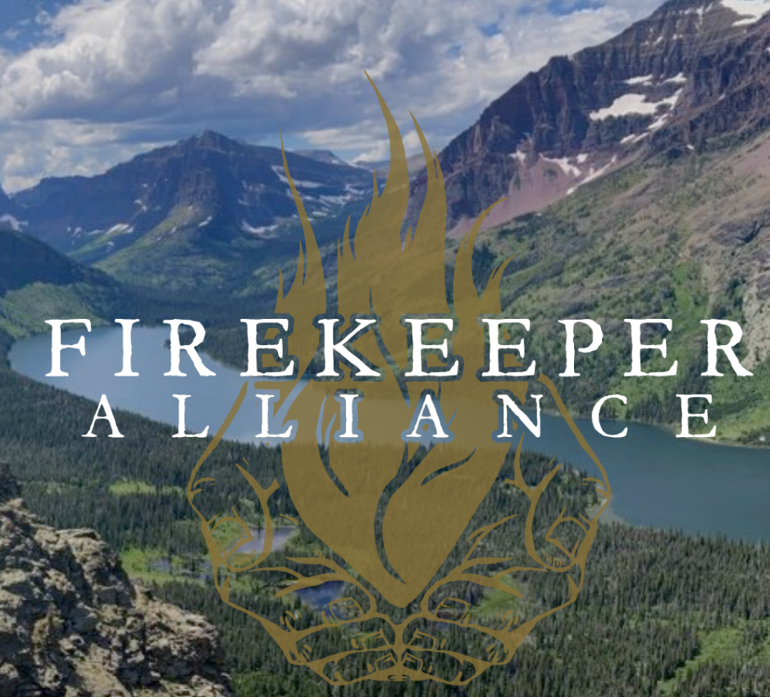
#9a – Leveraging Indigenous Resilience
A Lakota elder, James Clairmont:
The closest translation of “resilience” is a sacred word that means “resistance” . . . resisting bad thoughts, bad behaviors. We accept what life gives us, good and bad, as gifts from the Creator. We try to get through hard times, stressful times, with a good heart. The gift [of adversity] is the lesson we learn from overcoming it.

Slide 26
Breaking Clairmont’s comment down
Resisting bad thoughts and behaviors (CBT)
We accept what life gives us, good and bad, as gifts from the Creator. (Mindfulness)
We try to get through hard times, stressful times, with a good heart. (Optimism and positivity)
The gift [of adversity] is the lesson we learn from overcoming it. (Learning from experience; what can I learn from this?; good learning days☺)

Slide 27
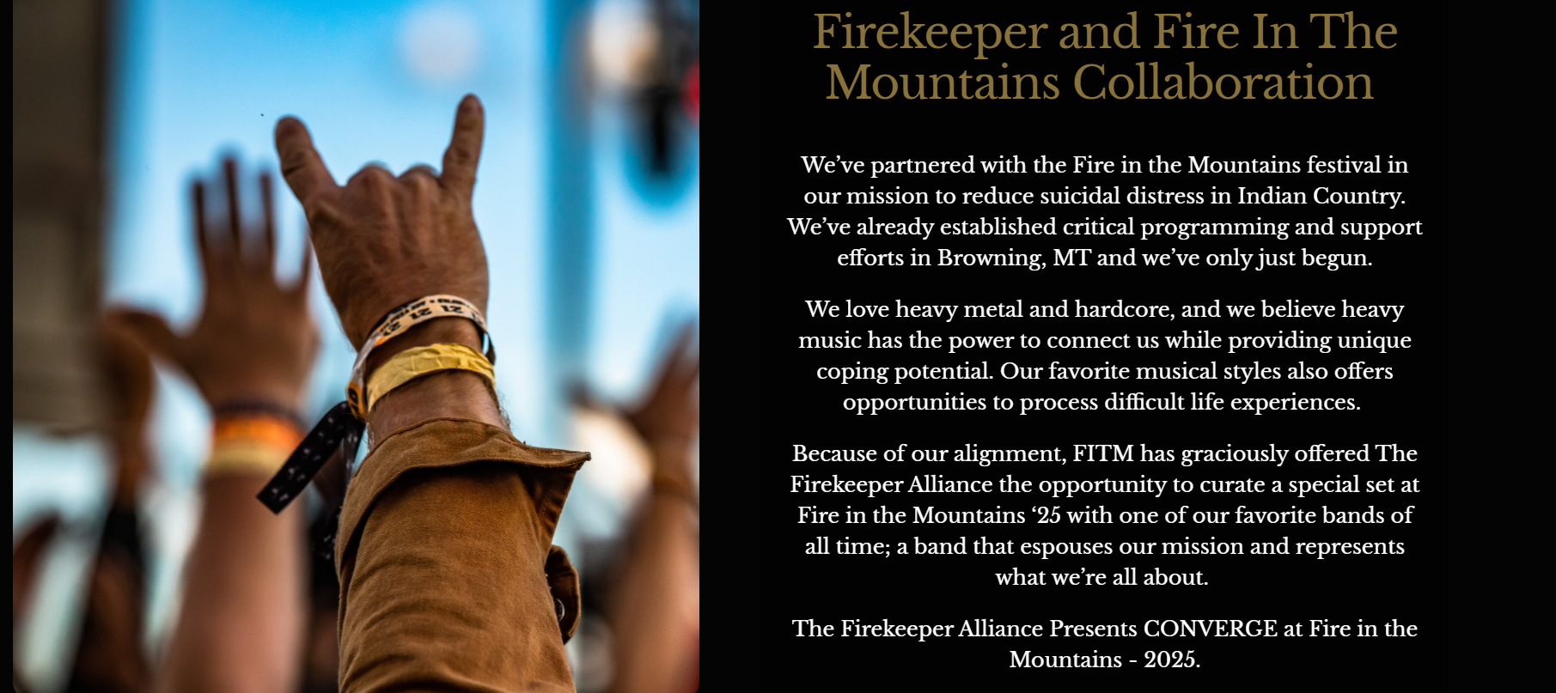
Leveraging Cultural and Intercultural Strengths

Slide 28
#10: Christopher Peterson
Other People Matter
And . . .
Notes:
Lillian

Slide 29

#11 – Let’s Really Focus on Mental Health
What’s Wrong with You?
What’s Right with You?
Diagnosis
Go deep
Deal with pain, trauma, social injustice
Focus on strengths
Nurture and grow skills, strengths, and resources
Externalize the problems (injustice is not what’s wrong with you)

Slide 30

Final Quiz
MH+ are wicked problems
We’re not good at predicting suicide
We’re not good at preventing suicide
Suicidal ideation is neither an illness nor a sin
Suicidal ideation is a natural human response to disturbing situations
We’re better at growing positive behaviors than shrinking negative ones
Focusing too much on happiness backfires
What shall we pursue, if not happiness
White cultural solutions [Leveraging Indigenous resilience]
“Other people matter”
Let’s REALLY focus on mental health

Slide 31


Thanks for listening and please take good care of yourselves
John Sommers-Flanagan, Ph.D.
Department of Counseling
University of Montana
John.sf@mso.umt.edu or
https://johnsommersflanagan.com/ for resources
Montana Happiness Project for more resources

Slide 32

#12 – Bonus: What You Can Do
Approach everyone with respect and empathy
Consider suicidality as an expression of pain
Emphasize belongingness or inclusiveness
Help people feel useful
Remember: Stress accumulates; opportunity ameliorates (Garbarino, 1986) . . . Create opportunities!!

Slide 33

Double Bonus
Strengths-Based Tools for Suicide Assessment

Slide 34

#1
Assessment Skill/Tool: Normalizing
Ask directly but prep first
  Prep – Role Induction – Use the word suicide with limits of confidentiality
  Prep – I will ask you some questions that can be hard. Like I’ll ask about suicide. The reason I ask is because many people think about suicide. . . And thoughts about suicide are a sign of something emotionally painful in your life. If you tell me about suicidal thoughts, I won’t immediate think about hospitalizing you. We’ll work to reduce your emotional pain

Slide 35
#1
Assessment Skill/Tool: Normalizing
Ask directly AND normalize the asking
  I’ve read that up to 50% of teenagers have thought about suicide. Is that true for you?
  People who feel down and have been subjected to injustice may think about suicide from time to time. Have you had thoughts about suicide?
  Normalize the asking: “I ask everyone I see.”

Slide 36
#1
Practice:
Use Normalizing Language
It can be difficult to find the right words in the moment. You don’t need to use my words; it’s better to use your words, words that are authentic to you and that fit with your setting.
Think of a patient now, and, for practice, imagine what you would say to convey the normalizing message (Jillian story)

