Slide 1

Ten Things Everyone Should Know About Mental Health, Grief, Suicide, and Happiness
John Sommers-Flanagan, Ph.D.
Department of Counseling
University of Montana
For free resources: https://johnsommersflanagan.com/
https://montanahappinessproject.com/

Slide 2



Gratitude
Thanks to Meg Smith and Dr. Tina Barrett for the invite and for organizing
Thanks to all the scientists . . .
Thanks for being YOU and being here

Slide 3
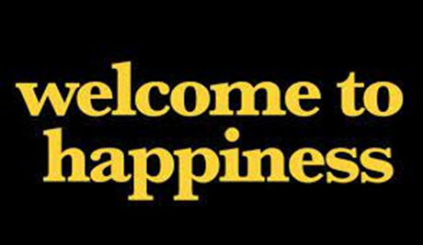
First, A Word From Our Sponsors
The Arthur M. Blank Family Foundation ($300K to support Montana educators) and the Montana Happiness Project and University of Montana Safe Schools Center
Contact via email or https://montanahappinessproject.com/
Now and the future: $9.4M for The entity briefly known as the PJW Institute for Positive Education, but now the Phyllis J. Washington Center for the Advancement of Positive Education
Notes:
John

Slide 4


Preparation
Trigger Warnings
I will be talking about happiness
I will be saying contrary things
I will be talking about suicide, grief, and mental health
Don’t let my trigger warnings set you up to over-react☺

Slide 5
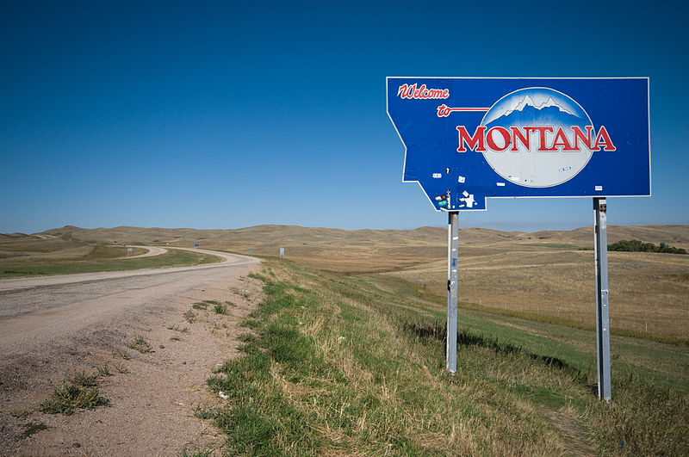
Goals
My goals
Your goals
Our goals
Gain new knowledge, insights, and perspectives on mental health, suicide, grief, and happiness

Slide 6

#1 – Suicide, Mental Health, Grief, and Happiness are wicked problems
not linear
Multidimensional, Multiple perspectives, formulations, and emotional reactions
Not testable; Efforts to solve can backfire (CBT vs. Journey); multiple approaches are needed

Slide 7
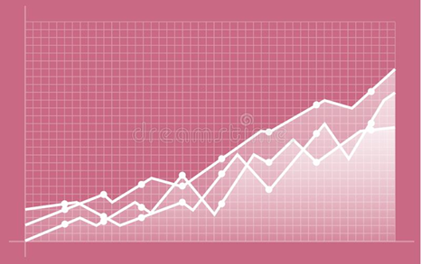
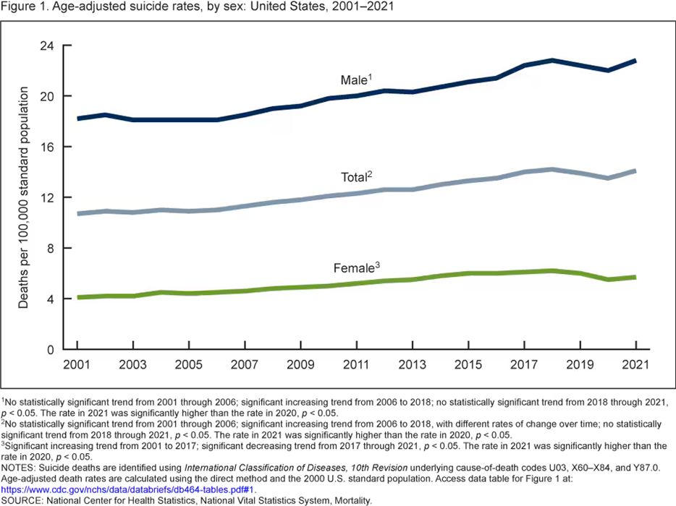
Wicked Problems are why. . .
  Everything is worse
  Anxiety, depression, trauma, ADHD, complext grief, narcissism, addictions, etc.
  Trigger warnings backfire
  And suicide is up 40% over 20 years . . .

Slide 8
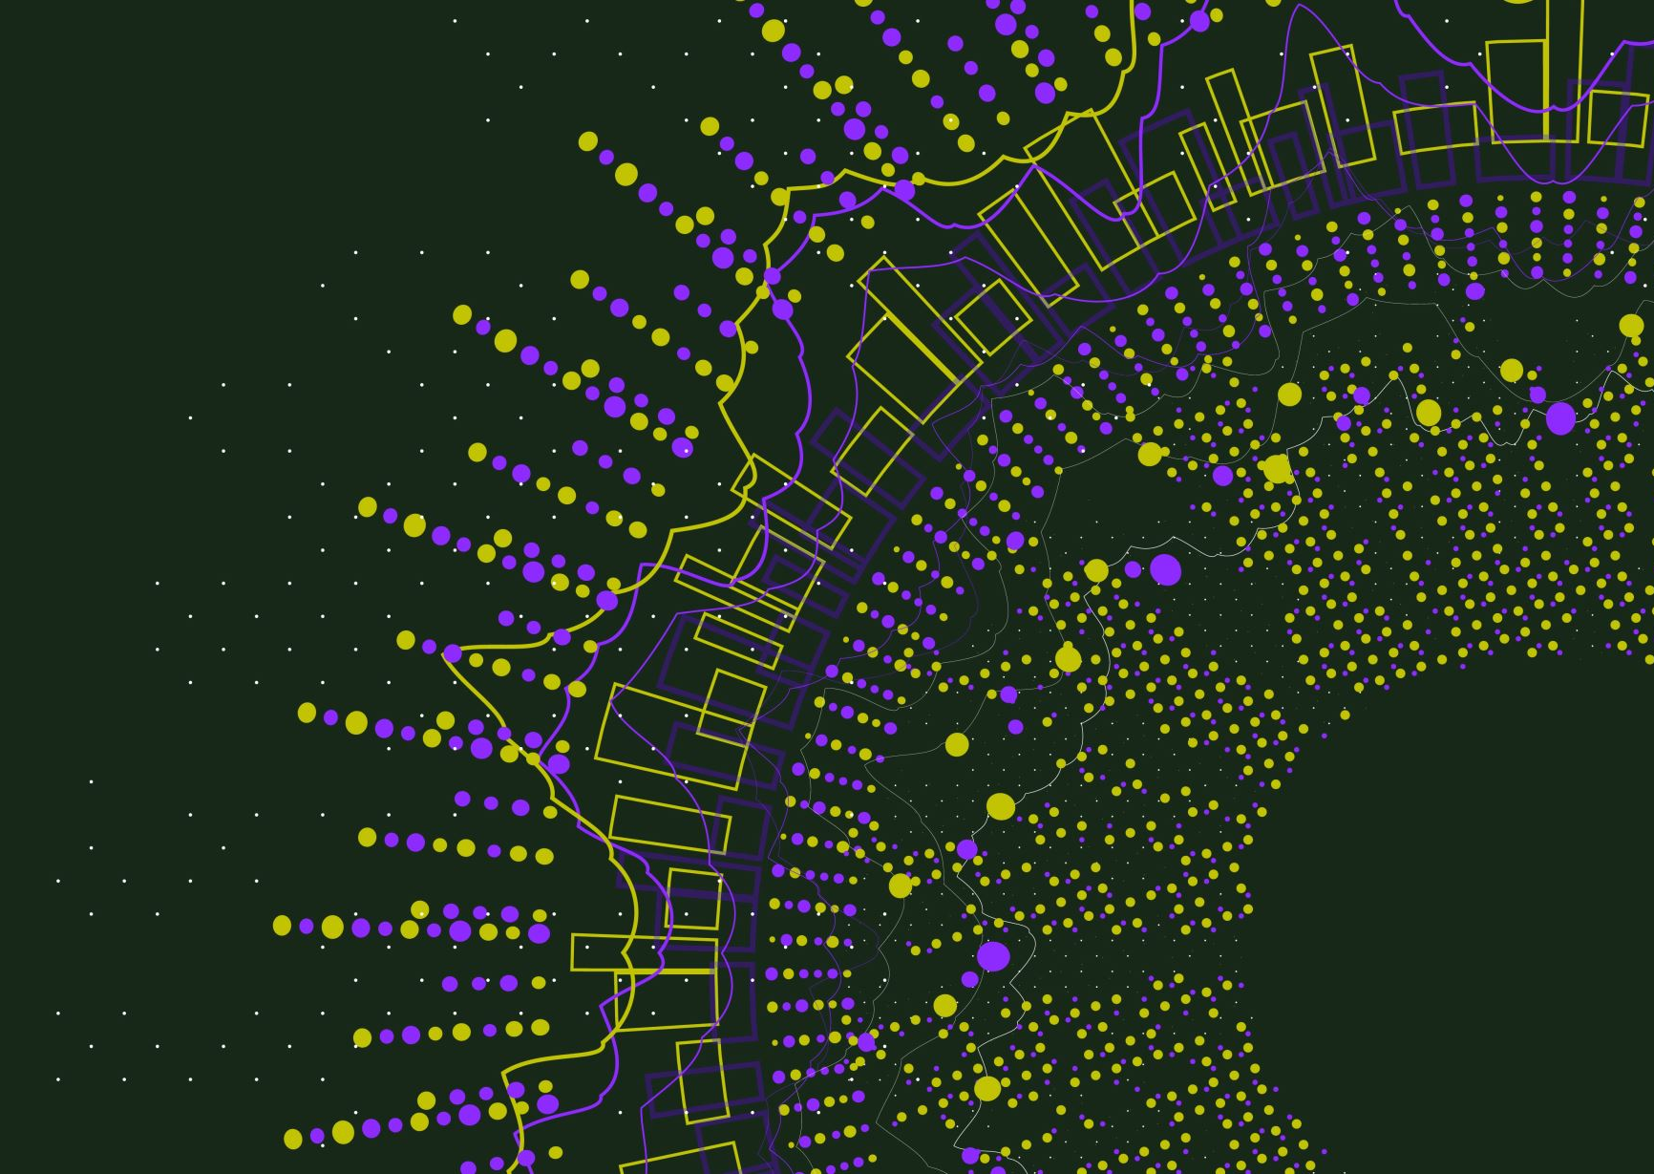
The Ten Things
#2
Why We Should Be in Pursuit of Eudaimonia
(Not just “Happiness”)

Slide 9

Flashback: What is the Pursuit of Happiness?
Aristotle and Happiness
  Not an emotion
  Not material wealth
  Not political achievement
  Not so much an outcome, but a process of fulfilling one’s virtuous potentials in the context of community
  And NOT this . . .
Notes:
Lillian

Slide 10


















Slide 11


The Best Definition?
Aristotle’s idea (and others) – That place where the flowering of your greatest (and unique) virtues, gifts, skills, and talents intersect with the needs of the world [aka family, community, patients].
Notes:
Lillian

Slide 12

The Best Definition and You?
How do you match your gifts with the needs of your friends, family, clients/patients, communities, and the world?
JSF – Biking story
Notes:
John

Slide 13

Reflection
In your mind:
Think of a nice story of the manifestation of your unique strengths (gifts, skills, talents, virtues) coming out in your interactions with others . . .
Pair and share (5 min)
This can feel awkward . . . but, we’d love to hear a couple stories
Notes:
Lillian

Slide 14
Why Push Eudaimonic Happiness?
In the beginning, psychology spent 100+ years mostly studying: What’s WRONG with YOU?
  Psychopathology and mental disorders
  Anxiety, depression, suicide, OCD, ADHD, ODD, PTSD, etc.
  Freud: “Neurotic misery” to “common unhappiness”
  Goals: Help people – just like you – become more aware of problems and then struggle in their efforts to fix them
Notes:
John

Slide 15
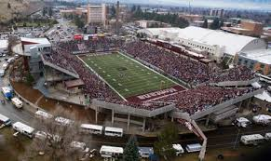
#3 – We’re Not Good at Predicting Suicide
Imagine yourself at Washington Grizzly Stadium on January 1 – Capacity 25K
It’s filled with Montana teenagers
By Dec 31, 6-8 of those 25K teenagers will die by suicide.
Your job: Identify and intervene to prevent suicide?

Slide 16

Predicting Suicide II
We could screen for depression and suicidal ideation
With depression, we’ll cut our number from 25K to about 10K (but which 6 or 8 of the 10K?)
If we screen for suicidal ideation, we’ll cut our numbers to about 5K (but which 6 or 8 of the 5K?)

Slide 17
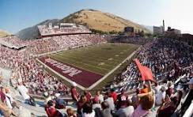
Predicting Suicide III
But, if we dismiss the students who screen negative, we’ll miss about ½ of the youth who will die by suicide because they won’t report SI or depression
If we screen for so-called “Mental Illness” we’ll do even worse

Slide 18
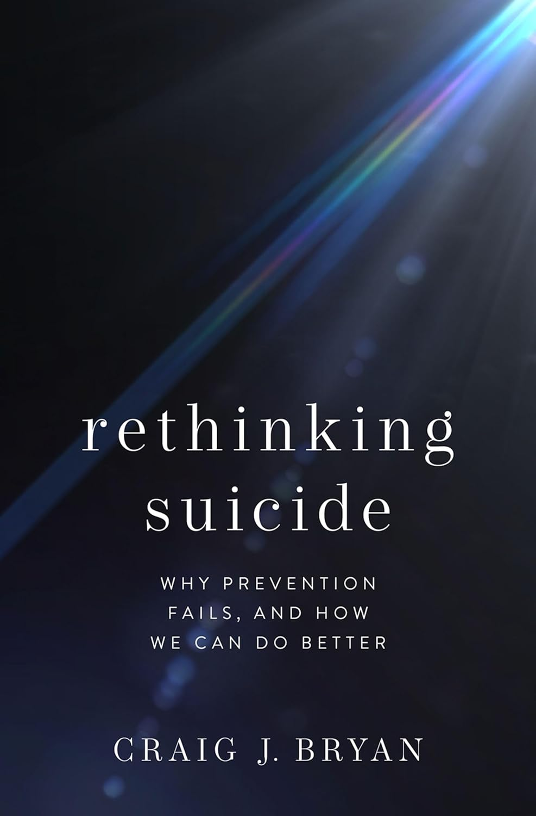
Predicting Suicide IV
“The majority of patients who die by suicide screen negative for suicidal ideation. If you are a MH professional/agency who uses decision trees that designate negative screens as ‘low risk,’ you should consider discontinuing that practice. This is especially applicable to clinicians-agencies that use the C-SSRS’s red/orange/yellow scoring system. The C-SSRS will ‘miss’ most patients who kill themselves.” [False negatives]
  Craig Bryan, Ph.D., Feb 7, 2024 – LinkedIn post

Slide 19

#4 – We’re ALSO Not Good at Preventing Suicide
Here’s a Typical* Suicide Prevention Message
Suicide rates for at-risk youth can be substantially reduced by:
  Knowing the signs. Four out of five suicide deaths are preceded by warning signs such as suicidal threats, previous suicide attempts, preoccupation or obsession with death, depression, and final arrangements.
  *From: https://www.americashealthrankings.org/explore/health-of-women-and-children/measure/teen_suicide/state/MT

Slide 20
Time Out for Reflection
Why am I saying these things?
I think we should DO EVERYTHING WE CAN to prevent suicide . . . AND
I think we should be REALISTIC . . .
Because if we assume suicide is predictable and preventable . . . We will feel EVEN MORE GUILTY when students, family, friends die by suicide

Slide 21

#5 – Suicidal Ideation is not an Illness, Mental Disorder, Sin (or even a good predictor of suicide)
Suicidal ideation is a natural human response to disturbing, painful, stressful circumstances, over which we feel little control.
High rates of suicidal ideation means people are living lives of despair and experiencing hopelessness

Slide 22

The Wickedness of the Problem
From 1999-2022 we did more suicide prevention than ever before (National Strategy, 2001; 2012; 2024).
And suicide rates went up every year except two. . . Usually by 2-3% each year. Per capita up 40%
Which years did they go down? [2020, 2021] Why did they go down? [Wicked Problem]
The raw number of suicides have increased by about 60%.

Slide 23
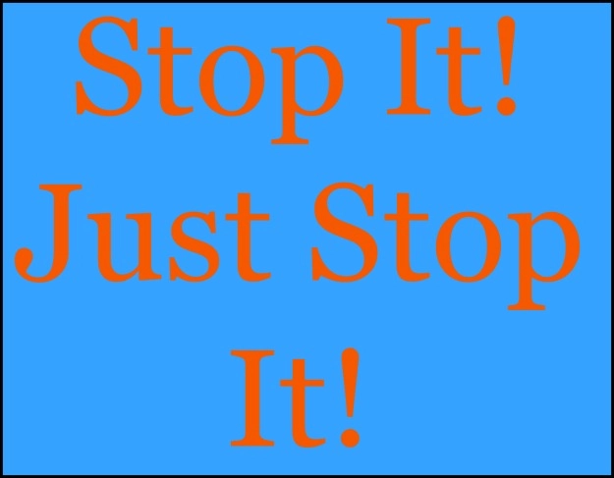
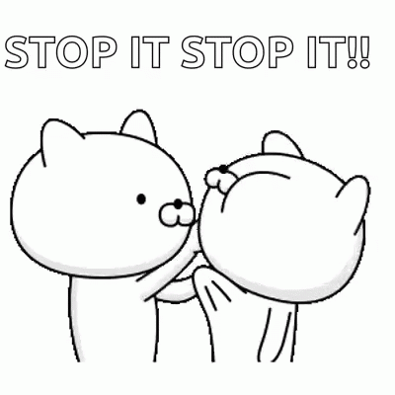
#6: We’re Better at Growing (+) Behaviors than Shrinking (-) Behaviors
Negative behaviors and problems are VERY difficult to stop [“Just chill” “cheer up”]
Growing positive behaviors and crowding out negative behaviors works better than trying to get people to stop the negative
And . . . Grief may be an exception – as we go deeper, we can experience meaning and growth

Slide 24
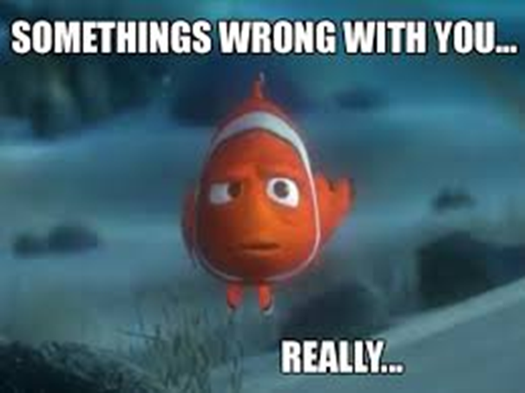

#7 We naturally focus on WHAT’S WRONG - TIKTOK
What’s your problem? Are you okay? Is there something wrong with your brain?
Self-awareness is NOT just awareness of what’s wrong with us. [What else?]

Slide 25
Positive Psychotherapy: What Shall We Grow? Intentionality is Required
Problems:
Grief,
Suicidality
Well-Being
Well-Being
Not just inside a person but also between and among people and within and between communities
Conoley, C. W., & Scheel, M.J. (2018). Goal focused positive psychotherapy: A strengths-based approach. Oxford University Press.
Notes:
Positive psychotherapy integrates positive psychology principles and empirically-supported techniques (PPIs) with foundational principles of psychotherapeutic change (e.g., therapeutic relationship is critical, person-in-context, therapeutic attunement). Most approaches grounded in Broaden and Build and most intentionally cultivate positive emotions. Actual moves of therapists is what varies.
Goal-focused positive psychotherapy (Conoley & Scheel, 2018) contributes to client’s ability to face and accept life’s losses and unchangeable difficulties by increasing subjective well-being. “The inevitability of suffering and loss in life heightens the importance of learning the skills to embrace the joy in life, to be meager or bountiful” (p. 5). The physical sciences metaphor of “fixing” broken thoughts, feelings, and behaviors is not a good fit with the human condition with all of our limits and capabilities. Pain and suffering associated with loss and death but also posttraumatic growth and/or expressions of resilience and thriving.
Plumb et al., 2020: GFPP therapists collaborate with client to: a) set approach goals, b) cultivate positive emotions generally and within session, c) focus on client and cultural strengths, and foster hope using techniques like: a) Three Good Things, b) Capitalization (by therapist), and c) Mindful self-compassion.
Hence, Helen Neville’s focus on Justice and Joy (or Black Girl Magic/Joy).

Slide 26
Maybe we should focus on happiness?
Are YOU happy?
#8 – Nope. Thinking too much about whether we’re happy has a backward affect
Preoccupation with whether you’re happy will, in most cases, make you feel worse [Jung’s Trickster]
That’s ANOTHER reason why we’re pursuing eudaimonic happiness
Notes:
Lillian

Slide 27
#9: Christopher Peterson
Other People Matter
And we are all other people to everyone else
Notes:
Lillian

Slide 28
#10 – The Three-Step Emotional Change Trick
(JSF, 1997)
Step One: Honor the emotion – We don’t do toxic positivity
Step Two: Think a new thought or do something different
Step Three: Share the good mood
Notes:
We may or may not do this-John

Slide 29

#11 – Let’s Really Focus on Mental Health
What’s Wrong with You?
What’s Right with You?
Diagnosis
Go deep
Deal with pain, trauma, social injustice
Focus on strengths
Nurture and grow skills, strengths, and resources
Externalize the problems (injustice is not what’s wrong with you)

Slide 30

Final Quiz
MH+ are wicked problems
Let’s pursue eudaimonic happiness
We’re not good at predicting suicide
We’re not good at preventing suicide
Suicidal ideation is neither an illness nor a sin [a natural response]
We’re better at growing positive behaviors than shrinking negative ones
We naturally focus on WHAT’S WRONG
Focusing too much on happiness backfires
As Chris Peterson said: “Other people matter”
Let’s all do the three-step emotional change trick (not toxic positivity)
Can we REALLY focus on mental health?

Slide 31

#12 – Bonus: What You Can Do
Approach everyone with respect and empathy
Consider suicidality as an expression of pain
Emphasize belongingness or inclusiveness
Help people feel useful
Remember: Stress accumulates; opportunity ameliorates (Garbarino, 1986) . . . Create opportunities!!

Slide 32

#13 Double Bonus: Positive Distractions
Life is hard
We all experience common unhappiness and wonder about ourselves
Emotions are a pain☺; your work is immensely stressful
Sometimes, we need distractions
  What places? What cat videos? What . . . ?
  [Tommie] What songs help you feel your feelings or boost your mood? [JSF]

Slide 33


Thanks for listening and please take good care of yourselves
John Sommers-Flanagan, Ph.D.
Department of Counseling
University of Montana
John.sf@mso.umt.edu or
https://johnsommersflanagan.com/ for resources
Montana Happiness Project for more resources

