Slide 1
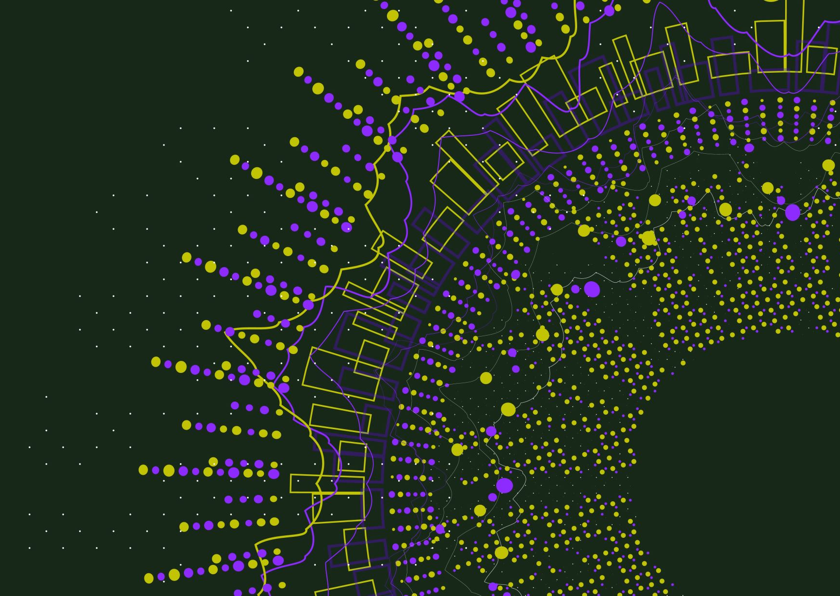

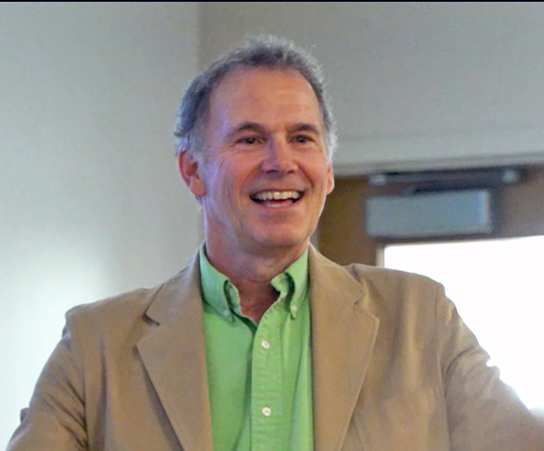
Why We Should Be in Pursuit of Eudaimonia
(Not just “Happiness”)
John Sommers-Flanagan, Ph.D.
Professor of Counseling
john.sf@mso.umt.edu
Victor Yapuncich, M.D.
Family Medicine
Intermountain Health
4.9 of 5 stars ☺
198 Ratings, 52 Reviews
https://johnsommersflanagan.com/
https://montanahappinessproject.com/

Slide 2



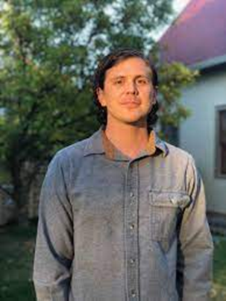




Hello and Welcome
Thanks to Darin Bell, Jess Tripp, and YOU
Thanks also to AMBFF, the brand new IPE at PJW, and Montana Happiness Project team
Notes:
John

Slide 3
Learning Objectives
Articulate the definition of eudaimonic happiness and why we should pursue it
Describe at least three positive psychology interventions (PPIs) that can increase eudaimonic happiness and physical health
Apply a PPI or two to yourself and possibly others

Slide 4

The Flashback: What is the Pursuit of Happiness?
Aristotle and Happiness
  Not an emotion
  Not material wealth
  Not political achievement
  Not so much an outcome, but a process of fulfilling one’s virtuous potentials in the context of community
  And NOT this . . .
Notes:
Lillian

Slide 5


















Slide 6


The Best Definition?
Aristotle’s idea (and others) – That place where the flowering of your greatest (and unique) virtues, gifts, skills, and talents intersect with the needs of the world [aka family, community, patients].
Notes:
Lillian

Slide 7

The Best Definition and Healthcare Professionals?
How do you match your gifts with the needs of your friends, family, patients, communities, and the world?
JSF – Biking story
Vic – Colonoscopy
Notes:
John

Slide 8

Reflection
In your mind:
Think of a nice story of the manifestation of your unique strengths (gifts, skills, talents, virtues) coming out in your interactions with others . . .
Pair and share
This can feel awkward . . . but, we’d love to hear a couple stories
Notes:
Lillian

Slide 9
Why Push Eudaimonic Happiness?
In the beginning, psychology spent 100+ years mostly studying: What’s WRONG with YOU?
  Psychopathology and mental disorders
  Anxiety, depression, suicide, OCD, ADHD, ODD, PTSD, etc.
  Freud: “Neurotic misery” to “common unhappiness”
  Goals: Help people – just like you – become more aware of deficiencies and then usually fail in their efforts to fix them
Notes:
John

Slide 10

Why?
This seems to be the way most of our brains are built
Notes:
John

Slide 11
Enter: Positive Psychology
Martin Seligman – 1998 – San Francisco – Positive psychology
Let’s study joy, happiness, what strengthens people, and what makes people emotionally healthy and well?
Seligman and others created and evaluated Positive Psychology Interventions (PPIs); PPIs are practices designed to increase positive affect and engagement with a meaningful life.
Notes:
John

Slide 12

Evidence-Based Eudaimonia with PPIs
Three Good Things
Grounding, Calming, and Sleeping
Gratitude Practice
Savoring
The Three-Step Emotional Change Trick
Distractions
Notes:
Lillian

Slide 13

Tool #1: Three Good Things
Survey – Thoughts and insomnias
Rumination is all-natural, but not helpful
Notes:
John

Slide 14

Three Good Things
Seligman’s signature technique
  Before you go to sleep (or right now)
  Write down (or think about) three good things that happened during the day (or last 24 hours)
  Then track down in your mind “Why” those things happened
  Seligman: After a week, you’ll want to keep doing it (JSF: Maybe)
  Volunteer?

Slide 15

Tool #2: Sleep Well
“What’s the most important thing for college success health care workers’ health?” – Sleep
  Why? Sleep disruption is linked to accidents, illness, lower achievement, depression, irritability, worse MH, suicidality, etc!
  Sleep paralysis, MHCC and the DSM – Wait a minute☺

Slide 16

Rural Referrals
One principle of positive psychology is to focus on resources
CBT-I
PsychologyToday.com – Self referral

Slide 17
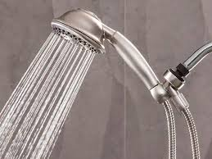
Sleep Hygiene
(Not just showering)
Routines
Daily exercise
Caffeine curfews
Light and dark and sound and comfort
Beds are for sleeping
Limit naps to less than 30 min [coffee naps]
Avoid certain foods
The temperature decline (Bath or shower)
Screen light exposure and Tech in the bedroom?
Have a plan for dealing with troubling thoughts and dreams [3 Good Things; mindfulness meditation]

Slide 18
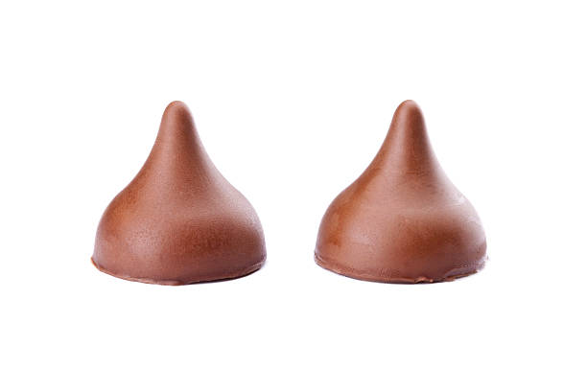
Tool #3: Savoring
What is savoring?
Deliberate effort to extend and expand positive experiences [improves mood; increases satisfaction]
  Track/review fun
  Track/review meaning
  Your next run/walk/shopping/conversation

Slide 19
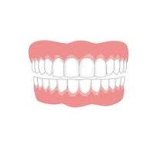
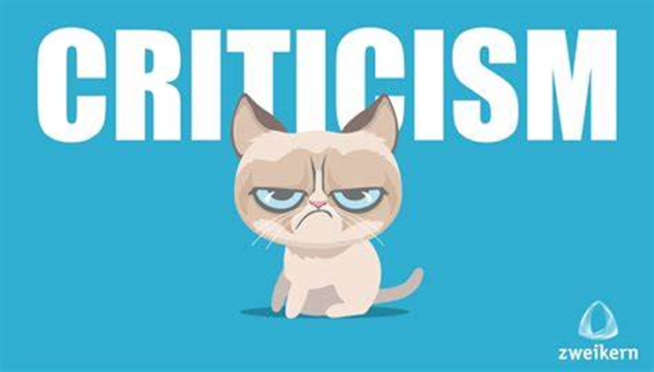
What we do . . . Naturally. . .
The Opposite of Savoring
We dampen or spoil good experiences, while savoring or chewing on our mistakes
Anybody ever get stuck chewing on the negative or spoiling the positives? [Yet another natural obstacle to happiness]

Slide 20

Easier Savoring
Mutual savoring
Find a friend – Remember when…
  Improves mood and hope
  Improves likelihood of repeating
  Increases planning
  How will you REMEMBER to savor the positives?

Slide 21

Tool #4: Gratitude
Do you want to increase optimism, improve life satisfaction, be healthier, exercise more, and be happier?
Weave intentional gratitude into your life

Slide 22

Gratitude PRACTICE Now
Get centered and reflect
Think of one thing, one person, one experience, one event, one goal, or one moment you’re thankful for.
Choose one of these things and write it down or pop it into the front of your brain.
Share with someone if/when you want to [Homework]

Slide 23

Bonus: Positive Distractions
Life is hard
We all experience common unhappiness and wonder about ourselves
Emotions are a pain☺; your work is immensely stressful
Sometimes, we need distractions
  What songs help you feel your feelings or boost your mood? [JSF]
  What places? What cat videos? What . . . ?

Slide 24

Summary
Three good things
Strategies for sleeping (or almost sleeping) well
Savoring
Gratitude
Positive distractions
(If time permits) Three-step emotional change trick

Slide 25
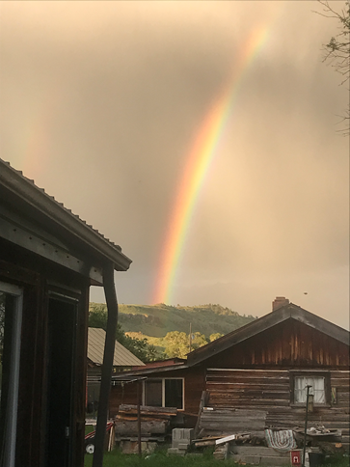
Final Conclusions
The brain, our culture, the news . . . are all built to track negativity
Well-being (eudaimonic happiness) requires awareness, intention, effort, reminders, and persistence
Most of us will forget to apply these unless we REMEMBER
Select and practice a few evidence-based positive psychology interventions and see what happens.
Experiment!

Slide 26
Resources
For more homework ideas, just do an internet search: Sommers-Flanagan + Happiness Homework
University of Pennsylvania Positive Psychology Center: https://ppc.sas.upenn.edu/
Greater Good Magazine: https://greatergood.berkeley.edu/
The Montana Happiness Project: https://montanahappinessproject.com/

Slide 27
Tool #1: The Three-Step Emotional Change Trick
[We do not do toxic positivity]
Step One: Honor the emotion
Step Two: Think a new thought or do something different
Step Three: Share the good mood
Notes:
We may or may not do this-John

