Slide 1
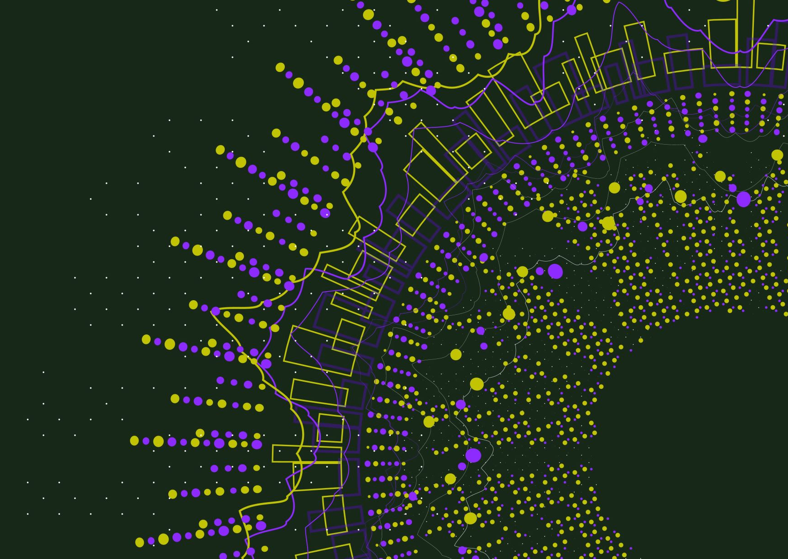

Positive Psychology and Eudaimonia. . . for Greater Happiness and Health
John Sommers-Flanagan, Ph.D.
Professor of Counseling
john.sf@mso.umt.edu
https://johnsommersflanagan.com/
https://montanahappinessproject.com/

Slide 2



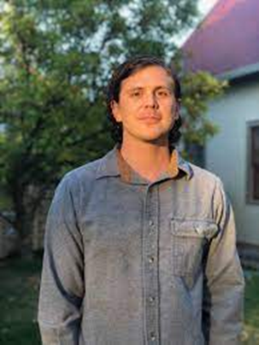


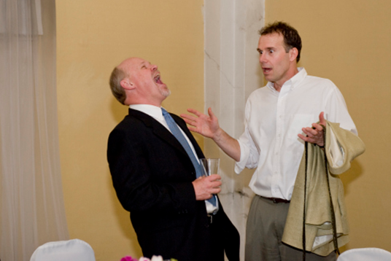

Hello and Welcome
Thanks to Robin, the Friday Medical Conference, and YOU
Thanks also to the Montana Happiness Project team
Notes:
John

Slide 3
Learning Objectives
Articulate the definition of eudaimonic happiness
Describe at least three positive psychology interventions (PPIs) that can increase eudaimonic happiness and physical health

Slide 4
In the Beginning
Psychology spent 100+ years mostly studying: What’s WRONG with YOU?
  Psychopathology and mental disorders
  Anxiety, depression, suicide, OCD, ADHD, ODD, PTSD, etc.
  Freud: “Neurotic misery” to “common unhappiness”
  Goals: Help people – just like you – become more aware of deficiencies and then usually fail in their efforts to fix them
Notes:
John

Slide 5
David Myers 1967-2000 Review
Articles about….
Depression: 54,040
Anxiety: 41,416
Anger: 5,584
Life Satisfaction: 2,582
Happiness: 1,710
Joy: 415
Overall Ratio: 21/1 – Why?
How could this be?
Notes:
John

Slide 6

Why?
This seems to be the way most of our brains are built
Notes:
John

Slide 7
Enter: Positive Psychology
Martin Seligman – 1998 – San Francisco – Positive psychology
Let’s study joy, happiness, what strengthens people, and what makes people emotionally healthy and well?
Seligman and others created and evaluated Positive Psychology Interventions (PPIs); PPIs are practices designed to increase positive affect and engagement with a meaningful life.
Notes:
John

Slide 8

But First: Are You Happy?
What happens when you’re forced to reflect on this question?
  Self-consciousness and self-awareness increase
  Feel a little fake
  Feel more depressed
  We aren’t meant to continuously monitor whether we’re happy or not . . . Stop It! It’s not a yes-or-no question.
  Preoccupation with whether you’re happy will, in most cases, make you feel worse
Notes:
Lillian

Slide 9


















Slide 10

Defining Happiness
True confessions: We’re not talking about smiley hedonistic (material) happiness . . .
That won’t last because of hedonic adaptation
Notes:
John

Slide 11
The Flashback: What is the Pursuit of Happiness?
Aristotle and Happiness
  Not an emotion
  Not material wealth
  Not political achievement
  Not so much an outcome, but a process of fulfilling one’s virtuous potentials in the context of community
  And NOT this . . .
Notes:
Lillian

Slide 12


The Best Definition?
Aristotle’s idea – That place where the flowering of your greatest (and unique) virtues, gifts, skills, and talents intersect (over time) with the needs of the world [aka community].
Notes:
Lillian

Slide 13

The Best Definition and Healthcare Professionals
How do you match your gifts with the needs of your friends, family, patients, mentors, and the world?
JSF – Biking story
Notes:
John

Slide 14

Reflection
In your mind:
Think of a nice story of the manifestation of your unique strengths (gifts, skills, talents, virtues) coming out in your interactions with others . . .
This can feel awkward . . . but, lingering on your strengths and positive qualities will serve you better than being preoccupied with your flaws
Notes:
Lillian

Slide 15

Evidence-Based Eudaimonia
Three Good Things
Gratitude Practice
Savoring
Grounding, Calming, and Sleeping
Notes:
Lillian

Slide 16
How does positive psychology/psychotherapy work?
Well-Being
Problems
Well-Being
Not just inside a person but also between and among people and within and between communities
Conoley, C. W., & Scheel, M.J. (2018). Goal focused positive psychotherapy: A strengths-based approach. Oxford University Press.

Slide 17
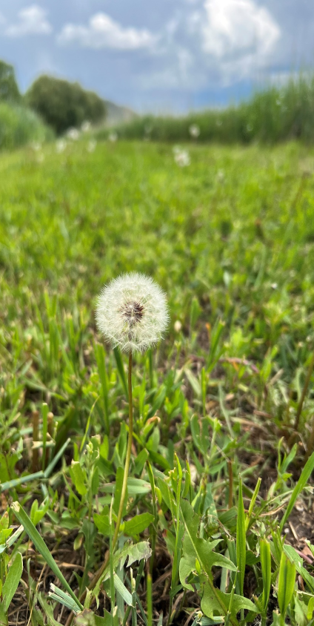
Our UM Outcomes
COUN 591
177 educators
Before the course 32% of educators scored in the clinically depressed range
After the Course
Only 12% scored in the depressed range
Educators reported:
  Reduced depression
  More hope, positive emotions, mindfulness, and social support
  Better sleep
  Fewer headaches and sick days
  Reduced gastrointestinal
  and respiratory distress

Slide 18

PPI #1: Three Good Things
Survey
Rumination is all-natural, but not helpful
Notes:
John

Slide 19

Three Good Things
Seligman’s signature technique
  Before you go to sleep (or right now)
  Write down (or think about) three good things that happened during the day (or last 24 hours)
  Then track down in your mind “Why” those things happened
  Seligman: After a week, you’ll want to keep doing it (JSF: Maybe)
  Volunteer?

Slide 20
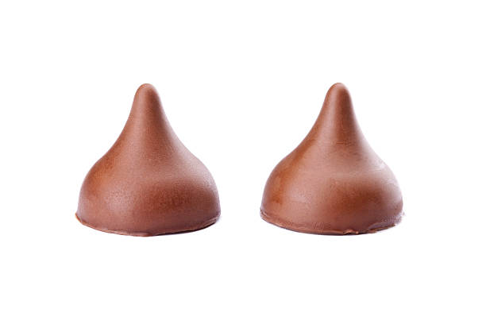
PPI #2: Savoring
What is savoring?
Deliberate effort to extend and expand positive experiences [improves mood; increases satisfaction]
  Track/review fun
  Track/review meaning
  Your next run/walk/shopping/conversation

Slide 21
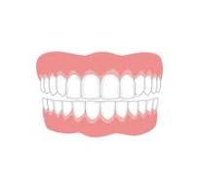
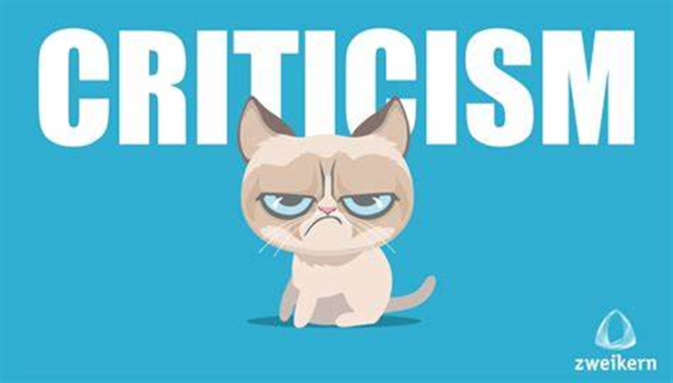
What we do . . . Naturally. . .
The Opposite of Savoring
We dampen or spoil good experiences, while savoring or chewing on our mistakes
Anybody ever get stuck chewing on the negative or spoiling the positives? [Yet another natural obstacle to happiness]

Slide 22
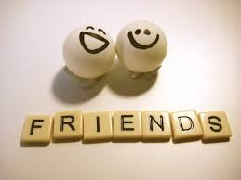
Easy Savoring
Mutual savoring
Find a friend – Remember when . . .
  Improves mood and hope
  Improves likelihood of repeating
  Increases planning
  How will you REMEMBER to savor the positives?

Slide 23

PPI #3: Gratitude
Do you want to increase optimism, improve life satisfaction, be healthier, exercise more, and be happier?
Weave intentional gratitude into your life

Slide 24

Gratitude PRACTICE Now
Get centered and reflect
Think of one thing, one person, one experience, one event, one goal, or one moment you’re thankful for.
Choose one of these things and write it down or pop it into the front of your brain.
Share with someone if/when you want to [Homework]

Slide 25

PPI #4: Sleep Well
“What’s the most important thing for life success and good health?” – Sleep
  Why? Sleep disruption is linked to accidents, illness, lower achievement, depression, irritability, worse MH, suicidality, etc!
  Sleep paralysis, MHCC and the DSM – Wait a minute☺

Slide 26
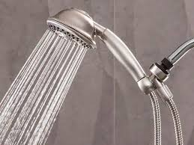
Sleep Hygiene
(Not just showering)
Routines
Daily exercise
Caffeine curfews
Light and dark and sound and comfort
Beds are for sleeping
Limit naps to less than 30 min [coffee naps]
Avoid certain foods
The temperature decline (Bath or shower)
Screen light exposure and Tech in the bedroom?
Have a plan for dealing with troubling thoughts and dreams [3 Good Things; mindfulness meditation; “Almost Sleep”]

Slide 27

Bonus: Positive Distractions
Life is hard
We all experience common unhappiness and wonder about ourselves
Emotions are a pain☺; your work is immensely stressful
Sometimes, we need distractions
  What songs help you feel your feelings or boost your mood? [JSF]
  What places? What cat videos? What . . . ?

Slide 28

Summary
Eudaimonic happiness and your sweet spot
Three good things
Savoring
Gratitude
Strategies for sleeping (or almost sleeping) well
Bonus: Positive distractions

Slide 29

Final Conclusions
The brain, our culture, the news . . . are all built to track negativity
Well-being (eudaimonic happiness) requires awareness, intention, effort, reminders, and persistence
PPIs can help us have greater positive affect and pursue meaning . . . only if we REMEMBER to use them
Select and practice a few PPIs and see what happens.
Experiment with positivity on yourself, family, patients!

Slide 30
Resources
For more homework ideas, just do an internet search: Sommers-Flanagan + Happiness Homework
University of Pennsylvania Positive Psychology Center: https://ppc.sas.upenn.edu/
Greater Good Magazine: https://greatergood.berkeley.edu/
The Montana Happiness Project: https://montanahappinessproject.com/

