Slide 1

Integrating Strengths-Based and Traditional (Medical Model) Suicide Assessment
Presented on behalf of the Professional
Counseling Association of Montana – 12/4/24
John Sommers-Flanagan, Ph.D.
University of Montana
Department of Counseling
John.sf@mso.umt.edu
Free Resources: https://johnsommersflanagan.com/

Slide 2
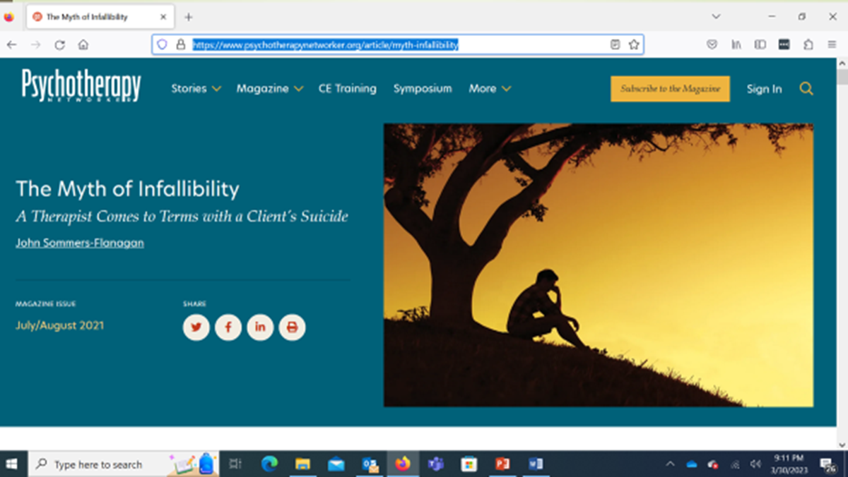
Preparation
Thanks to Cindy for organizing, and you!
Emotionally challenging topic: Activation warning x 3
30+ years ago – 2021 Networker article: https://www.psychotherapynetworker.org/article/myth-infallibility
Please practice proactive and positive coping

Slide 3
Learning Objectives
List key differences between medical model and collaborative strengths-based approaches to suicide assessment and treatment
Describe at least one way to integrate medical model and strengths-based assessment approaches
Identify and implement at least three specific assessment strategies to help facilitate collaborative and constructive problem-solving.

Slide 4
Learning Process
We are distant, but can still be engaged
  I will talk about a strengths-based suicide approach
  You imagine yourself working effectively with clients or people who are feeling suicidal
  You engage* in learning/practice opportunities
  We all cope well with this challenging topic
Notes:
Talk about sex loud in public

Slide 5


Why a Strengths-Based Approach?
People who feel suicidal need to be seen, accepted, respected, and valued – not dismissed or reduced to a stereotype or told they should or shouldn’t feel particular ways.
This is especially true for people with identities that have been historically and are currently marginalized.
Notes:
Lillian

Slide 6
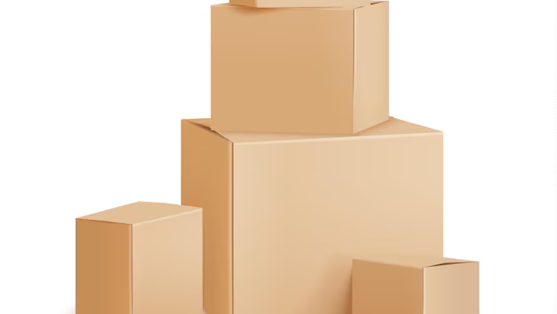
Inside the Box
The Traditional Medical Model

Slide 7
Basic Principles – Positivistic Philosophy
Suicidal thoughts and behaviors represent illness; we need to intervene (90% estimate; What’s the CDC estimate?)
We are authority figures who know more about patient health than they do
The patient is a suicidal person
We can predict and prevent suicide
We use research-based risk assessment procedures and questionnaires to categorize risk as mild, moderate, severe, extreme
We treat mental disorders that are linked to death by suicide

Slide 8
Example: The PHQ-9
Nine items from the DSM Major Depression diagnostic criteria
Item #9: “Thoughts that you would be better off dead, or thoughts of hurting yourself in some way?”
4-point Likert scale: Not at all; several days; more than half the days; nearly every day
David Jobes says: “Never use the PHQ-9”

Slide 9
The Columbia (C-SSRS)
Two opening questions:
Have you wished you were dead or wished you could go to sleep and not wake up? [Passive suicidality]
Have you actually had any thoughts about killing yourself? [Suicidal ideation]

Slide 10
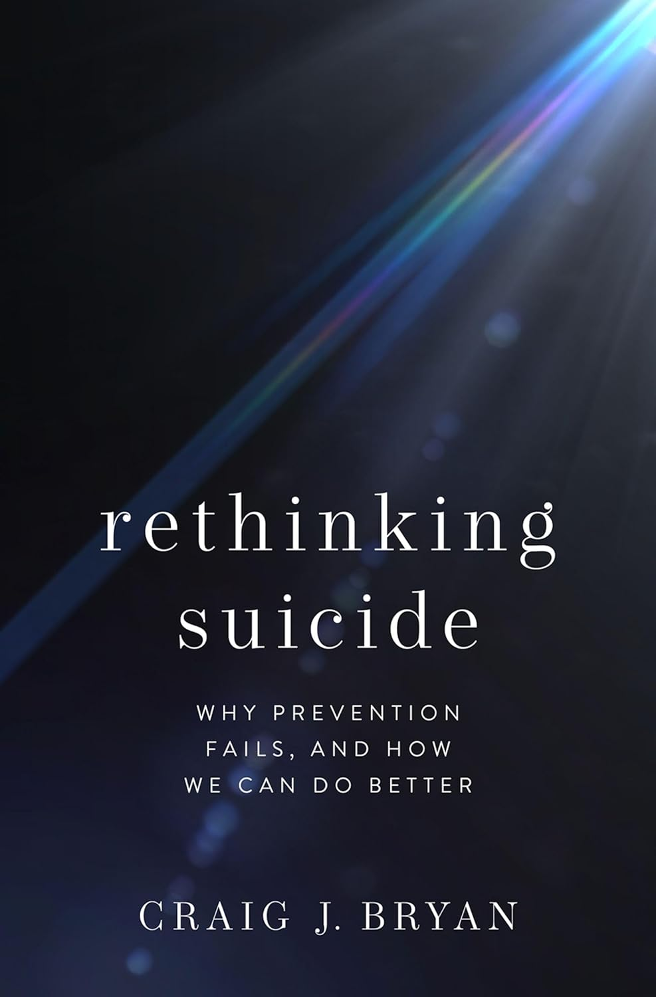
Example: C-SSRS
“The majority of patients who die by suicide screen negative for suicidal ideation. If you are a MH professional/agency who uses decision trees that designate negative screens as ‘low risk,’ you should consider discontinuing that practice. This is especially applicable to clinicians/agencies that use the C-SSRS’s red/orange/yellow scoring system. The C-SSRS will ‘miss’ most patients who kill themselves.” [False negatives]
  Craig Bryan, Ph.D., Feb 7, 2024 – LinkedIn post

Slide 11

Outside the Box
Strengths and Suicide

Slide 12

Strengths-Based Principles – I
Embrace Shneidman’s position: suicidal thoughts and behaviors are neither an illness nor a sin.
De-pathologize:
View suicide disclosures as a natural communication of pain, often from untenable life situations [*Not med model] and unmatched opportunity to offer compassionate help.

Slide 13

Strengths-Based Principles – 2
Recognize the limits of risk/protective factor assessment (because mostly it doesn’t work; 50 year meta-analysis; cutting; cultural variability).
We are transparent (e.g., hosp), build trust and collaborate to develop individualized safety plans (e.g., veterans/firearms) and decrease personal distress. [This is our North star]
.

Slide 14

Strengths-Based Principles – 3
While focusing on suicide (which is essential), resist the temptation to over-focus on suicide.
The client is a whole person with unique strengths and resources (vets/construction and teams): Show compassion for suicide pain, but pay attention to and draw out the positives (not naively; the best way is to be with). [7 dimensions]

Slide 15

Strengths-Based Principles – 4
Use collaborative and therapeutic assessment:
Start with empathy and compassion, NORMALIZE, and recognize that the problem may not be “in” the person [We acknowledge our legacy of pathologizing diversity; e.g., Black/African American]
Balance your questioning: Don’t just go through the PHQ-9.

Slide 16

Strengths-Based Principles – 5
Implement specific interventions that target distress and suicidality.
Why? – Interventions can stimulate HOPE

Slide 17
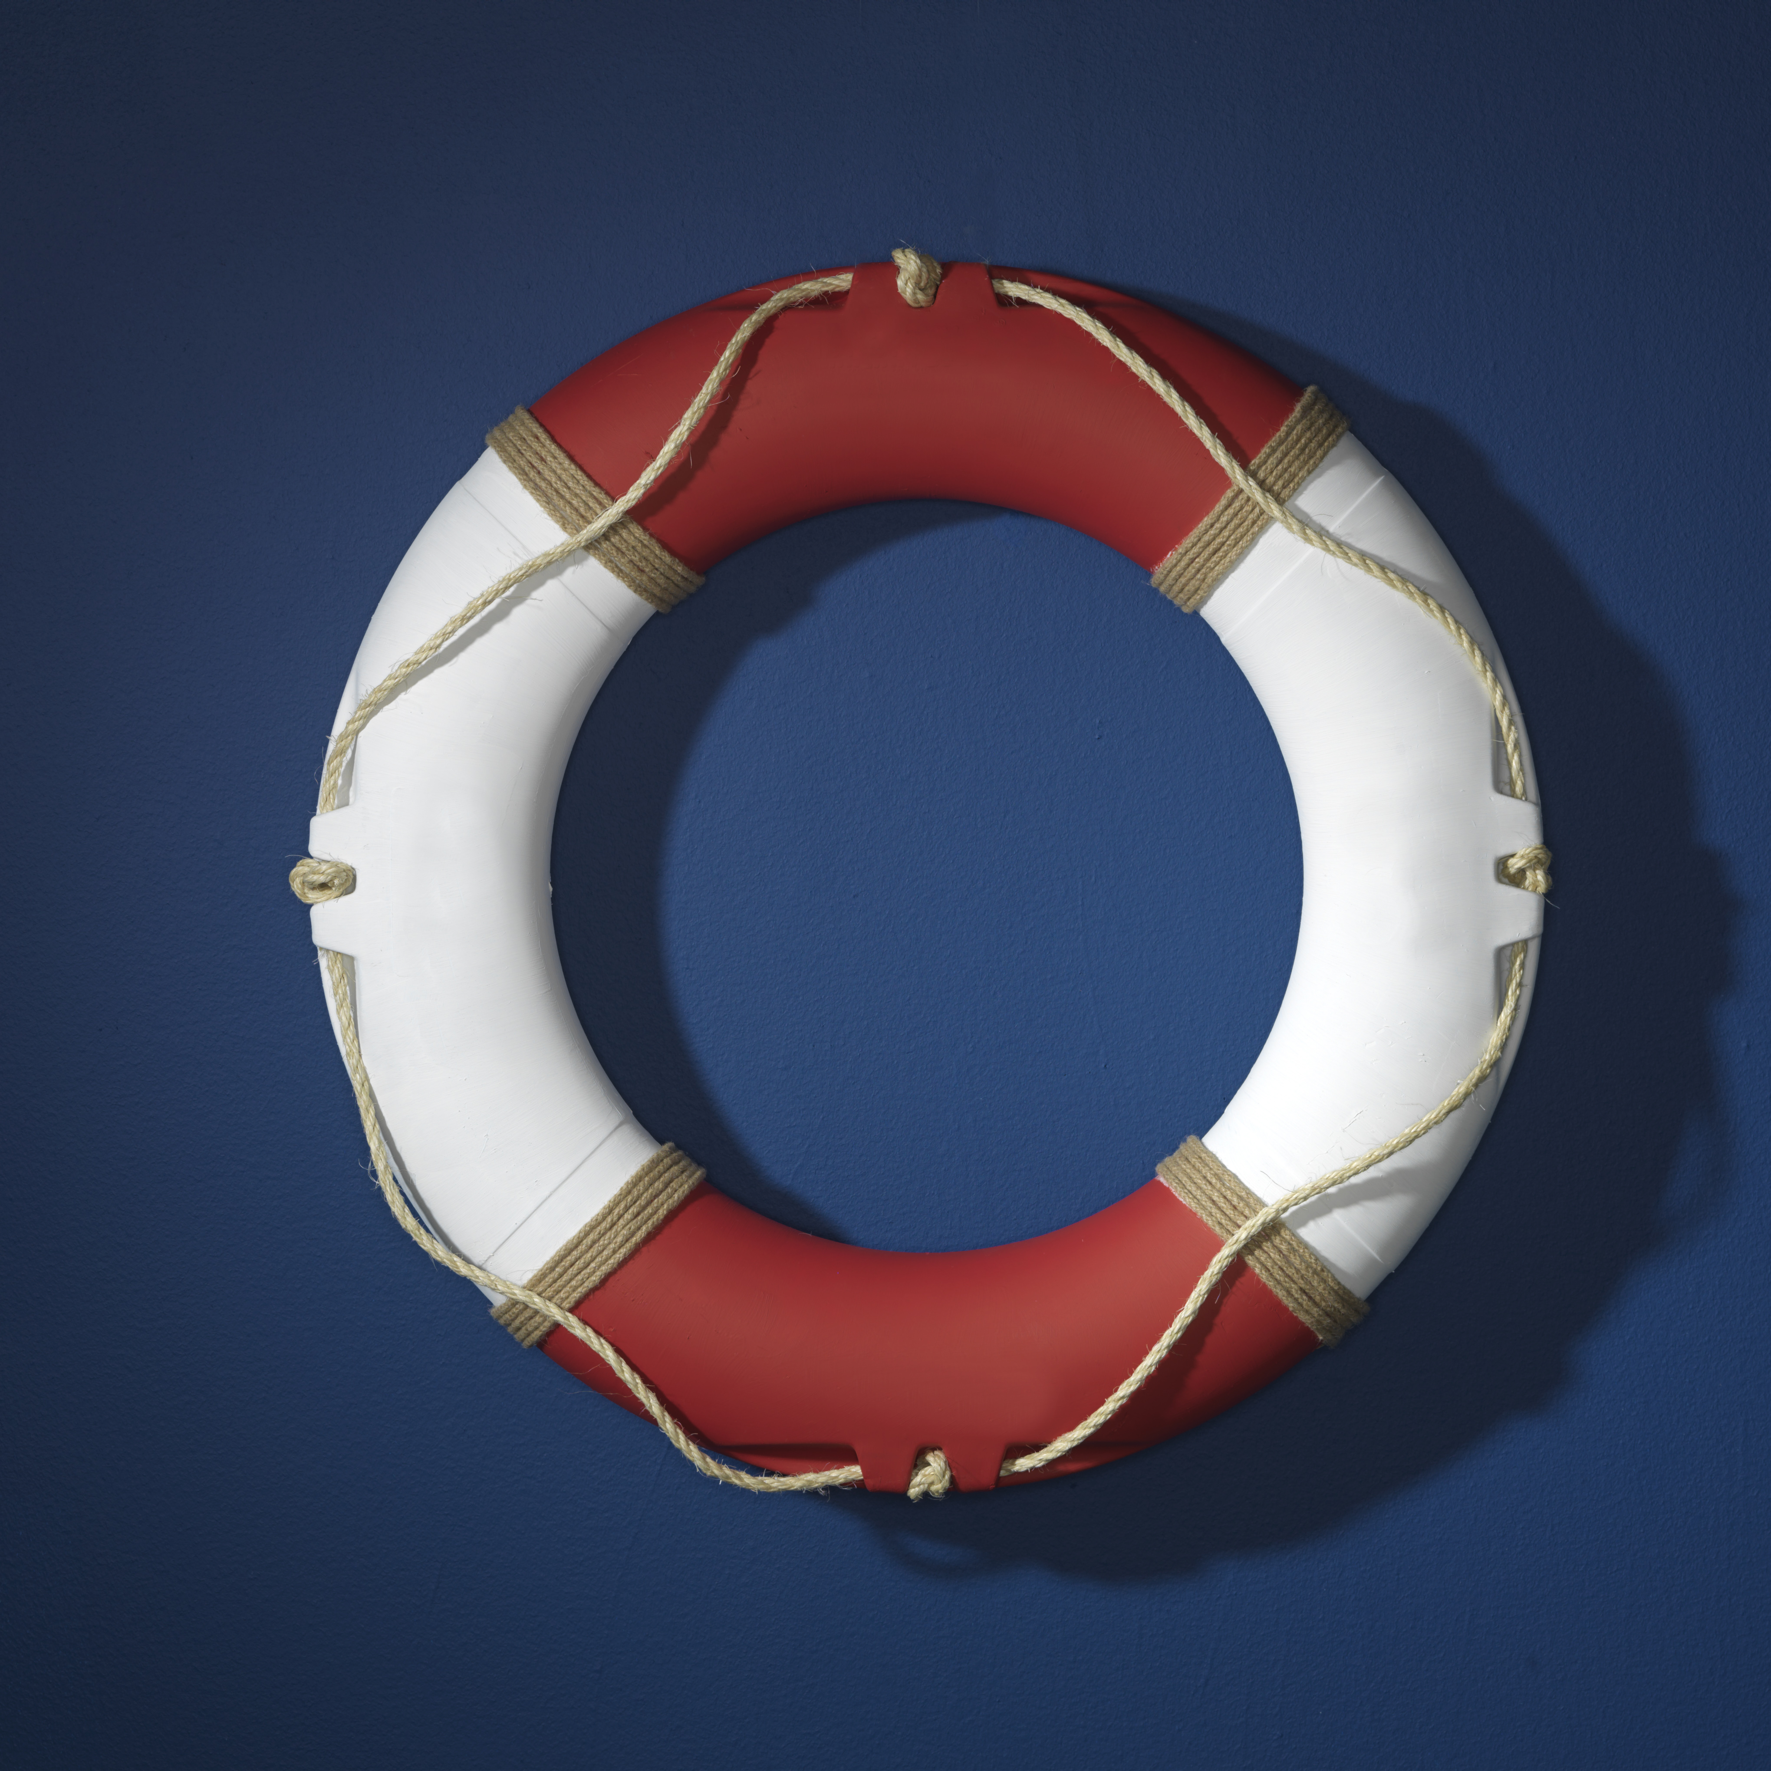
Strengths-Based Principles – 6
Despite embracing a strengths-based model. . . remember you may need to be directive, you may need to initiate protective action, and you may need to be the voice of authority and rational decision-making in the room.

Slide 18

Strengths-Based Principles – 7
Recognizing the immense stress we carry in this role, we practice excellent self-care, including evidence-based happiness activities (see: https://montanahappinessproject.com/)
We support each other
We acknowledge and talk about our own emotional challenges
We use the skills we teach

Slide 19
Medical Model vs. Strengths-Based An Overview
A Positivistic Philosophy
Suicidal thoughts and behaviors represent illness; we need to intervene
We are authority figures who know more about patient health than they do
We’re working with a suicidal patient
We can predict and prevent suicide
We use risk assessment procedures and questionnaires
We treat mental disorders
A Social Constructivist Philosophy
Suicidal thoughts and behaviors are a natural communication of pain
We collaborate to develop individualized safety plans
We’re working with a whole person
Suicide is mostly unpredictable
We use collaborative and therapeutic assessment
We treat client distress and suicidality

Slide 20

Strengths-Based
Tools for Suicide Assessment

Slide 21

#1
Assessment Skill/Tool: Normalizing
Ask directly AND normalize the asking
  I’ve read that it’s not unusual for people in the construction industry who are experiencing pressure at work to have thoughts about suicide. Is that true for you?
  People who feel down and have been subjected to injustice may think about suicide from time to time. Have you had thoughts about suicide?
  Normalize the question itself

Slide 22
#1
Practice:
Use Normalizing Language
It can be difficult to find the right words in the moment. You don’t need to use my words; it’s better to use your words, words that are authentic to you and that fit with your setting and population (e.g., veterans).
Think of how you might use a normalizing statement for people with whom you work?

Slide 23

#2
Assessment Skill:
Evaluate Ideation
Ask directly and then evaluate ideation
Disclosure is good news (it’s a sign of trust)!
  Trigger – What usually triggers your SI?
  Frequency – How often?
  Intensity – All you can think? Or background?
  Duration – How long usually?
  Termination – What’s going on when no SI? (Tommie)

Slide 24

#3
Assessment Skill:
That One Thing (1/2)
“If we could somehow magically change just one thing in your life that would eliminate your suicidal risk all together, what would that be?” (Jobes, 2023, p. 63)
This question points you and the person toward a treatment focus
It also may reveal irrational expectations

Slide 25
#3
Assessment Skill:
That One Thing (2/2)
Possible “irrational” responses:
“My mother would be alive”
“I wouldn’t have been sexually abused as a child”
“There would be no more hate”
What are some therapy targets linked to these responses?

Slide 26

#4
Assessment Skill:
Mood Scaling with a Suicide Floor
This is my favorite 5 minute interview strategy
Demo: Live participation now
May I ask some questions about your mood?

Slide 27
#4
Practice:
Mood Scaling
Rate your mood, using a zero to 10 scale. Zero is the worst mood possible. Zero means you’re totally depressed and so you’re just going to kill yourself. A 10 is your best possible mood. A 10 would mean you’re as happy as you could be, maybe dancing or singing or doing whatever you do when you’re extremely happy. Using zero to 10, what rating would you give your mood right now?
What’s happening now that makes you give your mood that rating?
What’s the worst or lowest mood rating you’ve ever had? What was happening to make you feel so down?
For you, what would be a normal mood rating on a normal day?
What’s the best mood rating you’ve ever had? What was happening that helped you have such a high mood rating?

Slide 28
Integration – The Minimal
Frame the Questionnaire Process
  I’m going to ask you nine questions from this questionnaire. These are very important questions. I hope you’ll answer them honestly.
  I want to know much more about you than what’s on this questionnaire. When we’re finished with the questionnaire, we can talk about other things important to you.

Slide 29
Additional Assessment Information
The comprehensive suicide assessment interview (RIPSCIP) https://johnsommersflanagan.com/2016/02/06/r-i-p-sc-i-p-an-acronym-for-remembering-the-essential-components-of-a-suicide-assessment-interview/
Need a PHQ-9 or C-SSRS alternative ? The ASQ Toolkit.pdf: https://www.nimh.nih.gov/research/research-conducted-at-nimh/asq-toolkit-materials

Slide 30
More Integration
Sample Columbia Questions
Have you been thinking about how you might do this?
Add: What thoughts do you have that make you feel like you don’t want to die? (or how to prevent this suicide from happening)
Have you had these thoughts and had some intention of acting on them?
Add: Have you had thoughts and then decided not to act on them? What made you not act?
Have you started to work out or worked out the details of how to kill yourself? Did you intend to carry out this plan?
Add: Just to be balanced, we should work out a detailed and easy to enact plan to save yourself.

Slide 31
And More Integration
Combine Two Approaches
Example: Use the Columbia (but delete the word “actually”☺)
Add the Mood Scaling with a Suicide Floor to start generating ideas for treatment

