Slide 1

Strengths-Based Assessment, Treatment, and Prevention with Diverse Populations
Presented on behalf of the Office of Suicide Prevention
Maryland Department of Health – 10/2/24
John Sommers-Flanagan, Ph.D.
University of Montana
Department of Counseling
John.sf@mso.umt.edu
Free Resources: https://johnsommersflanagan.com/

Slide 2

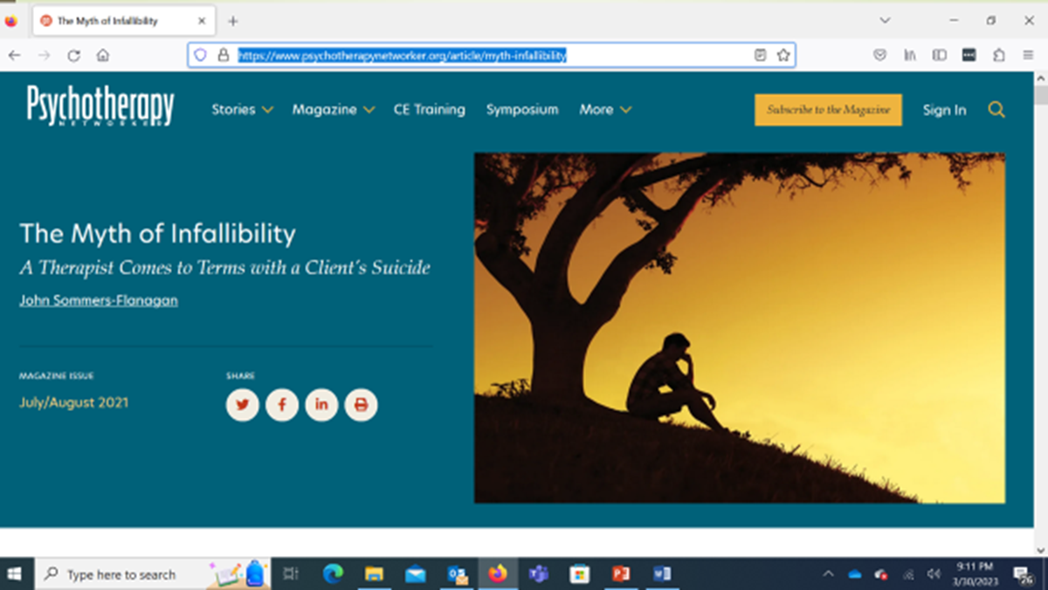
Preparation
Thanks to Dionne, Enjoli, the amazing Office of Suicide Prevention, all the presenters, and you!
Emotionally challenging topic: Trigger warning x 3
30+ years ago – 2021 Networker article: https://www.psychotherapynetworker.org/article/myth-infallibility
Please practice proactive and positive coping

Slide 3
Learning Objectives
Describe principles of strengths-based suicide assessment and treatment planning
Critique traditional, medical model approaches to suicide assessment and treatment with people who have experienced oppression/marginalization.
Apply suicide assessment and intervention strategies that are sensitive, collaborative, and empowering.

Slide 4

Learning Process
We are distant, but can still be engaged
  I will talk about a strengths-based suicide approach: – especially for people with diverse identities who have been historically and currently misunderstood, underappreciated, and oppressed
  You imagine yourself slightly modifying how you work with patients or clients or people who are suicidal, especially if they are from historically and/or currently marginalized/oppressed groups
  You engage* in pop-up learning/practice opportunities
  We all cope well with this challenging topic
Notes:
Talk about sex loud in public

Slide 5


Why a Strengths-Based Approach?
People who feel suicidal need to be seen, accepted, respected, and valued – not dismissed or reduced to a stereotype or told they should or shouldn’t feel particular ways.
This is especially true for people with identities that have been historically and are currently marginalized – [today].
Notes:
Lillian

Slide 6

Inside the Box
The Traditional Medical Model

Slide 7
Basic Principles – Positivistic Philosophy
Suicidal thoughts and behaviors represent illness; we need to intervene (90% estimate; What’s the CDC estimate?)
We are authority figures who know more about patient health than they do
The patient is a suicidal person
We can predict and prevent suicide
We use research-based risk assessment procedures and questionnaires to categorize risk as mild, moderate, severe, extreme
We treat mental disorders that are linked to death by suicide

Slide 8
Example: The PHQ-9
Nine items from the DSM Major Depression diagnostic criteria
Item #9: “Thoughts that you would be better off dead, or thoughts of hurting yourself in some way?”
4-point Likert scale: Not at all; several days; more than half the days; nearly every day

Slide 9

Outside the Box
Strengths and Suicide

Slide 10

Strengths-Based Principles – I
Embrace Shneidman’s position: suicidal thoughts and behaviors are neither an illness nor a sin.
De-pathologize:
View suicide disclosures as a natural communication of pain, often from untenable life situations [*Not med model] and unmatched opportunity to offer compassionate help.

Slide 11

Strengths-Based Principles – 2
Recognize the limits of risk/protective factor assessment (because mostly it doesn’t work; 50 year meta-analysis; cutting; cultural variability).
We are transparent (e.g., hosp), build trust and collaborate to develop individualized safety plans (e.g., veterans/firearms) and decrease personal distress. [This is our North star]
.

Slide 12

Strengths-Based Principles – 3
While focusing on suicide (which is essential), resist the temptation to over-focus on suicide.
The client is a whole person with unique strengths and resources (vets/construction and teams): Show compassion for suicide pain, but pay attention to and draw out the positives (not naively; the best way is to be with). [7 dimensions]

Slide 13

Strengths-Based Principles – 4
Use collaborative and therapeutic assessment:
Start with empathy and compassion, NORMALIZE, and recognize that the problem may not be “in” the person [We acknowledge our legacy of pathologizing diversity; e.g., Black/African American]
Balance your questioning: Don’t just go through the PHQ-9. If you need to use it, use it like this*

Slide 14

Strengths-Based Principles – 5
Implement specific interventions that target distress and suicidality.
We will cover at least two examples of these today – Interventions can stimulate HOPE

Slide 15

Strengths-Based Principles – 6
Despite embracing a strengths-based model. . . remember you may need to be directive, you may need to initiate protective action, and you may need to be the voice of authority and rational decision-making in the room.

Slide 16

Strengths-Based Principles – 7
Recognizing the immense stress we carry in this role, we practice excellent self-care, including evidence-based happiness activities
We support each other
We acknowledge and talk about our own emotional challenges
We use the skills we teach

Slide 17
Medical Model vs. Strengths-Based An Overview
A Positivistic Philosophy
Suicidal thoughts and behaviors represent illness; we need to intervene
We are authority figures who know more about patient health than they do
We’re working with a suicidal patient
We can predict and prevent suicide
We use risk assessment procedures and questionnaires
We treat mental disorders
A Social Constructivist Philosophy
Suicidal thoughts and behaviors are a natural communication of pain
We collaborate to develop individualized safety plans
We’re working with a whole person
Suicide is mostly unpredictable
We use collaborative and therapeutic assessment
We treat client distress and suicidality

Slide 18

Strengths-Based Tools for Suicide Assessment

Slide 19

#1
Assessment Skill/Tool: Normalizing
Ask directly AND normalize the asking
  I’ve read that it’s not unusual for people in the construction industry who are experiencing pressure at work to have thoughts about suicide. Is that true for you?
  People who feel down and have been subjected to injustice may think about suicide from time to time. Have you had thoughts about suicide?
  Normalize the question itself

Slide 20
#1
Practice:
Use Normalizing Language
It can be difficult to find the right words in the moment. You don’t need to use my words; it’s better to use your words, words that are authentic to you and that fit with your setting and population (e.g., veterans; deaf and hard of hearing; others) .
Think of how you might use a normalizing statement for people with whom you work?

Slide 21

#2
Assessment Skill:
Evaluate Ideation
Ask directly and then evaluate ideation
Disclosure is good news (it’s a sign of trust)!
  Trigger – What usually triggers your SI?
  Frequency – How often?
  Intensity – All you can think? Or background?
  Duration – How long usually?
  Termination – What’s going on when no SI? (Tommie)

Slide 22

#3
Assessment Skill:
That One Thing (1/2)
“If we could somehow magically change just one thing in your life that would eliminate your suicidal risk all together, what would that be?” (Jobes, 2016, p. 63)
This question points you and the person toward a treatment focus
It also may reveal irrational expectations

Slide 23
#3
Assessment Skill:
That One Thing (2/2)
Possible “irrational” responses:
“My mother would be alive”
“I wouldn’t have been sexually abused as a child”
“There would be no more hate”
What are some therapy targets linked to these responses?

Slide 24

#4
Assessment Skill:
Mood Scaling with a Suicide Floor
This is my favorite 5 minute interview strategy
Demo: Live participation now
May I ask some questions about your mood?

Slide 25
#4
Practice:
Mood Scaling
Rate your mood, using a zero to 10 scale. Zero is the worst mood possible. Zero means you’re totally depressed and so you’re just going to kill yourself. A 10 is your best possible mood. A 10 would mean you’re as happy as you could be, maybe dancing or singing or doing whatever you do when you’re extremely happy. Using zero to 10, what rating would you give your mood right now?
What’s happening now that makes you give your mood that rating?
What’s the worst or lowest mood rating you’ve ever had? What was happening to make you feel so down?
For you, what would be a normal mood rating on a normal day?
What’s the best mood rating you’ve ever had? What was happening that helped you have such a high mood rating?

Slide 26
Additional Assessment Information
The comprehensive suicide assessment interview (RIPSCIP) https://johnsommersflanagan.com/2016/02/06/r-i-p-sc-i-p-an-acronym-for-remembering-the-essential-components-of-a-suicide-assessment-interview/
Need a PHQ-9 or C-SSRS alternative ? The ASQ Toolkit.pdf: https://www.nimh.nih.gov/research/research-conducted-at-nimh/asq-toolkit-materials

Slide 27

Part 3
Social Justice Sensitive Suicide Intervention and Management Strategies

Slide 28
Seven Organizing Life Dimensions
Emotional [Core: Excruciating distress]
Cognitive or Mental [Mental constriction, “nothing helps”]
Interpersonal [Social disconnection or perceived burden]
Physical/Biomedical [Agitated, impulsive, ill, and drugs]
Spiritual/Cultural [Meaninglessness or disconnection]
Behavioral [Suicide plan/intent, lethal means available]
Contextual [Sociological, political, and environmental stressors]

Slide 29
Emotional Dimension
Main Treatment Planning Targets:
Excruciating Distress (Psychache!)
Affect dysregulation
Acute or chronic shame, guilt, sadness, or anger (for oppressed individuals and groups, we can conceptualize this as internalized oppression and re-externalize it; e.g., Black people who are D or HH may feel invisible, undervalued, and internalize those thoughts and feelings)

Slide 30
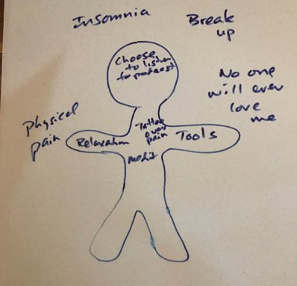
Emotional: Separate Pain From Self
Label problems and PAIN outside self.
Put strengths, strategies, and skills inside self

Slide 31
Contextual Dimension
Main Treatment Planning Targets:
Poverty (April 2020 example; resources)
Neighborhood violence (safety)
Racism—perceived systemic oppression (affirmation/acceptance)
Also: urban, rural, school, government, society, culture, situational triggers, toxic environments, unemployment, high pressure employment, MH resources, bootstrap

Slide 32
Re-Externalizing the External
At age 82, in an interview with the Los Angeles Times (Stein, 1986), B. F. Skinner said:
“I have to tell people that they are not responsible for their behavior. They’re not creating it; they’re not initiating anything. It’s all found somewhere else.”

Slide 33
Social Justice and Therapeutic Tools
Empathic commiseration and affirmation
Use externalization: Put the pattern and problem outside the person and team with them to address the distress (Skinner; narrative treatments)
Discernment and Goal-Setting
Opportunity Ameliorates (advocate for opportunity – especially with like-minded prosocial groups)
Building hope from the bottom up

Slide 34
Interpersonal [Social]
Main Treatment Planning Targets:
Unwanted Social Disconnection*
Social Skill Deficits
Social Burden

Slide 35
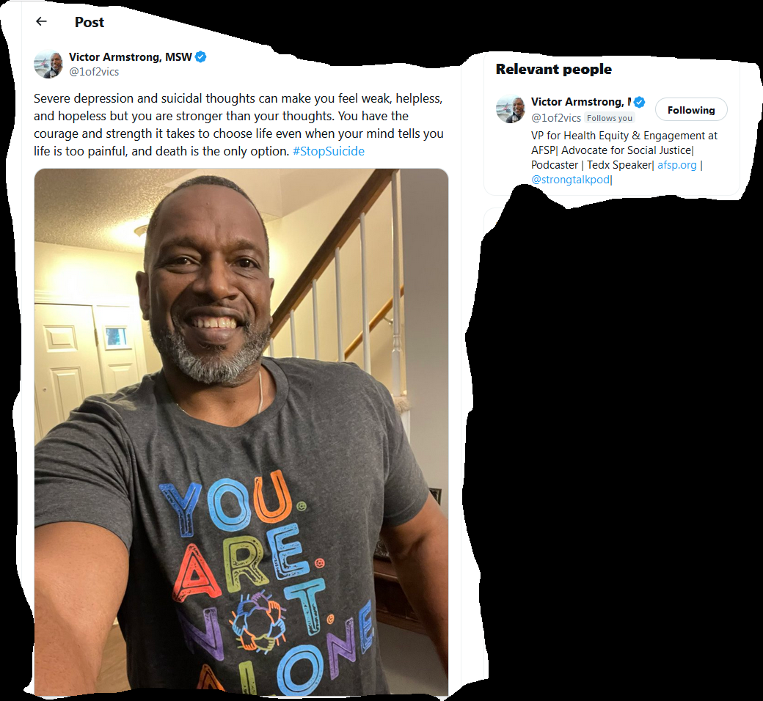
Social Connection
Getting connected can be in-person and online.
Finding relatable people who generate hope is important.
This is Victor Armstrong who gives encouraging and insightful messages on Twitter (X).

Slide 36

In Closing
Closing story
What do you want to remember?
What can you implement soon?
Thanks for being you . . .
Monitor and take care of yourself and your colleagues

Slide 37
Free Resources
https://montanahappinessproject.com/
https://johnsommersflanagan.com/

