Slide 1
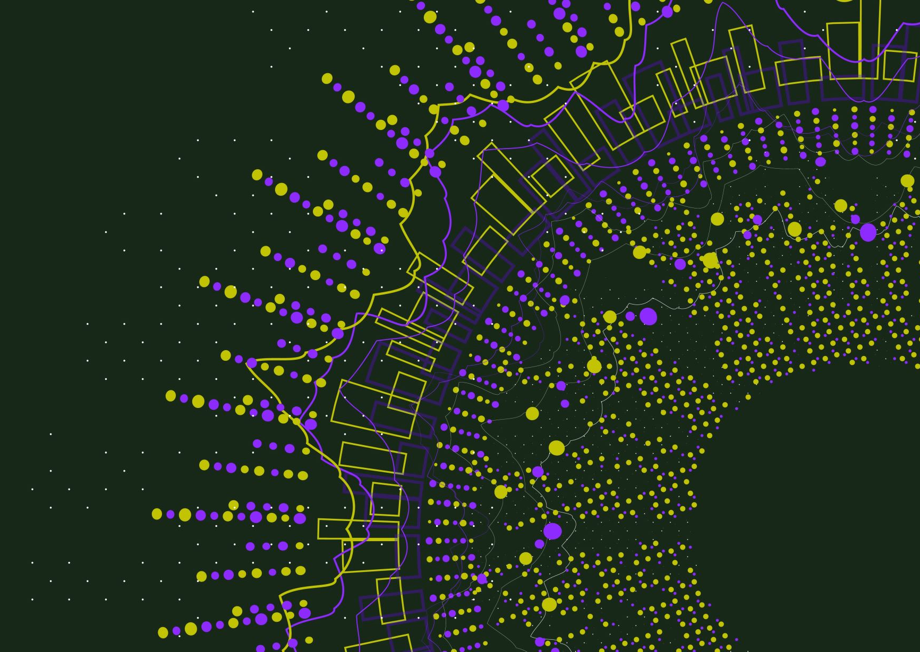
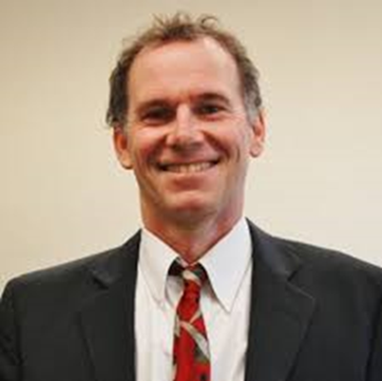
Let’s Pursue Eudaimonia . . . Together
John Sommers-Flanagan, Ph.D.
Professor of Counseling
University of Montana
john.sf@mso.umt.edu
https://johnsommersflanagan.com/
https://montanahappinessproject.com/

Slide 2

But First: What is the Pursuit of Happiness?
Aristotle and Happiness
  Not an emotion
  Not material wealth
  Not political achievement
  Not so much an outcome, but a process of fulfilling one’s virtuous potentials in the context of community
  And NOT these SELF-focused messages . . .
Notes:
Lillian

Slide 3


















Slide 4


The Best Definition?
Aristotle’s idea – That place where the flowering of your greatest (and unique) virtues, gifts, skills, and talents intersect (over time) with the needs of the world [aka community].
Notes:
Lillian

Slide 5

The Best Definition and You?
How do you match your gifts with the needs of your friends, family, communities, and the world?
JSF – Biking story
Notes:
John

Slide 6

Reflection Activity
In your mind:
Think of a nice story of the manifestation of your unique strengths (gifts, skills, talents, virtues) coming out in your work or teaching or research or . . .
This can feel awkward . . . but, let’s swap stories for 5 minutes
Notes:
Lillian

Slide 7

One Personal Eudaimonia Skill
Three Good* Things
Survey on sleep
Rumination is all-natural, but not helpful
Notes:
John

Slide 8

Three Good Things
Seligman’s signature technique
  Before you go to sleep (or right now)
  Write down (or think about) three good things that happened during the day (or last 24 hours)
  Then track down “Why” those things happened
  Seligman: After a week, you’ll want to keep doing it (JSF: Maybe)
  Volunteer?

Slide 9

The Bonus Slide
  Unhappiness happens
  Emotions, work, and relationships are difficult and stressful
  Positive distractions
    What places, people, etc., boost your mood?
  All together now☺

