Slide 1
Suicide and Happiness
Using Suicide Theories and
Data to Construct Meaningful Interventions
Presented on behalf of the
Mental Health Academy – 24 August 2024
John Sommers-Flanagan, Ph.D.
University of Montana
Contact: John.sf@mso.umt.edu
Free Stuff: https://johnsommersflanagan.com

Slide 2


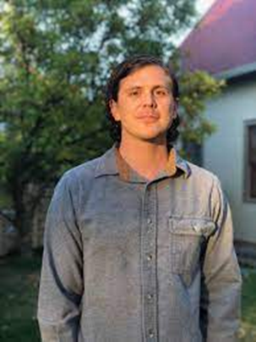



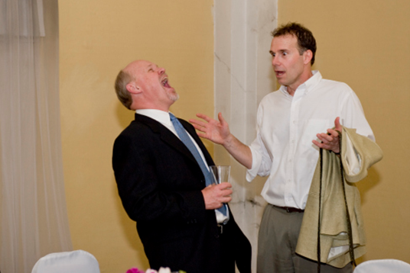

Gratitude
Thanks to Pedro, Greg, and the MHA for their dedication to worldwide education and mental health
Thanks to my Montana Happiness team. For more info, see: https://montanahappinessproject.com/ and https://johnsommersflanagan.com/

Slide 3

Learning Objectives
Describe methods for connecting with clients and collaboratively identifying their unique suicide drivers
Connect client suicide drivers with established theories of suicide
Develop co-constructed interventions that honor clients’ experiences and move them toward more frequent positive affect and greater meaning and well-being.

Slide 4

Collaboration
Why be collaborative?
Embrace Beginner’s Mind
  Let go of preconceptions.* Most people who think about suicide are sensitive, intelligent, and the best experts on themselves.
Display Transparency
  Regarding SI and hospitalization (listen; address pain; create safety)
Track and respond empathically to Shneidman’s psychache

Slide 5
Theoretical and Empirical Foundations
Shneidman – Psychache [the emotional dimension]
Klonsky and May (and Beck) – Hopelessness (including Shneidman’s mental constriction) [the cognitive dimension]
Joiner – Thwarted belongingness and perceived burdensomeness [the interpersonal dimension]

Slide 6

Psychache - Strategies
Track, reflect, acknowledge distress with empathy
Explore unique distress “trigger(s)?” – Jobes’s “That one thing question”
Use Linehan’s (DBT) distress tolerance
Use three-step emotional change trick to explore positive affect
Use individualized insomnia interventions: Three Good Things, Imagery Rehearsal Therapy, CBT-I [Sleep hygiene]

Slide 7

Psychache (Emotional Dimension): That One Thing
“If we could somehow magically change just one thing in your life that would eliminate your suicidal risk all together, what would that be?” (Jobes, 2023)
This question points you and the client toward a treatment focus
It also may reveal irrational expectations

Slide 8
Psychache (Emotional Dimension): That One Thing – 2
Possible “irrational” responses:
“My mother would be alive”
“I wouldn’t have been sexually abused as a child”
“There would be no more hate”
What are the treatment targets linked to these responses?
Notes:
John

Slide 9

Psychache: Three Good Things
Survey
Rumination about the past and future is all-natural, but not helpful
Notes:
John

Slide 10

Psychache: Insomnia and
Three Good Things
Seligman’s signature technique
  Before you go to sleep (or right now)
  Write down (or think about) three good things that happened during the day (or last 24 hours)
  Then track down in your mind “Why” those things happened
  Seligman: After a week, you’ll want to keep doing it (JSF: Maybe)
Notes:
John

Slide 11



Happiness is an Activating Word
We do not do toxic positivity B.S.
Notes:
John

Slide 12
The Three-Step Emotional Change Technique
[We do not do toxic positivity]
Step One: Honor the emotion – we do this for as long as needed
Step Two: Think a new thought or . . . (individualized, when ready)
Step Three: Share the good mood (other people matter)
Notes:
We may or may not do this-John

Slide 13

Belongingness and Burdensomeness
In a friendly, normalizing, non-pathologizing way, be like Adler and Rogers and track, reflect, acknowledge distress with empathic responding . . . AND
Remember thwarted belongingness is about dynamics like: (a) anticipated rejection, (b) fear of abandonment, (c) activated deep cognitive schema around being unlovable, defective, shame, etc., (d) forgiveness of self/others
Interpersonal patterns REPEAT [repetition compulsion]
Notes:
Leah
Mostly focus on thwarted belonginess and not so much on perceived burdensomeness (maps well onto adler’s theory of people need to feel useful through work and relationship)
What leads to thwarted belonginess? (ie: poor social skills, people feeling rejected and attributing to themselves because they were not good at vulnerability or listening to other people)
Social anxiety – fearing the scrutiny from others. OK – well what is about the scrutiny of others that you fear?

Slide 14
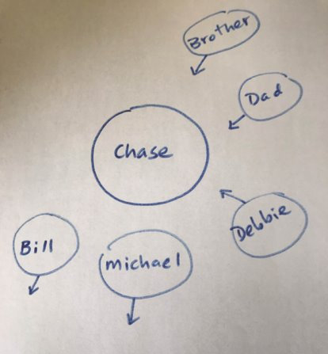
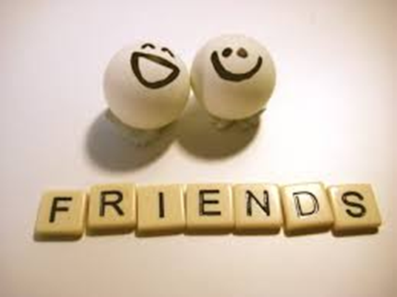
Case Vignette: Chase's Social Universe
Notes:
John

Slide 15
Hopelessness
Build a continuum from the bottom up
    “I’ve tried everything. Nothing works.” Ask: “What’s the worst idea you’ve ever tried? . . . And, the next worse?”
Watch for and move (experimentally) toward HOPE
    Tommie – What’s happening when you’re NOT thinking about suicide?
Notes:
John

Slide 16
Alternatives to Suicide
  Shneidman Story – combatting mental constriction
  Kay from psychotherapy.net
  JSF Story

Slide 17
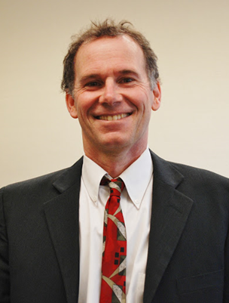
Summary
Theory and research merge to help us co-construct interventions for unique clients
Psychache (Emotional) – Insomnia (physical)
Belongingness – Therapeutic relationship + Social Universe
Hopelessness (Cognitive) – Bottom-up + Alternatives to Suicide

Slide 18
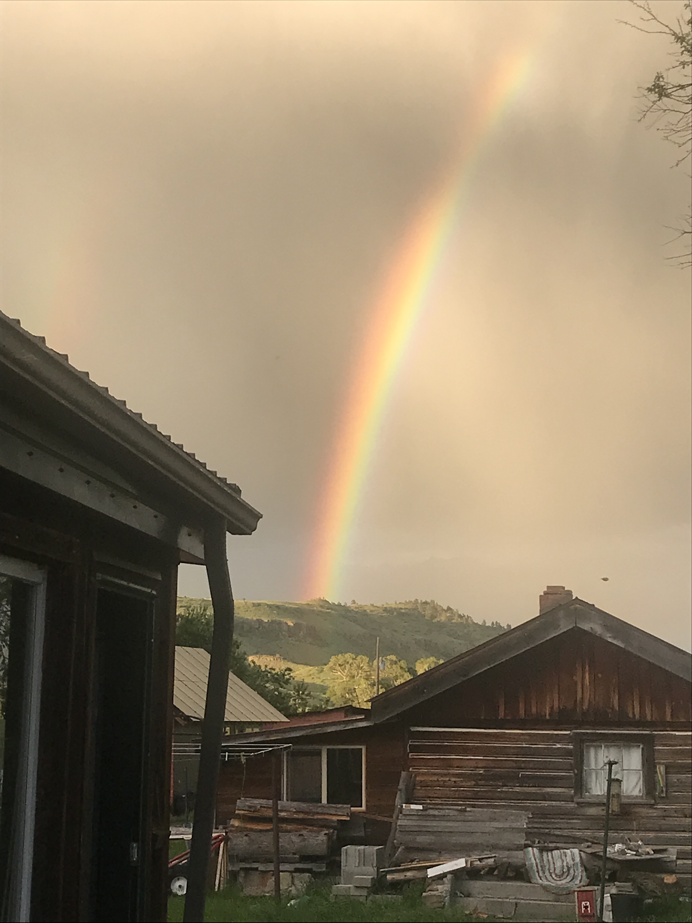
Resources
For free stuff, go to:
https://montanahappinessproject.com/
https://johnsommersflanagan.com/
https://johnsommersflanagan.com/2023/03/05/the-three-step-emotional-change-trick-revisited-again-with-a-side-note-on-plagiarism/
For IRT: http://wichitasac.com/wp-content/uploads/2018/10/Reflections-A-Brief-Guide-to-Imagery-Rehearsal-Therapy-for-Nightmares.pdf

Slide 19
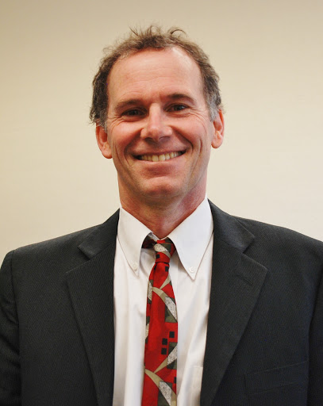
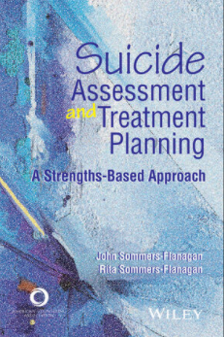



Books by…
John and Rita Sommers-Flanagan

Slide 20

Bonus: Sleep Hygiene
(Not just showering☺)
Routines
Daily exercise
Caffeine curfews
Light and dark and sound and comfort
Beds are for sleeping
Limit naps to less than 30 min [coffee naps]
Avoid certain foods
The temperature decline (Bath or shower)
Screen light exposure and Tech in the bedroom?
You will be awake anyway: Make a plan for dealing with troubling thoughts and dreams [3 Good Things; mindfulness meditation]

