Slide 1

Blending Traditional and Strengths-Based Approaches to Suicide Assessment
Presented on behalf of PacificSource – July 24, 2024
John Sommers-Flanagan, Ph.D.
University of Montana
Department of Counseling
John.sf@mso.umt.edu
Free Resources: https://johnsommersflanagan.com/

Slide 2
Preparation
Welcome and thanks again to Trudy and Janae and YOU!
Emotionally challenging topic: Trigger warning
30+ years ago – 2021 Networker article: https://www.psychotherapynetworker.org/article/myth-infallibility
Please practice proactive and positive coping

Slide 3
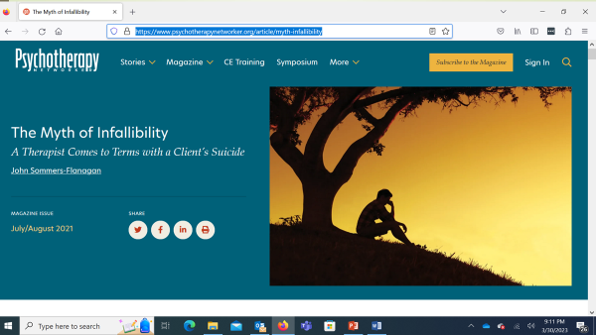
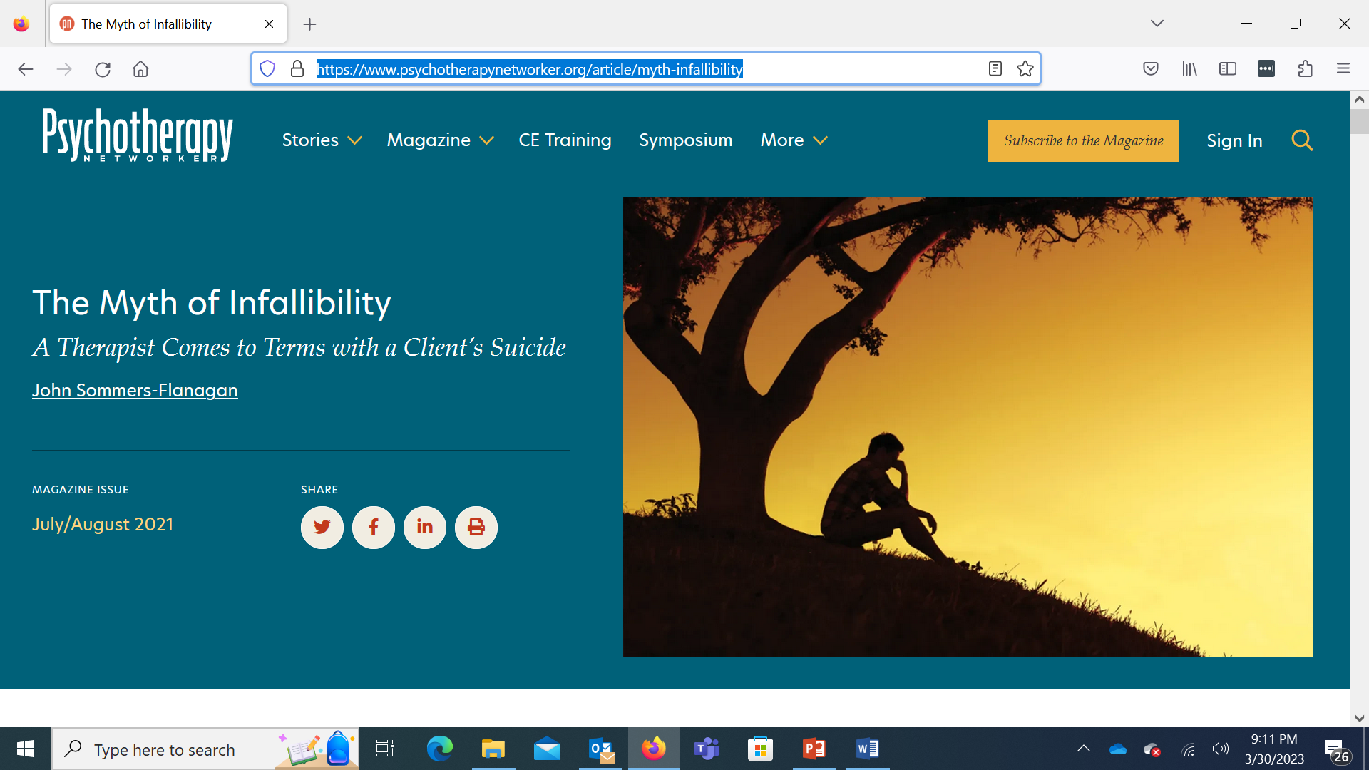

Slide 4
Learning Process
We are distant, but can still be engaged
  I will talk about and demonstrate traditional (briefly) and strengths-based suicide assessment approaches
  As I talk, give examples, and share a video clip, you can imagine yourself slightly modifying how you work with students, clients, or patients who are suicidal
  You post questions and comments as you wish
  I ramble onward☺

Slide 5
Learning Objectives
L.O. - 1: List the core differences between traditional and collaborative approaches to suicide assessment
L.O. - 2: Describe at least one way to blend traditional and collaborative approaches
L.O. - 3: Identify and implement at least three collaborative assessment strategies

Slide 6

Inside the Box
The Traditional Medical Model

Slide 7
Basic Principles – Positivistic Philosophy
Suicidal thoughts and behaviors represent illness; we need to intervene (90% estimate)
We are authority figures who know more about patient health than they do
The patient is a suicidal person
We can predict and prevent suicide
We use research-based risk assessment procedures and questionnaires to categorize risk as mild, moderate, severe, extreme
We treat mental disorders that are linked to death by suicide

Slide 8
Common Standardized Questionnaires
The Patient Health Questionnaire-9 (PHQ-9)
The Columbia Suicide Severity Rating Scale (C-SSRS)
The Ask Suicide-Screening Questions (ASQ)
The diagnostic clinical interview (see JSF – 2024, chapter 10 – Suicide Assessment)

Slide 9
Questionnaire Advantages
Gather information efficiently
Standardization – reliability, validity, and norms
Some patients will be more open with a questionnaire
Liability protection
Prediction accuracy (maybe?)

Slide 10
Example: The PHQ-9
Nine items from the DSM Major Depression diagnostic criteria
  Item #9: “Thoughts that you would be better off dead, or thoughts of hurting yourself in some way?” (David Jobes and the CAMS-care people just put a universal ghostbuster sign on the PHQ-9 as a suicide assessment tool)
  4-point Likert scale: Not at all; several days; more than half the days; nearly every day

Slide 11
The Columbia (C-SSRS)
Two opening questions:
Have you wished you were dead or wished you could go to sleep and not wake up? [Passive suicidality]
Have you actually had any thoughts about killing yourself? [Suicidal ideation]

Slide 12
The Columbia – Next Three Questions
Have you been thinking about how you might do this?
Have you had these thoughts and had some intention of acting on them?
Have you started to work out or worked out the details of how to kill yourself? Did you intend to carry out this plan?

Slide 13
The Columbia – Always Ask
Have you done anything, started to do anything, or prepared to do anything to end your life?
Examples: Took pills, tried to shoot yourself, cut yourself, tried to hang yourself, took out pills but didn’t swallow any, held a gun but changed your mind or it was grabbed from your hand, went to the roof but didn’t jump, collected pills, obtained a gun, gave away valuables, wrote a will or suicide note, etc.
If yes, was this within the past 3 months?

Slide 14
The Columbia – Limits and Problems
The question on the Columbia that has limited predictive value is #6 (the previous attempt/prep question). . .
Problems
False positives – Passive SI, SI, intent, and suicide planning have low predictive value. Previous attempt is likely better, but not good.
False negatives – Suicide is frequently impulsive, coupled, and not pre-meditated.
Machine Learning option – But we still have to interview

Slide 15

Outside the Box
Strengths and Suicide

Slide 16

Strengths-Based
Principles

Slide 17

Strengths-Based Principles – I
Embrace Shneidman’s position: suicidal thoughts and behaviors are neither an illness nor a sin.
De-pathologize:
View suicide disclosures as a natural communication of pain, often from untenable life situations [*Not med model] and unmatched opportunity to offer compassionate help.

Slide 18

Strengths-Based Principles – 2
Recognize the limits of risk/protective factor assessment (because mostly it doesn’t work; 50 year meta-analysis; cutting; cultural variability).
We are transparent (e.g., hosp), build trust and collaborate to develop individualized safety plans (e.g., firearms) and decrease personal distress. [This is our North star]
.

Slide 19
Suicide Rates and Prediction - 2022
U.S. Highest
Wyoming – 33.0/100,000
U.S. Lowest
New Jersey – 7.3/100,000
U.S. Average
U.S. – 14.5/100,000
Montana – 31.8/100,000
UW Husky Stadium
on January 1
22/70,000
Reactions?

Slide 20

Strengths-Based Principles – 3
While focusing on suicide (which is essential), resist the temptation to over-focus on suicide.
The patient is a whole person with unique strengths and resources: Show compassion for suicide pain, but pay attention to and draw out the positives (not naively; the best way is to be with). [7 dimensions next week]

Slide 21

Strengths-Based Principles – 4
Use collaborative and therapeutic assessment:
Start with empathy and compassion, NORMALIZE, and recognize that the problem may not be “in” the person [We acknowledge our legacy of pathologizing diversity]
Balance your questioning: Don’t just go through the PHQ-9. Question #9 is a well-known mish-mash, hugger mugger, blend of passive suicidality and self-harm.

Slide 22

Strengths-Based Principles – 5
Implement specific intervention (management strategies) that target distress and suicidality.
Remember – Interventions can stimulate HOPE [and we’ll focus on interventions and management next week]

Slide 23

Strengths-Based Principles – 6
Despite embracing a strengths-based model. . . remember you may need to be directive, you may need to initiate protective action, and you may need to be the voice of authority and rational decision-making in the room.

Slide 24

Strengths-Based Principles – 7
Recognizing the immense stress we carry in this role, we practice excellent self-care, including evidence-based happiness activities
We support each other
We acknowledge and talk about our own emotional challenges
We use the skills we teach

Slide 25
Medical Model vs. Strengths-Based [Let’s embrace both]
A Positivistic Philosophy
Suicidal thoughts and behaviors represent illness; we need to intervene
We are authority figures who know more about patient health than they do
The patient is a suicidal person
We can predict* and prevent suicide
We use risk assessment procedures and questionnaires
We treat mental disorders
A Social Constructivist Philosophy
Suicidal thoughts and behaviors are a natural communication of pain
We collaborate to develop individualized safety plans
The patient is a whole person
Suicide is mostly unpredictable*
We use collaborative and therapeutic assessment
We treat patient distress and suicidality

Slide 26

Strengths-Based Tools for Suicide Assessment

Slide 27

#1
Assessment Skill/Tool: Normalizing
Ask directly AND normalize the asking
  I’ve read that up to 50% of teenagers have thought about suicide. Is that true for you?
  People who feel down and have been subjected to injustice may think about suicide from time to time. Have you had thoughts about suicide?
  Normalize the asking: “I ask everyone I see.”

Slide 28
#1
Practice:
Use Normalizing Language
It can be difficult to find the right words in the moment. You don’t need to use my words; it’s better to use your words, words that are authentic to you and that fit with your setting.
Think of a patient now, and, for practice, imagine what you would say to convey the normalizing message (Jillian story)

Slide 29

#2
Assessment Skill:
Evaluate Ideation
Ask directly and then evaluate ideation
Disclosure is good news (it’s a sign of trust)!
  Trigger – What usually triggers your SI?
  Frequency – How often?
  Intensity – All you can think? Or background?
  Duration – How long usually?
  Termination – What’s going on when no SI?

Slide 30
Exploring Ideation and Treatment
  Remember Tommie from last week?
    Singing and poetry [self-expression]
  Other examples:
    Sean – “Biking and playing basketball”
    Chase – “Being with someone (or somewhere) who validates who I am”
    Cory – “Doing something meaningful with my niece or for my tribe”
Notes:
Worked with a suicidal client in a counseling setting OR had a friend or family member who struggled with SI

Slide 31
Where Does Evaluating Ideation Lead?
Plan – S-L-A-P the plan
Previous attempts – Listen, reflect, ask “How did you recover and get here?” or “What helped?”
Keep some structure, but let this flow and reassure your patient that your goal is to be helpful and promote safety, not to hospitalize

Slide 32

#3
Assessment Skill:
That One Thing (1/2)
“If we could somehow magically change just one thing in your life that would eliminate your suicidal risk all together, what would that be?” (Jobes, 2016, p. 63)
This question points you and the patient toward a treatment focus
It also may reveal irrational expectations

Slide 33
#3
Assessment Skill:
That One Thing (2/2)
Possible “irrational” responses:
“My mother would be alive”
“I wouldn’t have been sexually abused as a child”
“There would be no more hate”
What are the treatment targets linked to these responses?

Slide 34

#4
Assessment Skill:
Mood Scaling with a Suicide Floor
This is my favorite 5 minute interview strategy
Demo: video
May I ask some questions about your mood?

Slide 35
#4
Practice:
Mood Scaling
Rate your mood, using a zero to 10 scale. Zero is the worst mood possible. Zero means you’re totally depressed and so you’re just going to kill yourself. A 10 is your best possible mood. A 10 would mean you’re as happy as you could be, maybe dancing or singing or doing whatever you do when you’re extremely happy. Using zero to 10, what rating would you give your mood right now?
What’s happening now that makes you give your mood that rating?
What’s the worst or lowest mood rating you’ve ever had? What was happening to make you feel so down?
For you, what would be a normal mood rating on a normal day?
What’s the best mood rating you’ve ever had? What was happening that helped you have such a high mood rating?

Slide 36
Integration – The Minimal
Frame the Questionnaire Process
  I’m going to ask you nine questions from this questionnaire. These are very important questions. I hope you’ll answer them honestly.
  I want to know much more about you than what’s on this questionnaire. When we’re finished with the questionnaire, we can talk about other things important to you.

Slide 37
More Integration
Sample Columbia Questions
Have you been thinking about how you might do this?
Add: What thoughts do you have that make you feel like you don’t want to die? (or how to prevent this suicide from happening)
Have you had these thoughts and had some intention of acting on them?
Add: Have you had thoughts and then decided not to act on them? What made you not act?
Have you started to work out or worked out the details of how to kill yourself? Did you intend to carry out this plan?
Add: Just to be balanced, we should work out a detailed and easy to enact plan to save yourself.

Slide 38
And More Integration
Combine Two Approaches
Example: Use the Columbia (but delete the word “actually”☺)
Add the Mood Scaling with a Suicide Floor to start generating ideas for treatment

Slide 39
For Additional Assessment Info
The comprehensive suicide assessment interview (RIPSCIP) https://johnsommersflanagan.com/2016/02/06/r-i-p-sc-i-p-an-acronym-for-remembering-the-essential-components-of-a-suicide-assessment-interview/
Need a PHQ-9 or C-SSRS alternative ? The ASQ Toolkit.pdf: https://www.nimh.nih.gov/research/research-conducted-at-nimh/asq-toolkit-materials

Slide 40

Assessment Practice
What felt challenging?
Where do you need practice?

Slide 41

In Closing
What do you want to remember?
What can implement soon?
Thanks for being you . . .
Monitor and take care of yourself and your colleagues

Slide 42
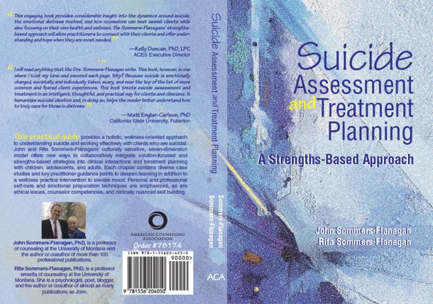
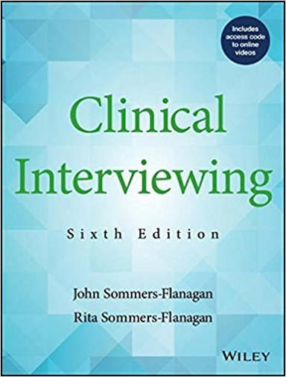
Books

Slide 43
Free Resources
https://montanahappinessproject.com/
https://johnsommersflanagan.com/

