Slide 1

Suicide and Happiness
Using Suicide Theories and
Data to Construct Meaningful Interventions
John Sommers-Flanagan, Ph.D.
Leah Finch, M.A.
Department of Counseling
University of Montana
Notes:
Leah starts; JSF follows

Slide 2

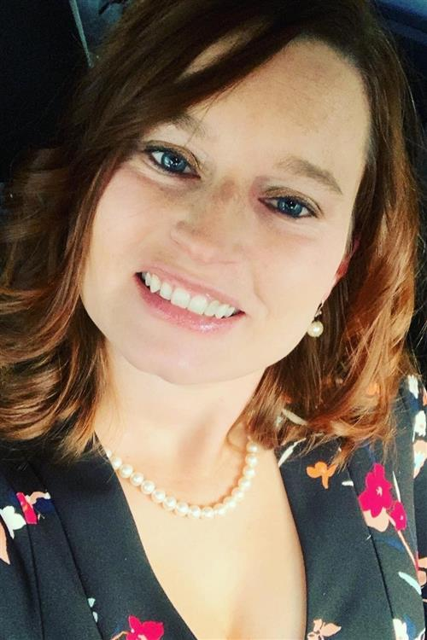
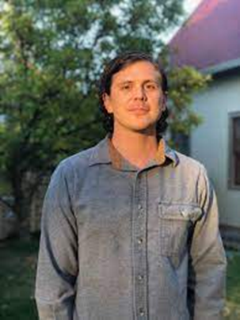



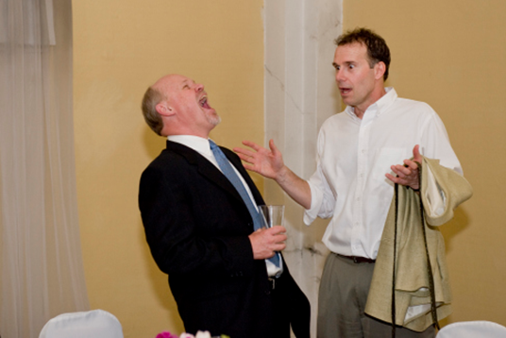

Gratitude
Thanks to Tracy, Katie, and Jen for organizing and for their dedication
Thanks to the Montana Happiness team. For more info, see: https://montanahappinessproject.com/ and https://johnsommersflanagan.com/
Notes:
John

Slide 3

Learning Objectives
Describe methods for connecting with clients and collaboratively identifying their unique suicide drivers
Connect client suicide drivers with established theories of suicide
Develop co-constructed interventions that honor clients’ experiences and move them toward more frequent positive affect and greater meaning and well-being.
Notes:
Leah
(“driver” not “risk factor”)
3. Be alongside, don’t push a strengths-based agenda

Slide 4
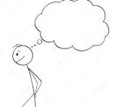
Collaboration
Embrace your Beginner’s Mind
  Let go of preconceptions in the therapeutic
  encounter. Be collaborative. Most people who
  think about suicide are sensitive, intelligent,
  and the best experts on themselves.
Display Transparency
  Regarding your response to SI (listen; address pain; create safety)
Track and respond empathically to Shneidman’s psychache
Notes:
John

Slide 5
Theoretical and Empirical Foundations
Shneidman – Psychache
Joiner – Thwarted belongingness and perceived burdensomeness
Klonsky and May (and Beck) – Hopelessness (including Shneidman’s mental constriction) [the cognitive dimension]
ACT for counselors/therapists and as a therapeutic tool
Notes:
Leah- Joiner & apply cognitive defusion to hopelessness through the cognitive dimension (Klonsky, May, Beck)
Leah to add in experiential avoidance of SI and hopelessness. ACT is not a suicide theory but we’re going to use it as a theory to talk about how counselor’s can use it to help with some of their own issues/avoidance around suicide as well as some practical
ACT is a recovery-oriented, psychosocial, evidence-based approach for treatment of individuals experiencing unwanted thoughts and feelings. • The heart of Acceptance and Commitment Therapy is captured in its acronym, “ACT”- to accept what is out of your control, connect with your values, and take actions that are consistent with what you want your life to stand for. • ACT teaches psychological skills to step out of the struggle with painful thoughts, emotions, and sensations, but unlike other therapies, ACT is not about correcting or getting rid of unwanted thoughts, emotions, and sensations. ACT directly targets functional recovery by assisting patients in identifying and engaging in valueconsistent behaviors despite the potential for distress.

Slide 6


Psychache - Strategies
ACT acceptance and willingness
Explore unique distress “trigger?” – Jobes’s “That one thing question” helps tailor your treatment to clients’ suicide driver(s)
Use individualized insomnia interventions: Three Good Things, Imagery Rehearsal Therapy, CBT-I [Sleep hygiene]
Notes:
John

Slide 7
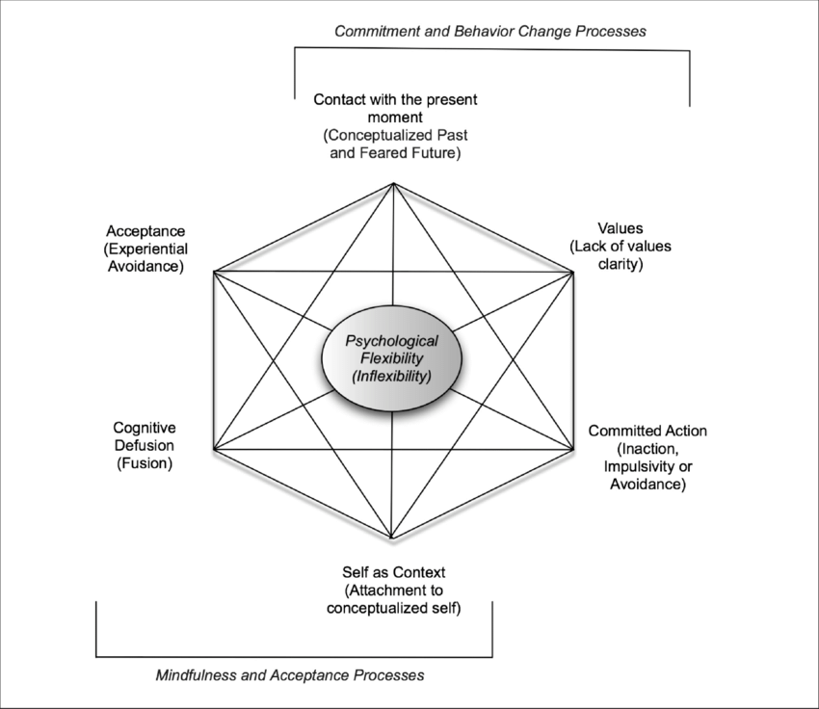
ACT
Suicide ideation as experiential avoidance (and/or extreme attempt at control)
  Unwanted internal experiences: hopelessness, burdensomeness
ACT in suicide treatment
Research supports the theoretical applicability of ACT to suicide prevention based on associations between ACT processes and suicide-related outcomes
  Experiential Avoidance: DeBeer et al., 2017; Zvolensky et al., 2016
  Mindfulness: Chesin & Jeglic, 2016
  Values and Committed Action: Bahraini et al., 2013; Monteith et al., 2015
Notes:
The function of suicide is to control unwanted emotions, thoughts, and/or physical sensations (i.e., internal experience).
• Suicidal ideation and behaviors can result in both the cessation of unwanted experiences (e.g., agitation) and/or the start of wanted experiences (e.g., sense of control)
• Suicide can be negatively and/or positively reinforcing and is often maintained through multiple pathways. Suicide results from persistent and escalating attempts to succeed at an unworkable agenda of internal control.
• destigmatize suicidal ideation and urges by highlighting them as an extreme part of the control agenda
• Normalize attempts to control unwanted experiences while also helping the Veteran discover the limited efficacy and high cost of attempts to control unwanted internal experiences
• promote mindfulness of experiences driving suicidal behaviors and increase capacity to respond flexibly in their presence
• directly target functional recovery by assisting patients in identifying and engaging in value-consistent behaviors despite associated aversive thoughts, emotions, or sensations

Slide 8

Psychache:
That One Thing (1/2)
“If we could somehow magically change just one thing in your life that would eliminate your suicidal risk all together, what would that be?” (Jobes, 2016, p. 63)
This question points you and the client toward a treatment focus
It also may reveal irrational expectations
Notes:
John

Slide 9
Psychache:
That One Thing (2/2)
Possible “irrational” responses:
“My mother would be alive”
“I wouldn’t have been sexually abused as a child”
“There would be no more hate”
What are the treatment targets linked to these responses?
Notes:
John

Slide 10

Psychache: Three Good Things
Survey
Rumination about the past and future is all-natural, but not helpful
Notes:
John

Slide 11

Psychache: Insomnia and
Three Good Things
Seligman’s signature technique
  Before you go to sleep (or right now)
  Write down (or think about) three good things that happened during the day (or last 24 hours)
  Then track down in your mind “Why” those things happened
  Seligman: After a week, you’ll want to keep doing it (JSF: Maybe)
Notes:
John

Slide 12



Happiness is an Activating Word
We do not do toxic positivity
Notes:
John

Slide 13
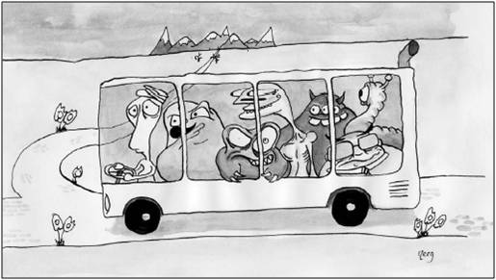
Accepting your client’s suicidal thoughts
Notes:
Leah going meta
Process of hearing what clients think of this is more important than the outcome here – exposes their spoiling/negative cognitions. If the clinician can accept that they can help the client move past it.
Leah to talk about parallel process: Counselor using mindfulness/ACT. Parallel process – attend to the negative cognitions AND YET it might be useful for you to experiment this as being in line with values of well-being/living

Slide 14

Belongingness and Burdensomeness
In a friendly, normalizing, non-pathologizing way, be like Adler and Rogers and track, reflect, acknowledge distress with empathic responding . . . AND
Remember thwarted belongingness is about dynamics like: (a) anticipated rejection, (b) fear of abandonment, (c) activated deep cognitive schema around being unlovable, defective, shame, etc., (d) forgiveness of self/others
Interpersonal patterns REPEAT [repetition compulsion]
Notes:
Leah
Mostly focus on thwarted belonginess and not so much on perceived burdensomeness (maps well onto adler’s theory of people need to feel useful through work and relationship)
What leads to thwarted belonginess? (ie: poor social skills, people feeling rejected and attributing to themselves because they were not good at vulnerability or listening to other people)
Social anxiety – fearing the scrutiny from others. OK – well what is about the scrutiny of others that you fear?

Slide 15
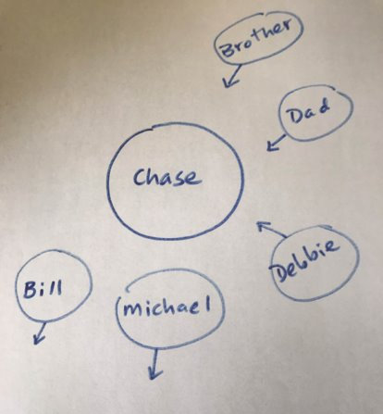

Case Vignette: Chase's Social Universe
Notes:
John

Slide 16
Hopelessness
Build a continuum from the bottom up
    What’s the worst idea you’ve ever tried?
Watch for and move toward HOPE
    Tommie – What’s happening when you’re NOT thinking about suicide?
Notes:
John

Slide 17
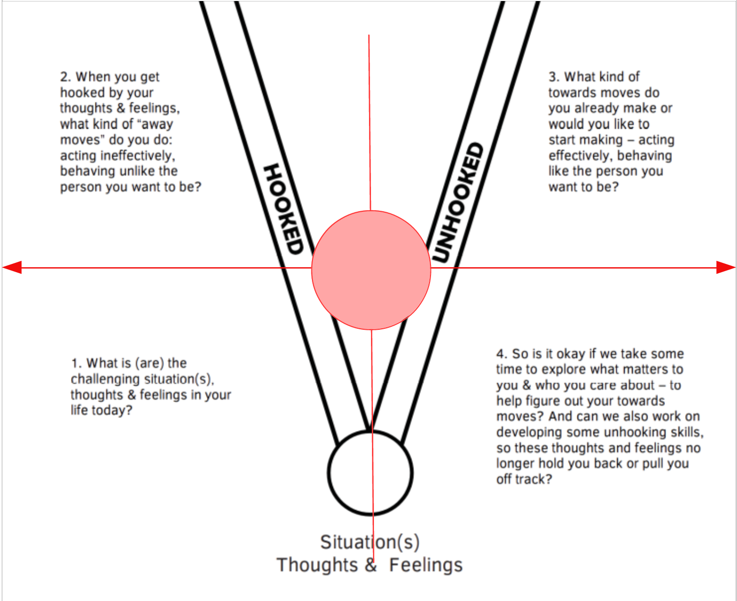
Reorient toward values/purpose
“He who has a why to live can bear almost any how” - Friedrich Nietzsche
Notes:
Leah

Slide 18
Alternatives to Suicide
  Shneidman Story – combatting mental constriction
  Kay Clips from psychotherapy.net
  JSF Story

Slide 19
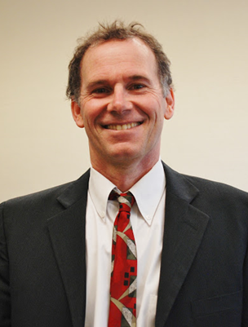
Summary
Theory and research merge to help us co-construct interventions for unique clients
Psychache – Insomnia + 3-step ECT
Belongingness – Therapeutic relationship + Social Universe
Hopelessness – Bottom-up + Alternatives to Suicide

Slide 20
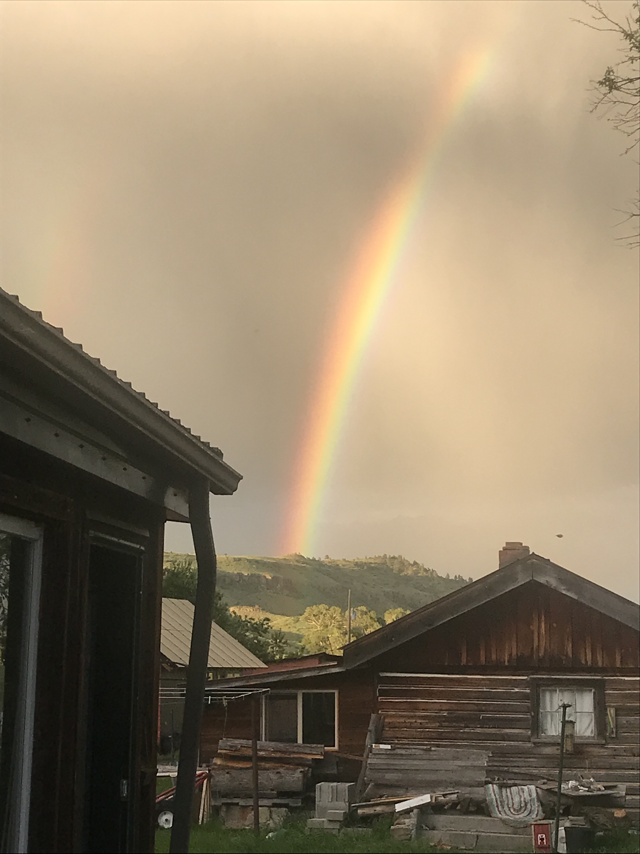
Resources
For free stuff, go to:
https://montanahappinessproject.com/
https://johnsommersflanagan.com/
https://johnsommersflanagan.com/2023/03/05/the-three-step-emotional-change-trick-revisited-again-with-a-side-note-on-plagiarism/

Slide 21
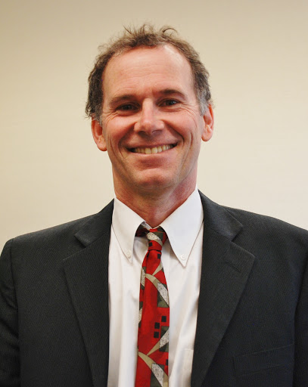
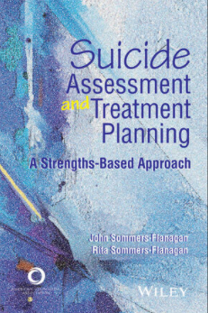


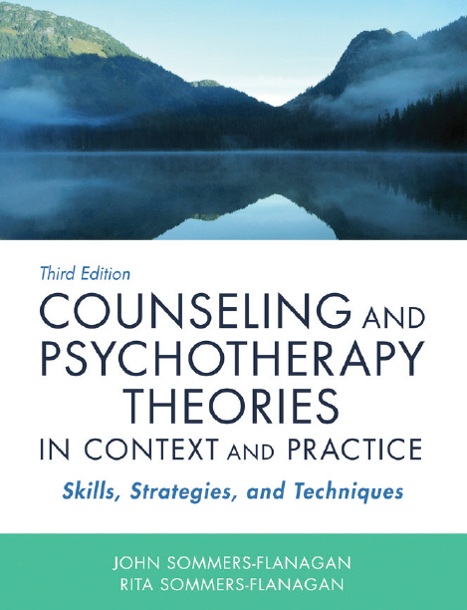
Books by…
John and Rita Sommers-Flanagan

Slide 22

Bonus: Sleep Hygiene
(Not just showering☺)
Routines
Daily exercise
Caffeine curfews
Light and dark and sound and comfort
Beds are for sleeping
Limit naps to less than 30 min [coffee naps]
Avoid certain foods
The temperature decline (Bath or shower)
Screen light exposure and Tech in the bedroom?
You will be awake anyway: Make a plan for dealing with troubling thoughts and dreams [3 Good Things; mindfulness meditation]

