Slide 1

Strengths-Based Approaches to Managing Patient Suicidality
Presented on behalf of PacificSource – July 31, 2024
John Sommers-Flanagan, Ph.D.
University of Montana
Department of Counseling
John.sf@mso.umt.edu
Free Resources: https://johnsommersflanagan.com/

Slide 2

Last Time: Assessment
This time – Interventions
Caveat: Good assessment should be therapeutic

Slide 3
Gratitude and Introductions
Welcome and thanks again to Trudy and Janae and YOU!
Part 3 of a three-part presentation on caring for people who are suicidal
Today, a very activating video clip, so please practice positive coping

Slide 4

Part 3
Suicide Intervention and Management Strategies
Warning: Some slides are “too much”

Slide 5
Seven Organizing Life Dimensions
Emotional [Core: Excruciating distress]
Cognitive or Mental [Mental constriction, “nothing helps”]
Interpersonal [Social disconnection or perceived burden]
Physical/Biomedical [Agitated, impulsive, ill, and drugs]
Spiritual/Cultural [Meaninglessness or disconnection]
Behavioral [Suicide plan/intent, lethal means, desensitization]
Contextual [Sociological, political, oppression, and environmental stressors]

Slide 6
Emotional Dimension
Main Treatment Planning Targets:
  Excruciating Distress [Psychache]
  Affect dysregulation
  Acute or chronic shame, guilt, sadness, or anger (for oppressed individuals and groups, we can conceptualize this as internalized oppression and re-externalize it)

Slide 7
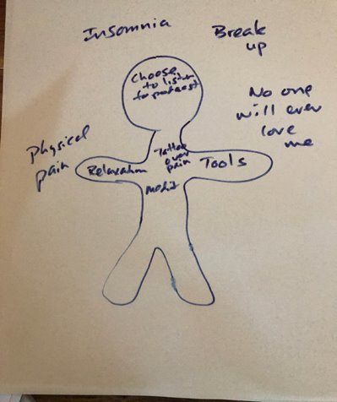
Emotional: Separate Pain From Self
Label problems and PAIN outside self.
Put strengths, strategies, and skills inside self

Slide 8
Emotional: Dysregulation and Regulation
DBT (Linehan): Mindfulness+
Distress tolerance: Just Breathe
Three-step emotional change trick: https://wordpress.com/post/johnsommersflanagan.com/2101

Slide 9
Cognitive Dimension
Main Treatment Planning Targets:
  Problem-Solving Impairment
  Hopelessness
  Negative Core Beliefs

Slide 10
Interpersonal [Social]
Main Treatment Planning Targets:
  Unwanted Social Disconnection*
  Social Skill Deficits
  Social Burden

Slide 11
Physical Dimension
Main Treatment Planning Targets:
    Arousal-Agitation
    Trauma, insomnia, nightmares
    Physical symptoms of depression

Slide 12
Kobe and Trauma and Culture
1:48:01 – 1:54:48
Kobe is a 28-year-old member of the Lakota-Sioux tribe and Iraqi war veteran

Slide 13
Kobe Debrief – Chat Time
What do we know about Cory in the emotional, cognitive, interpersonal, and other dimensions?
How can we work with Cory on emotions?
What will goal-setting look like with Cory?
What are your thoughts on his risk level?

Slide 14
Case Formulation and Planning - Cory
Problems or Chief Distress
Interventions [to Move Toward Goals]
Collaborative Goals
Cognitive: Stay focused on collectivist goals
Emotional: Increase positive affect; engage in trauma work*; practice culturally accepted shame/anger expression
Interpersonal: Increase meaningful local and tribal community interactions
Cultural/Spiritual : Re-establish sense of social/community identity
Behavioral: Enact safety plan as needed
PTSD and Alcohol Abuse: War trauma; intergenerational trauma; alcohol use for numbing
Emotional: Shame, anger, nightmares
Cognitive: Mental constriction
Interpersonal: Social disengagement
Cultural/Spiritual: Tribal disconnection
Behavioral: Destructive impulses [no intent + reasons for living]
Cognitive: Collectivist goal-setting [in-session]
Emotional: Reframe talking about emotions as a strength he can share [this will take time]; use IRT
  Interpersonal: Weekly contact with niece via telephone. Build community at UM
  Cultural/Spiritual: Brainstorm and enact tribal connections
  Behavioral: Addictions counseling; collaborative safety plan

Slide 15
Cultural and Spiritual
Main Treatment Planning Targets:
  Cultural/Spiritual Disconnection
  Meaninglessness
  Shame (Emotional)

Slide 16
Behavioral
Main Treatment Planning Targets:
  Suicide Desensitization
  Lethal Means
  Suicide Intent and Planning

Slide 17
Safety Planning
Follow the Stanley and Brown SPI protocol – or whatever your agency is using​
When you safety plan, be explicitly collaborative and compassionate​
To read a safety planning example with a 21-year-old: https://johnsommersflanagan.com/2021/03/30/how-to-do-suicide-safety-planning-a-case-example/

Slide 18
Safety Planning (with Kennedy)
How Can I Make My Environment Safe?**
My Unique Warning Signs
My internal Coping Strategies
People and Settings that Provide Support and Distraction
Who Can I Ask for Help?
Professionals or Agencies I Can Contact for Support
How I Can Make My Environment Even Safer?

Slide 19
Contextual Dimension
Main Treatment Planning Targets:
Poverty (April 2020 example; resources)
Neighborhood violence (safety)
Racism—perceived systemic oppression (affirmation/acceptance)
Also: urban, rural, school, government, society, culture, situational triggers, toxic environments, unemployment, MH resources, bootstrap

Slide 20
Re-Externalizing the External
At age 82, in an interview with the Los Angeles Times (Stein, 1986), B. F. Skinner said:
“I have to tell people that they are not responsible for their behavior. They’re not creating it; they’re not initiating anything. It’s all found somewhere else.”

Slide 21
Social Justice and Therapeutic Tools
Empathic Commiseration and affirmation
Use externalization: Put the pattern and problem outside the patients and team with them to address the distress (Skinner; narrative treatments)
Discernment and Goal-Setting
Opportunity Ameliorates (clinician advocacy for opportunity)
Building hope from the bottom up

Slide 22

In Closing: Q & R
What do you want to remember?
What can you implement soon?
Thanks for being you . . .
Monitor and take care of yourself and your colleagues

Slide 23
Free Resources
https://montanahappinessproject.com/
https://johnsommersflanagan.com/

Slide 24


Books

Slide 25
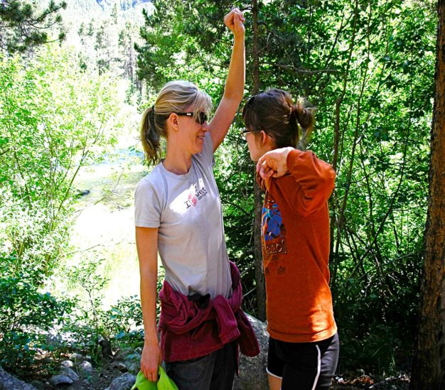
Check up and Check-in

