Slide 1

Happiness and You
Methods for Managing Your Moods
John Sommers-Flanagan, Ph.D.
with Alli Bristow, M.A.
and Hannah Lewis, B.S.

Slide 2
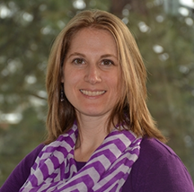
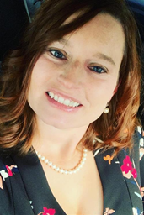
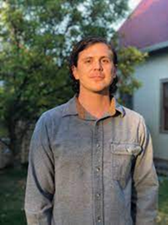



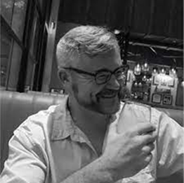
Gratitude
Thanks to Beth, Stacia, Kelsea, and all the Camp staff and supporters and YOU
Thanks to the Montana Happiness team. For more info, see: https://montanahappinessproject.com/

Slide 3
Ground Rules
Talk and listen with respect
Be open to learning
Participate as you can

Slide 4

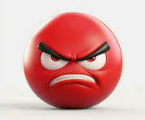
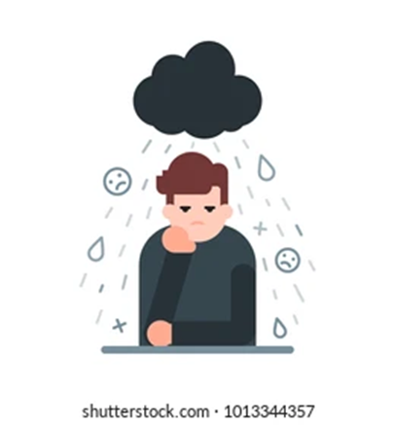

Bad Moods
Has anyone here
ever been in a bad mood?

Slide 5
Bad Moods – 2
Anyone here
ever had someone tell you to
“Cheer Up?!”
Or
“Smile!”

Slide 6
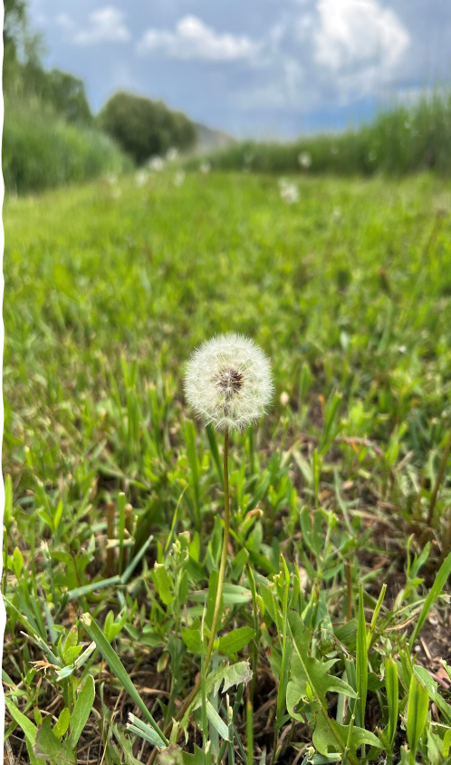
Bad Moods – 3
The Truth is:
You get to be the
THE CAPTAIN
of your own emotional ship

Slide 7
The Three-Step Emotional
Change Trick
Step One
Honor YOUR Emotion
Notes:
We may or may not do this-John

Slide 8
The Three-Step Emotional
Change Trick
Step Two
Think a New Thought
or
Do Something Different
Notes:
We may or may not do this-John

Slide 9
The Three-Step Emotional
Change Trick
Step Three
Share the Good Mood
Notes:
We may or may not do this-John

Slide 10
The Three-Step Emotional
Change Trick
Step Four
Teach Someone the 3 Steps
Notes:
We may or may not do this-John

Slide 11

How
Our
Brains Work:
Two Wolves

Slide 12
It Can Take Us Down Unhelpful Paths

Slide 13

One Volunteer
Please
Notes:
John

Slide 14

















Slide 15
Defining Happiness
True confessions: We’re not talking about smiley happiness . . .
We can’t control that very well
Notes:
John

Slide 16
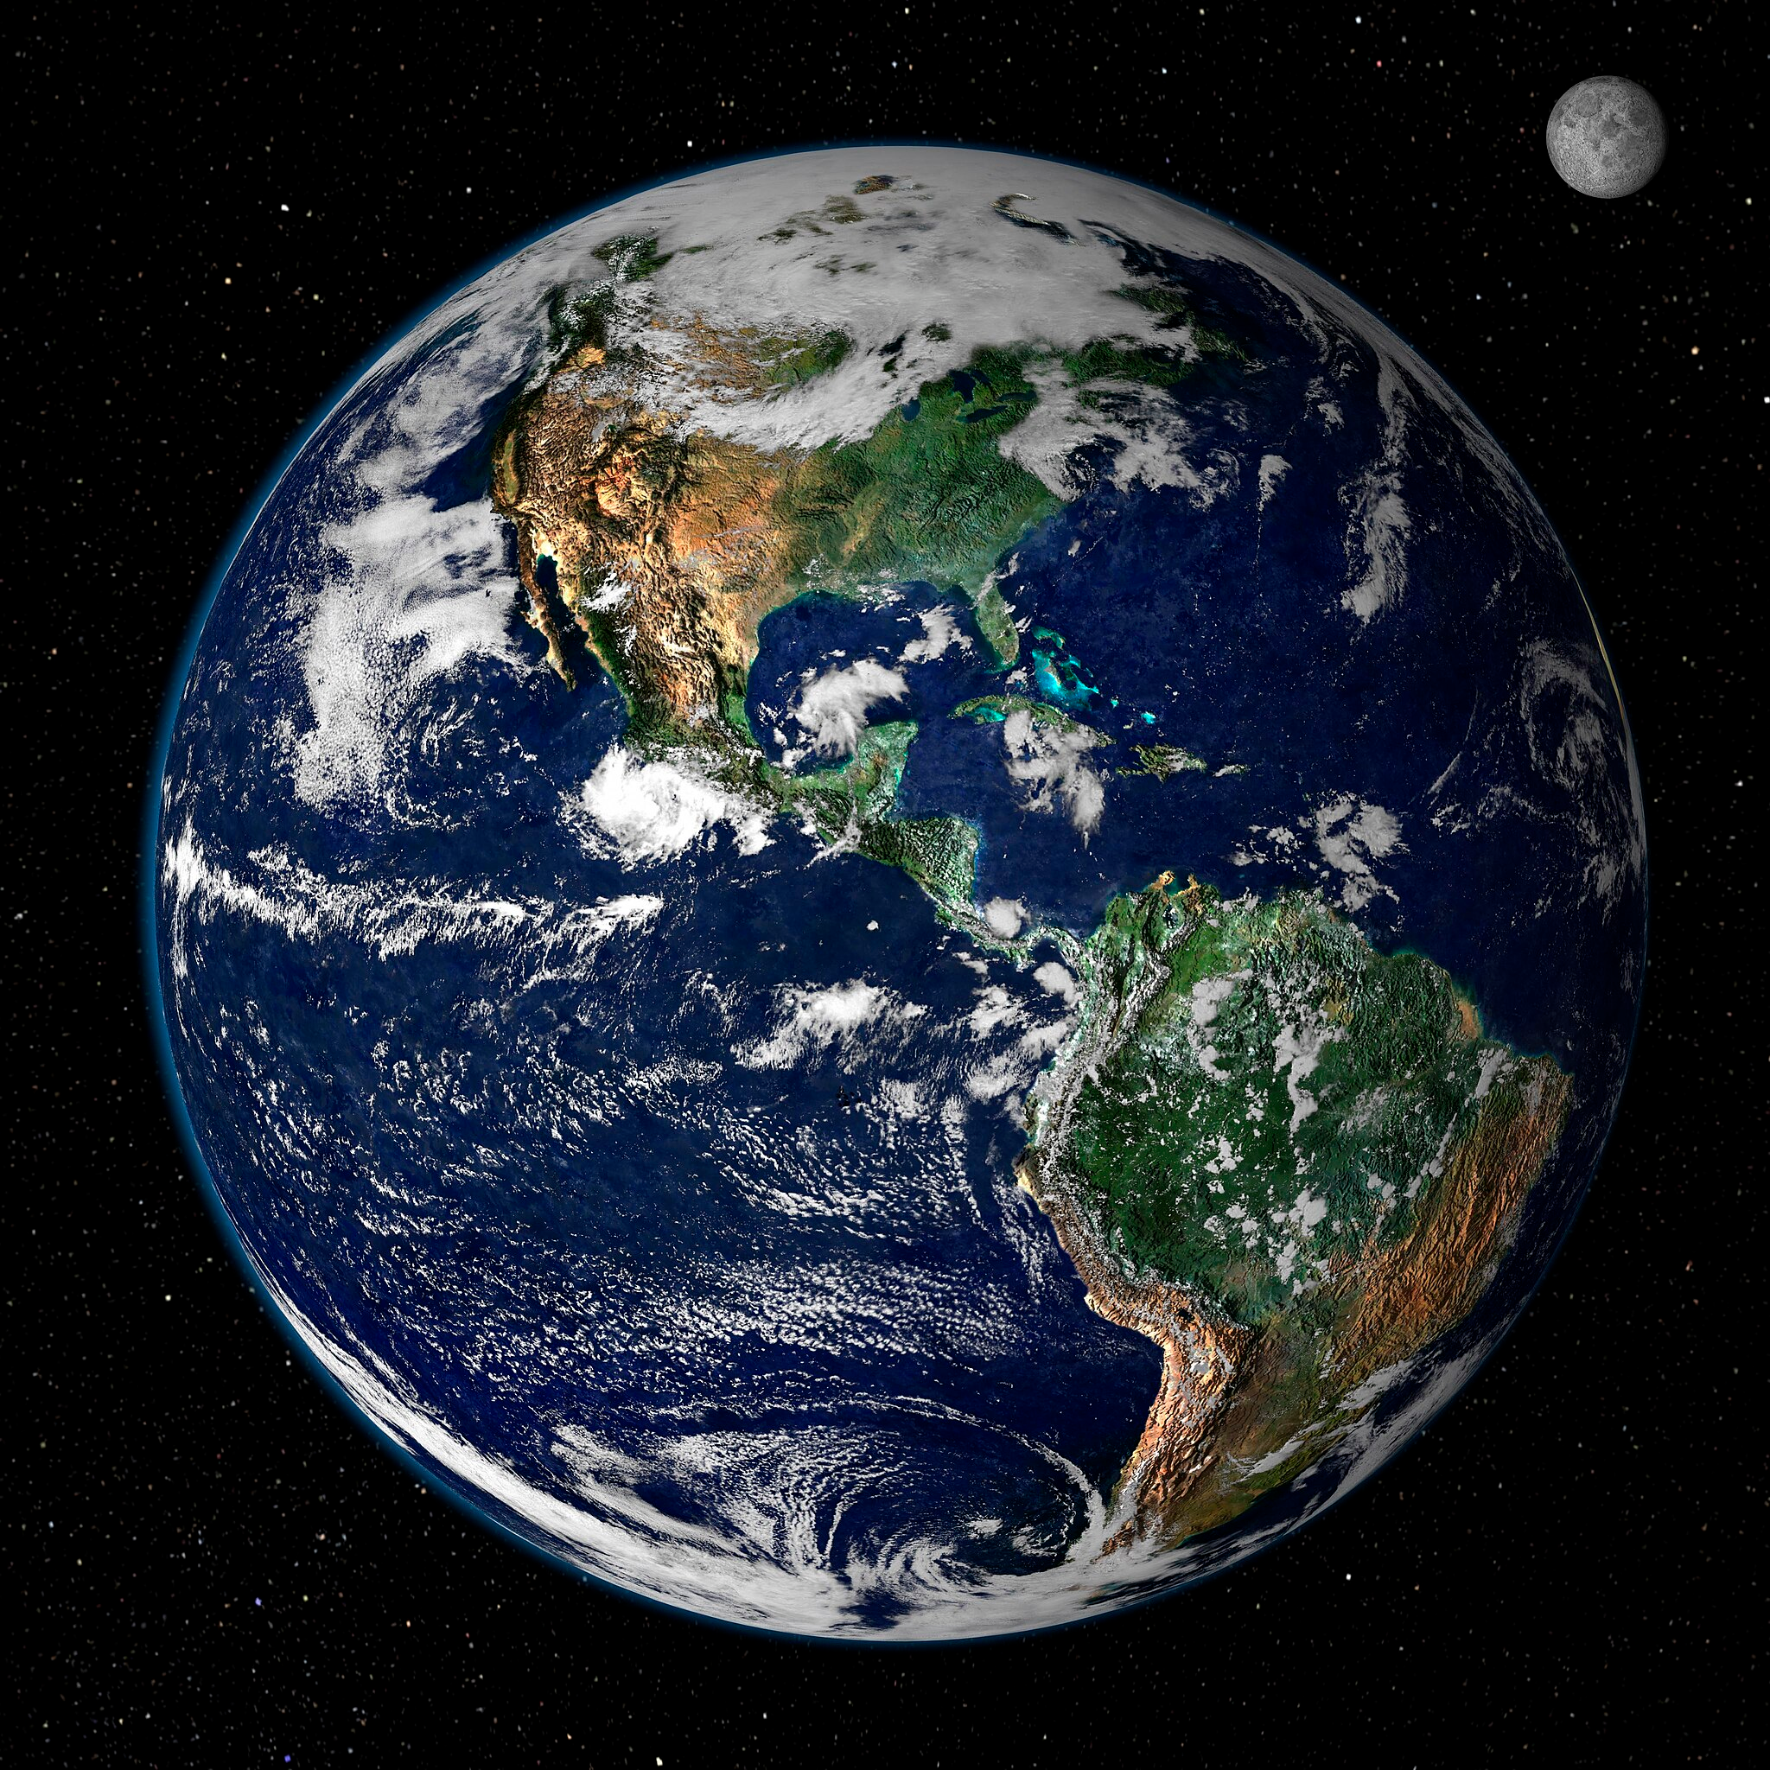

The Best Definition?
That place where the flowering of your greatest (and unique) virtues, gifts, skills, and talents intersect (over time) with the needs of the world [aka community].
Notes:
Lillian

Slide 17

The Best Definition and YOU?
How do you match your gifts with the needs of your friends, family, mentors, and the world?
JSF – Biking story
Notes:
John

Slide 18

What’s Good About
YOU?
In pairs
Ask the same question FIVE times
One rule: You can’t use the same answer twice
Another rule: Do the best you can
This can feel awkward: because our brains naturally take us down negative tracks, we need to work at building the positivity muscle in our brains

Slide 19

Bonus: Positive Distractions
We all experience unhappiness and wonder about ourselves
Emotions are a pain☹; life is stressful
Sometimes, we need distractions
What songs help you feel your feelings or boost your mood? [JSF]
What places? What cat videos? What . . . ?

Slide 20
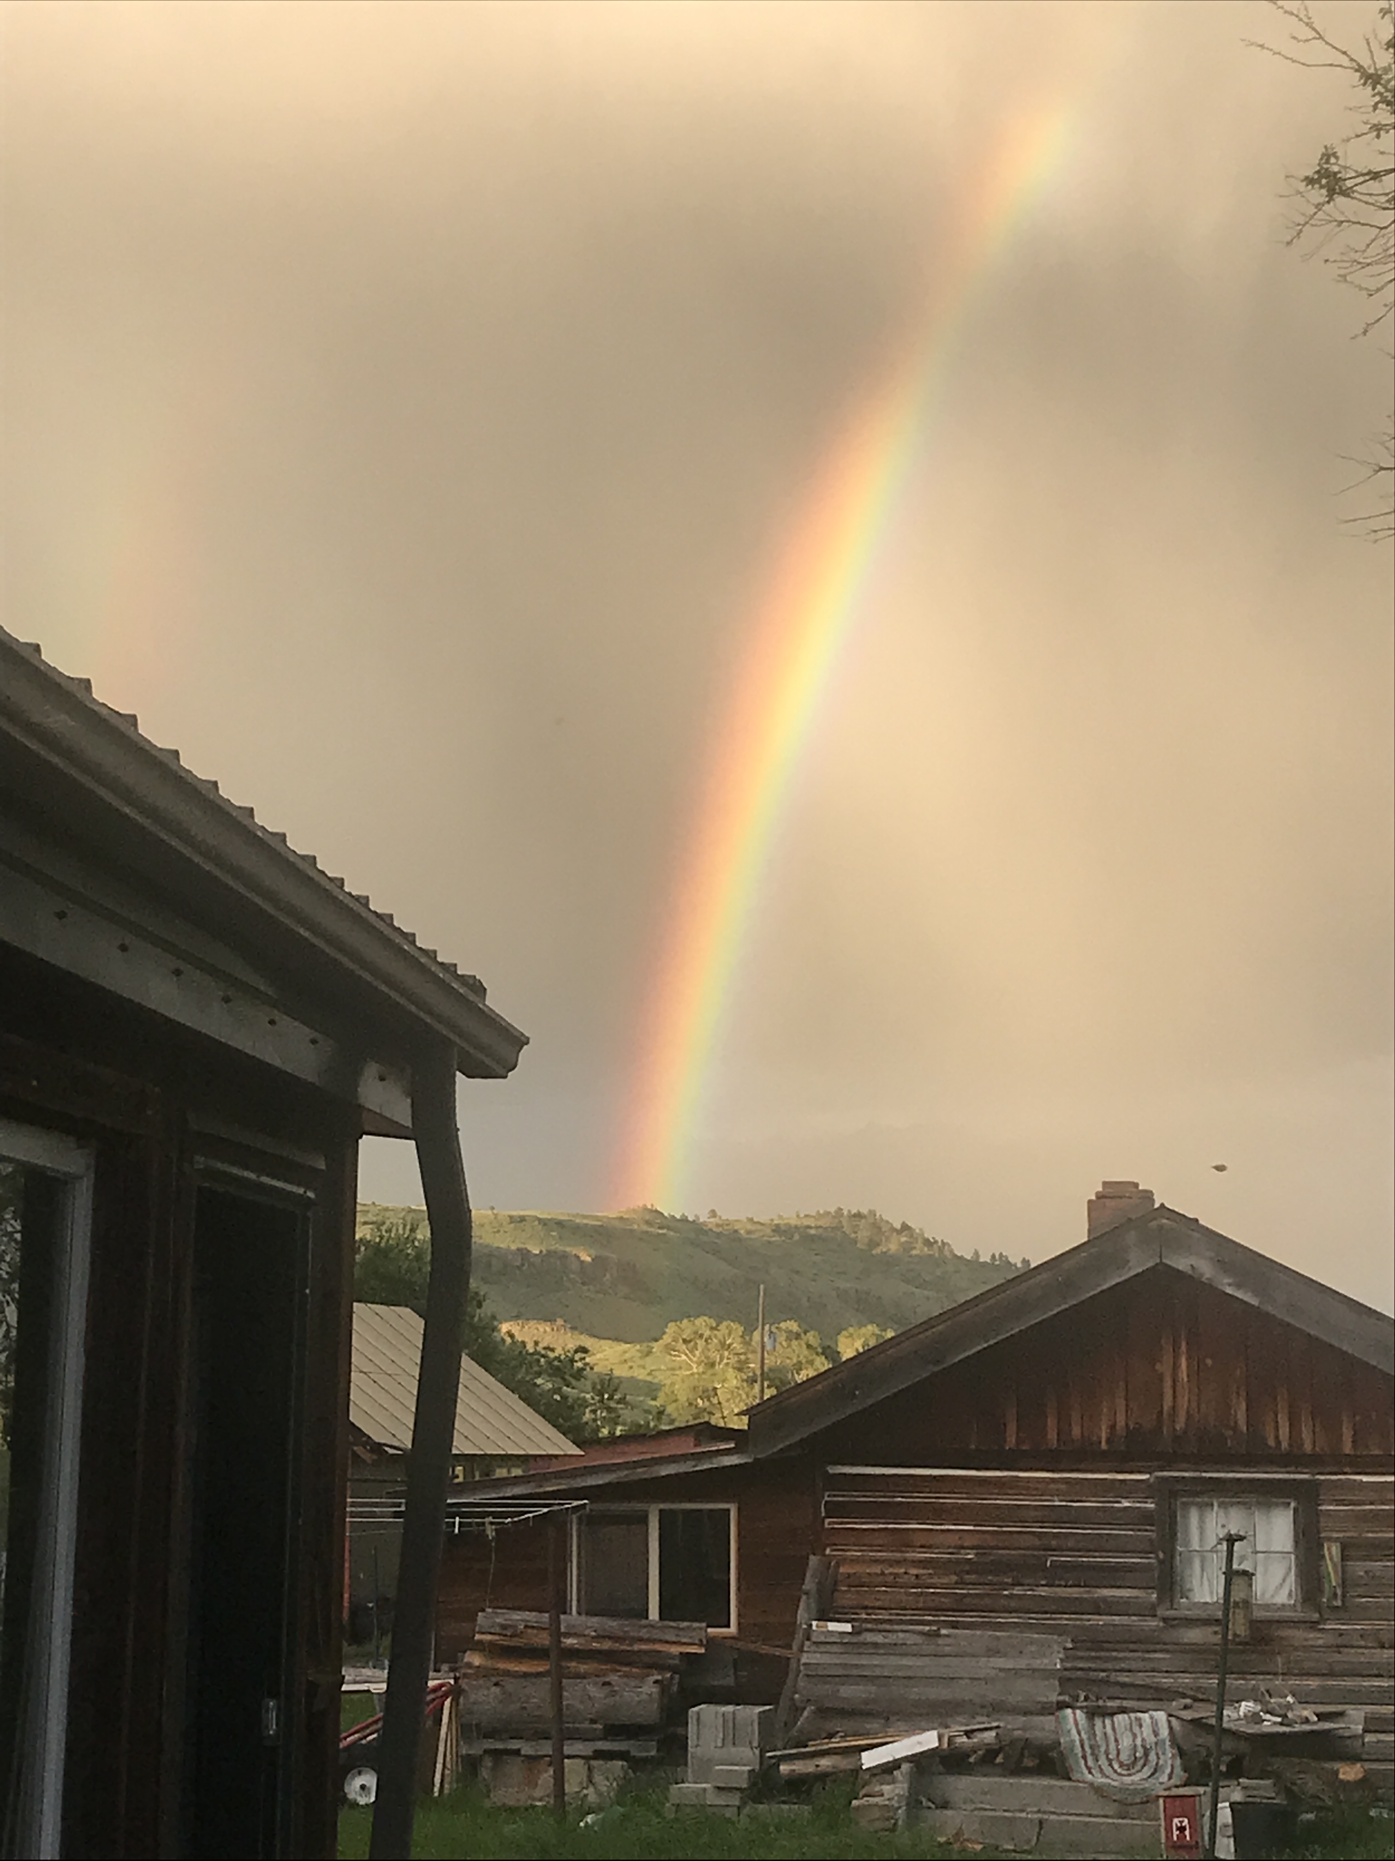

Summary
Three-step emotional change trick
Our brains naturally focus on the negative. We need to build our positive brain muscles
What’s Good About You?
Positive distractions
Three Good Things
For more, go to:
https://johnsommersflanagan.com/

Slide 21

Additional Information . . .
If time permits
Notes:
John

Slide 22

Bonus #2: Three Good Things
Survey
Rumination is all-natural, but not helpful
Notes:
John

Slide 23

Three Good Things
  Before you go to sleep
  Write down (or think about) three good things that happened recently
  Then track down in your mind “Why” those things happened
  Volunteer?

Slide 24
Why Does Three
Good Things Work?
When you go to bed, you NATURALLY begin a negative (depressive) review or anticipatory (anxiety) preview
Thinking three good things shifts you partway
Identifying “Why” those things happened activates a positive brain search

Slide 25

Why do We Need 3 Good Things?
This seems to be the way most of our brains are built
Notes:
John

