Slide 1
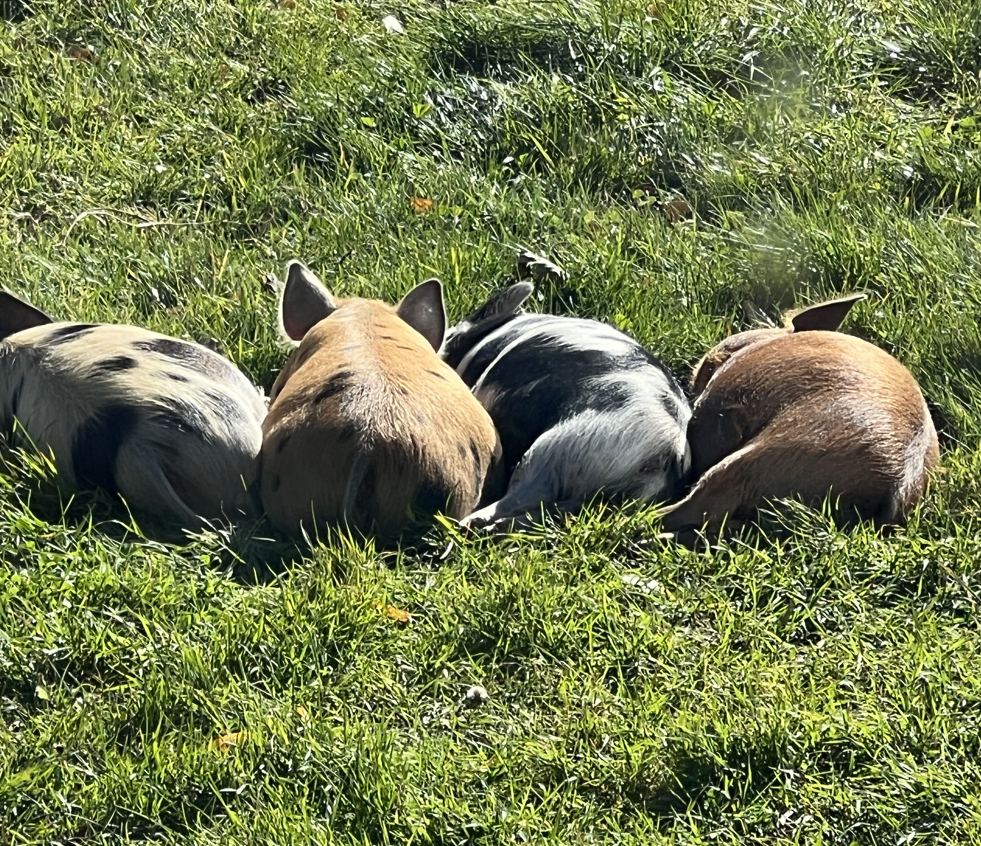
Group Counseling Day 2
COUN 520
with John S-F

Slide 2

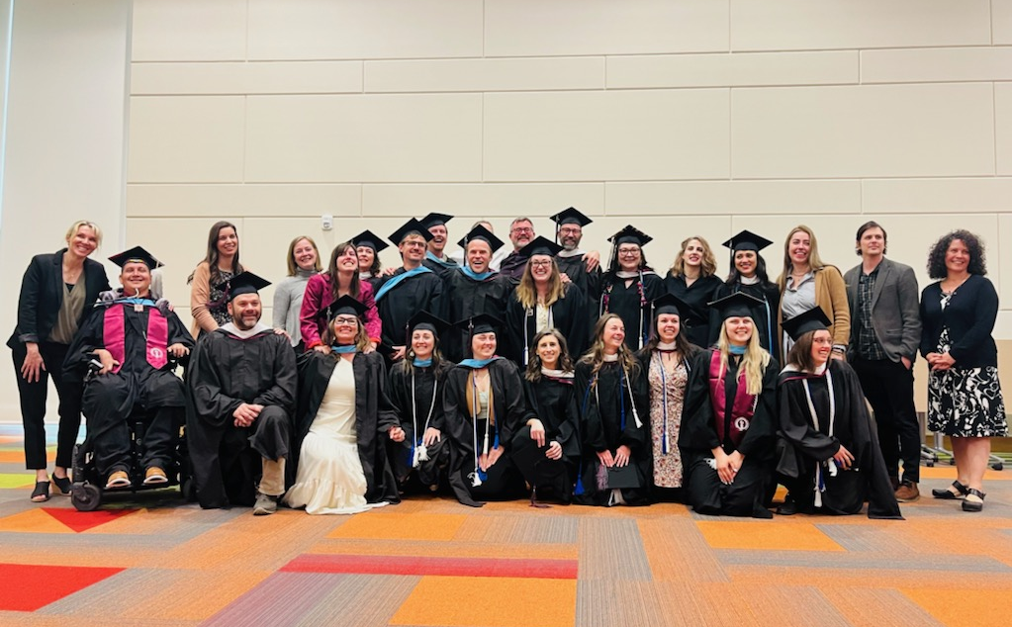
Agenda
[Group is Still Open]
Memories and leftovers from last week
sign-ups and Questions
Takeaway review and apologies
Maroon Group Fishbowl
Therapeutic factors
What’s a good discussion group?
Silver Group Fishbowl
group stages

Slide 3

Standard second session Questions
What do you recall from last week?
What felt important to you?
What did you learn and want to remember?

Slide 4
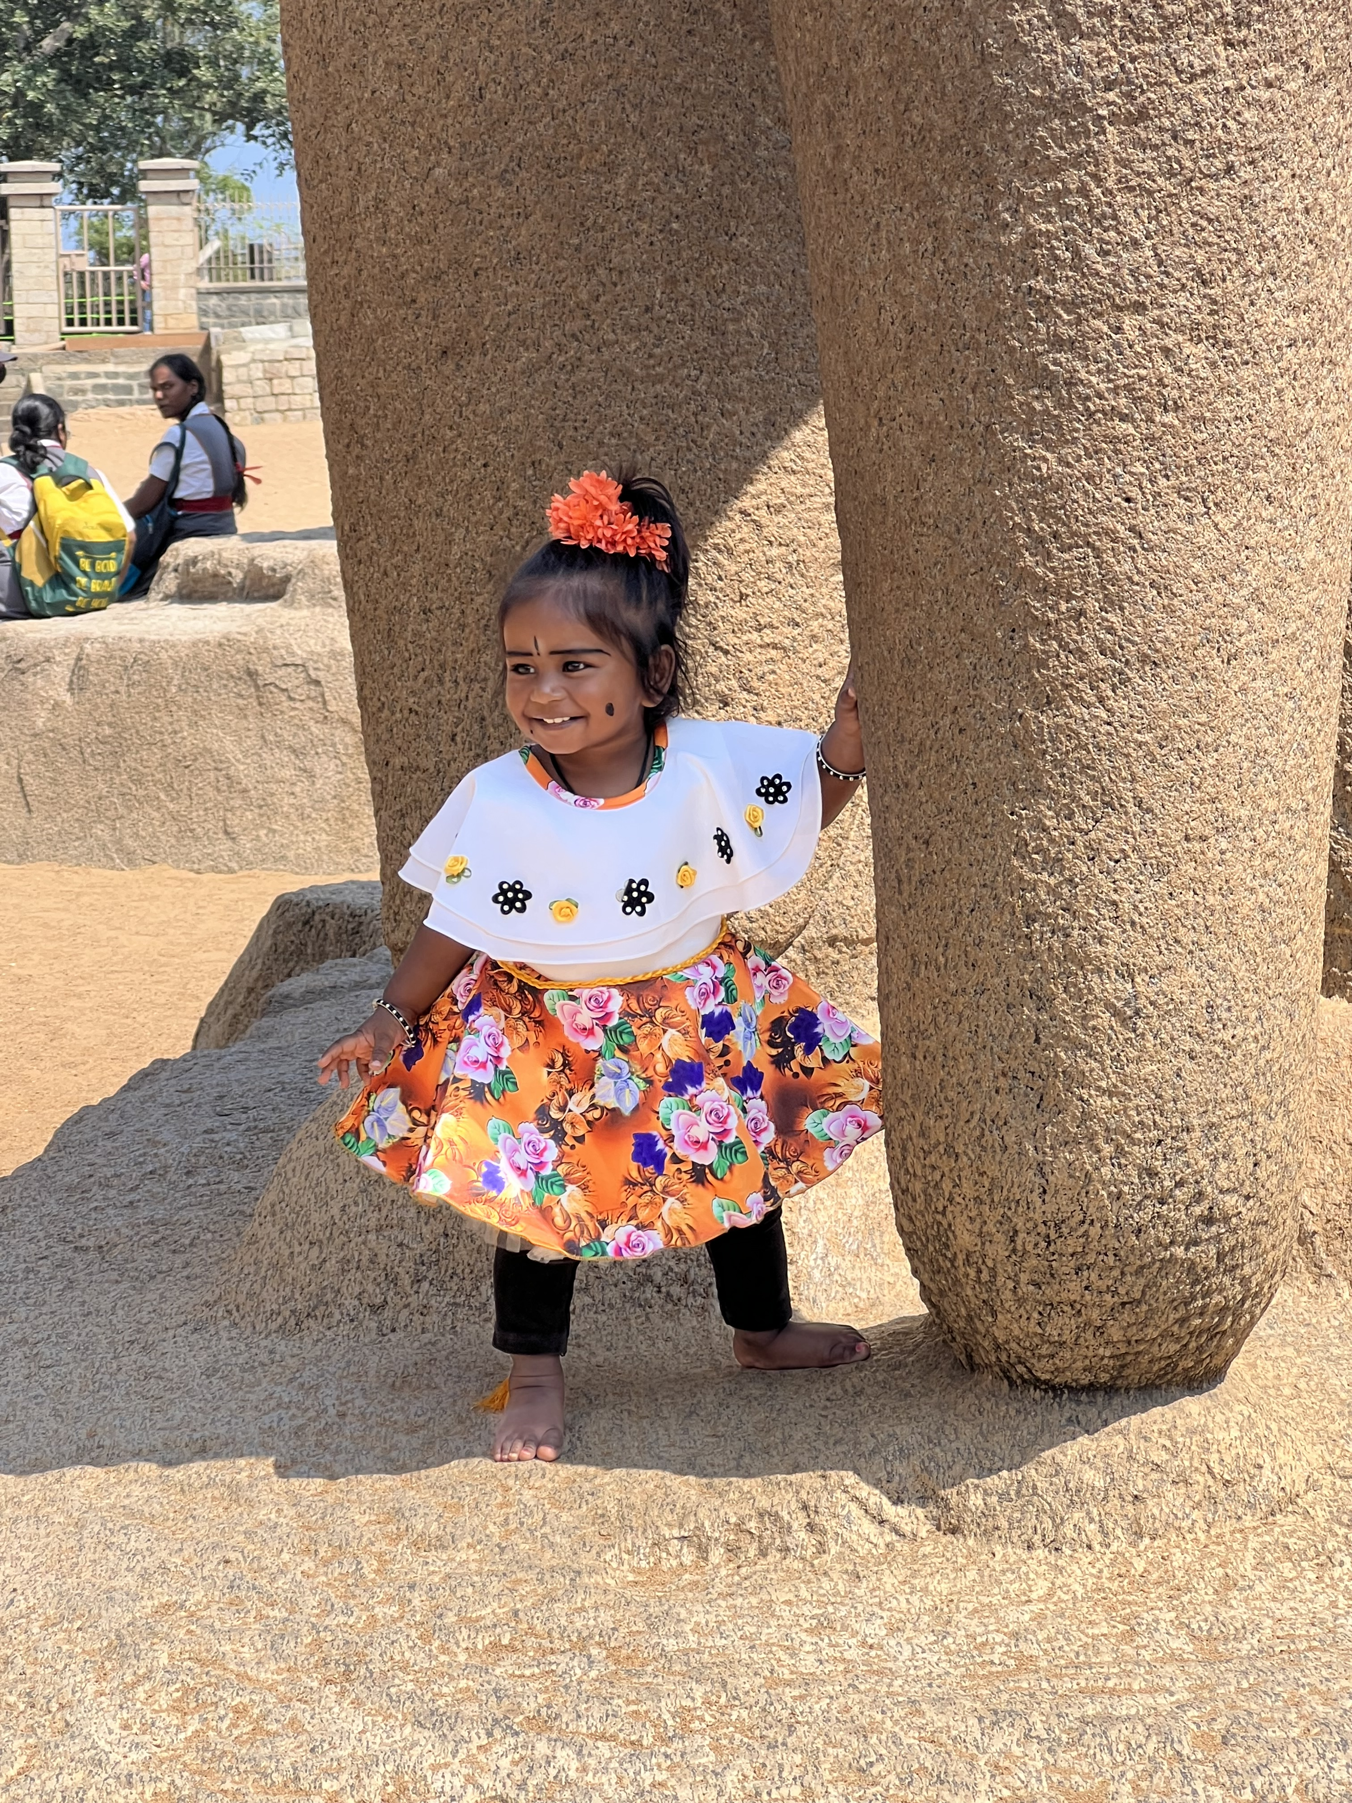
Beginner’s Mind
We benefit from adopting an attitude of “not knowing” and of “valuing” the experiences and perspectives of others
This requires collaboration: We work with groups to explore and discover together

Slide 5
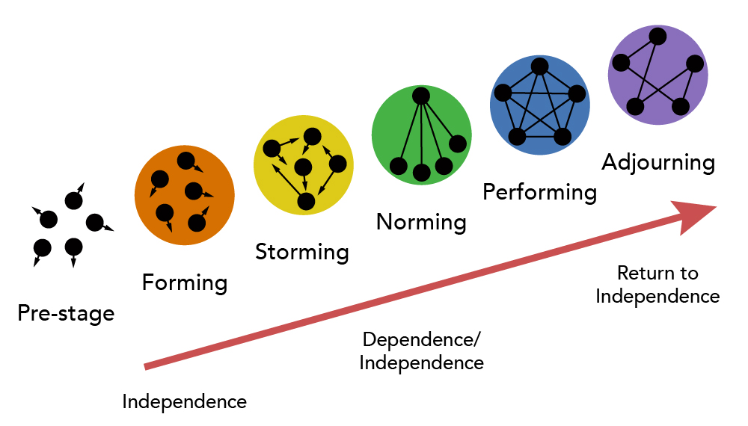
Group Stages: Where are we now?
Forming (Initial)
Norming
Storming (Transition)
Performing (Working)
Adjourning (Termination)

Slide 6
Our In-Class Groups
Know your group☺
    Maroon
    Gold
    Green
    Silver
Let’s do an opening with the Gold group

Slide 7
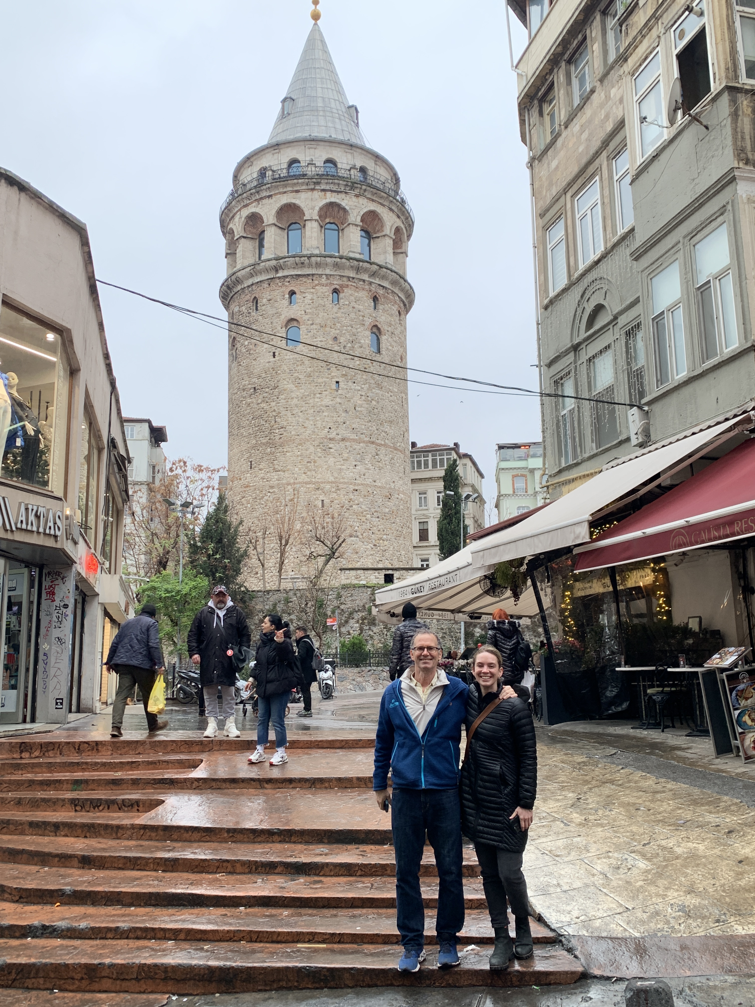
Gold Group
Meghan F
Rylynn G
Seth H
Kobe H
Jennifer J
Ruby Z
Jade B
Katherine B
Maureen O

Slide 8
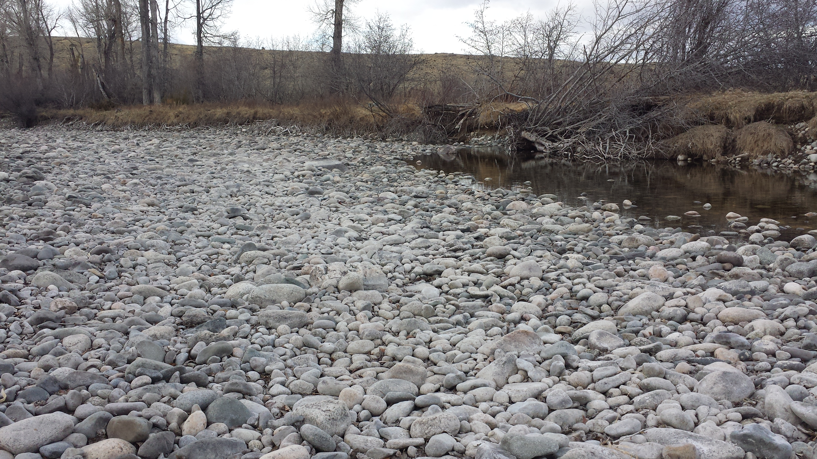
The Reflective Loop
What did you notice?
Any norming?
Any storming?
Opening statement? Linking? Why?
Hope? How?
Depth? Disclosures?
The three phases

Slide 9
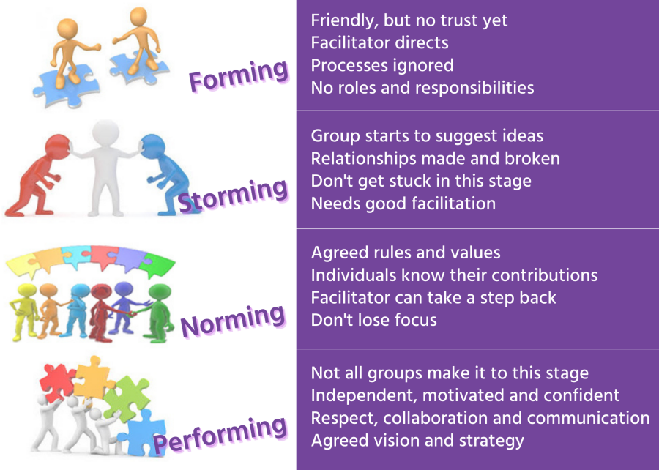

Slide 10
Therapeutic Factors
Instillation of hope
Universality
Imparting information
Altruism
The corrective recapitulation of the family group
Development of socializing techniques
Imitative behavior
Interpersonal learning
Group cohesiveness
Catharsis
Existential factors

Slide 11
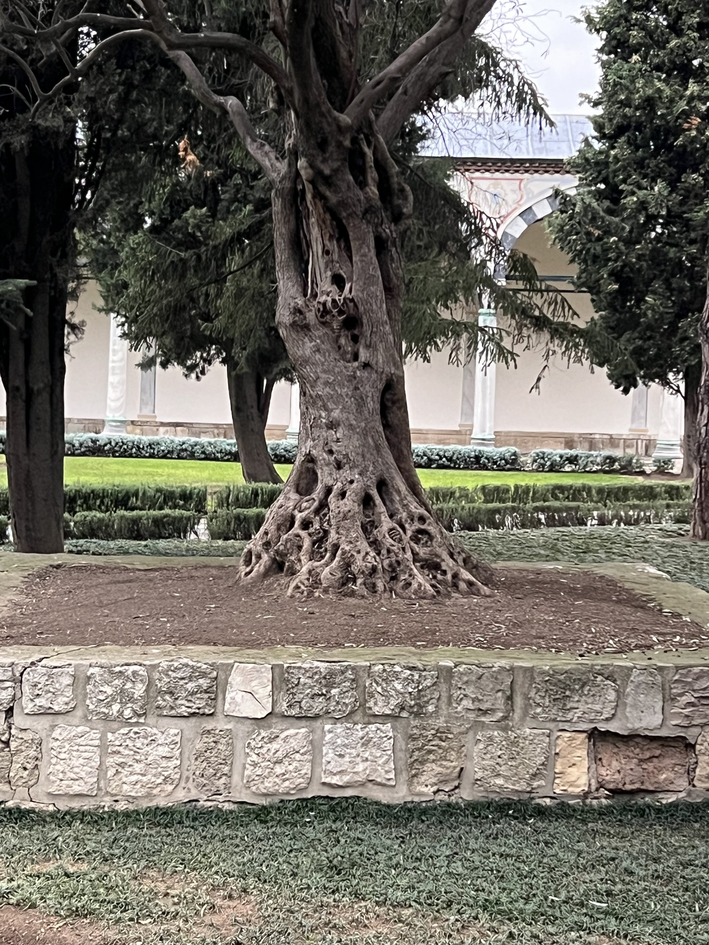
Instillation of Hope
Placebo effects with depressed children
Trapper pre-group meetings (cake)
The therapist reinforces positive expectations and removes negative preconceptions (“that’s actually not true”)
We call attention to positive changes (caps and other prizes)
We believe in ourselves and the power of group
We allow positive testimonials

Slide 12
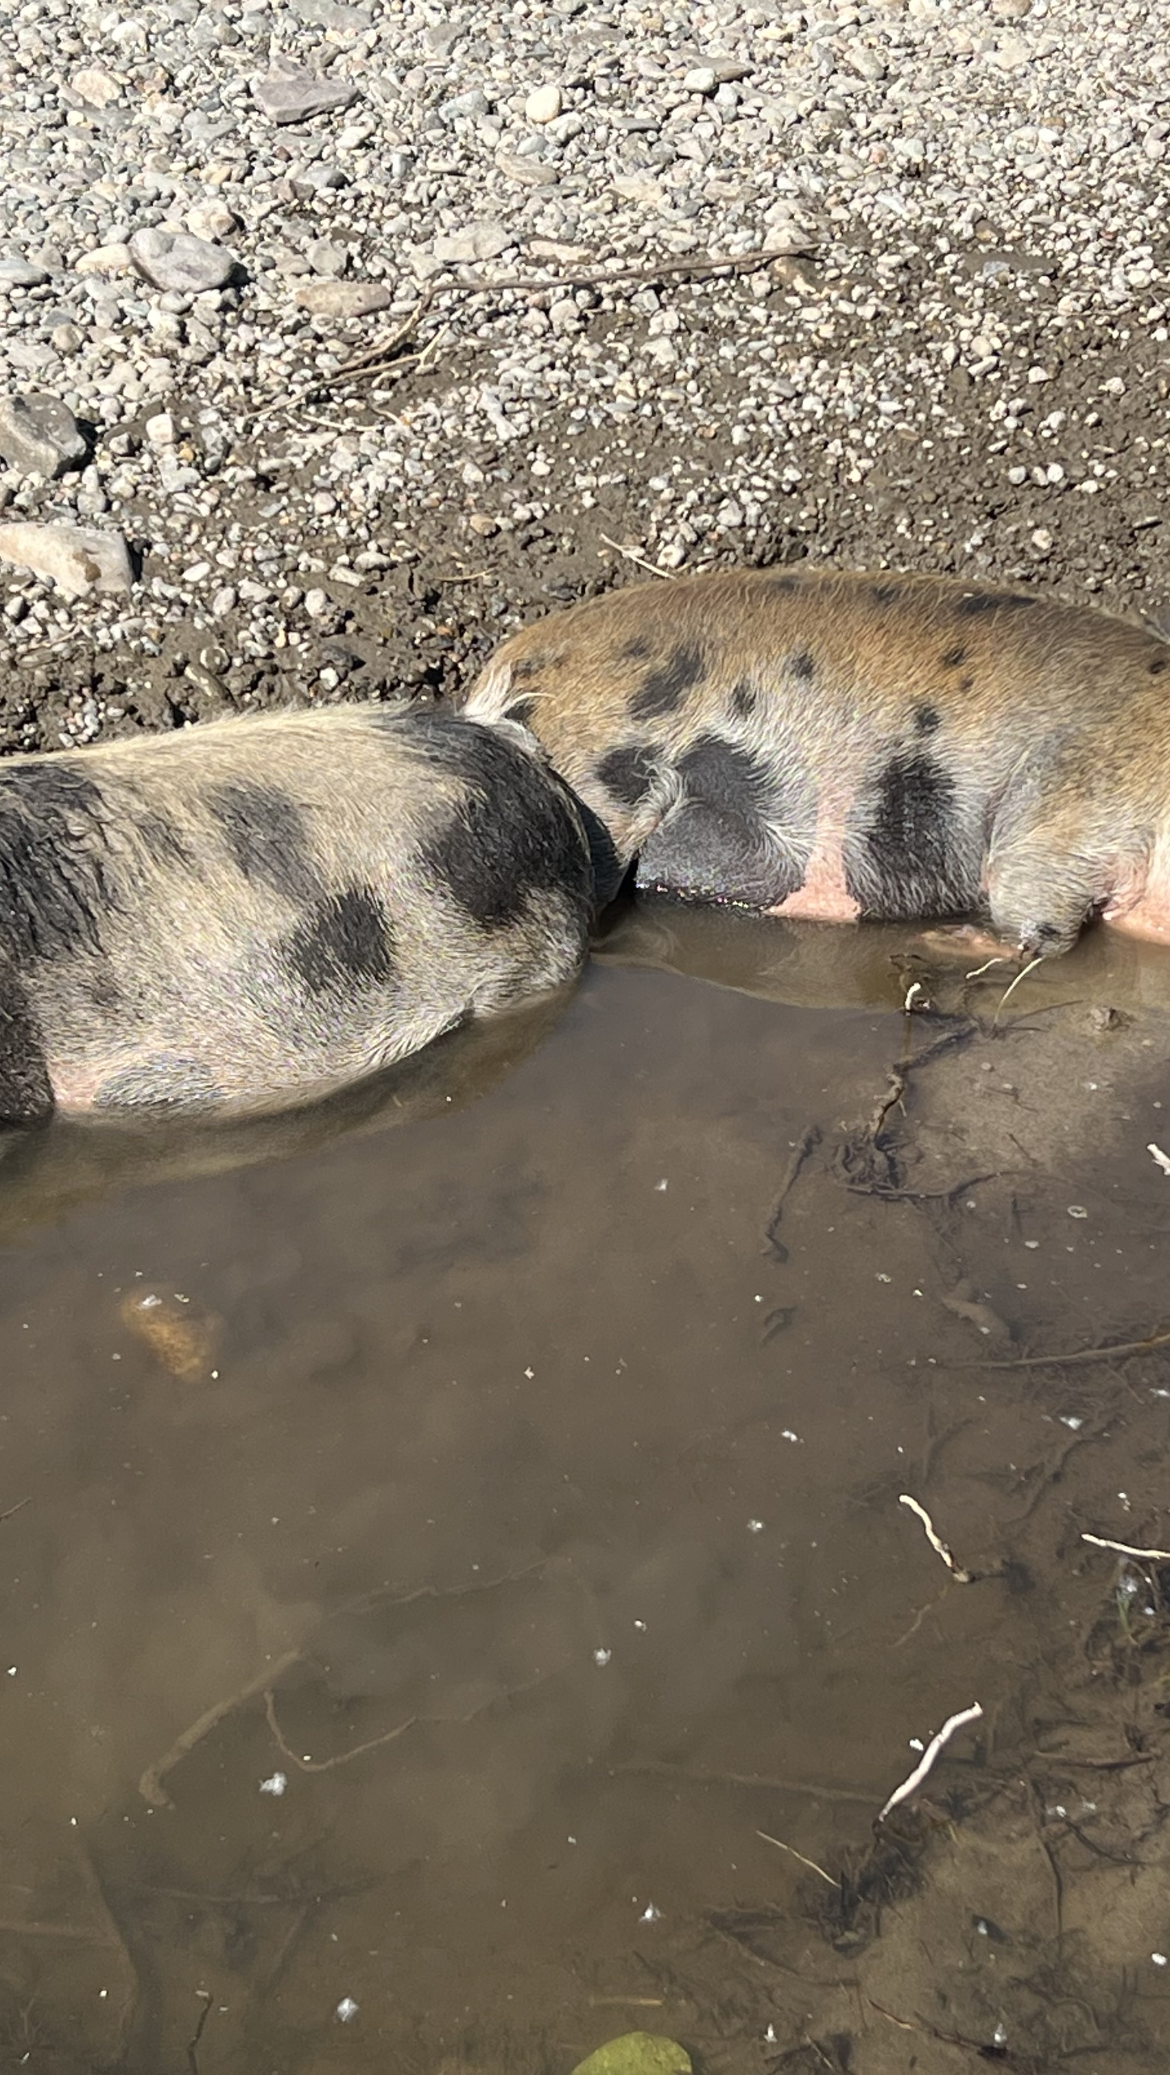
Universality
Carl Jung Story
Misery loves “miserable” company
Yalom: That seems to be the way we’re built
What are the 3 common secrets/themes Yalom refers to? Why are these important?
Oregon retreat and COUN reflections

Slide 13
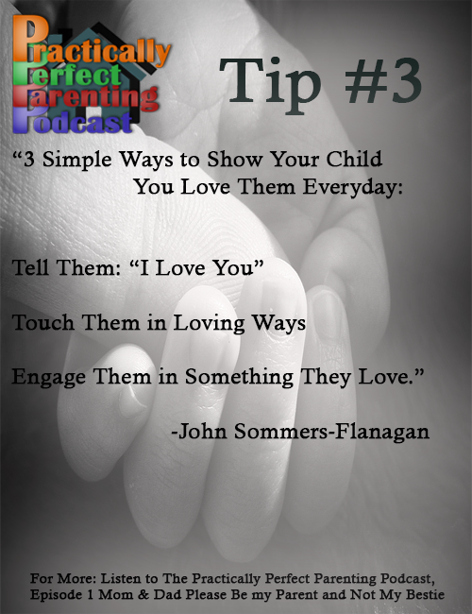
Imparting Information
Didactic Instruction (e.g., panic disorder; sleep problems)
  Psychoeducation and countertransference (Hellgate H.S.; sleep education)
  Prepare yourself intellectually and emotionally to impart information

Slide 14
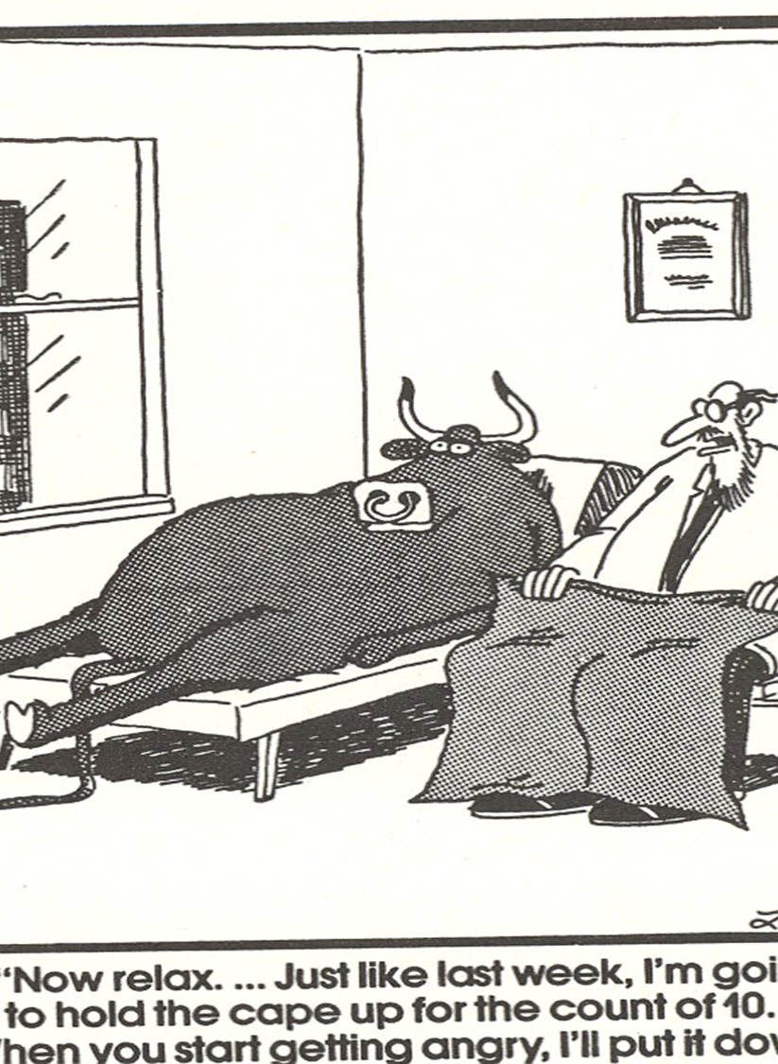
Imparting Information II
Direct Advice: If there’s a group giving lots of advice, Yalom says that’s not good. [Maybe/maybe not?]
What will happen when someone discloses a “problem?”
What is the positive byproduct of advice giving?
Solutions to the yes-but pattern

Slide 15
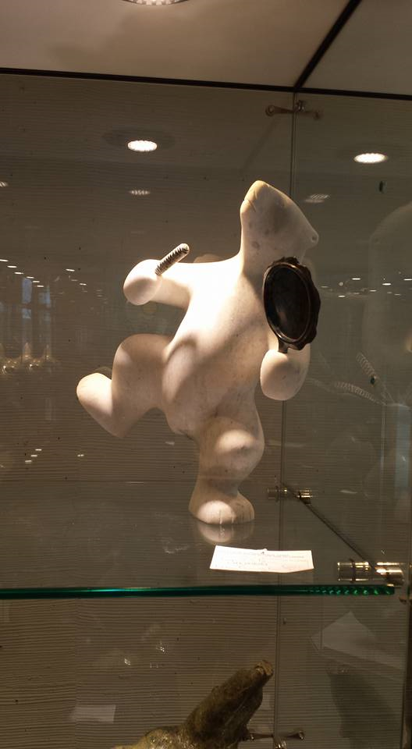
Altruism
Clients improve because they help!
The natural tug of Adler’s social interest
What does Yalom say about the “patient who deplores the prospect of getting help from others?” [I have NT to offer . . . or . . . or?]
When meaninglessness happens, self-focus multiplies; when altruism happens, meaning ensues

Slide 16
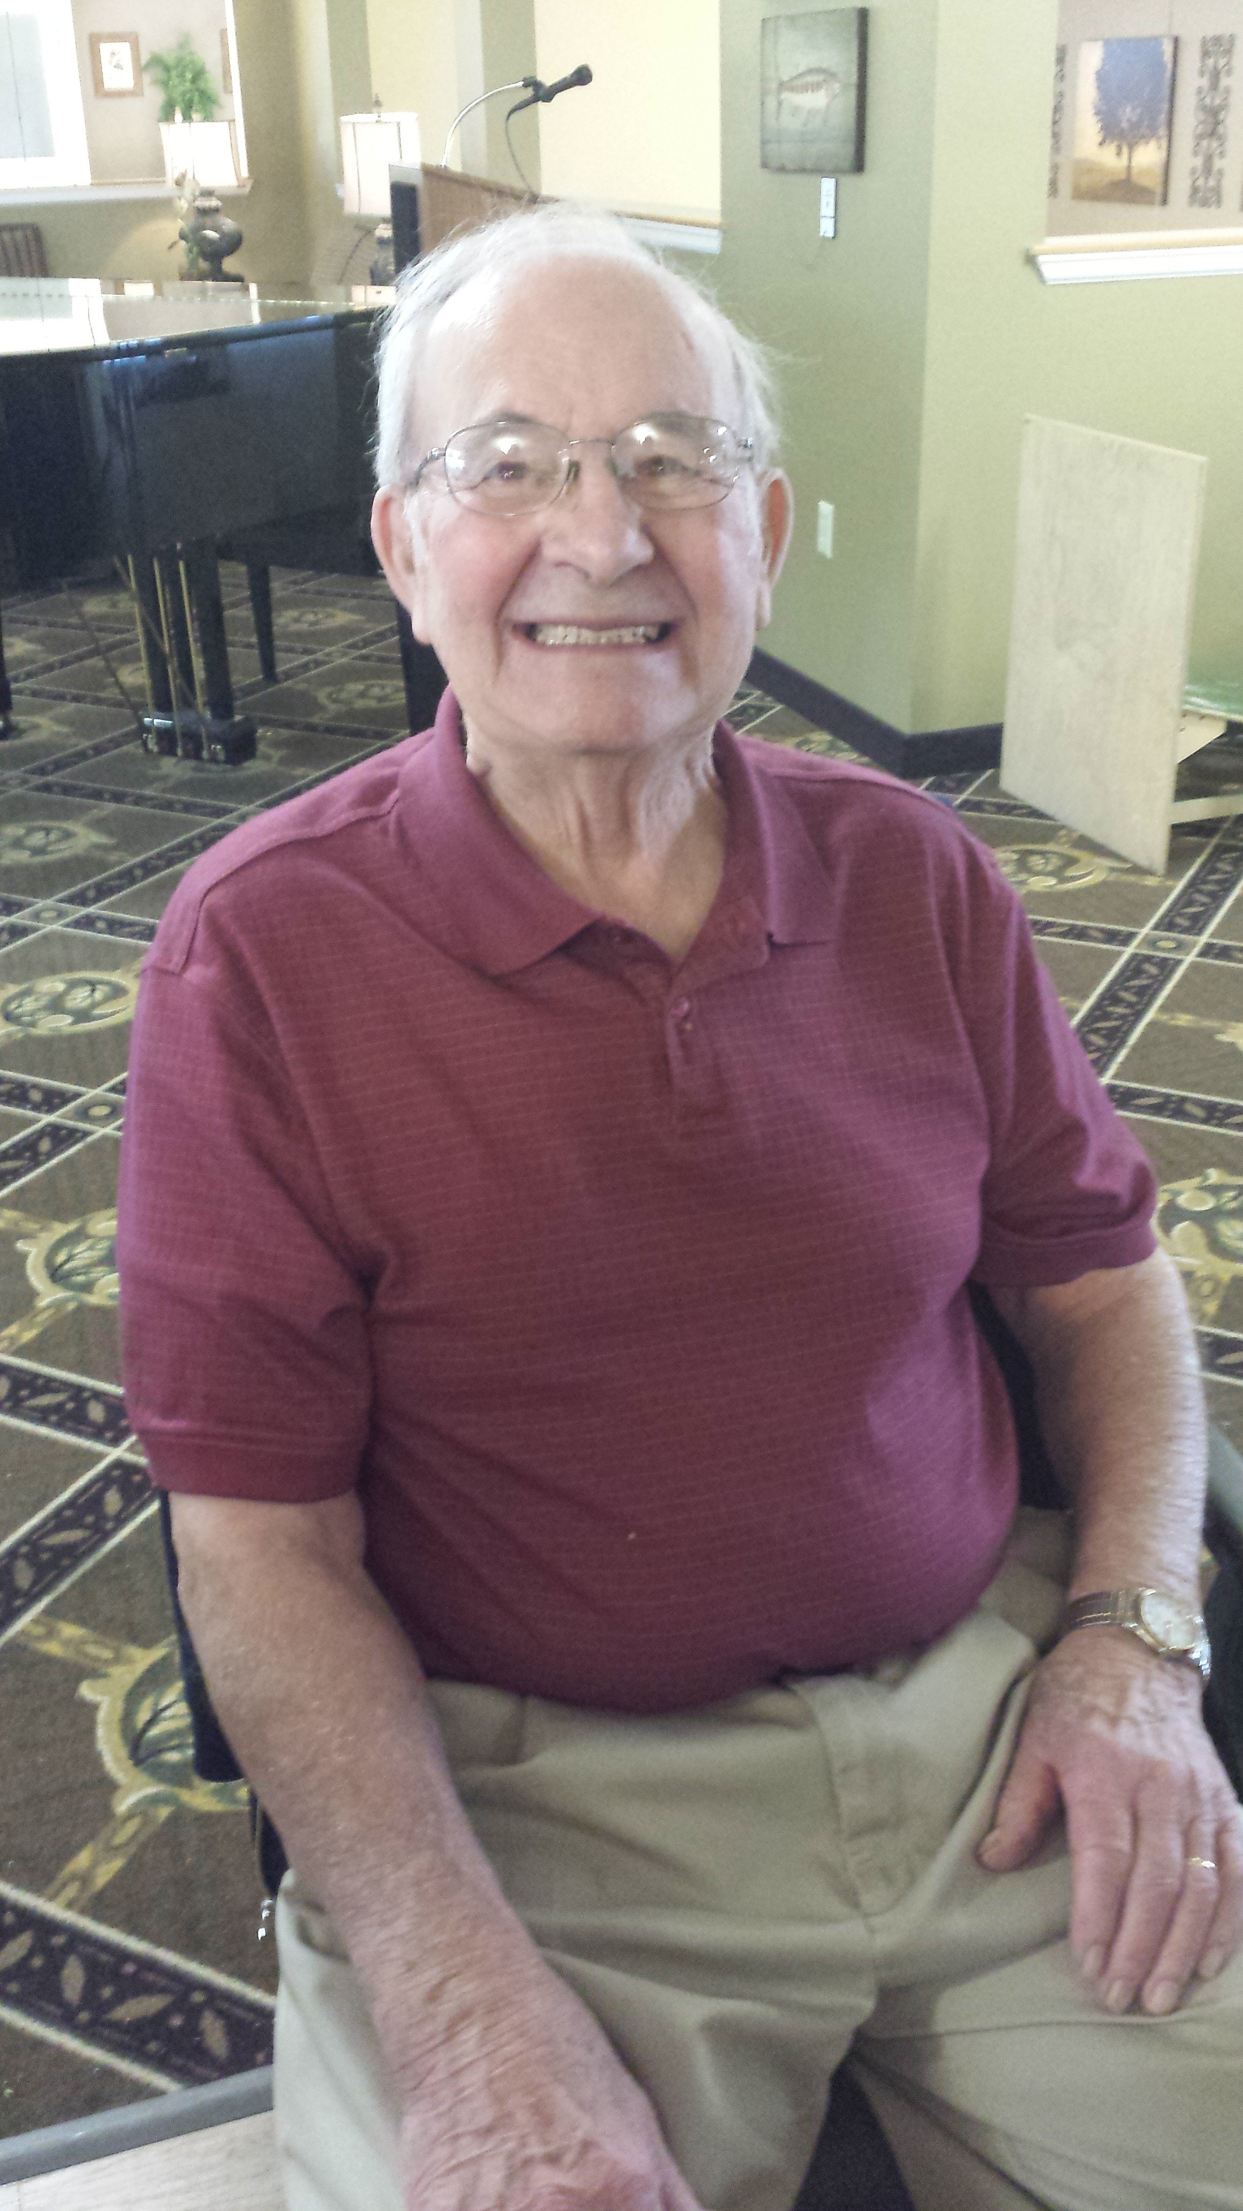
The Corrective Recapitulation of the Primary Family Group
Re-exposure without repair only makes a bad situation worse.
You have students/clients who complain you favor others . . . What if they’re right? [think: recapitulation]
Understand that in all groups recapitulation will happen. [FF example]

Slide 17
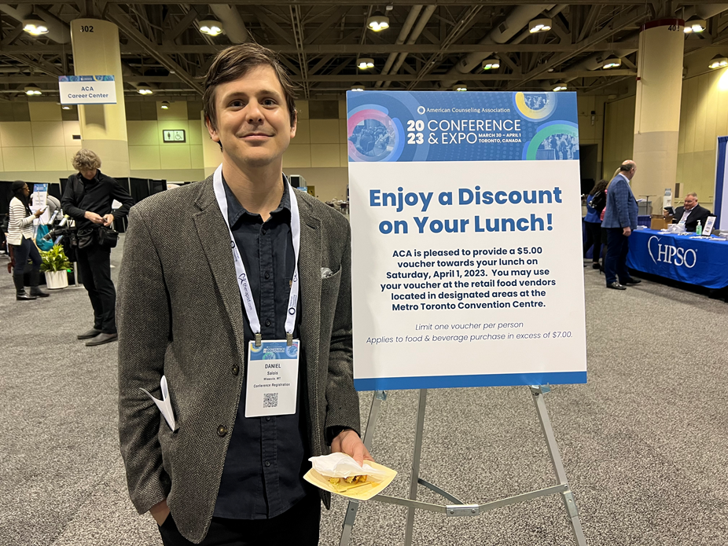
Development of Socializing Techniques
The group is an opportunity for accurate interpersonal feedback [and that BROADENS our perspective and perceptions].
Palmistry and astrology
Lisa story – Last 2 sessions in 10 session elementary school group [New territory. . . I’ve never. . .]

Slide 18
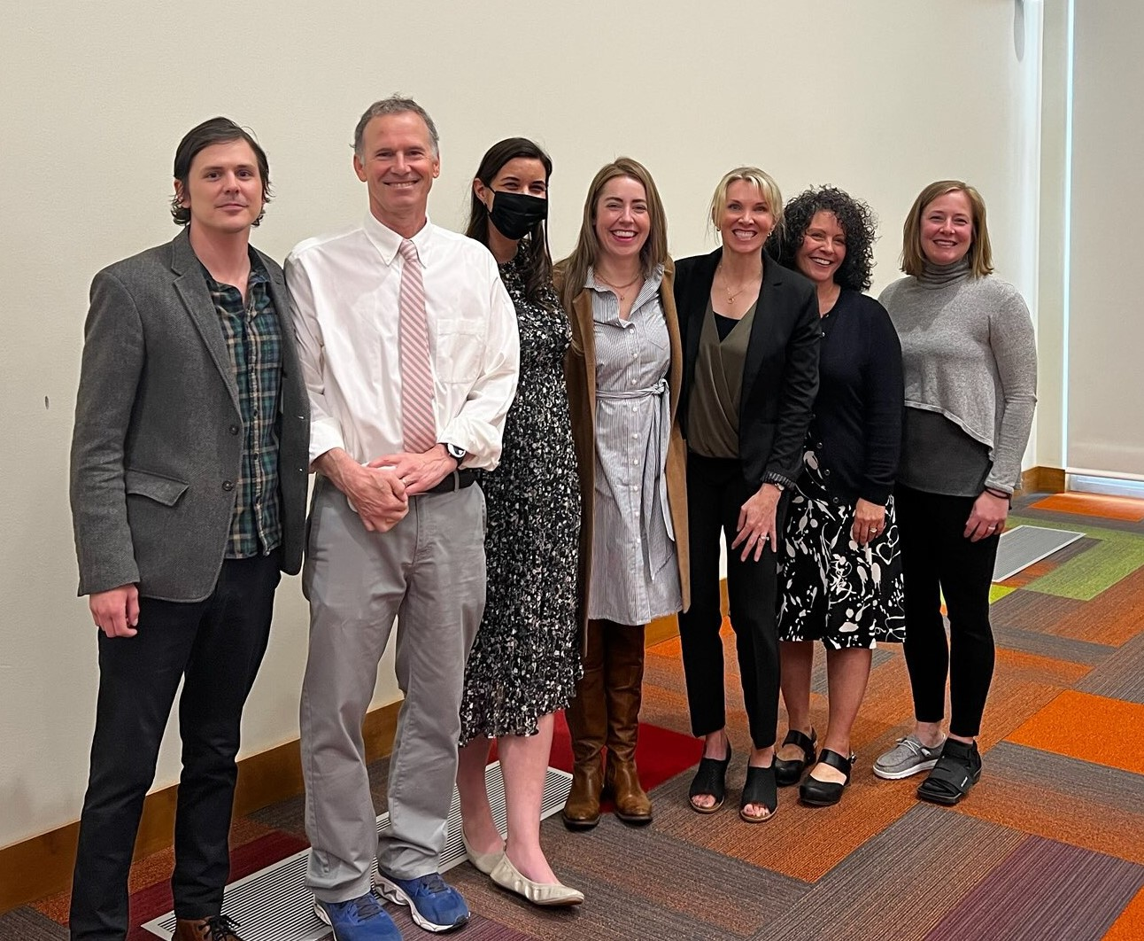
Imitative
Behavior
Fitness center imitation
Who do you imitate? Who do you WANT to imitate?
Adolescence is a time of normative deviance
Introject and IntroJack and IntroSara

Slide 19
Our In-Class Groups
Know your group☺
    Maroon
    Gold
    Green
    Silver
Let’s do a fishbowl activity with the Silver group
Name plus favorite Missoula activity or place to go

Slide 20
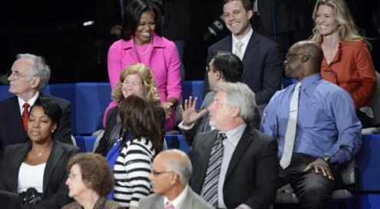
Group Types
  Task or Work Groups
  Psychoeducational Groups
  Counseling and Psychotherapy Groups
  Discussion Groups
  Support Groups
  Self-Help Groups
  Growth/Experiential Groups
    Other typologies: Heterogeneous vs. Homogeneous; Open vs. Closed; Gendered

Slide 21

Discussion Groups
  Let’s wait a week
  Next time: Suzie and Lillian will come talk a bit about happiness groups with youth

Slide 22




Summary
Today we did a couple fishbowls and mostly focused on therapeutic factors.
Start thinking about your takeaways!

Slide 23
