Slide 1
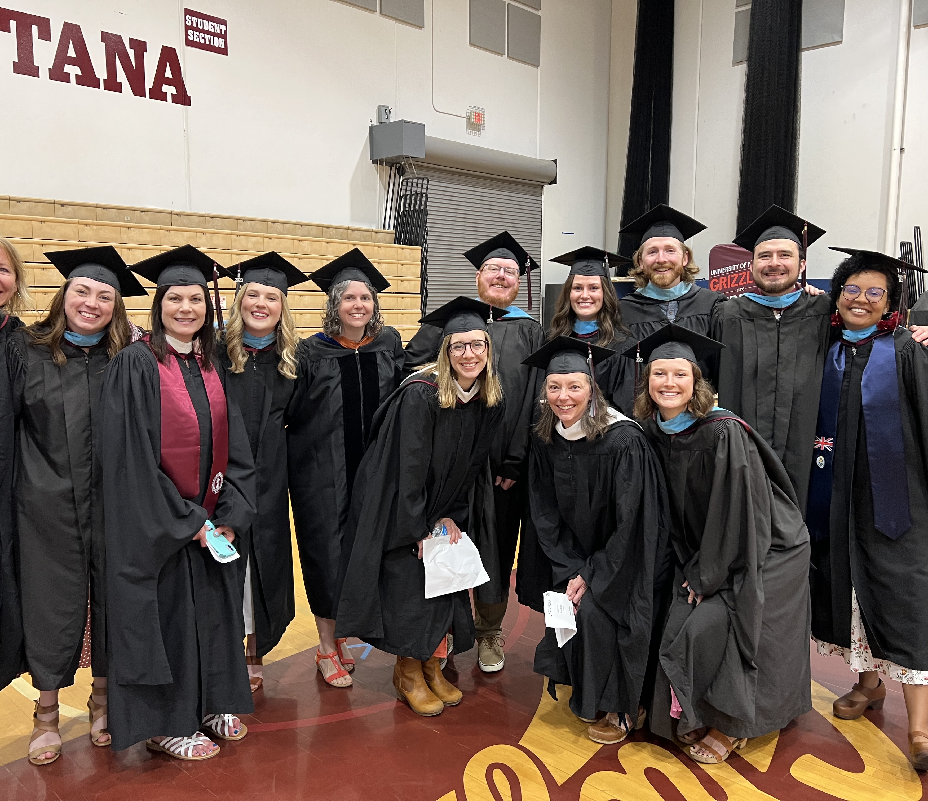
Group Counseling Day 1
COUN 520
with John S-F

Slide 2


Agenda
[Group is Open]
Welcome and introductions (Group Activity)
Syllabus review and sign-ups
Basic information about group counseling, group types, and group stages
Experiential Icebreakers

Slide 3

Our First Group Ground Rules
Ground Rules
But . . .
Treat others with Respect and work to have empathy – Brain development
You can always pass
We will learn with and from each other
That means we emphasize our boring old listening skills
Wait . . . are these even ground rules?
This Photo by Unknown author is licensed under CC BY.

Slide 4

Opening Group
Activity
We won’t do The worst Intro Icebreaker ever, Instead:
  Get into groups of 5-6
  generate 2 or 3 questions that focus on what you’d like to know about each other
  write these questions on the board as we all CIRCLE UP

Slide 5

Questions for Each Other – Part 1
let’s do rounds
you can each answer a question or two of your choice
Be sure to also share your
Name
Academic program
“Home” town

Slide 6

The Self-Reflective Loop
•What were your process observations ?
•Did everything remain balanced?
•What norms got established?
•Did we need ground rules?
•What are the advantages and disadvantages of explicit ground rules and facilitator- vs. Participant- generated ground rules?
•
•Got names?

Slide 7
Opening Activity – Take 2
Let’s do this again, but differently
Instructions
For 15 minutes, everyone can take turns and ask a question from the board (or off the Board) directly to any other group member in any order
we’ll begin (again) with a question asking activity

Slide 8
The Reflective Loop
[Again]
•What felt different?
•How did patterns start?
•Did everything remain balanced?
•What norms got established?
•Did we need more ground rules?
•Who got skipped? How did that feel?
•Other comments?
•
•Got names?

Slide 9

The Feel of
More or Less Structure
Popcorn vs. doing rounds
Pros and Cons
Freedom to ask others vs. told what to do/say
What are the advantages and disadvantages of these approaches?
Developmental and cultural adjustments?

Slide 10
More Reflection Questions
What Did You Feel?
And Think?
•Did you participate fully?
•Did you hold back?
•Did you notice others taking the lead?
•Did you want to jump in and be more engaged or did you like sitting back more passively?
•What’s your usual pattern in groups?
•How aware are you of your patterns?
•How satisfied?
•Other comments?

Slide 11

Assignments
Activities
Syllabus Quiz (10)
Questionnaire (20)
Weekly Take-Aways (70)
Midterm (50)
Color Groups (40)
Discussion Groups (40)
Happiness Groups (50)
Final Reflections (40)
Attendance and Participation (50)
Learning
This Photo by Unknown author is licensed under CC BY-SA-NC.

Slide 12
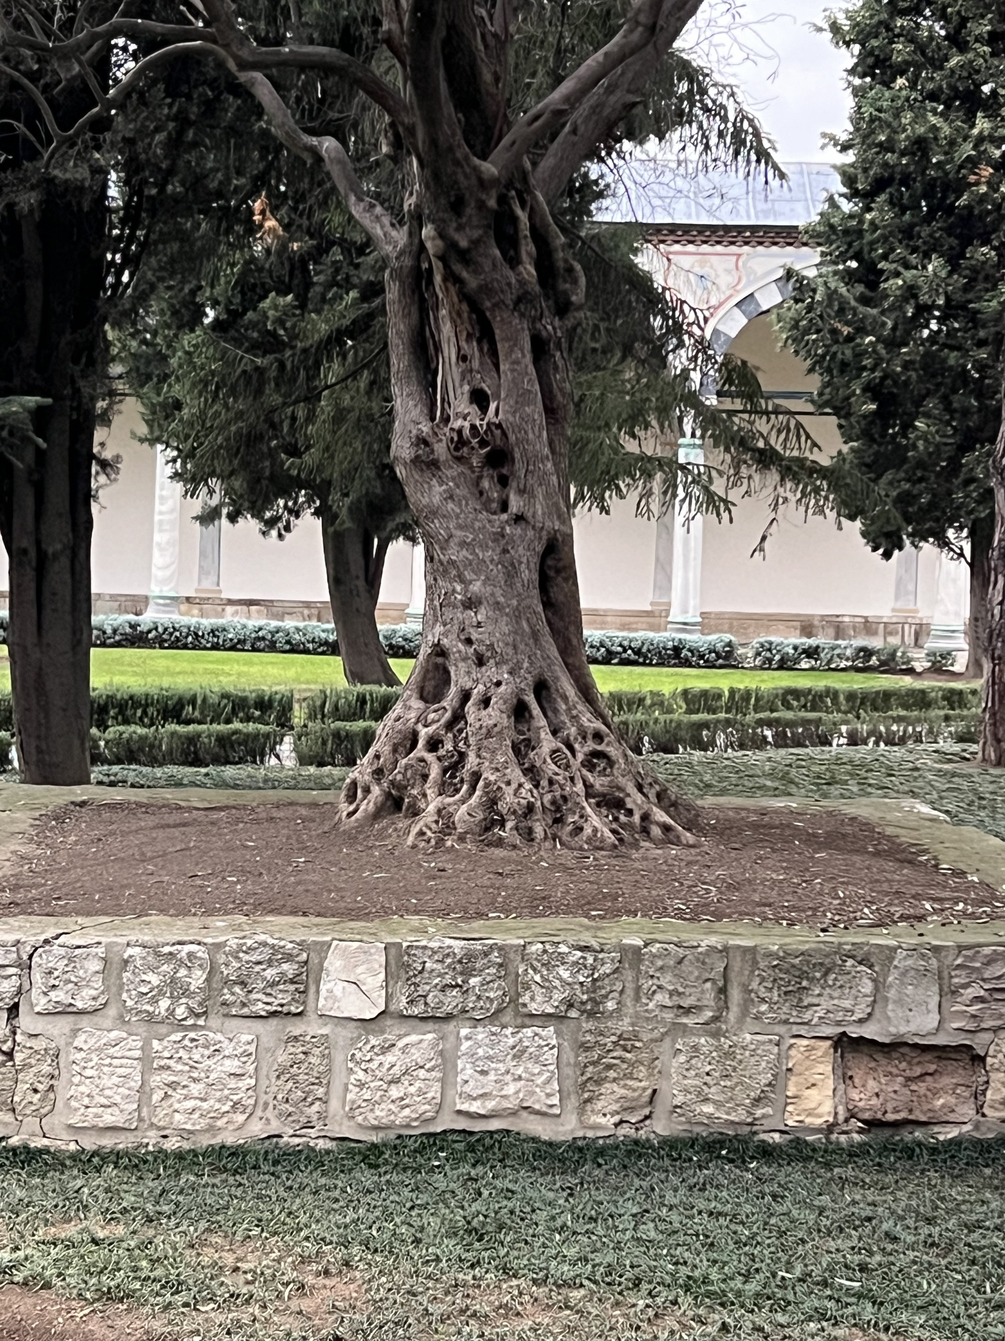
Let’s Talk Feedback
Feedback can be scary – vulnerability and self-consciousness
Feedback is essential (Allen Ivey quote)
When you practice in public, you deserve applause
We will start with self-assessment (aka self-feedback)
We will ask permission to give feedback
Like for couples, the positive/constructive feedback ratio should be 5:1 minimum
We will try to be specific for positives
We will suggest alternative responses for possible growth

Slide 13
Group Counseling Basics
Why Do Groups?
Unique to Group
Efficiency (Dealing with big caseloads)
Co-leadership (Work with your friends)
More resources and viewpoints
Vicarious learning
Real-life encounters
Commonality, belonging, feedback
Other thoughts?

Slide 14
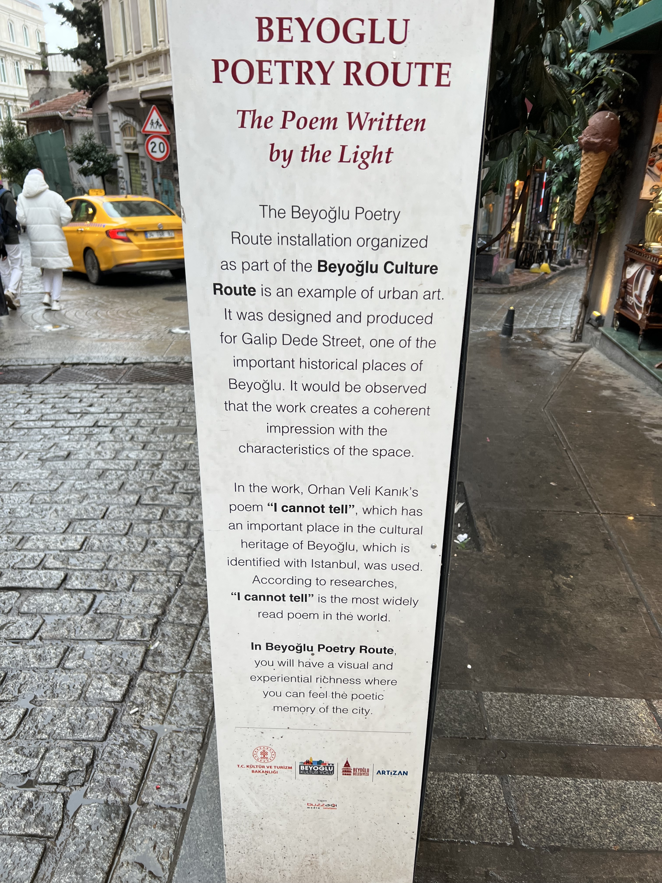
Group Counseling: Research Efficacy
What’s more effective: Individual or group counseling?
Optional Assignment: Spend 20 minutes online this week trying to answer this question and come back next week ready to report your findings and how you got the information

Slide 15
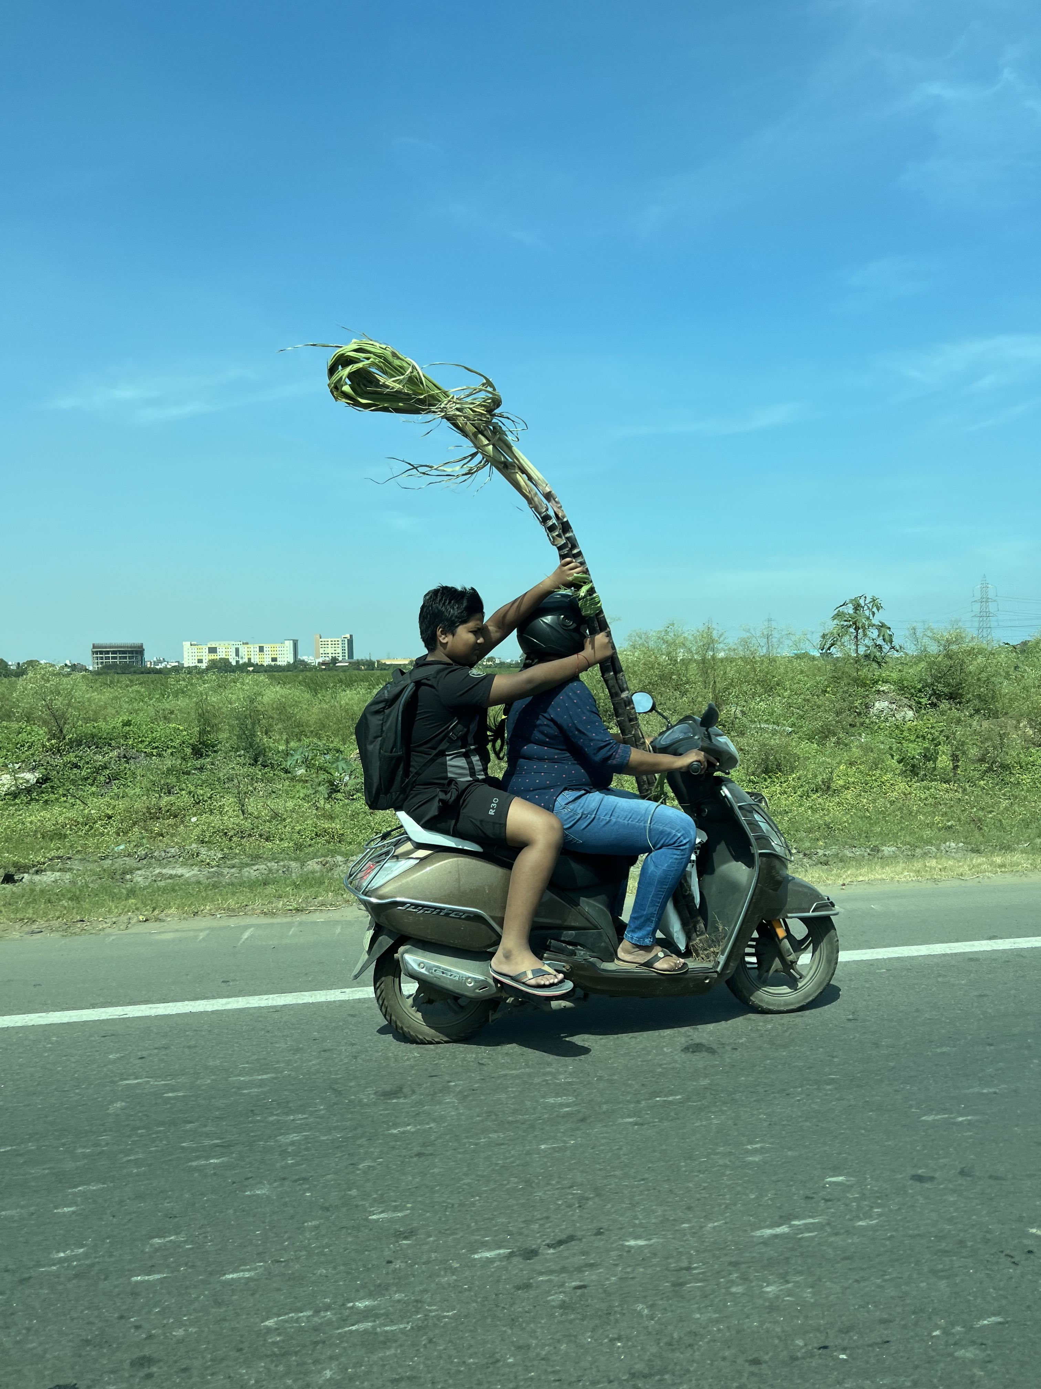
Group Types
  Task or Work Groups
  Psychoeducational Groups
  Counseling and Psychotherapy Groups
  Discussion Groups
  Support Groups
  Self-Help Groups
  Growth/Experiential Groups
    Other typologies: Heterogeneous vs. Homogeneous; Open vs. Closed; Gendered

Slide 16
Group Types – Task
The focus is on the completion of a specific task. The group dies at the completion point.
The leader balances content and process, keeps people focused, and manages conflict en route to task completion (attend to warm-up, action, and closure).
Examples: Mission statement committee; student group projects in your classes (watch out for the social loafer!)

Slide 17
Psychoeducational Groups
There is an informational or educational deficit and the PRIMARY goal is to provide information and elicit reactions
The communication goes through and from the leader into the group
Examples: Study skills, parenting education, and what we’re doing right now!

Slide 18
Counseling Groups
These address a specific, challenging problem
The leader is an expert and facilitates member interactions based on a theoretical approach [Highly variable]
The focus is on interpersonal process and problem-solving strategies that emphasize conscious thoughts, feelings, and behaviors
Examples: Coping with depression; DBT

Slide 19
Psychotherapy Groups
Just like counseling groups only. . .
A focus on deeper, chronic problems
Ambitious goals of “personality” change
Probably longer; less structured
Examples: Trauma/abuse; sex offenders; others?

Slide 20
Discussion Groups
The focus is on the TOPIC and not the person or a problem
Perspectives are elicited and limits are set by the leader
Examples: Book clubs, Religious study groups, and our class discussion groups, etc.

Slide 21
Self-Help Groups
Non-experts work together to help each other
There is no professional leader
Examples: AA; NA

Slide 22
Growth and Experiential Groups
This group involves facilitating an experience
The leader knows the terrain and guides members through the experience
Examples: T-groups, ropes courses, etc., where experiencing and debriefing the activities is THE point

Slide 23
Support Groups
People with a common interest or experience come together for support
Leaders encourage sharing (the goal) and communication is from member-to-member
Examples: Coping with illnesses; Single Parent; Cancer survivors; Alynon

Slide 24

Cultural Humility
Cultural humility is an evidence-based orientation with three parts
    An other-orientation instead of a self-orientation [this means—in part—approaching people who are different than us with interest in and respect for their cultural ways of being.]
    Respect for others and their values/ways of being
    An attitude that includes a lack of superiority

Slide 25
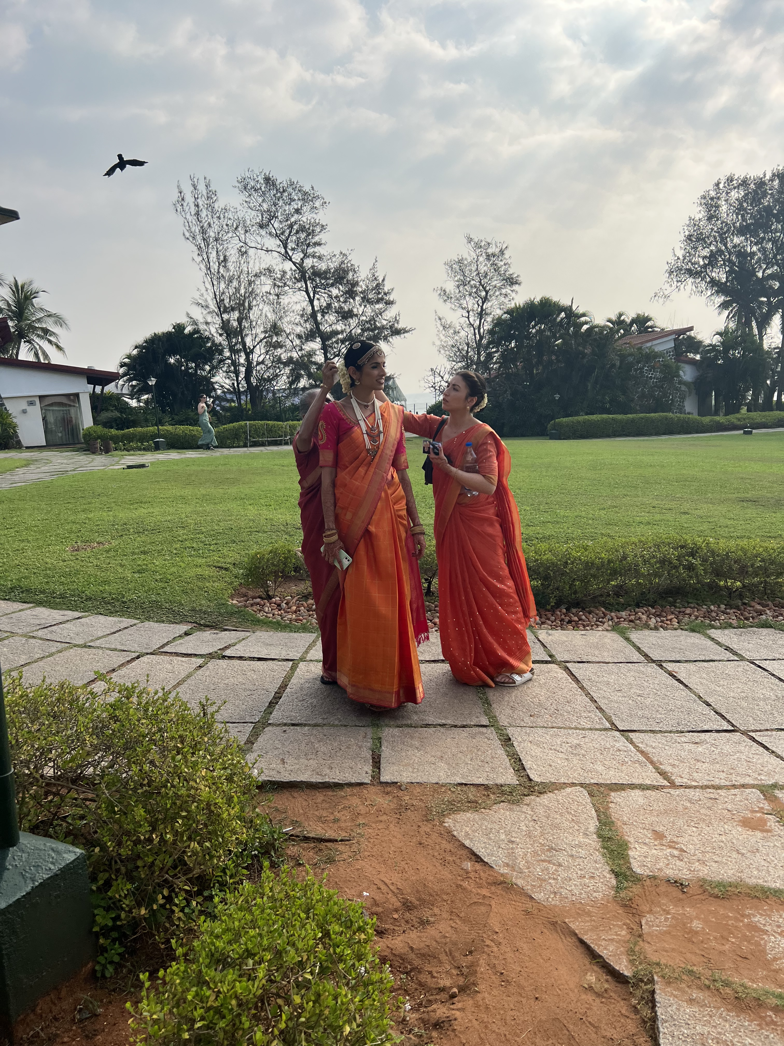
The Dialectic of
Lived Experiences
You have lived experiences that are different from mine. I will strive to gain understanding and hold compassion for your experiences.
I have lived experiences that are different from yours. You will strive to gain understanding and hold compassion for my experiences.
Our lived experiences, although VERY meaningful, are narrow, limited, and make us vulnerable to personal, cultural, and other prejudices.

Slide 26
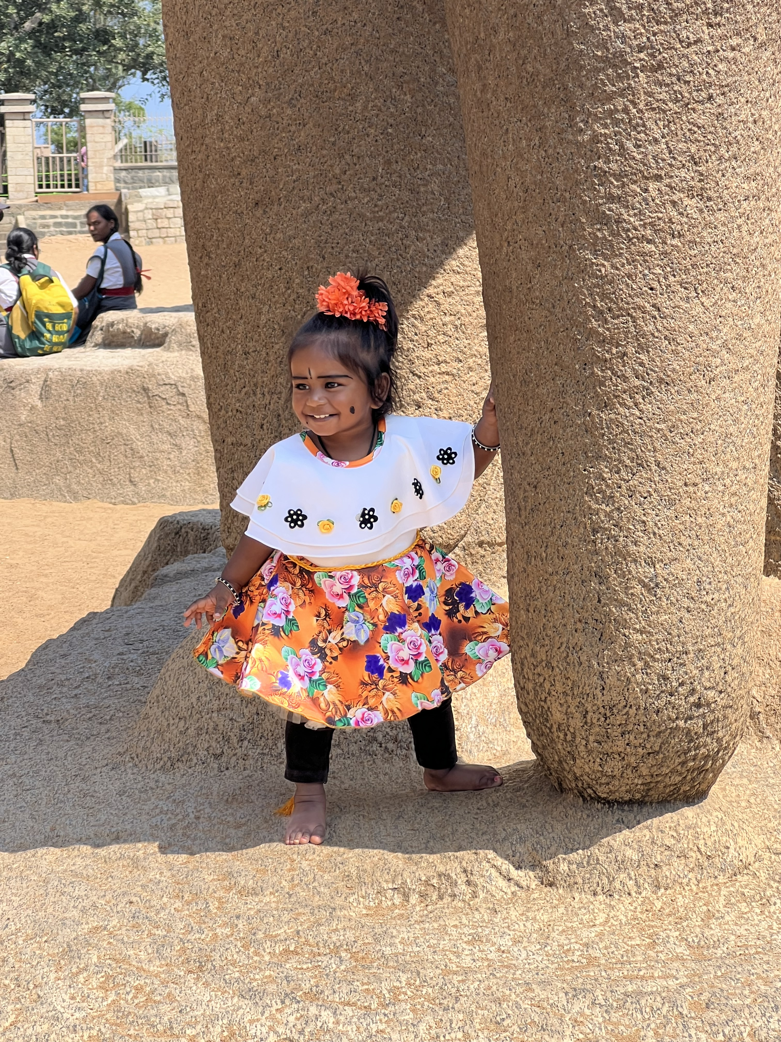
Beginner’s Mind
We benefit from adopting an attitude of “not knowing” and of “valuing” the experiences and perspectives of others
This requires collaboration

Slide 27
Group Stages: Where are we now?
Forming (Initial)
Norming
Storming (Transition)
Performing (Working)
Adjourning (Termination)

Slide 28
Our In-Class Groups
Know your group☺
Maroon
Gold
Green
Silver
Let’s do an opening fishbowl ice-breaker with the Maroon group

Slide 29
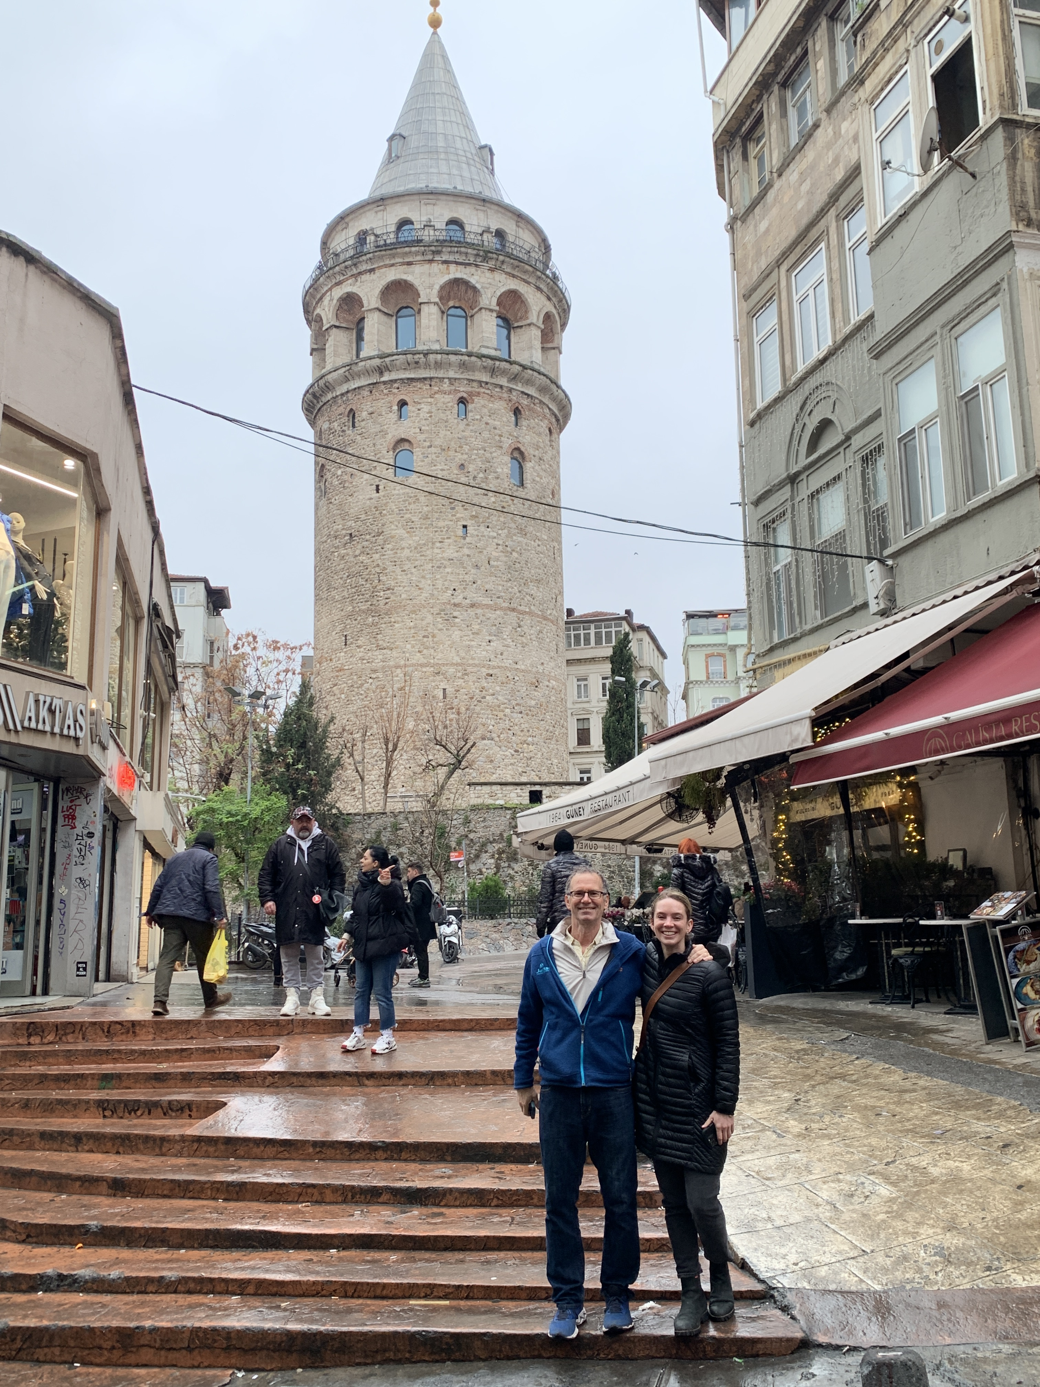
Maroon
Elizabeth A
Claire B
Chris B
Faith B
Megan C
Sydney L
Katie E
Paisley F

Slide 30




Summary
I shared ideas about brain development. We experimented with group process/structure. We debriefed, talked about feedback, and reviewed the syllabus. We did an overview of groups types and stages. Maybe we did more . . . or less.
What would you like to remember?

Slide 31
Sample Support Group
https://www.youtube.com/watch?v=aJyppEAWkmQ

