Slide 1

Blending Traditional and Strengths-Based Approaches to Suicide Assessment
Presented on behalf of WVU – December 8, 2023
John Sommers-Flanagan, Ph.D.
University of Montana
Department of Counseling
John.sf@mso.umt.edu
Free Resources: https://johnsommersflanagan.com/

Slide 2
Preparation
Welcome and thanks to Dr. Dan Salois for organizing... and to you!
Emotionally challenging topic: Trigger warning
30+ years ago – 2021 Networker article: https://www.psychotherapynetworker.org/article/myth-infallibility
Please practice proactive and positive coping

Slide 3
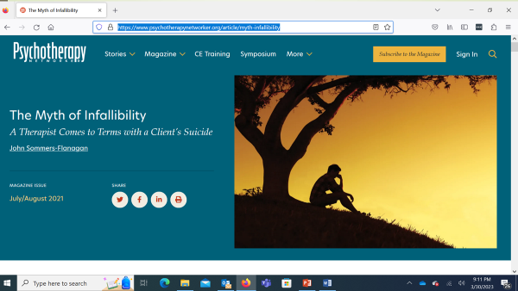
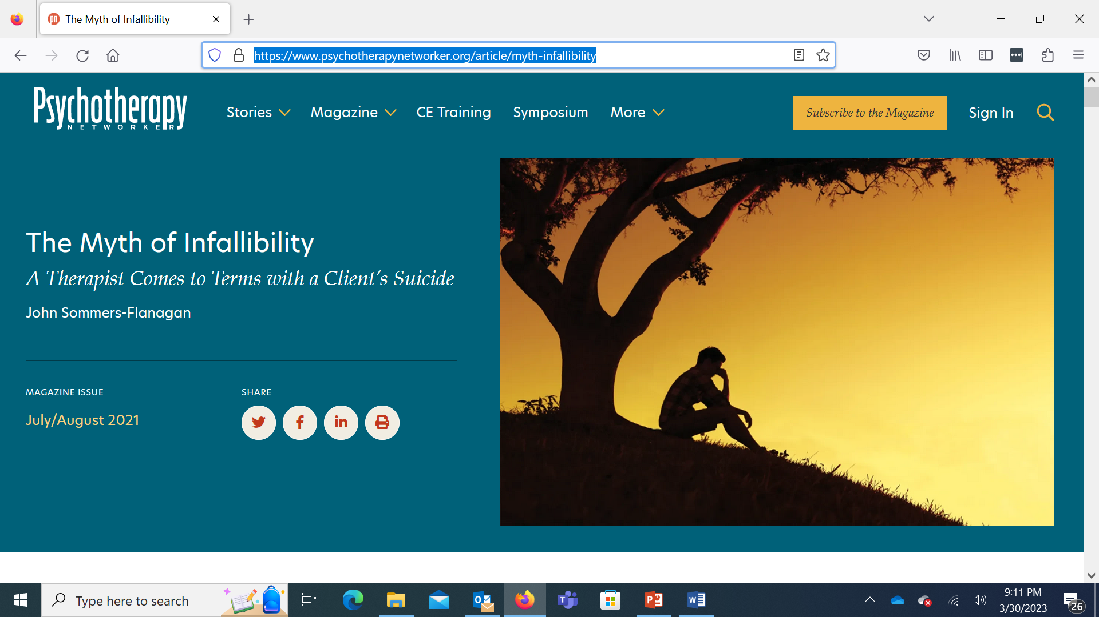

Slide 4
Coping Takeaways
For you:
Assessments are always flawed
We cannot always get it right; we will make mistakes
After a client’s suicide death or attempt, the adverse emotional responses can linger . . . for 30+ years!
We should not to isolate, because our dark and depressive thoughts can grow if we feed them
For you and colleagues:
We should ask, “How am I doing?”
We should ask each other: “How are you doing?”
We should be especially kind and supportive when our colleagues are dealing with emotionally challenging clients or suicidal situations
Self-blame is enough, and possibly too much

Slide 5
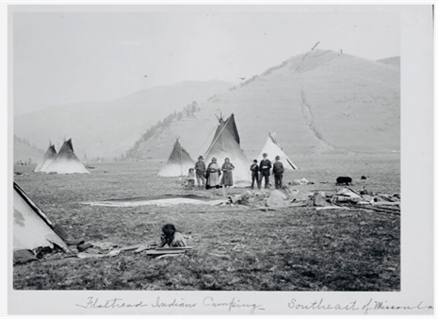
University of Montana
Land Acknowledgement
UM is in the aboriginal territories of the Salish, Kalispel, and other indigenous peoples, many of whom are colleagues, students, and friends. Long before the founding of UM, the Salish and Kalispel people educated their children on this land. This knowledge guides what we do at UM, including the importance we place on educational events like this one.

Slide 6
Learning Process
We are distant, but can still be engaged
  I will talk about and demonstrate traditional and strengths-based suicide assessment approaches
  I need volunteers
  We will watch video clips
  You imagine yourself slightly modifying how you work with students, clients, or patients who are suicidal
  You comment as you wish
  I keep us on track and on time☺

Slide 7
Learning Objectives
L1: Describe the underlying philosophy and basic principles of traditional (medical model) and strengths-based (social constructivist) suicide assessment processes
L2: Critique traditional, medical model and social constructivist approaches to suicide assessment
L3: Apply specific assessment strategies, and some intervention strategies, that can be used with clients in general, but especially with populations that have been oppressed/marginalized.

Slide 8

Caveats
One of my daughters is an attorney☺
  Information provided today is based on research and clinical experience. I hope it will help you in your work. Nothing is always effective.
  Nothing always works
  As professionals, you’re responsible for applying this and other training experiences into your work.

Slide 9
Reflections on Suicide Rates - 2022
U.S. Highest
Wyoming – 33.0/100,000
U.S. Lowest
New Jersey – 7.3/100,000
U.S. Average
U.S. – 14.5/100,000
Montana – 31.8/100,000
Washington Grizzly Stadium
25,000/8
Reactions?

Slide 10

Inside the Box
The Traditional Medical Model

Slide 11
Basic Principles – Positivistic Philosophy
Suicidal thoughts and behaviors represent illness; we need to intervene
We are authority figures who know more about patient health than they do
The patient is a suicidal person
We can predict and prevent suicide
We use research-based risk assessment procedures and questionnaires to categorize risk as mild, moderate, severe, extreme
We treat mental disorders that are linked to death by suicide

Slide 12
Common Standardized Questionnaires
The Patient Health Questionnaire-9 (PHQ-9)
The Columbia Suicide Severity Rating Scale (C-SSRS)
The Ask Suicide-Screening Questions (ASQ)
The diagnostic clinical interview

Slide 13
Questionnaire Advantages
Gather information efficiently
Standardization – reliability, validity, and norms
Some patients will be more open with a questionnaire
Liability protection
Prediction accuracy (maybe?)

Slide 14
Example: The PHQ-9
Nine items from the DSM Major Depression diagnostic criteria
Item #9: “Thoughts that you would be better off dead, or thoughts of hurting yourself in some way?”
4-point Likert scale: Not at all; several days; more than half the days; nearly every day

Slide 15
The Columbia (C-SSRS)
Two opening questions:
Have you wished you were dead or wished you could go to sleep and not wake up? [Passive suicidality]
Have you actually had any thoughts about killing yourself? [Suicidal ideation]

Slide 16
The Columbia – Next Three Questions
Have you been thinking about how you might do this?
Have you had these thoughts and had some intention of acting on them?
Have you started to work out or worked out the details of how to kill yourself? Did you intend to carry out this plan?

Slide 17
The Columbia – Always Ask
Have you done anything, started to do anything, or prepared to do anything to end your life?
Examples: Took pills, tried to shoot yourself, cut yourself, tried to hang yourself, took out pills but didn’t swallow any, held a gun but changed your mind or it was grabbed from your hand, went to the roof but didn’t jump, collected pills, obtained a gun, gave away valuables, wrote a will or suicide note, etc.
If yes, was this within the past 3 months?

Slide 18
The Columbia – Limits and Problems
The main question on the Columbia that has limited predictive value is #6 (the previous attempt/prep question). . .
Problems
False positives – Passive SI, SI, intent, and suicide planning have low predictive value. Previous attempt is likely better, but not good.
False negatives – Suicide is frequently impulsive, coupled, and not pre-meditated.

Slide 19

Outside the Box
Strengths and Suicide

Slide 20

Part 1
Strengths-Based Principles

Slide 21

Strengths-Based Principles – I
Embrace Shneidman’s position: suicidal thoughts and behaviors are neither an illness nor a sin.
De-pathologize:
View suicide disclosures as a natural communication of pain, often from untenable life situations [*Not med model] and unmatched opportunity to offer compassionate help.

Slide 22

Strengths-Based Principles – 2
Recognize the limits of risk/protective factor assessment (because mostly it doesn’t work; 50 year meta-analysis; cutting; cultural variability).
We are transparent (e.g., hosp), build trust and collaborate to develop individualized safety plans (e.g., firearms) and decrease personal distress. [This is our North star]
.

Slide 23

Strengths-Based Principles – 3
While focusing on suicide (which is essential), resist the temptation to over-focus on suicide.
The client is a whole person with unique strengths and resources: Show compassion for suicide pain, but pay attention to and draw out the positives (not naively; the best way is to be with). [7 dimensions]

Slide 24

Strengths-Based Principles – 4
Use collaborative and therapeutic assessment:
Start with empathy and compassion, NORMALIZE, and recognize that the problem may not be “in” the person [We acknowledge our legacy of pathologizing diversity]
Balance your questioning: Don’t just go through the PHQ-9. Question #9 is a well-known mish-mash, hugger mugger, blend of passive suicidality and self-harm.

Slide 25

Strengths-Based Principles – 5
Implement specific intervention (management strategies) that target distress and suicidality.
We will cover at least two examples of these today –Interventions can stimulate HOPE

Slide 26

Strengths-Based Principles – 6
Despite embracing a strengths-based model. . . remember you may need to be directive, you may need to initiate protective action, and you may need to be the voice of authority and rational decision-making in the room.

Slide 27

Strengths-Based Principles – 7
Recognizing the immense stress we carry in this role, we practice excellent self-care, including evidence-based happiness activities
We support each other
We acknowledge and talk about our own emotional challenges
We use the skills we teach

Slide 28
Medical Model vs. Strengths-Based An Overview
A Positivistic Philosophy
Suicidal thoughts and behaviors represent illness; we need to intervene
We are authority figures who know more about patient health than they do
The patient is a suicidal person
We can predict and prevent suicide
We use risk assessment procedures and questionnaires
We treat mental disorders
A Social Constructivist Philosophy
Suicidal thoughts and behaviors are a natural communication of pain
We collaborate to develop individualized safety plans
The client is a whole person
Suicide is mostly unpredictable
We use collaborative and therapeutic assessment
We treat client distress and suicidality

Slide 29

Part 2
Strengths-Based Tools for Suicide Assessment

Slide 30

#1
Assessment Skill/Tool: Normalizing
Ask directly AND normalize the asking
  I’ve read that up to 50% of teenagers have thought about suicide. Is that true for you?
  People who feel down and have been subjected to injustice may think about suicide from time to time. Have you had thoughts about suicide?

Slide 31
#1
Practice:
Use Normalizing Language
It can be difficult to find the right words in the moment. You don’t need to use my words, because it’s better to use your words, words that are authentic to you and that fit with your setting.
Think of a client now, and, for practice, write out, think through, or shout out your own normalizing statement

Slide 32

#2
Assessment Skill:
Evaluate Ideation
Ask directly and then evaluate ideation
Disclosure is good news (it’s a sign of trust)!
  Trigger – What usually triggers your SI?
  Frequency – How often?
  Intensity – All you can think? Or background?
  Duration – How long usually?
  Termination – What’s going on when no SI?

Slide 33
Demo – Exploring Ideation
Back to a scenario
  You’re doing counseling
  You need to ask about suicide
  Tommie, 18 y/o Yup’ik tribe – 14:14 to 15:15
https://players.brightcove.net/624142947001/r1evdKsni_default/index.html?videoId=5095441194001
Notes:
Worked with a suicidal client in a counseling setting OR had a friend or family member who struggled with SI

Slide 34
Where Does Evaluating Ideation Lead?
Plan – S-L-A-P the plan
Previous attempts – Listen, reflect, ask “How did you recover and get here?” or “What helped?”
Keep some structure, but let this flow and reassure your client that your goal is to be helpful, not to hospitalize

Slide 35

#3
Assessment Skill:
That One Thing (1/2)
“If we could somehow magically change just one thing in your life that would eliminate your suicidal risk all together, what would that be?” (Jobes, 2016, p. 63)
This question points you and the client toward a treatment focus
It also may reveal irrational expectations

Slide 36
#3
Assessment Skill:
That One Thing (2/2)
Possible “irrational” responses:
“My mother would be alive”
“I wouldn’t have been sexually abused as a child”
“There would be no more hate”
What are the treatment targets linked to these responses?

Slide 37

#4
Assessment Skill:
Mood Scaling with a Suicide Floor
This is my favorite 5 minute interview strategy
Demo: volunteer or video
May I ask some questions about your mood?

Slide 38
#4
Practice:
Mood Scaling
Rate your mood, using a zero to 10 scale. Zero is the worst mood possible. Zero means you’re totally depressed and so you’re just going to kill yourself. A 10 is your best possible mood. A 10 would mean you’re as happy as you could be, maybe dancing or singing or doing whatever you do when you’re extremely happy. Using zero to 10, what rating would you give your mood right now?
What’s happening now that makes you give your mood that rating?
What’s the worst or lowest mood rating you’ve ever had? What was happening to make you feel so down?
For you, what would be a normal mood rating on a normal day?
What’s the best mood rating you’ve ever had? What was happening that helped you have such a high mood rating?

Slide 39
Integration
Frame the Questionnaire Process
I’m going to ask you nine questions from this questionnaire. These are very important questions. I hope you’ll answer them honestly.
I want to know much more about you than what’s on this questionnaire. When we’re finished with the questionnaire, we can talk about other things important to you.

Slide 40
Integration
Sample Columbia Questions
Have you been thinking about how you might do this?
Add: What thoughts do you have that make you feel like you don’t want to die?
Have you had these thoughts and had some intention of acting on them?
Add: Have you had thoughts and then decided not to act on them? What made you not act?
Have you started to work out or worked out the details of how to kill yourself? Did you intend to carry out this plan?
Add: Just to be balanced, we should work out a detailed and easy to enact plan to save yourself.

Slide 41
Additional Assessment Information
The comprehensive suicide assessment interview (RIPSCIP) https://johnsommersflanagan.com/2016/02/06/r-i-p-sc-i-p-an-acronym-for-remembering-the-essential-components-of-a-suicide-assessment-interview/
Need a PHQ-9 or C-SSRS alternative ? The ASQ Toolkit.pdf: https://www.nimh.nih.gov/research/research-conducted-at-nimh/asq-toolkit-materials

Slide 42

Assessment Practice
What felt challenging?
Where do you need practice?

Slide 43

Part 3
Social Justice Sensitive Suicide Intervention and Management Strategies

Slide 44
Seven Organizing Life Dimensions
Emotional [Core: Excruciating distress]
Cognitive or Mental [Mental constriction, “nothing helps”]
Interpersonal [Social disconnection or perceived burden]
Physical/Biomedical [Agitated, impulsive, ill, and drugs]
Spiritual/Cultural [Meaninglessness or disconnection]
Behavioral [Suicide plan/intent, lethal means available]
Contextual [Sociological, political, and environmental stressors]

Slide 45
Treatment Planning Big Picture
 | Problems | Strengths (Examples) | Assessment/Tx Tools
Emotional | Excruciating distress or Shneidman’s “Psychache” | Can identify mood triggers; mood responsiveness | Mood rating with suicide floor; separate pain from person
Cognitive | Problem-solving impairment; hopeless | Can brainstorm in session; hopefulness | Alternatives to suicide; prob-solving; build hope
Interpersonal | Thwarted belongingness or perceived burden | Presence of social support; employ/rec | Social universe mapping; beh’l activation
Physical | Arousal/agitation; health distress; trauma | Exercise; nutrition; Relax/calming skills | Irritability interpret; activity scheduling
Cultural- Spiritual | Absence or loss of meaningful life exper | Freq religious service attend; family accepts | Exist 6 months question; social interest activities
Behavioral | Desensitization; intent; plan; lethal means | Reasons for living; engagement in coun | SLAP; safety planning; lethal means restriction
Contextual | Poverty; community,+ | Resources; support | What’s out of your control?

Slide 46
Contextual Dimension
Main Treatment Planning Targets:
Poverty (April 2020 example; resources)
Neighborhood violence (safety)
Racism—perceived systemic oppression (affirmation/acceptance)
Also: urban, rural, school, government, society, culture, situational triggers, toxic environments, unemployment, MH resources, bootstrap

Slide 47
Re-Externalizing the External
At age 82, in an interview with the Los Angeles Times (Stein, 1986), B. F. Skinner said:
“I have to tell people that they are not responsible for their behavior. They’re not creating it; they’re not initiating anything. It’s all found somewhere else.”

Slide 48
Social Justice and Therapeutic Tools
Empathic Commiseration and affirmation
Use externalization: Put the pattern and problem outside the clients and team with them to address the distress (Skinner; narrative treatments)
Discernment and Goal-Setting
Opportunity Ameliorates (clinician advocacy for opportunity)
Building hope from the bottom up

Slide 49
Interpersonal [Social]
Main Treatment Planning Targets:
Unwanted Social Disconnection*
Social Skill Deficits
Social Burden

Slide 50
The Chase Video (7 min)
Cognitive Interventions:
Watch for: JSF trying an interpretation of a longstanding pattern and switching . . . to
A concrete non-blaming strategy and building hope from the bottom up
Social Intervention:
Chase's social universe

Slide 51
Chase Video Goes Here
Link: https://www.youtube.com/watch?v=UNBR3bKyE4I

Slide 52
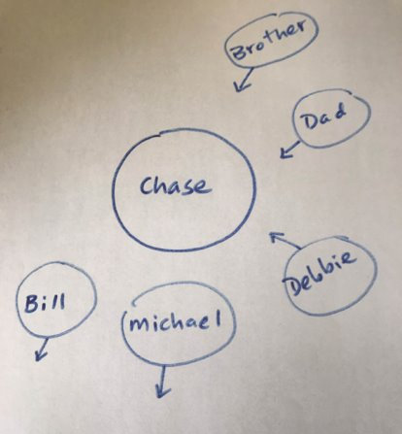
Chase's Social Universe

Slide 53
Social Universe Skill
How might you use this social universe assessment therapeutically?
Building hope (continuum) from the bottom up

Slide 54
Emotional Dimension
Main Treatment Planning Targets:
Excruciating Distress (Psychache!)
Affect dysregulation
Acute or chronic shame, guilt, sadness, or anger (conceptualize this as internalized oppression and re-externalize it)

Slide 55
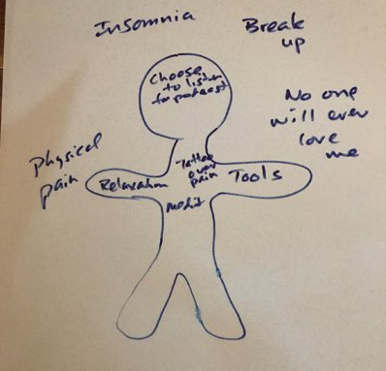
Emotional: Separate Pain From Self
Label problems and PAIN outside self.
Put strengths, strategies, and skills inside self

Slide 56

In Closing
What do you want to remember?
What can implement soon?
Thanks for being you . . .
Monitor and take care of yourself and your colleagues

Slide 57
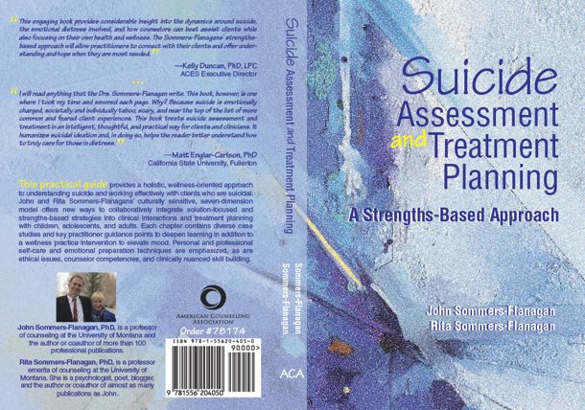

Books

Slide 58

Check up and Check-in

Slide 59
Free Resources
https://montanahappinessproject.com/
https://johnsommersflanagan.com/

Slide 60

Bonus Slides
Safety Planning

Slide 61
Behavioral
Main Treatment Planning Targets:
Suicide Desensitization
Lethal Means
Suicide Intent and Planning

Slide 62
Safety Planning (EBT)
How Can I Make My Environment Safe?**
My Unique Warning Signs
My internal Coping Strategies
People and Settings that Provide Support and Distraction
Who Can I Ask for Help?
Professionals or Agencies I Can Contact for Support
How I Can Make My Environment Even Safer?

Slide 63
Safety Planning
Follow the Stanley and Brown SPI protocol – or whatever your agency is using​
When you safety plan, be explicitly collaborative and compassionate​
To watch a safety planning example with a 15-year-old: https://johnsommersflanagan.com/2021/03/30/how-to-do-suicide-safety-planning-a-case-example/

