Slide 1

Counseling for Happiness
Facilitating Client and Student Wellness
The Montana Happiness Project
Presented at ACA 2023
John Sommers-Flanagan, Ph.D.
Professor of Counseling
University of Montana
For free resources, Go to: https://johnsommersflanagan.com/

Slide 2


Hello and Welcome
Thanks . . .
Introductions – JSF and the Montana Happiness Project
We work with corporations, government entities, and non-profits to facilitate happiness and reduce suicide

Slide 3


The Plan
This talk is NOT about toxic positivity
Last month and 1995 and the three-step emotional change trick
Let’s . . .
  Think together about the science of positive psych/happiness
  Learn and experience 4* PPIs
  Take away a few ideas to test in our lives – and maybe in your students’ lives

Slide 4

But Wait: Are You Happy?
What happens when you reflect on this question?
  Self-consciousness and self-awareness increase
  Stop It! It’s not a yes-or-no question.
  Preoccupation with happiness will mostly make you feel worse
  There are so many stupid happiness quotations on the internet that it makes me so unhappy I need to show you.

Slide 5


















Slide 6


Defining Happiness
We’re not talking about smiley hedonistic
(material) happiness . . .
That won’t last

Slide 7

Defining Happiness – 2
We’re talking about Aristotelian eudaimonic happiness: living well physically, psychologically, socially, spiritually, emotionally, and more. The secret to happiness is no secret . . .
Eudaimonic happiness
requires intention and effort
to live your virtues.

Slide 8
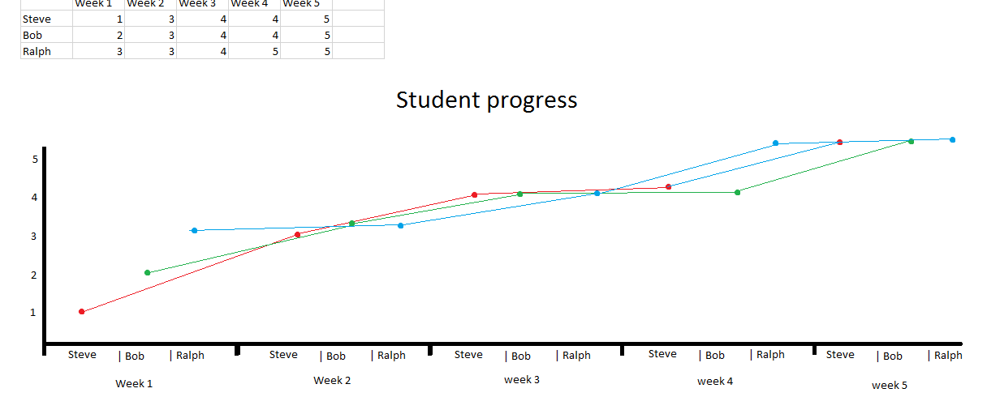
Principles of Happiness Practice
Nothing works for everyone (even EBTs)
Pick a tool or two and practice with an experimental mindset
Build on your strengths and
past successes [Don’t do what you
should do; do what you can do]

Slide 9



Now . . . Let’s explore
Evidence-Based Happiness* Tools

Slide 10

Tool #1: Three Good Things
Survey
Rumination is all-natural, but not helpful

Slide 11

Three Good Things
Seligman’s signature technique
  Before you go to sleep (or right now)
  Write down (or think about) three good things that happened during the day (or last 24 hours)
  Then track down in your mind “Why” those things happened
  Seligman: After a week, you’ll want to keep doing it (JSF: Maybe)
  Volunteer?

Slide 12
Why does Three Good Things Work?
When you go to bed, you inevitably and NATURALLY embark on either a negative (depressive) review or anticipatory (anxiety) preview
Thinking three good things shifts you partway
Identifying “Why” those things happened activates a brain search toward positive and empowering attributions (JSF)

Slide 13

The Attention Focus Tug of War

Slide 14
Tool #2: Attention Training and Attention Control
Attention control (aka mindfulness) ALWAYS FAILS; this failure is another natural obstacle to eudaimonic happiness
But Harvard study (n = 2,000+) paying attention to what you’re doing increases happiness ratings (JKZ)
The amazing brain – Now

Slide 15
Pretend Activity
Everyone
One minute
Begin at 1 and mentally count your “out” breaths
If you lose track, start back at 1
Be mindfully non-judgmental of losing track

Slide 16
Mindfulness Knowledge and Tricks
The mind is a yapping dog – Give it a bone – Mantra
Balance how much you care about being mindful with NOT CARING AT ALL about being mindful
Extend your outbreath (or use a soothing object) to engage the parasympathetic nervous system (and be less mentally jumpy)
Practice. But remember, practice DOES NOT make perfect

Slide 17

What to Remember. . .
Mindfulness is about accepting failure, not about ACHIEVEMENT
Notice your distractions; they are successes☺; mindful distractions
We accept and value the process
Mindfulness is about EXPERIENCING and ACCEPTING of the process of taking time to not try too hard to achieve mindfulness
Some of you will HATE the idea of mindfulness [ACCEPT that too]

Slide 18
Tool #3: Sleep Well
“What’s the most important thing for college student (or human) success?”
  The answer: “That’s easy, Sleep.”
  Why? Sleep disruption is linked to accidents, illness, lower achievement, depression, irritability, worse MH, suicidality, etc!
  Sleep paralysis, MHCC and the DSM – Wait a minute☺

Slide 19

Understanding sleep problems
Advice is cheap; but knowledge is POWER
What disrupts sleep? – The insomnias
What disrupts sleep? – Awakenings (nightmares)
What disrupts sleep? – Cognitions and behaviors [Expectations and poor sleep hygiene]

Slide 20

Almost Sleep:
The Relaxation Response
Herbert Benson – 1975
  A comfortable Position
  A quiet place
  A mental device [something to focus on]
  A passive attitude [mindful acceptance]

Slide 21

Many Paths to
Relaxation
Soccer consultation
Measure your calmness-tension 0-100
Deep breathing
Progressive muscle relaxation
Visual imagery
Autogenic training
Yoga, weight-lifting, or cardio, followed by one or more of the preceding
Find YOUR calming stimulus

Slide 22
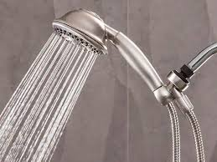
Sleep Hygiene
(Not just showering)
Routines
Daily exercise
Caffeine curfews
Light and dark and sound and comfort
Beds are for sleeping
Limit naps to less than 30 min [coffee naps]
Avoid certain foods
The temperature decline (Bath or shower)
Screen light exposure and Tech in the bedroom?
Have a plan for dealing with troubling thoughts and dreams [3 Good Things; mindfulness meditation]

Slide 23
Stunning Conclusions
Our Happiness Data on Sleep and Headaches
What do you want to remember about sleeping well?

Slide 24
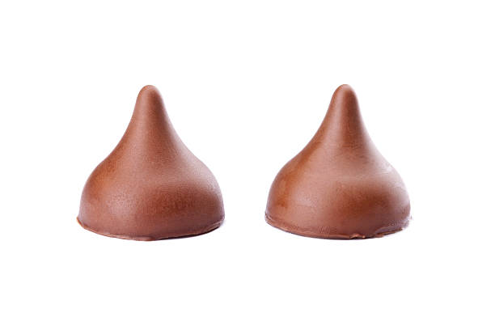
Tool #4: Savoring
What is savoring?
Deliberate effort to extend and expand positive experiences [improves mood; increases satisfaction]
  Track/review fun
  Track/review meaning
  Your next run/walk/shopping/conversation
  Chocolate kisses at Frenchtown HS (imagine something now)

Slide 25
What we do . . . Naturally. . .
The Opposite of Savoring
We dampen or spoil good experiences, while savoring or chewing on our mistakes
Anybody ever get stuck chewing on the negative or spoiling the positives? [Yet another natural obstacle to happiness]

Slide 26
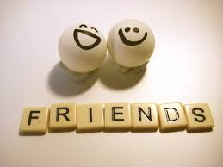
The Easiest Savoring
Mutual savoring
Find a friend – Remember when . . .
  Improves mood and hope
  Improves likelihood of repeating
  Increases planning
  How can you REMEMBER to savor the positives?

Slide 27

Tool #5: gratitude
Do you want to increase optimism, improve life satisfaction, be healthier, and exercise more?
Weave intentional gratitude into your life

Slide 28
Gratitude – Part 2
But the mind is built to count up hassles rather than blessings
“My two years of rejections”
  There had been many
    But there had also been much more
    This was like counting cloudy days – the outcome is easy to predict

Slide 29
Gratitude PRACTICE Now
Look around
Think of one thing, one person, one experience, one event, one goal, or one moment you’re thankful for.
Choose one of these things and write it down or pop it into the front of your brain.
Share with yourself or with a neighbor

Slide 30

Gratitude – Homework
To whom do you want to express gratitude?
Write a postcard or letter or email or text or IM of gratitude to a person you value
Even better: Tell the person directly
Results?? Not about the response.

Slide 31

Strategy #6: Coping with Triggers
Know Your triggers
Use a positive Planned Response
What situations and people tend to activate negative thoughts or unpleasant emotions or somatic distress?
Plan your “best” response in advance
Practice the response
Don’t expect perfection
Build a cushion (WGAY idea)

Slide 32

Strategy #7: Therapeutic Writing
James Pennebaker
Laura King
Writing about the hard (traumatic) stuff can increase mood and improve immune functioning
Writing positive essays about your “Best Possible Self” in the future can reduce depression and increase goal-orientation

Slide 33

Bonus
Positive Distractions
Life is hard
We all experience common unhappiness and wonder about ourselves
Emotions are a pain☺; your jobs are immensely stressful
Sometimes, we need distractions
  What songs help you feel your feelings or boost your mood? [JSF]
  What places? What cat videos? What . . . ?

Slide 34

For you and Your Clients and Students
Three-step emotional change trick
Three good things
Failing at mindfulness (which is a success)
Strategies for sleeping (or almost sleeping) well
Savoring
Gratitude
Coping with triggers
Therapeutic writing
Positive distractions

Slide 35

You will Remember . . . What to watch for
Average outcomes = +11%
Teach the 3-step emotional change trick
Notice your distractions when awake, and gently return to your focus
When you go to bed or wake up, which is going to happen anyway, think of this moment, and try 3 good things, mindfulness, or almost sleep

Slide 36
Final Conclusions
The brain, our culture, the news . . . are all built to track negativity
Well-being (eudaimonic happiness) requires awareness, intention, effort, reminders, and persistence
Most of us will forget to apply these unless we REMEMBER
Select and practice a few evidence-based positive psychology interventions and then see what happens.
Experiment! [Sign up for one of our “Happiness for Educators” courses]

Slide 37
Resources
For more homework ideas, just do an internet search: Sommers-Flanagan + Happiness Homework
University of Pennsylvania Positive Psychology Center: https://ppc.sas.upenn.edu/
Greater Good Magazine: https://greatergood.berkeley.edu/
The Montana Happiness Project: https://montanahappinessproject.com/

Slide 38
Words from a Happiness Student
Hi John,
Words are inadequate to express my gratitude for
the Happiness Class. Literally transforming my life
after a very difficult and sad nine months;
plus it’s a heckuva lot of fun. Again, thank you.
-- Happiness class student

