Slide 1

Men, Suicide, and Happiness
Helping Men Live Meaningful Lives
John Sommers-Flanagan
Matt Englar-Carlson
Daniel Salois

Slide 2


Morning Coffee with Men
Dan
Matt
John

Slide 3
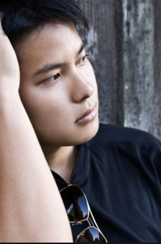
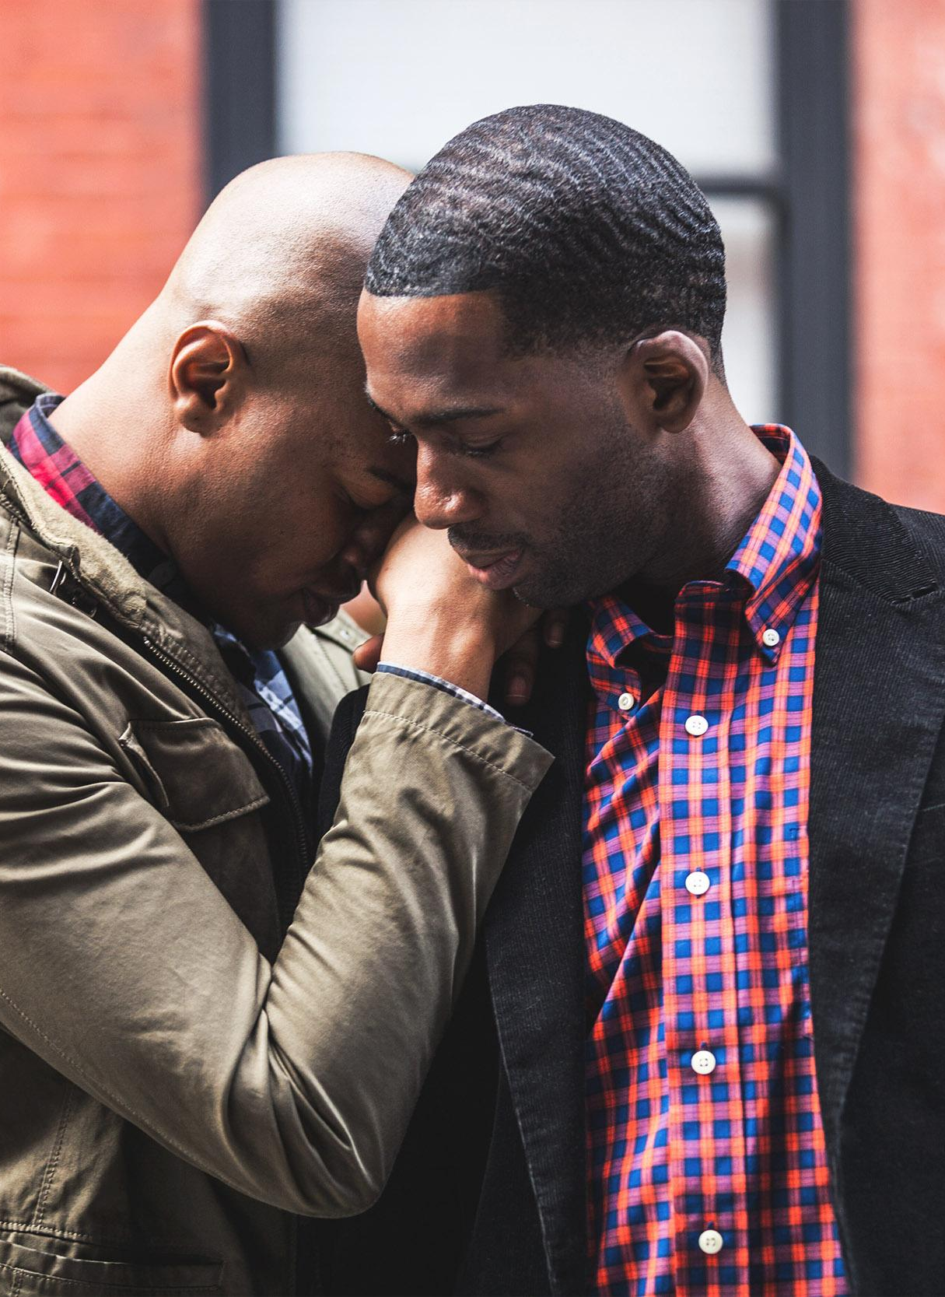

Why focus on men?
In Western countries significant disparity in suicide completion rates between men and women:
Roughly 4 to 1 male to female disparity over lifespan in Western countries
Relative silence on male suicide in relation to impact: Related to duality of oppression
Relative silence in relation to the significant concerns facing boys and men in Western society
Lack of success to reach the men who need the most help: mismatch between what men need and are offered

Slide 4
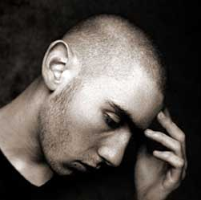
What Does Socialization Teach Men?
To Externalize Blame & Impact
To Self-Medicate
Anger is the Funnel Emotion
Emotional Expression Does Not Relive Stress
To Silence Intimacy Needs
To Avoid Health Care
Encourages men to adopt ideologies associated with health risk behaviors

Slide 5
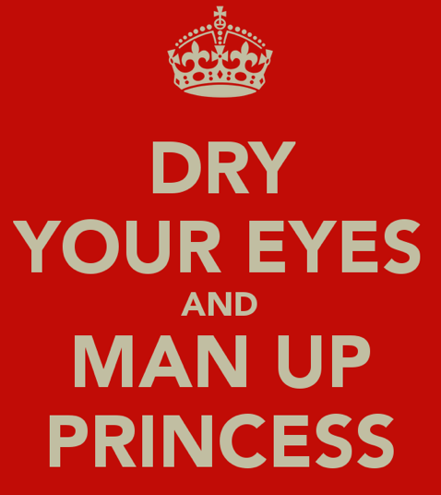
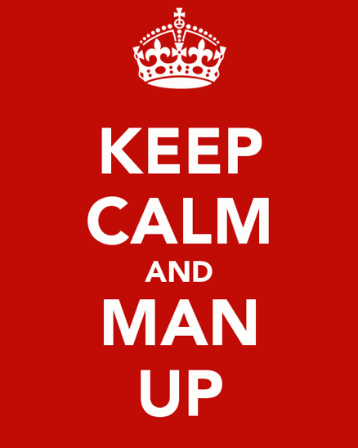
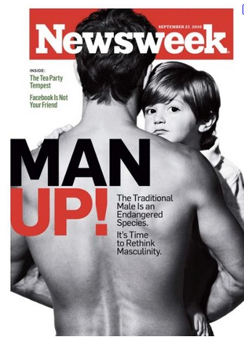
What stops men from talking about mental health
Shame
Fear of injury
Male gender role norms associated with independence and DIY
Other means of coping
Stigma: intersectional/vocational factors

Slide 6
Presenting Concerns of Men
Full range of psychological concerns
Although men have power & privilege, many men do not have access to that power
As they pursue power they experience pain, powerlessness, ill health and isolation>>>manifested as addiction, violence, interpersonal conflict, irritability
Often own psychic pain not obvious to men, thus in counseling not sure how to behave

Slide 7

Why Do Men Come to Therapy?
Relationship conflict or loss
Negative Affect (Depression and/or Anxiety)
Addiction Crisis/ Medicating Negative Affect
Court-mandated (anger, abuse, legal)
PTSD/Trauma/ Intrusive Consequences
Existential Crisis/ Loss of Meaning
Sexuality and Sexual Identity Concerns
Despair
Threats to their identity as men
Therapy is often last hope…present in acute distress

Slide 8
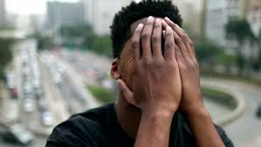
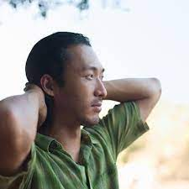
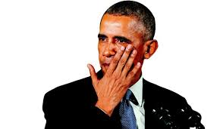
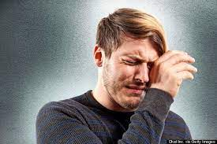
Emotions and Men
JSF and the case of Ruben
Socialization and modern men
Understanding link between emotions and context for men
Traditional person-centered emotional reflections
Using “safe” emotional language

Slide 9
Case of josh
Problems
Strengths
Depressive symptoms when season ended
Lack of identity outside of sport
Transitioning out of high school
Avoids intimacy
Injury history
Supportive FOO
Leader in friend group and on teams
Ambitious
Confident?

Slide 10
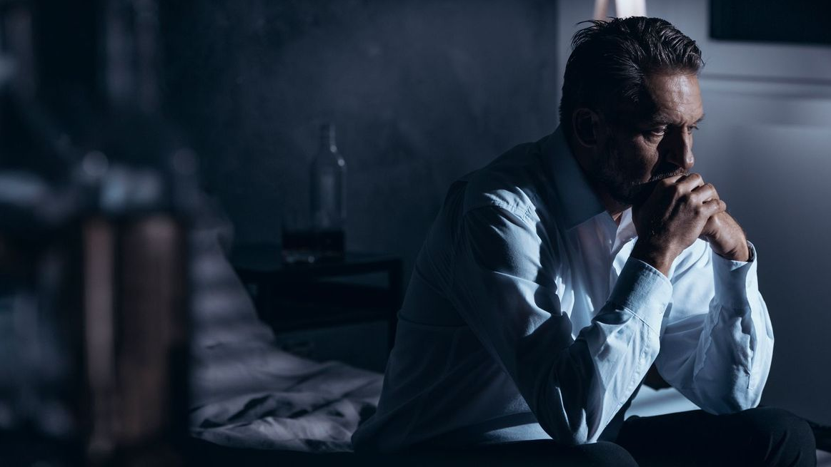
Understanding the why of Men and suicidality
Depression is main pathway to suicidality
Access to more lethal suicide means
More reluctant to seek help
Heavier users of drugs and alcohol
In response to stressful life events (divorce/separation, work problems), men more likely to withdraw, respond aggressively and/or experience depressive symptoms
Normalization of abuse/ violence, including self-harm
Smaller social networks and fewer friendships, less likely to have close confidant, particularly one other than a spouse
In times of stress men mobilize less varied social support
Notes:
Men experiencing depression are in a process of reconciling despair and countering suicide ideation

Slide 11
Masculinities as Suicide Risk Factor
Characteristics of traditional masculinity including independence, assertiveness, leadership, and dominance have strong correlations with suicidal thoughts in middle aged men
Threats to masculinity (e.g., loss of the role of breadwinner or household head) are associated with depression and suicidality
Solitary discourses around masculinity render men less socially connected, supported and networked than women, leaving them vulnerable to social isolation e a known risk factor for suicide
Men who align with masculine ideals are also more likely to engage maladaptive coping strategies, including alcohol and drug overuse
Men’s use of fast, violent methods (e.g., firearms, hanging) are distinctly masculine means to suicide
Media stories detailing suicide are known risk factors for vulnerable men
Notes:
Positive associations between adherence to masculine norms and suicidal thoughts:
Self-reliance associated with suicidal thinking
rigidity in sense of self and coping may be individual dispositions contributing to the suicide proneness

Slide 12
Suicide script theory
Unique situations when suicidal behavior is expected, from specific people, using specific methods, and with specific social responses and consequences
Suicide scripts organize, provide significance, and influence the frequency and dynamics of individual suicides.
In suicide-scripts theory, suicide is conceptualized as an idiom of distress with different meanings and consequences depending on culture, and within culture, by intersectionalities of, for example, age, sex, and ethnicity
Individual and cultural evidence suggests that male suicide may be enabled by its cultural acceptability, and also by its masculine connotation
Notes:
Example: in predominantly European-descent communities, suicide is deemed most acceptable when it involved an older adult and when it was precipitated by a physical illness
For example, European American men who rigidly and tenaciously abide to hegemonic-masculinity scripts, particularly the independent or the macho scripts, may be both least equipped for the challenges of aging, and most vulnerable to the indignities-of-aging suicide script. European American men may be particularly likely to act on the indignities-of-aging suicide script due to the connection, in European American culture, between masculinity and physical vigor, control, and autonomy.

Slide 13
Suicide Assessment: The Big Frame
Normalize and frame the question, while emphasizing suicide is a choice and being explicit about professional obligations
It’s not unusual
Men often don’t talk about it because they don’t want to be controlled
If you say the word suicide, I won’t immediately hospitalize you.
My goal is to help you live a high quality life
If you tell me you’re going out and shooting yourself this afternoon, I have a professional obligation
Broaden and build theory (Fredrickson, 2001)

Slide 14


Suicide Assessment: Three Techniques
  Direct questioning and strength questions (frequency of positive affect is more important than intensity): What relationships, what activities, what abilities, what accomplishments, what goals . . .
  Emotional scaling and suicidality
  That one thing question

Slide 15
Suicide interventions – Cory
  Using nuance and less directive and less emotional approaches to building a working alliance

Slide 16
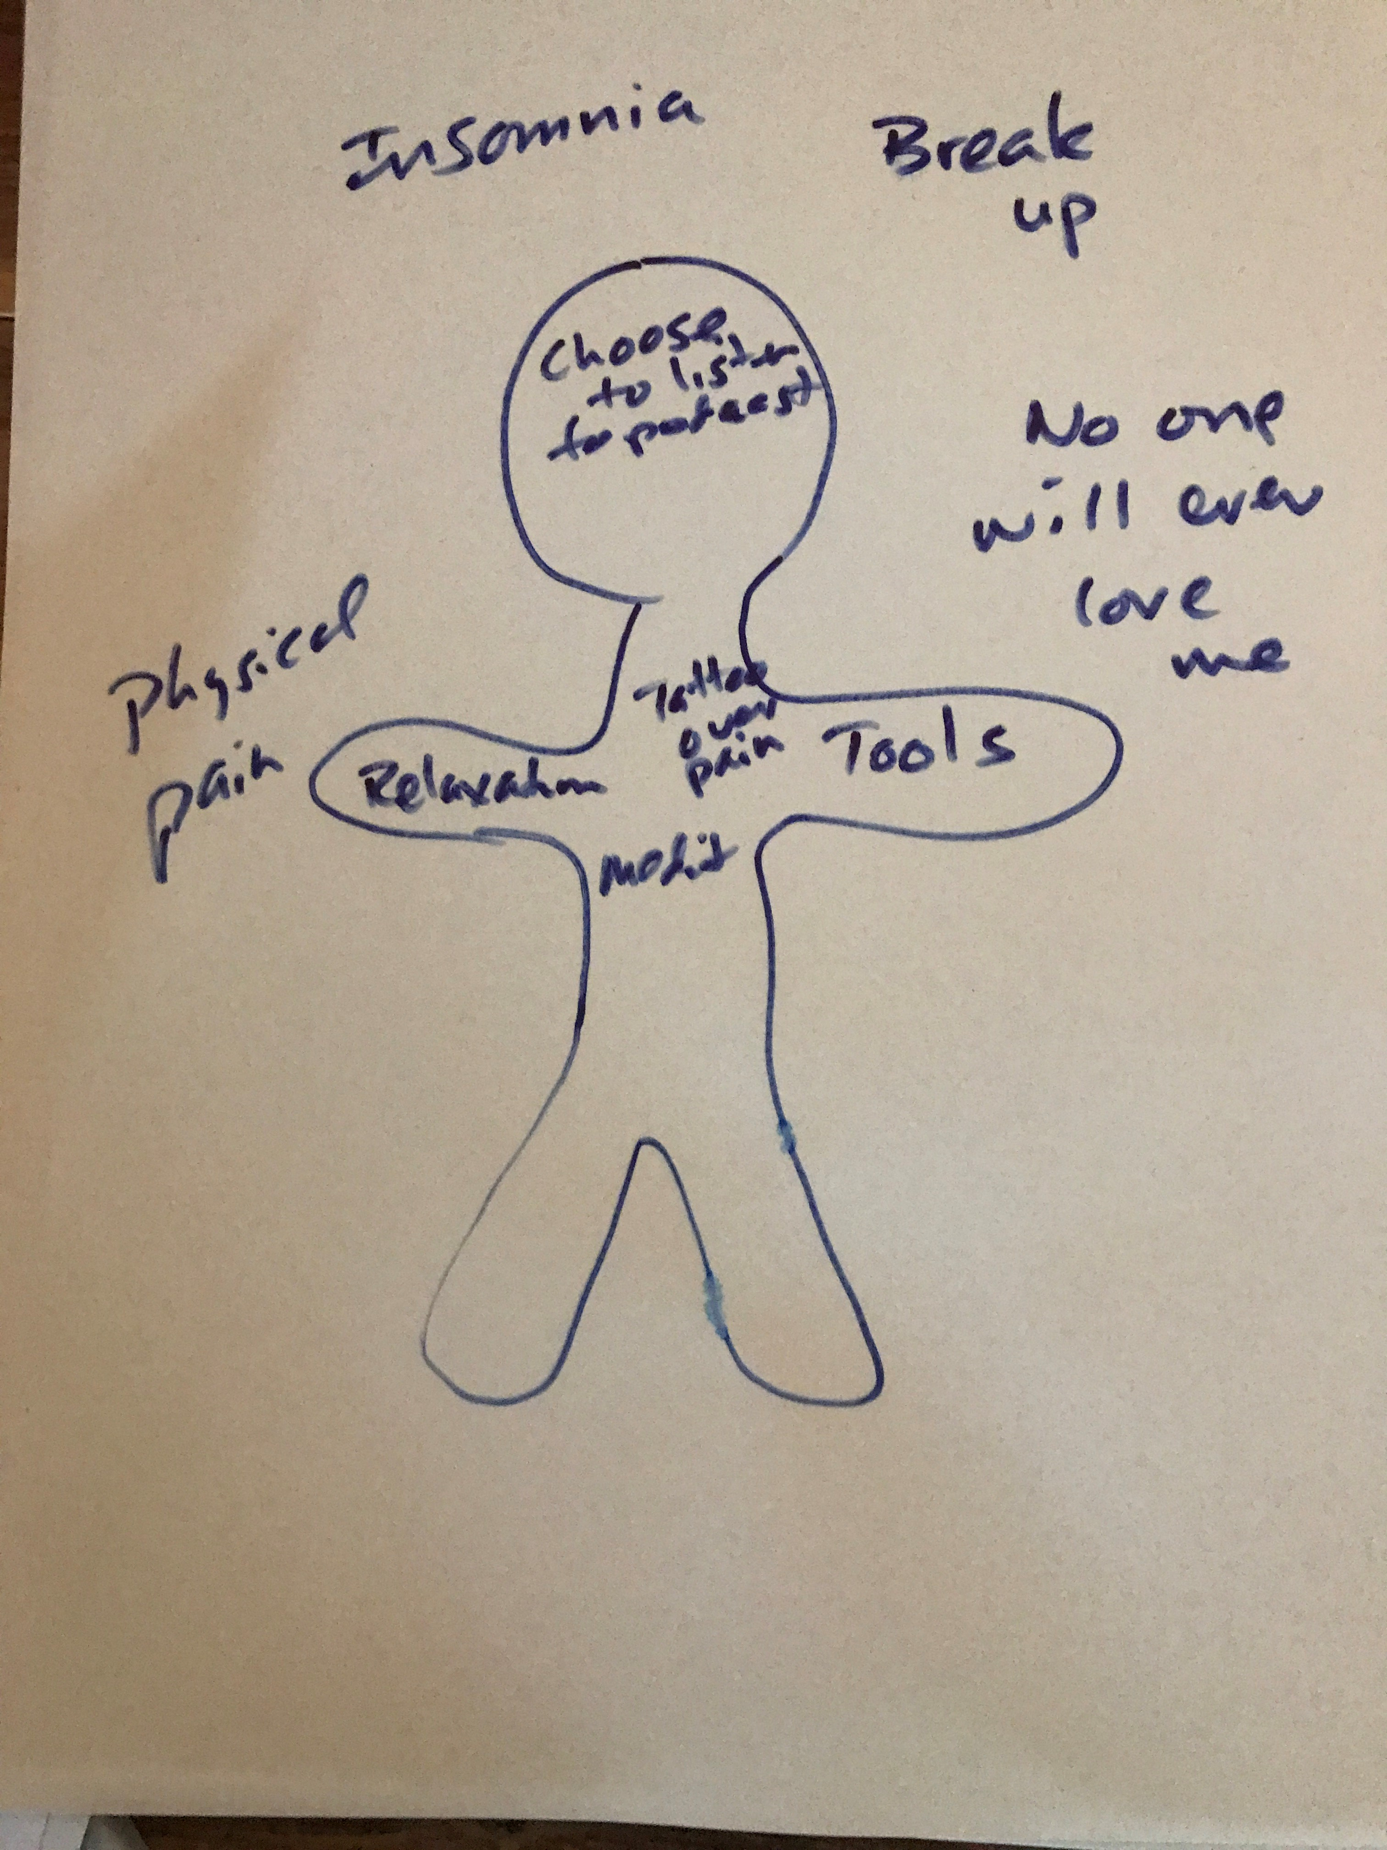
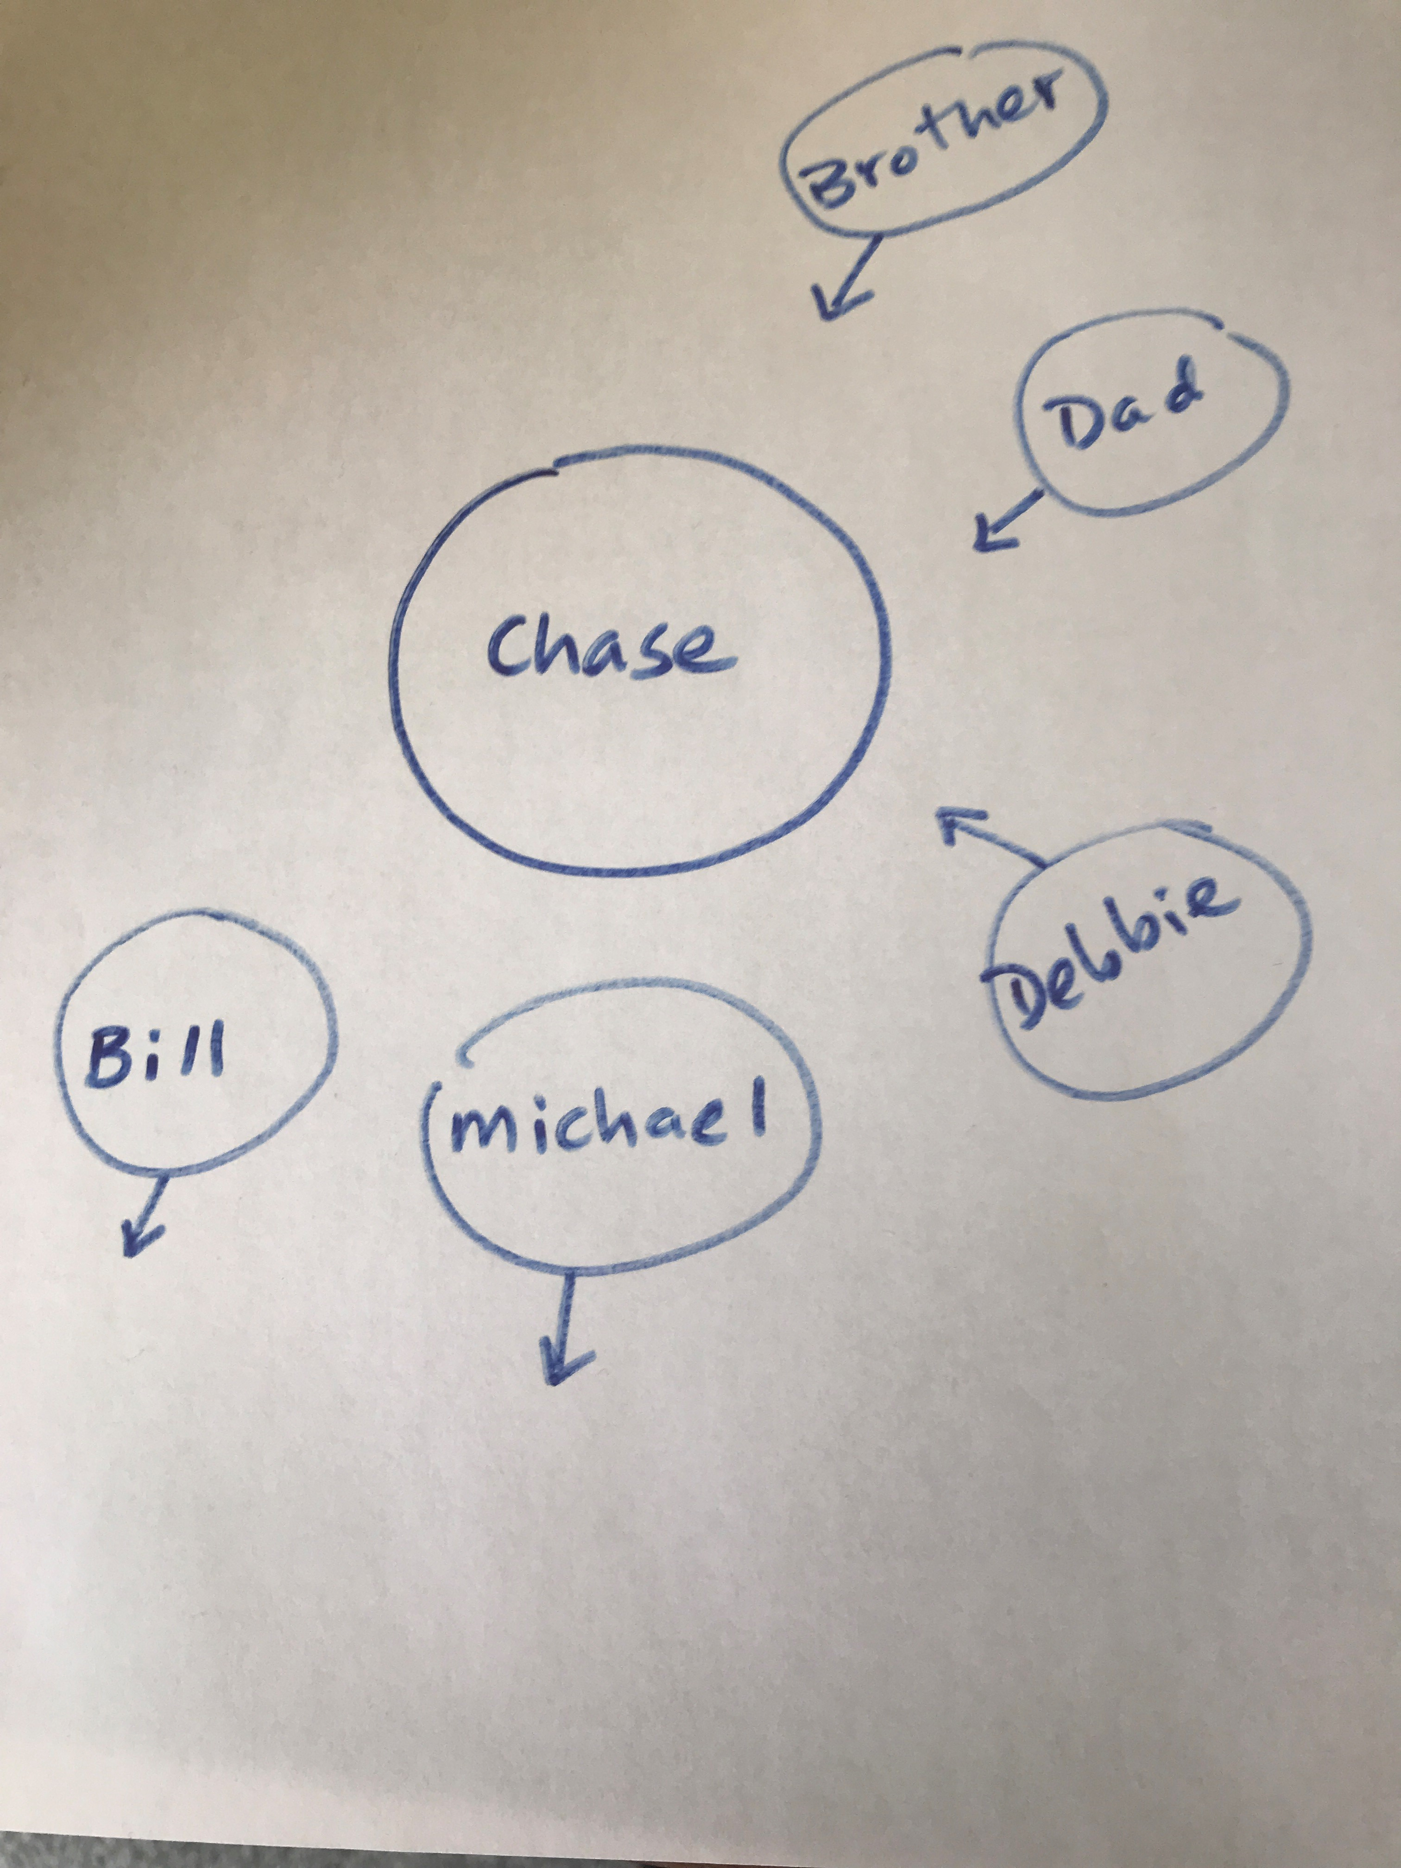
Suicide interventions – (Cont)
  Building hope from the bottom up
  Separating the pain from the self

Slide 17
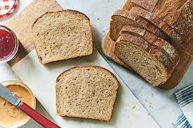
Suicide interventions – (Cont)
  Using direct and assertive strategies for addressing negative outcomes linked to hyper-masculinity and establishing counselor credibility [May I . . . ]
  Channeling or sublimating anger and aggressive impulses [Justice and social justice – meal delivery]
  Building belonging
  Feeling useful – Breadwinning+

Slide 18
Positive Psychology Interventions
Engaging men around “possible masculinities”: future focus, who is the man you want to be, engenders goal setting rather than shame on who one is not
Best Possible Self
Developing social interest: being a part of something bigger than oneself, pride at being of use (combats self-talk around lack of value)
Connections with social institutions (faith, spiritual, community)
Coping with distress through intentional acts of kindness, gratitude, and focusing on other’s well-being.
Identifying and aligning one’s life with values and purpose

Slide 19
Concluding Comments
Always be an advocate
Actively challenge suicide scripts around men and speak up

Slide 20
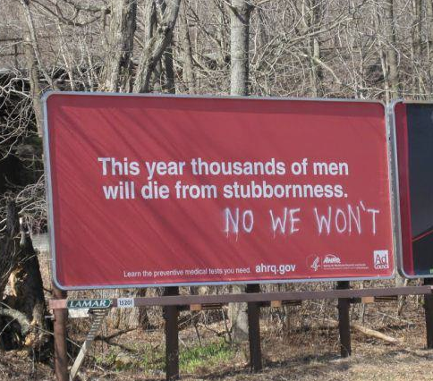

Slide 21


Thank You
We believe counselors need specialized awareness, knowledge, and skills to work effectively with men.
We want to open the doors to counseling for men.

Slide 22
For Info and ???s
Matt Englar-Carlson
mattec@Fullerton.edu

