Slide 1

Weaving Evidence-Based Happiness into the lives of Students and Educators
The Montana Happiness Project
First Annual Missoula Community Education Summit – 2/13/23
John Sommers-Flanagan, Ph.D.
Professor of Counseling
University of Montana
For free resources, Go to: https://johnsommersflanagan.com/

Slide 2


Hello and Welcome
Thanks to Erica Zins and Jenna Briggs
Introductions – JSF and Robert Ryan and research
My political platform – views of which are my own

Slide 3
Hello and Welcome
Thoughts on happiness* and the Montana Happiness Project
AMB – Grant – Deeply discounted (about 80% off) grad credit from UM – and in-services like this one (more on this later)

Slide 4


The Plan
This talk is NOT about toxic positivity
Last month and 1995 and the three-step emotional change trick
Let’s . . .
  Think together about the science of positive psych/happiness
  Learn and experience 7 PPIs
  Take away a few ideas to test in our lives – and maybe in your students’ lives

Slide 5
Ground Rules and Disclosures
Openness to learning
Respectful communication
To talk or not talk
To volunteer or not volunteer
Track your reactions; use what fits for you (because . . .)

Slide 6
Some History
In the beginning . . .
Psychology spent 100+ years mostly studying: What’s WRONG with YOU?
  Psychopathology and mental disorders
  Anxiety, depression, suicide, OCD, ADHD, ODD, PTSD, etc.
  Freud: “Neurotic misery” to “common unhappiness”

Slide 7

Why so Negative?
This mostly seems to be the way our brains are built

Slide 8

Enter: Positive Psychology
Martin Seligman – 1998 – San Francisco – Positive psychology
Let’s study joy, happiness, what strengthens people, and what makes people emotionally healthy and well?
Researchers began studying positive psychology interventions (aka PPIs) and developed evidence-based happiness practices

Slide 9

But Wait: Are You Happy?
What happens when you reflect on this question?
  Self-consciousness and self-awareness increase
  Stop It! It’s not a yes-or-no question.
  Preoccupation with happiness will mostly make you feel worse
  There are so many stupid happiness quotations on the internet that it makes me so unhappy I need to show you.

Slide 10


















Slide 11


Defining Happiness
We’re not talking about smiley hedonistic
(material) happiness . . .
That won’t last
because of hedonic adaptation . . . and
emotional opponent process theory

Slide 12
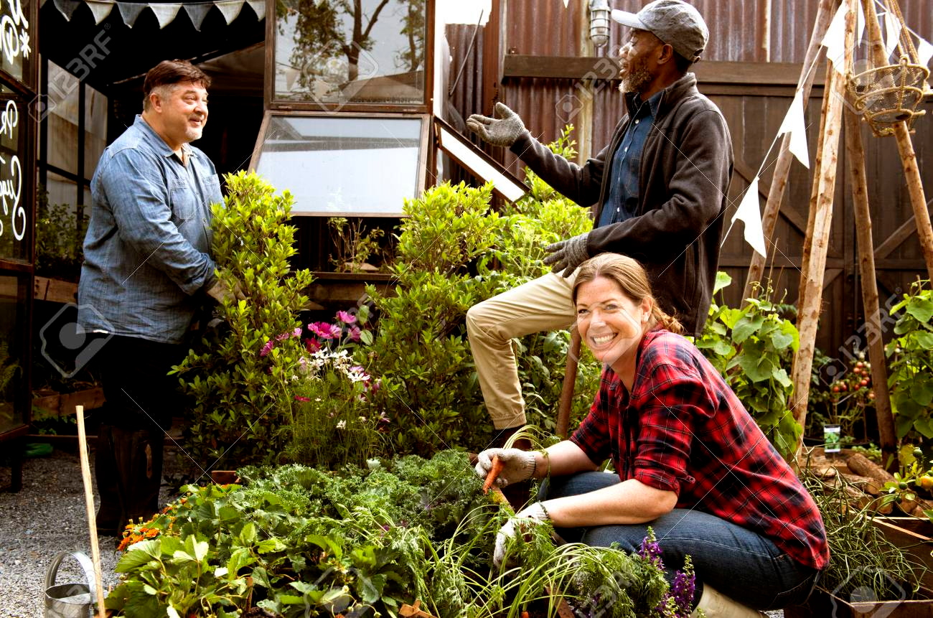
Defining Happiness – 2
We’re talking about Aristotelian eudaimonic happiness: living well physically, psychologically, socially, spiritually, emotionally, and more. The secret to happiness is no secret . . .
Eudaimonic happiness
requires intention and effort
to live your virtues.

Slide 13
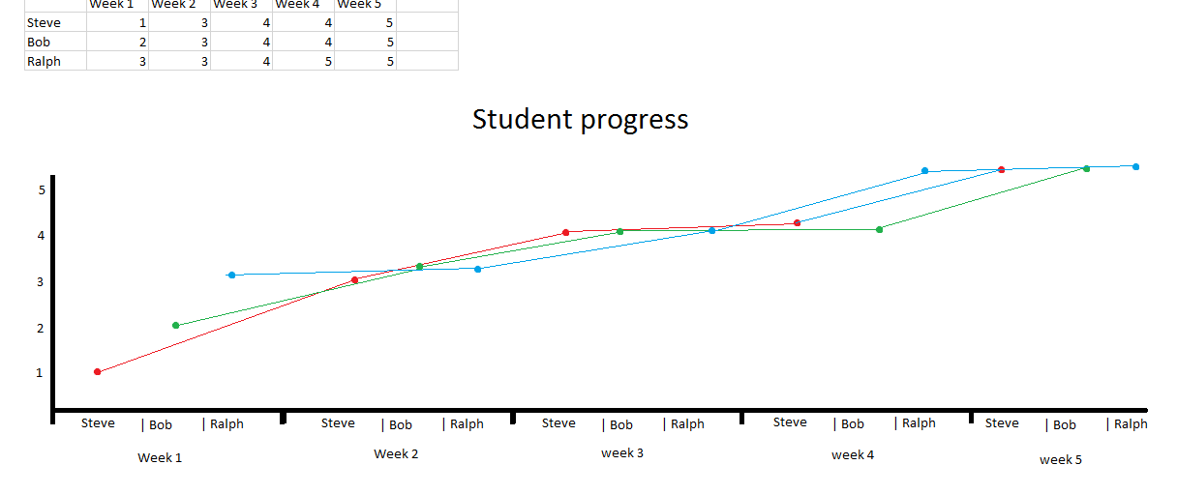
Principles of Happiness Practice
Nothing works for everyone (even EBTs)
Pick a tool or two and practice with an experimental mindset
Build on your strengths and
past successes [Don’t do what you
should do; do what you can do]

Slide 14


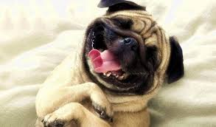
Now . . . Let’s explore Seven
Evidence-Based Happiness* Tools

Slide 15
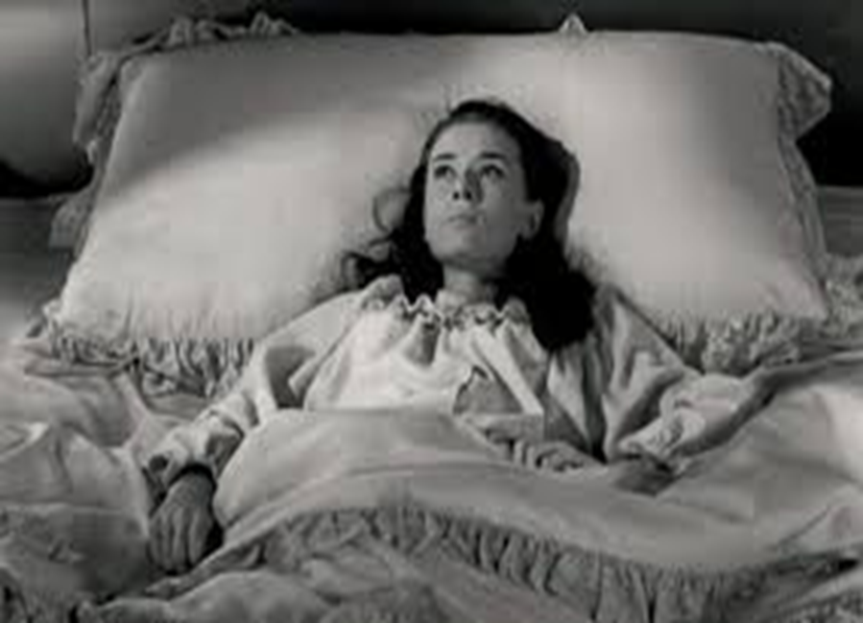
Tool #1: Three Good Things
Survey
Rumination is all-natural, but not helpful

Slide 16

Three Good Things
Seligman’s signature technique
  Before you go to sleep (or right now)
  Write down (or think about) three good things that happened during the day (or last 24 hours)
  Then track down in your mind “Why” those things happened
  Seligman: After a week, you’ll want to keep doing it (JSF: Maybe)
  Volunteer?

Slide 17
Why does Three Good Things Work?
When you go to bed, you inevitably and NATURALLY embark on either a negative (depressive) review or anticipatory (anxiety) preview
Thinking three good things shifts you partway
Identifying “Why” those things happened activates a brain search toward positive and empowering attributions (JSF)

Slide 18

The Attention Focus Tug of War

Slide 19
Tool #2: Attention Training and Attention Control
Attention control (aka mindfulness) ALWAYS FAILS; this failure is another natural obstacle to eudaimonic happiness
But Harvard study (n = 2,000+) paying attention to what you’re doing increases happiness ratings (JKZ)
The amazing brain – Now

Slide 20
Pretend Activity
Everyone
One minute
Begin at 1 and mentally count your “out” breaths
If you lose track, start back at 1
Be mindfully non-judgmental of losing track

Slide 21
Mindfulness Knowledge and Tricks
The mind is a yapping dog – Give it a bone – Mantra
Balance how much you care about being mindful with NOT CARING AT ALL about being mindful
Extend your outbreath (or use a soothing object) to engage the parasympathetic nervous system (and be less mentally jumpy)
Practice. But remember, practice DOES NOT make perfect

Slide 22

What to Remember. . .
Mindfulness is about accepting failure, not about ACHIEVEMENT
Notice your distractions; they are successes☺; mindful distractions
We accept and value the process
Mindfulness is about EXPERIENCING and ACCEPTING of the process of taking time to not try too hard to achieve mindfulness
Some of you will HATE the idea of mindfulness [ACCEPT that too]

Slide 23
Tool #3: Sleep Well
“What’s the most important thing for college student success?”
  The answer: “That’s easy, Sleep.”
  Why? Sleep disruption is linked to accidents, illness, lower achievement, depression, irritability, worse MH, suicidality, etc!
  Sleep paralysis, MHCC and the DSM – Wait a minute☺

Slide 24

Understanding sleep problems
Advice is cheap; but knowledge is POWER
What disrupts sleep? – The insomnias
What disrupts sleep? – Awakenings (nightmares)
What disrupts sleep? – Cognitions and behaviors [Expectations and poor sleep hygiene]

Slide 25
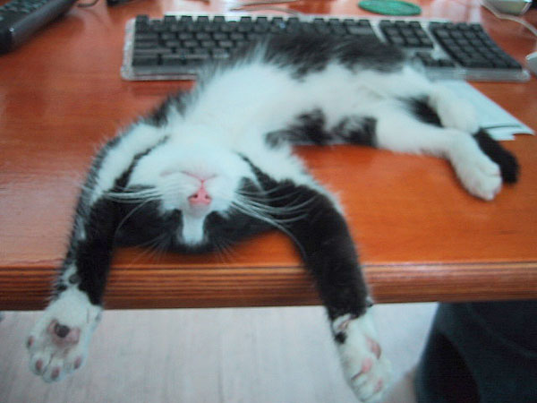
Almost Sleep:
The Relaxation Response
Herbert Benson – 1975
  A comfortable Position
  A quiet place
  A mental device [something to focus on]
  A passive attitude [mindful acceptance]

Slide 26

Many Paths to
Relaxation
Soccer consultation
Measure your calmness-tension 0-100
Deep breathing
Progressive muscle relaxation
Visual imagery
Autogenic training
Yoga, weight-lifting, or cardio, followed by one or more of the preceding
Find YOUR calming stimulus

Slide 27
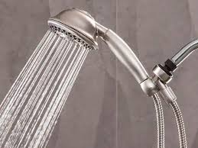
Sleep Hygiene
(Not just showering)
Routines
Daily exercise
Caffeine curfews
Light and dark and sound and comfort
Beds are for sleeping
Limit naps to less than 30 min [coffee naps]
Avoid certain foods
The temperature decline (Bath or shower)
Screen light exposure and Tech in the bedroom?
Have a plan for dealing with troubling thoughts and dreams [3 Good Things; mindfulness meditation]

Slide 28
Stunning Conclusions
Our Happiness Spring 2020 Data on Sleep and Headaches
What do you want to remember about sleeping well?

Slide 29
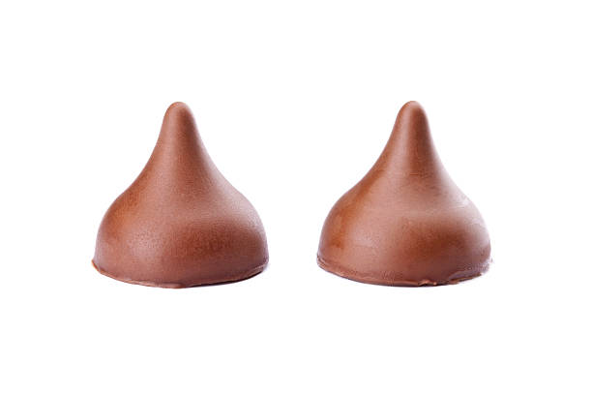
Tool #4: Savoring
What is savoring?
Deliberate effort to extend and expand positive experiences [improves mood; increases satisfaction]
  Track/review fun
  Track/review meaning
  Your next run/walk/shopping/conversation
  Chocolate kisses at Frenchtown HS (imagine something now)

Slide 30
What we do . . . Naturally. . .
The Opposite of Savoring
We dampen or spoil good experiences, while savoring or chewing on our mistakes
Anybody ever get stuck chewing on the negative or spoiling the positives? [Yet another natural obstacle to happiness]

Slide 31
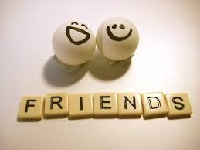
The Easiest Savoring
Mutual savoring
Find a friend – Remember when . . .
  Improves mood and hope
  Improves likelihood of repeating
  Increases planning
  How can you REMEMBER to savor the positives?

Slide 32

Tool #5: gratitude
Do you want to increase optimism, improve life satisfaction, be healthier, and exercise more?
Weave intentional gratitude into your life

Slide 33
Gratitude – Part 2
But the mind is built to count up hassles rather than blessings
“My two years of rejections”
  There had been many
    But there had also been much more
    This was like counting cloudy days – the outcome is easy to predict

Slide 34
Gratitude PRACTICE Now
Look around
Think of one thing, one person, one experience, one event, one goal, or one moment you’re thankful for.
Choose one of these things and write it down or pop it into the front of your brain.
Share with yourself or with a neighbor

Slide 35

Gratitude – Homework
To whom do you want to express gratitude?
Write a postcard or letter or email or text or IM of gratitude to a person you value
Even better: Tell the person directly
Results?? Not about the response.

Slide 36

Strategy #6: Coping with Triggers
Know Your triggers
Use a positive Planned Response
What situations and people tend to activate negative thoughts or unpleasant emotions or somatic distress?
Plan your “best” response in advance
Practice the response
Don’t expect perfection
Build a cushion (WGAY idea)

Slide 37

Strategy #7: Therapeutic Writing
James Pennebaker
Laura King
Writing about the hard (traumatic) stuff can increase mood and improve immune functioning
Writing positive essays about your “Best Possible Self” in the future can reduce depression and increase goal-orientation

Slide 38

Bonus
Positive Distractions
Life is hard
We all experience common unhappiness and wonder about ourselves
Emotions are a pain☺; your jobs are immensely stressful
Sometimes, we need distractions
  What songs help you feel your feelings or boost your mood? [JSF]
  What places? What cat videos? What . . . ?

Slide 39
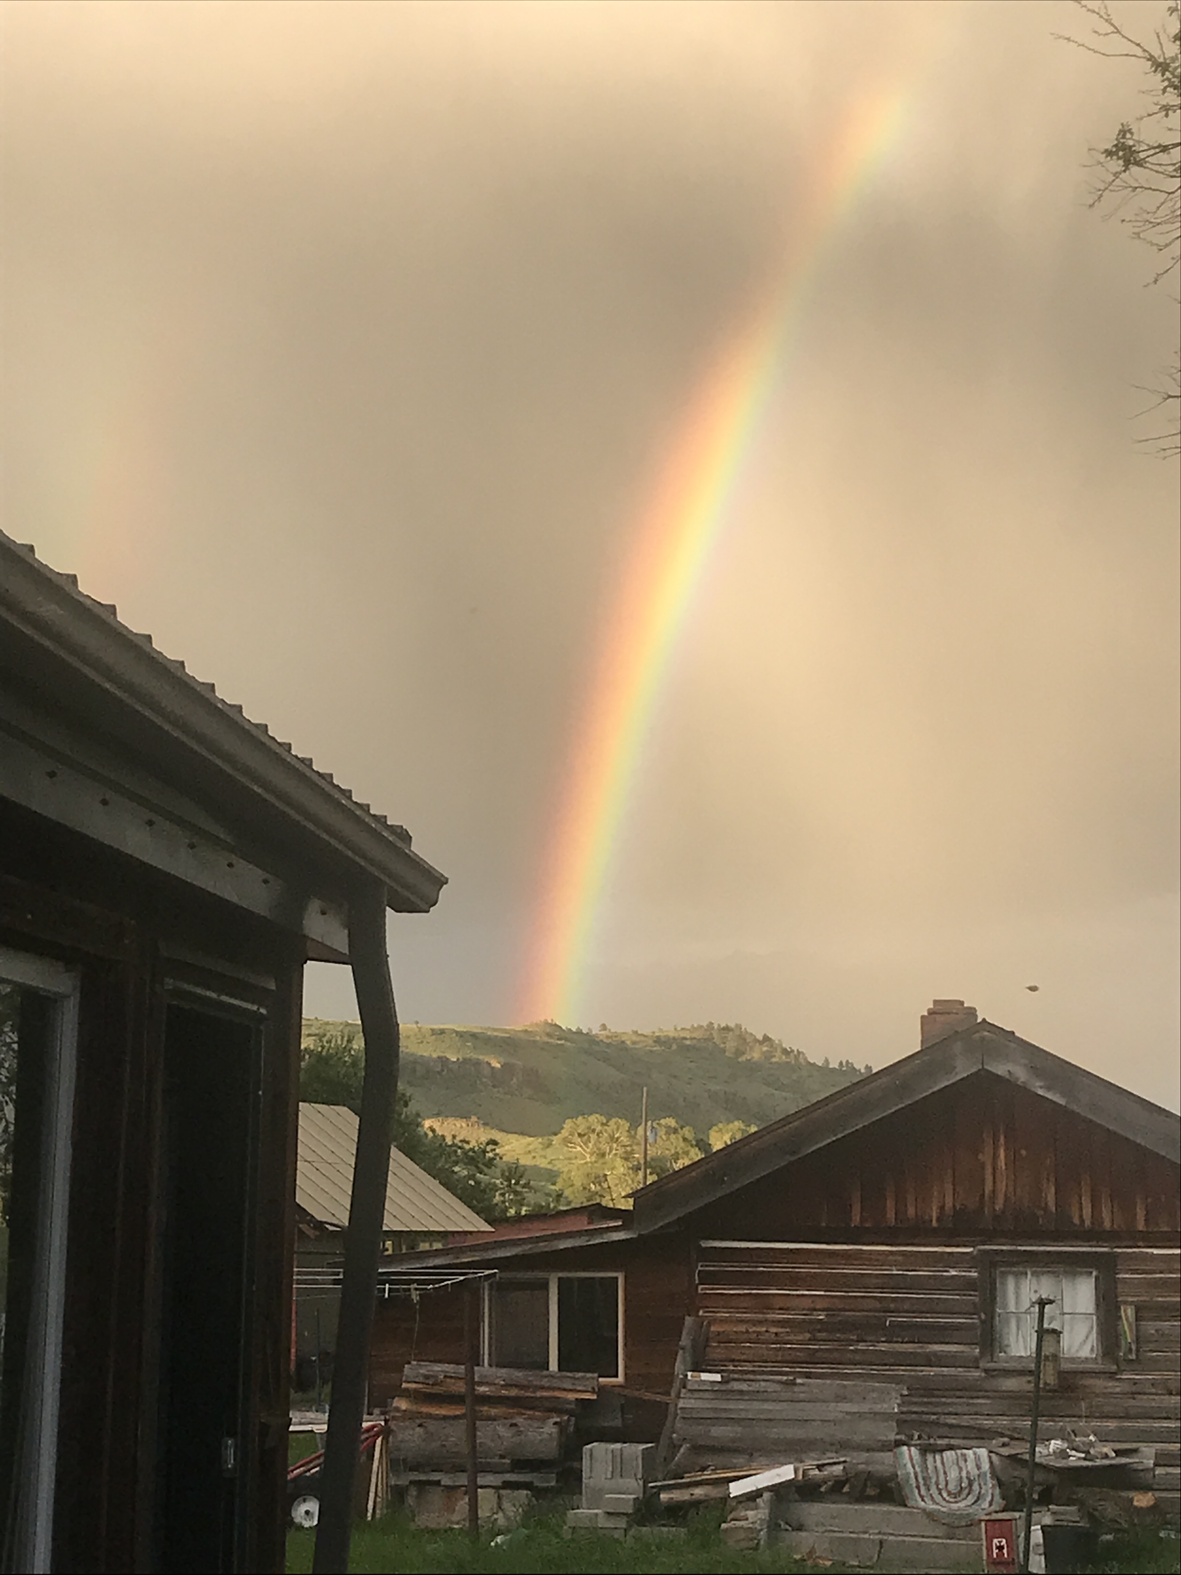
For you and Your Students
Three-step emotional change trick
Gratitude
Three good things
Failing at mindfulness (which is a success)
Strategies for sleeping (or almost sleeping) well
Savoring
Planning for triggers with your best response
Positive distractions

Slide 40

You will Remember . . . What to watch for
Average outcomes = +11%
Notice and nurture small signs of feeling nice about something meaningful
Notice your distractions when awake, and gently return to your focus
When you wake up, try 3 good things, mindfulness, or almost sleep
Savor when you can – try not to savor the negatives . . . Just learn from them and refocus
Get ready for and look forward to your triggers – they’re coming anyway

Slide 41
Final Conclusions
The brain, our culture, the news . . . are all built to track negativity
Well-being (eudaimonic happiness) requires awareness, intention, effort, reminders, and persistence
Most of us will forget to apply these unless we REMEMBER
Select and practice a few evidence-based positive psychology interventions and then see what happens.
Experiment! [Sign up for one of our “Happiness for Educators” courses]

Slide 42
Resources
For more homework ideas, just do an internet search: Sommers-Flanagan + Happiness Homework
University of Pennsylvania Positive Psychology Center: https://ppc.sas.upenn.edu/
Greater Good Magazine: https://greatergood.berkeley.edu/
The Montana Happiness Project: https://montanahappinessproject.com/

Slide 43
Words from a Happiness Student
Hi John,
Words are inadequate to express my gratitude for
the Happiness Class. Literally transforming my life
after a very difficult and sad nine months;
plus it’s a heckuva lot of fun. Again, thank you.
-- Happiness class student

