Slide 1
Exploring the Potential of
Evidence-Based Happiness
John Sommers-Flanagan, Ph.D.
University of Montana – Department of Counseling
john.sf@mso.umt.edu and https://johnsommersflanagan.com/
https://montanahappinessproject.com/

Slide 2
Introductions
Thanks Kyrie Russ
About me: Vancouver, USA, life goals, and failures
University of Montana X 5
Learning makes life better . . . [CP and PP]
Blogging at johnsommersflanagan.com

Slide 3
Introductions II
None Of Us Are Getting Out Of Here Alive...
“... So please stop treating yourself like an afterthought. Eat the delicious (and nutritious) food. Walk in the sunshine. Jump in the ocean. Say the truth you’re carrying in your heart like hidden treasure. Be silly. Be kind. Be weird. There’s no time for anything else.” - Nanea Hoffman

Slide 4
Our Ground Rules
Be open to learning
Communicate respectfully
Engage in experiential keynote activities to whatever extent you’re comfortable [*ignore me as needed]
Take care of yourself and have as much fun as we can as we learn together

Slide 5
HistorY
In the beginning, Psychology spent 100+ years mostly studying: What’s WRONG with YOU?
  Psychopathology and mental disorders
  Anxiety, depression, suicide, OCD, ADHD, ODD, PTSD, etc.
  Freud: “Neurotic misery” to “common unhappiness”
  Help people – just like you – become more aware of deficiencies and then usually fail in their efforts to fix them

Slide 6

Why so much Negative focus?
This seems to be the way our brains are built

Slide 7
Enter: Positive Psychology
Martin Seligman – 1998 – San Francisco – Positive psychology
Let’s study joy, happiness, what strengthens people, and what makes people emotionally healthy and well?
Seligman and others created evidence-based happiness/well-being interventions or activities . . . which we will get to soon

Slide 8

Defining Happiness
We’re not just talking about smiley hedonistic
(material) happiness . . . That won’t last
because of hedonic adaptation . . . and
emotional opponent process theory

Slide 9
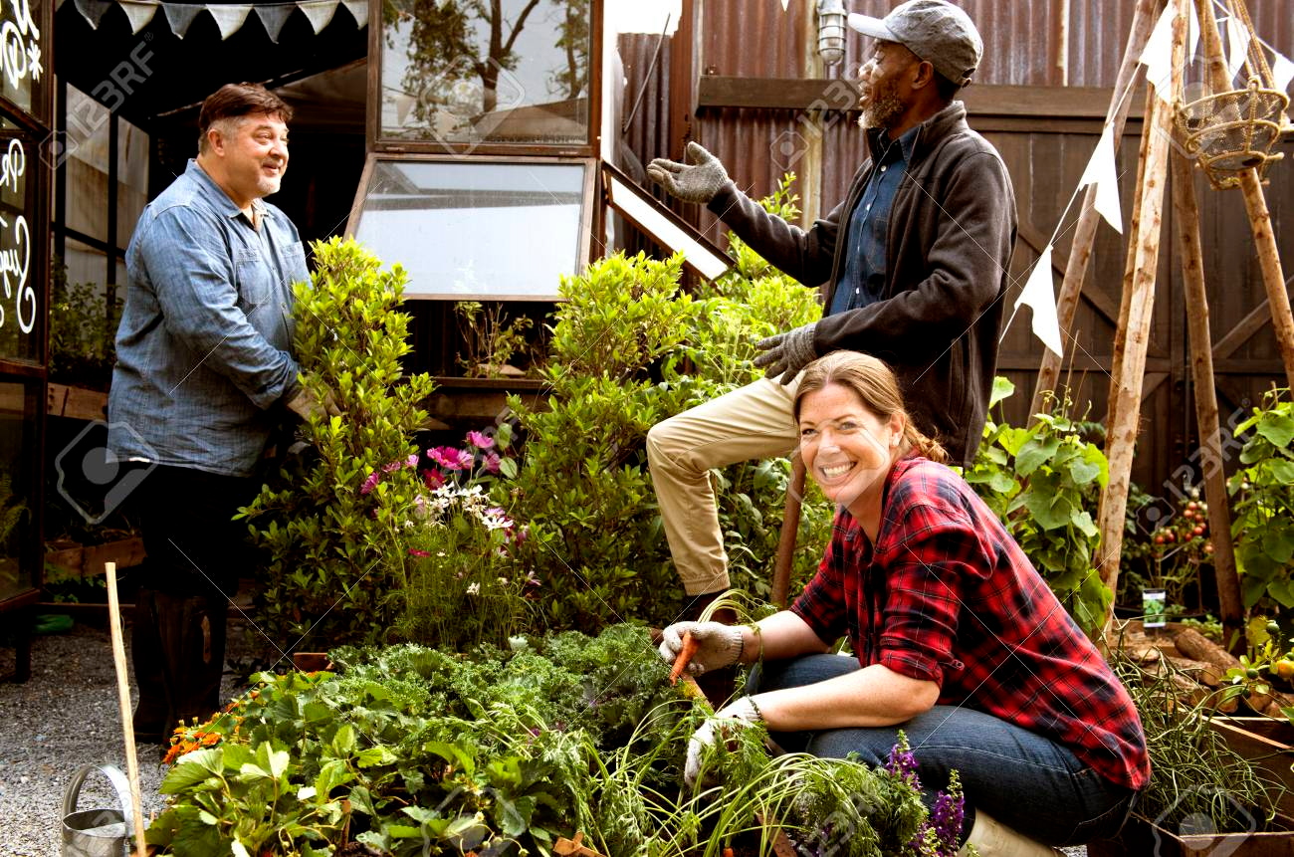
Defining Happiness – 3
We’re talking about Aristotelian eudaimonic happiness: living well physically, psychologically, socially, spiritually, emotionally, and more. The secret to happiness is no secret . . .
Eudaimonic happiness
requires effort

Slide 10
Big Principles of Happiness Practice
Nothing works for everyone (even EBTs)
Pick an EB tool or intervention and practice with an experimental mindset [Maybe one or two in five will work for you]
Build on your strengths and past successes [Don’t do what you should do; do what you can do]

Slide 11

The Plan:
CBT Happiness in Eight Chapters
  Body-mind stories
  Three good things
  Attentional control
  Cognitive storytelling
  Gratitude
  Savoring
  Planning
  Positive distractions and positive reinforcements

Slide 12
The Introduction
The three-step emotional change trick
Toxic positivity: Just cheer up – Smile – Be happy

Slide 13
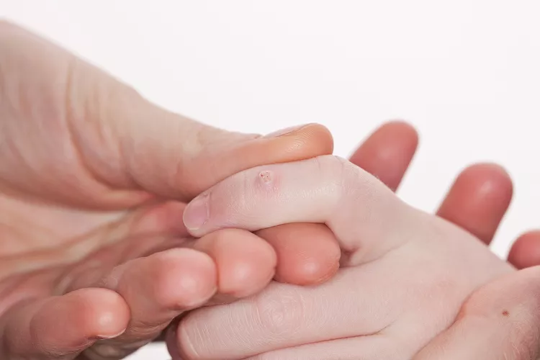
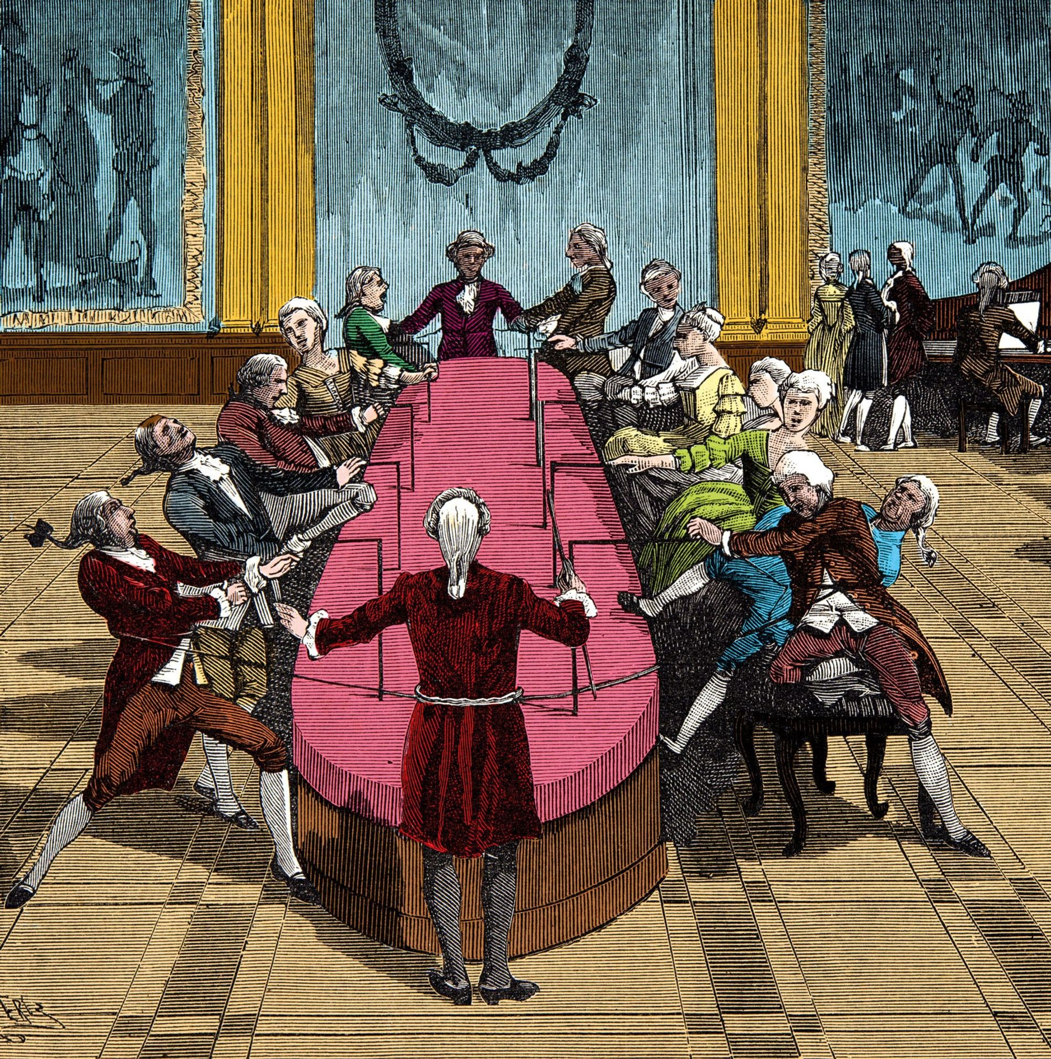
Chapter 1:
Tell me a story

Slide 14
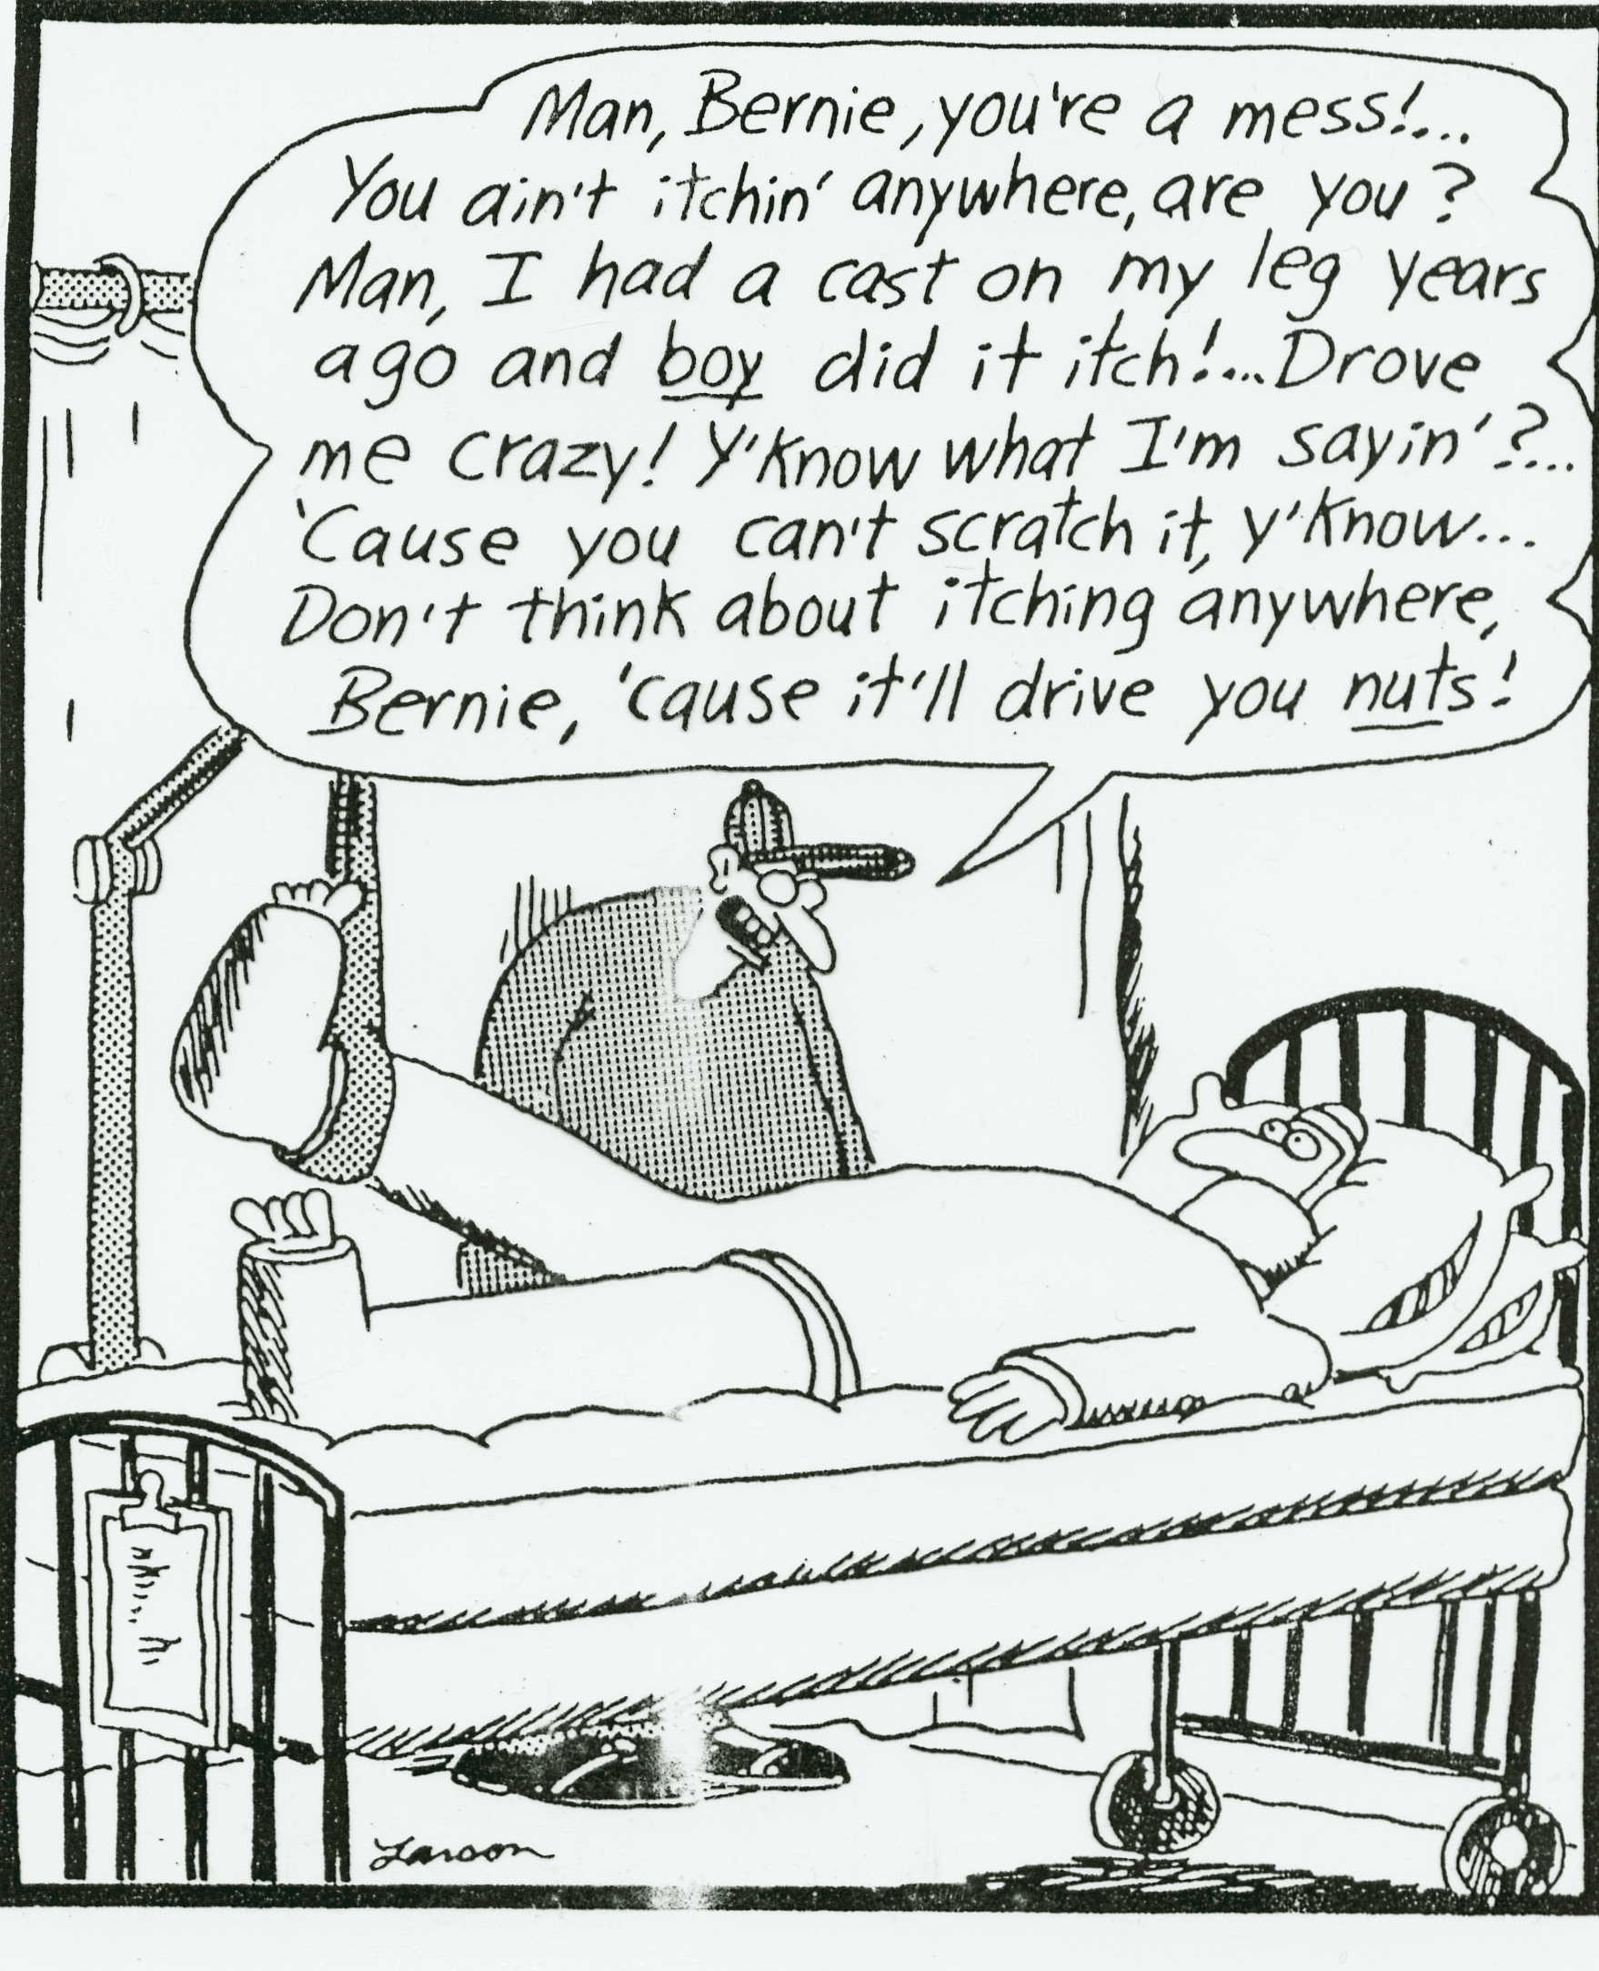

Slide 15

Chapter 1 – Part II: write me a story
There’s a tendency to choke off emotional expression . . . and avoid thinking about trauma . . . rather than actively exploring emotional pain and making meaning around it

Slide 16
Chapter 1 – Part II: write me a story
The Pennebaker study
½ are writing about trivia
½ are writing about thoughts and deeper emotions
Outcomes: Fewer medical visits; better immune functioning; happier

Slide 17
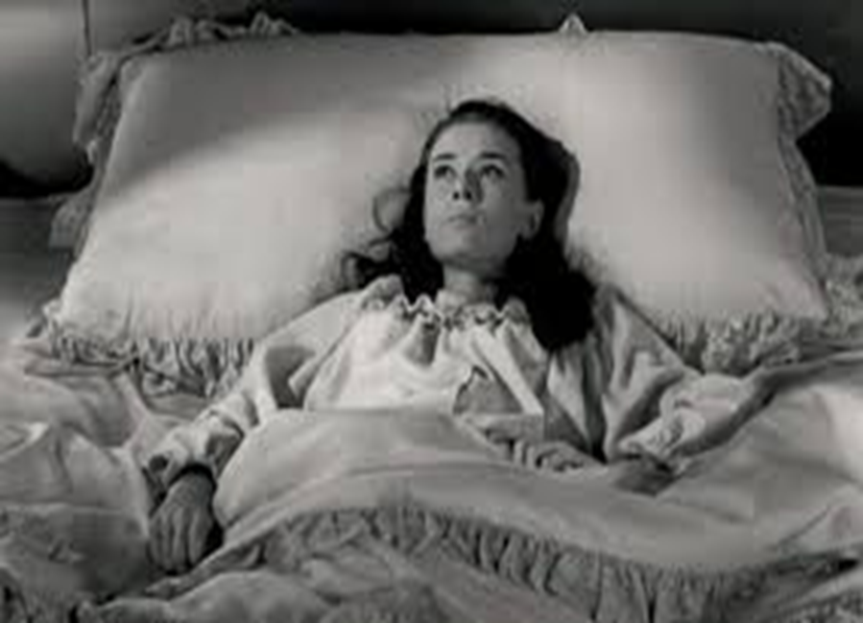
Chapter 2: Three Good Things
Survey
Rumination is all-natural, but not helpful

Slide 18
Three Good Things
Seligman’s signature technique
  Before you go to sleep (or right now)
  Write down (or think about) three good things that happened during the day (or last 24 hours)
  Then track down in your mind “Why” those things happened
  Seligman: After a week, you’ll want to keep doing it (JSF: Maybe)

Slide 19

Demonstration
A Volunteer – Three Good Things
Report three good things that happened during the day (or last 24 hours) . . . As you think of these three things, notice your thoughts and feelings
  What happens when. . . Spoiling
  Not remarkable [coffee; dog walk; talked to old friend]
  What it took (why): Self-awareness, initiative, set aside time

Slide 20
Why does Three Good Things Work?
When you go to bed, you inevitably and NATURALLY embark on a negative (depressive) review or anticipatory (anxiety) preview
Thinking three good things shifts you partway
Identifying “Why” those things happened activates a brain search toward positive and empowering attributions

Slide 21
Chapter 3: Attention Training and Attention Control
Attention control (aka mindfulness) ALWAYS FAILS; this failure is another natural obstacle to eudaimonic happiness
But Harvard study (n = 2,000+) paying attention to what you’re doing increases happiness ratings (JKZ)
The amazing brain – Now

Slide 22

The Attention Focus Tug of War

Slide 23
Pretend Activity
Everyone
Two minutes
Begin at 1 and mentally count your “out” breaths
If you lose track, start back at 1
Be mindfully non-judgmental of losing track

Slide 24
Mindfulness Knowledge and Tricks
The mind is a yapping dog – Give it a bone – Mantra
Balance how much you care about being mindful with NOT CARING AT ALL about being mindful
Extend your outbreath (or use a soothing object) to engage the parasympathetic nervous system (and be less mentally jumpy)
Practice. But remember, practice DOES NOT make perfect

Slide 25
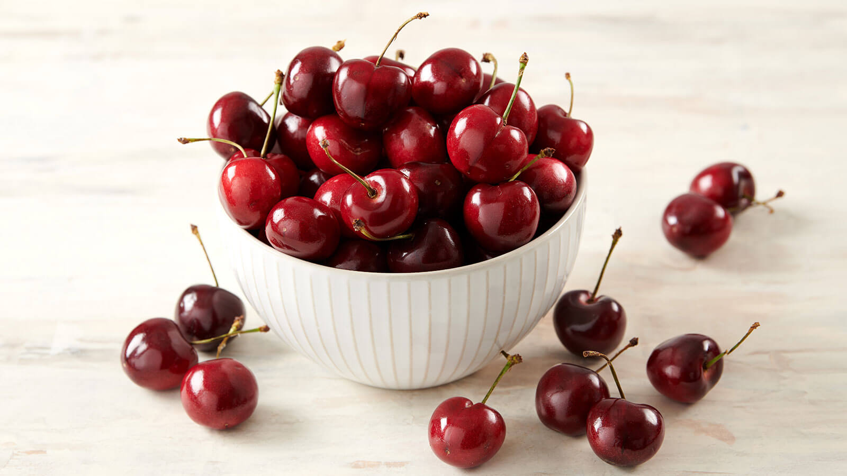
Chapter 4: Cognitive Storytelling

Slide 26

Cognitive Storytelling
It’s not what happens to us that causes us misery; it’s what we think about what happens to us that causes us misery
The Greek Stoics
Try telling these sorts of things to clients . . .

Slide 27

Chapter 5: gratitude
Do you want to increase optimism, improve life satisfaction, be healthier, and exercise more?
Weave intentional gratitude into your life

Slide 28
Gratitude – Part 2
But the mind is built to count up hassles rather than blessings
“My two years of rejections”
  There had been many
    But there had also been much more
    This was like counting cloudy days – the outcome is easy to predict

Slide 29
Gratitude PRACTICE
Take a moment to think of one thing you’re thankful for. Examples include a person, an event, something you’re good at, goals you have achieved, where you live, or opportunities. Choose one of these things you are grateful for and write this down or pop it into the front of your brain.

Slide 30
Gratitude PRACTICE II
Once you’ve got your gratitude focus, take a moment to ask yourself, “Why am I grateful for this?”
Write this reason down or pop it into the front of your brain.
Group reflection

Slide 31
Gratitude – Homework
Who do you want to express gratitude toward?
Write a postcard or letter or email or text or IM of gratitude to a person you value
Even better: Tell the person directly
Results?? Not about the response.

Slide 32
Chapter 6: Savoring
What is savoring?
Deliberate effort to extend and expand positive experiences [improves mood; increases satisfaction]
  Track/review fun
  Track/review meaning
  Your next run/walk/shopping/conversation

Slide 33
The Opposite of Savoring
We often dampen or spoil good experiences, while savoring or chewing on our mistakes
Anybody ever get stuck chewing on the negative or spoiling the positives? [Yet another natural obstacle to happiness]

Slide 34
Easy Savoring
Mutual savoring
Find a friend – Remember when . . .
  Improves mood and hope
  Improves likelihood of repeating
  Increases planning
  How can you REMEMBER to savor the positives?

Slide 35

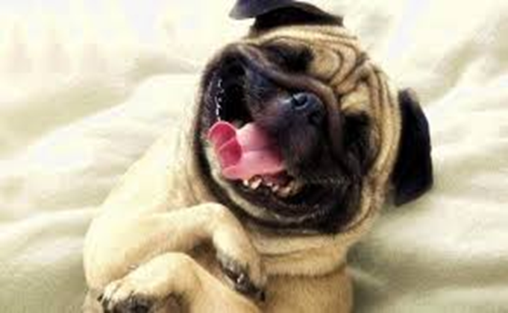
Chapter 7: Learning to Growl

Slide 36
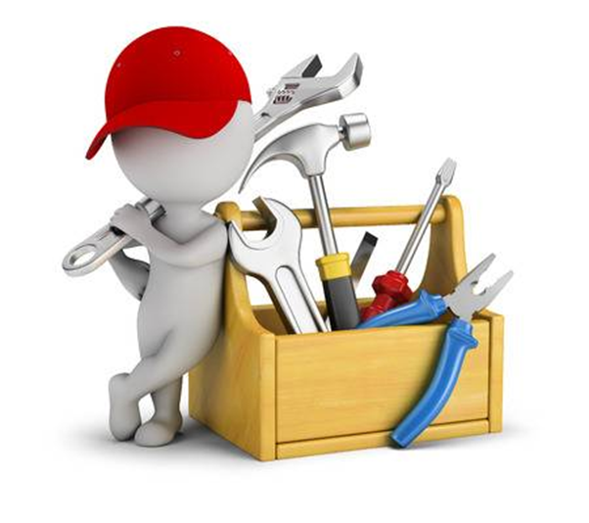
Chapter 8:
Positive Distractions
Life is hard
We all experience common unhappiness and wonder about ourselves
Emotions are a pain☺; your jobs are immensely stressful
Sometimes, we need distractions
  What songs help you feel your feelings or boost your mood? [JSF]
  What places? What cat videos? What . . . ?

Slide 37
Stunning Conclusions
The brain, culture, news . . . are all built to track negativity
Well-being (eudaimonic happiness) requires awareness, intention, effort, reminders, and persistence
Most of us will forget to apply these without reminders
Select and practice a few evidence-based positive psychology interventions and then see what happens.
Engage in collaborative empiricism!

Slide 38
Words from a Happiness Student
Hi John,
Words are inadequate to express my gratitude for
the Happiness Class. Literally transforming my life
after a very difficult and sad nine months;
plus it’s a heckuva lot of fun. Again, thank you.
-- Happiness class student

Slide 39
Resources
For more homework ideas, just do an internet search: Sommers-Flanagan + Happiness Homework
University of Pennsylvania Positive Psychology Center: https://ppc.sas.upenn.edu/
Greater Good Magazine: https://greatergood.berkeley.edu/
Positive Psychology: https://positivepsychology.com/
The Montana Happiness Project: https://montanahappinessproject.com/

Slide 40

Questions???
What felt important to you?
What strategies do you want to try out?

