Slide 1


Suicide Prevention and
The Pursuit of Happiness
Presented on Behalf of the Wallowa Valley Wellness Center
John Sommers-Flanagan, Ph.D.
Professor of Counseling
University of Montana
For free resources, Go to: https://johnsommersflanagan.com/

Slide 2


Gratitude
Thanks for being YOU
Thanks Mollie Cudmore☺

Slide 3
Trigger Warning*
Watch for your emotional buttons getting pushed in at least two ways
  Suicide is a hard topic and will be activating (And it’s so important to talk about that it makes me happy)
  I will say some things contrary to traditional suicide prevention

Slide 4

Today’s Plan
Opening: Problems and background info
Suicide prevention assumptions (myths?)
Suicide and happiness truths
Five evidence-based happiness skills
Questions and responses

Slide 5

The Problems
Over 40+ years, many individuals have been helped, but, overall:
  Anxiety and depression rates are worse
  PTSD and addiction rates are worse
  Autism and ADHD rates are worse
  Mental disorders are up and up
  Suicide rates are up
Thirty years ago . . . What I wish I knew then

Slide 6
Typical* Prevention Messages
Teen suicide is preventable. Prevention efforts should be aimed at all levels of influence: Individual, relationship, community and societal. Suicide rates for at-risk youth can be substantially reduced by:
  Knowing the signs. Four out of five suicide deaths are preceded by warning signs such as suicidal threats, previous suicide attempts, preoccupation or obsession with death, depression, and final arrangements.
  *From: https://www.americashealthrankings.org/explore/health-of-women-and-children/measure/teen_suicide/state/MT

Slide 7

Just Not True
Prevention efforts haven’t decreased overall suicide rates. In fact, from 1999 to 2019 suicide rates only went up, even though we did more state-wide and national suicide prevention than ever before in the history of time
Overall, the raw number of suicides have increased by about 60%
Suicide risk factors, protective factors, and warning signs are NOT good predictors of suicide (Franklin et al, 2017)

Slide 8
What we know about suicide
We should make every effort to prevent suicide, but not lead people to think they SHOULD be able to prevent suicides by “noticing signs”
Suicidal ideation – thinking of suicide – is not a sign of illness, mental disorder, sin, or good predictor of suicide; it’s a natural human response to disturbing circumstances [Prince Harry and Princess Meghan]
Suicidal ideation only means that people are in distress [Hopelessness]
Many unique factors contribute to distress (social and romantic relationships, feeling trapped, spiritual/religious disconnection, physical illness or injury or trauma or insomnia)

Slide 9
How to ask about suicide
Ask Directly AND Normalize: “It’s not unusual to have thoughts of suicide when . . .” “Have you had thoughts of suicide?”
Listen for distress and show empathy: “Sounds like what’s really hurting is . . .”
Normalize: “I’ve heard and I know that having thoughts of suicide feels horrible, but it doesn’t mean you’re crazy or anything like that.”
Ask about distress: “Where does it hurt? Or . . . What hurts most?”

Slide 10
What to Say
Thanks for telling me; thanks for being so honest, that takes courage.
What’s hurting and how can I help?
I know I can’t instantly make everything better, but, I want you to live and I want to help.
How can I best support you right now? Who else can help? What situations make you feel worse? What situations make you feel better?

Slide 11

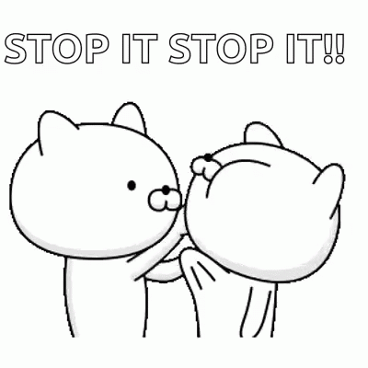
More Truth
Negative behaviors and problems are VERY difficult to stop
Marsha Linehan on “don’t think about suicide”
Most people want to be better and do better
Inspiring positive behaviors and crowding out negative behaviors works better than trying to get people to stop the negative

Slide 12



Now . . . Let’s explore
Evidence-Based Happiness Skills

Slide 13


















Slide 14

Defining Happiness
We’re not just talking about smiley hedonistic
(material) happiness . . . That won’t last
because of hedonic adaptation . . . and
emotional opponent process theory

Slide 15
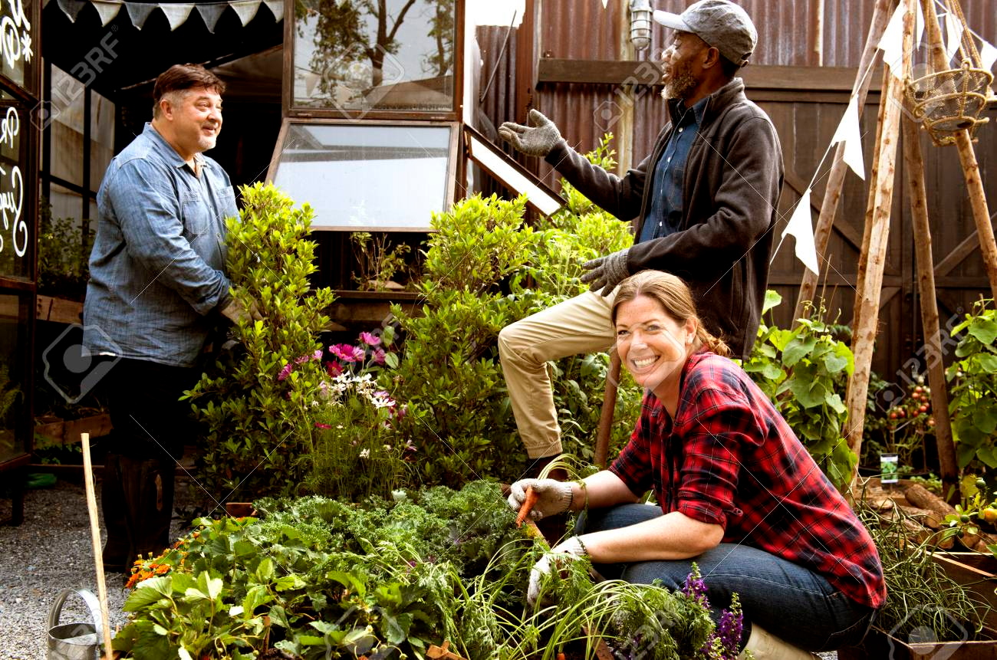
Defining Happiness – 2
We’re talking about Aristotelian eudaimonic happiness: living well physically, psychologically, socially, spiritually, emotionally, and more. The secret to happiness is no secret . . .
Eudaimonic happiness
requires effort

Slide 16
Big Principles of Happiness Practice
Nothing works for everyone (even EBTs)
Pick an EB skill or intervention and practice with an experimental mindset [Maybe one or two in five will work for you]
Build on your strengths and past successes [Don’t do what you should do; do what you can do]

Slide 17
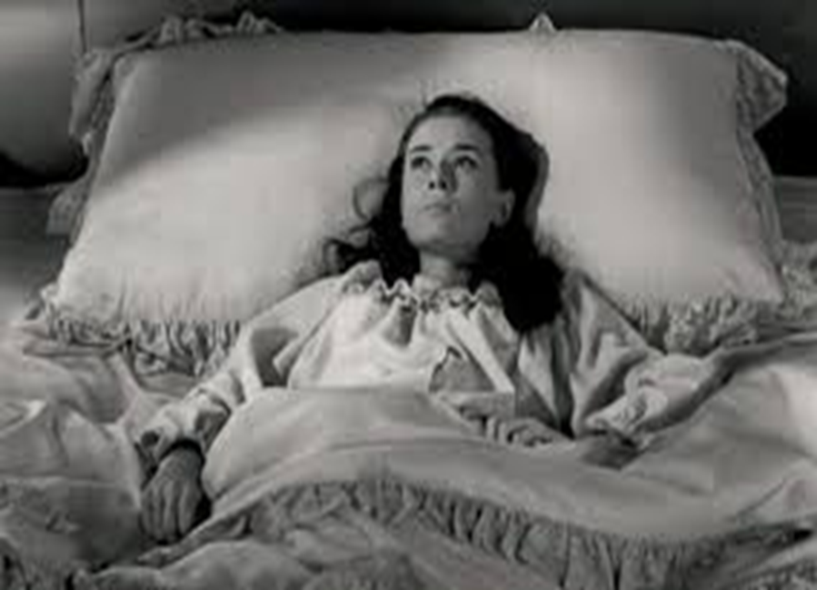
Skill #1: Three Good Things
Survey
Rumination is all-natural, but not helpful

Slide 18
Three Good Things
Seligman’s signature technique
  Before you go to sleep (or right now)
  Write down (or think about) three good things that happened during the day (or last 24 hours)
  Then track down in your mind “Why” those things happened
  Seligman: After a week, you’ll want to keep doing it (JSF: Maybe)
  DEMONSTRATION*

Slide 19
Why does Three Good Things Work?
When you go to bed, you inevitably and NATURALLY embark on either a negative (depressive) review or anticipatory (anxiety) preview
Thinking three good things shifts you partway
Identifying “Why” those things happened activates a brain search toward positive and empowering attributions

Slide 20
Skill #2: Sleep Well
“What’s the most important thing for college student and employee and human success?”
  The answer: “That’s easy, Sleep.”
  Why? Sleep disruption is linked to accidents, illness, lower achievement, depression, irritability, worse MH, suicidality, etc!
  Sleep paralysis, MHCC and the DSM – Wait a minute☺

Slide 21

Understanding sleep problems
Advice is cheap; but knowledge is POWER
Insomnia role play?
What disrupts sleep? – The insomnias
What disrupts sleep? – Awakenings (nightmares)
What disrupts sleep? – Cognitions and behaviors [Expectations and poor sleep hygiene]

Slide 22
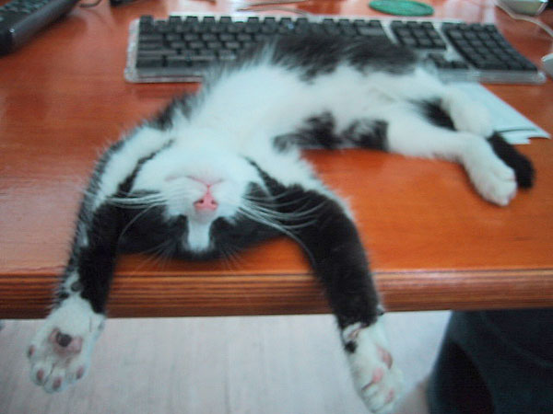
Almost Sleep:
The Relaxation Response
Herbert Benson – 1975
  A comfortable position
  A quiet place
  A mental device [something to focus on]
  A passive attitude [mindful acceptance]

Slide 23
Sleep Hygiene
(Not just showering)
Routines
Daily exercise
Caffeine curfews
Light and dark and sound and comfort
Beds are for sleeping
Limit naps to less than 30 min [coffee naps]
Avoid certain foods
The temperature decline (Bath or shower)
Screen light exposure and Tech in the bedroom?
Have a plan for dealing with troubling thoughts and dreams [3 Good Things; mindfulness meditation]

Slide 24
Final Thoughts ON Sleeping Well
Imagery Rehearsal Therapy
Our Spring 2020 Data on Sleep and Headaches
What do you want to remember about sleeping well?

Slide 25
Skill #3: Savoring
What is savoring?
Deliberate effort to extend and expand positive experiences [improves mood; increases satisfaction]
  Track/review fun
  Track/review meaning
  Your next run/walk/shopping/conversation

Slide 26
The Opposite of Savoring
We often dampen or spoil good experiences, while savoring or chewing on our mistakes
Anybody ever get stuck chewing on the negative or spoiling the positives? [Yet another natural obstacle to happiness]

Slide 27
Easy Savoring
Mutual savoring
Find a friend – Remember when . . .
  Improves mood and hope
  Improves likelihood of repeating
  Increases planning
  How can you REMEMBER to savor the positives?

Slide 28

Skill #4: gratitude
Do you want to increase optimism, improve life satisfaction, be healthier, and exercise more?
Weave intentional gratitude into your life

Slide 29
Gratitude – Part 2
But the mind is built to count up hassles rather than blessings
“My two years of rejections”
  There had been many
    But there had also been much more
    This was like counting cloudy days – the outcome is easy to predict

Slide 30
Gratitude PRACTICE
Take a moment to think of one thing you’re thankful for. Examples include a person, an event, something you are good at, goals you have achieved, where you live, or opportunities.
Once you’ve got your gratitude focus, take a moment to ask yourself, “Why am I grateful for this?”

Slide 31
Gratitude – Homework
Who do you want to express gratitude toward?
Write a postcard or letter or email or text or IM of gratitude to a person you value
Even better: Tell the person directly
Results?? Not about the response.

Slide 32
Skill #5: Coping with Triggers
Know Your triggers
Use a positive Planned Response
What situations and people tend to activate negative thoughts or unpleasant emotions or somatic distress?
Example: Relationship conflict
Plan your “best” response in advance
Practice the response
Don’t expect perfection

Slide 33
Stunning Conclusions
Some suicide myths might get in the way
Normalize suicidal thoughts; ask directly; show empathy; decrease distress
The brain, our culture, the news . . . are all built to track negativity
Well-being requires awareness, intention, effort, reminders, and persistence
Most of us will forget to apply these unless we have a reminder plan
Select and practice a few evidence-based happiness skills and see what happens. Experiment!

Slide 34
Words from a Happiness Student
Hi John,
Words are inadequate to express my gratitude for
the Happiness Class. Literally transforming my life
after a very difficult and sad nine months;
plus it’s a heckuva lot of fun. Again, thank you.
-- Happiness class student

Slide 35
Skill #6 (bonus): Positive Distractions
Life is hard
We all experience common unhappiness and wonder about ourselves
Emotions are a pain☺; your jobs are immensely stressful
Sometimes, we need distractions
  What songs help you feel your feelings or boost your mood? [JSF]
  What places? What cat videos? What . . . ?

Slide 36
Resources
For more homework ideas, just do an internet search: Sommers-Flanagan + Happiness Homework
University of Pennsylvania Positive Psychology Center: https://ppc.sas.upenn.edu/
Greater Good Magazine: https://greatergood.berkeley.edu/
Positive Psychology: https://positivepsychology.com/
The Montana Happiness Project: https://montanahappinessproject.com/

