Slide 1

How to apply evidence-based happiness interventions in your life
Presented on Behalf of the Hopes Project
John Sommers-Flanagan, Ph.D.
Professor of Counseling
University of Montana
For free resources, Go to: https://johnsommersflanagan.com/

Slide 2

The Plan
Why JSF is happy today > > >
This presentation is about science
Let’s think about happiness together, do some experiential learning together, and take away a few ideas to test in our lives

Slide 3
Ground Rules and Disclosures
Openness to learning
Respectful communication
Talk or not talk
Volunteer or not volunteer
Track your reactions; use what fits for you (because . . .)

Slide 4
Some History
In the beginning Psychology spent 100+ years mostly studying: What’s WRONG with YOU?
  Psychopathology and mental disorders
  Anxiety, depression, suicide, OCD, ADHD, ODD, PTSD, etc.
  Freud: “Neurotic misery” to “common unhappiness”
  Help people – just like you – become more aware of deficiencies and often fail in their efforts to fix them

Slide 5
David Myers 1967-2000 Study
Articles About
Articles About
Depression: 54,040
Anxiety: 41,416
Anger: 5,584
Overall Ratio: 21/1 – Why?
How could this be?
Life Satisfaction: 2,582
Happiness: 1,710
Joy: 415

Slide 6

Why so Negative?
This mostly seems to be the way our brains are built

Slide 7
Enter: Positive Psychology
Martin Seligman – 1998 – San Francisco – Positive psychology
Let’s study joy, happiness, what strengthens people, and what makes people emotionally healthy and well?
Seligman and others created evidence-based happiness/well-being interventions or activities

Slide 8

But First: Are You Happy?
What happens when you reflect on this question?
  Self-consciousness and self-awareness increase
  We aren’t meant to expect or monitor for constant happiness . . .
  Stop It! It’s not a yes-or-no question.
  Preoccupation with happiness will mostly make you feel worse [There are so many stupid happiness quotations on the internet that it makes me so unhappy I need to show you.]

Slide 9


















Slide 10

Defining Happiness
We’re not just talking about smiley hedonistic
(material) happiness . . . That won’t last
because of hedonic adaptation . . . and
emotional opponent process theory

Slide 11

Defining Happiness – 2
Hedonic adaptation: Your new car (or house or boyfriend or award or facelift gets old and you want more)
Emotional opponent process theory: What
goes up, must come down; and what goes
down, must come up

Slide 12
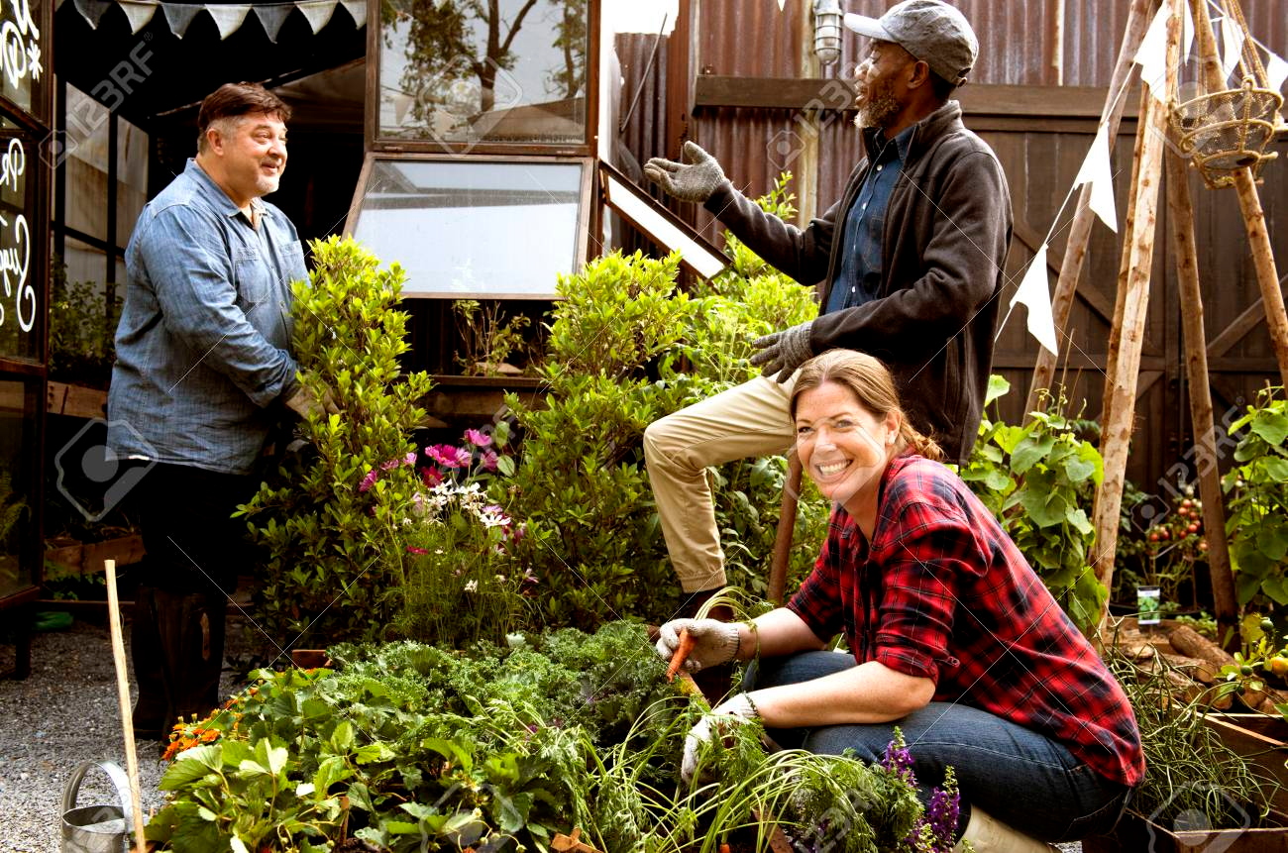
Defining Happiness – 3
We’re talking about Aristotelian eudaimonic happiness: living well physically, psychologically, socially, spiritually, emotionally, and more. The secret to happiness is no secret . . .
Eudaimonic happiness
requires effort

Slide 13
Big Principles of Happiness Practice
Nothing works for everyone (even EBTs)
Pick an EB tool or intervention and practice with an experimental mindset [Maybe one or two in five will work for you]
Build on your strengths and past successes [Don’t do what you should do; do what you can do]

Slide 14



Now . . . Let’s explore the
Evidence-Based Strategies

Slide 15
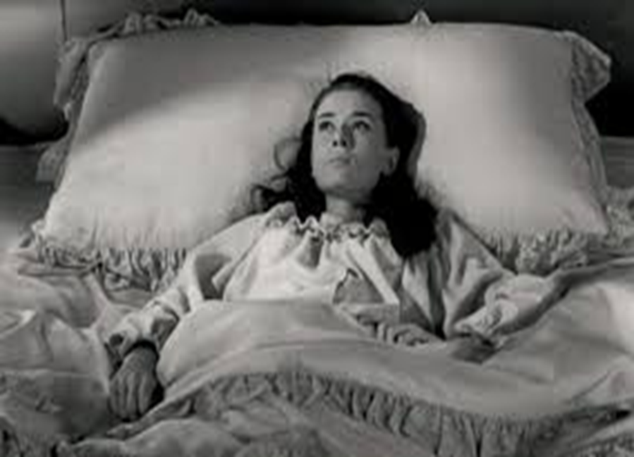
Strategy #1: Three Good Things
Survey
Rumination is all-natural, but not helpful

Slide 16
Three Good Things
Seligman’s signature technique
  Before you go to sleep (or right now)
  Write down (or think about) three good things that happened during the day (or last 24 hours)
  Then track down in your mind “Why” those things happened
  Seligman: After a week, you’ll want to keep doing it (JSF: Maybe)

Slide 17

Demonstration
A Volunteer – Three Good Things
Report three good things that happened during the day (or last 24 hours) . . . As you think of these three things, notice your thoughts and feelings
  What happens when. . . Spoiling
  Not remarkable [coffee; dog walk; talked to old friend]
  What it took (why): Self-awareness, initiative, set aside time

Slide 18
Why does Three Good Things Work?
When you go to bed, you inevitably and NATURALLY embark on either a negative (depressive) review or anticipatory (anxiety) preview
Thinking three good things shifts you partway
Identifying “Why” those things happened activates a brain search toward positive and empowering attributions

Slide 19

The Attention Focus Tug of War

Slide 20
Strategy #2: Attention Training and Attention Control
Attention control (aka mindfulness) ALWAYS FAILS; this failure is another natural obstacle to eudaimonic happiness
But Harvard study (n = 2,000+) paying attention to what you’re doing increases happiness ratings (JKZ)
The amazing brain – Now

Slide 21
Pretend Activity
Everyone
Two minutes
Begin at 1 and mentally count your “out” breaths
If you lose track, start back at 1
Be mindfully non-judgmental of losing track

Slide 22
Mindfulness Knowledge and Tricks
The mind is a yapping dog – Give it a bone – Mantra
Balance how much you care about being mindful with NOT CARING AT ALL about being mindful
Extend your outbreath (or use a soothing object) to engage the parasympathetic nervous system (and be less mentally jumpy)
Practice. But remember, practice DOES NOT make perfect

Slide 23

What to Remember. . .
Mindfulness is about accepting failure, not about ACHIEVEMENT
We always fail to achieve perfect mindfulness
We accept that and value the process
Mindfulness is about EXPERIENCING and ACCEPTING of the process of taking time to not try too hard to achieve mindfulness
Some of you will HATE the idea of mindfulness [ACCEPT that too]

Slide 24
Table Talk
What gets in the way of your mindfulness efforts – whether they are set-aside sitting meditation or everyday mindfulness
What are the circumstances that contribute to your mindfulness (the place, the people, the background sounds/sights/smells?)
How can you take one small step toward mindfulness practice WITHOUT having to commit a large chunk of time?

Slide 25
Strategy #3: Sleep Well
“What’s the most important thing for college student success?”
  The answer: “That’s easy, Sleep.”
  Why? Sleep disruption is linked to accidents, illness, lower achievement, depression, irritability, worse MH, suicidality, etc!
  Sleep paralysis, MHCC and the DSM – Wait a minute☺

Slide 26

Understanding sleep problems
Advice is cheap; but knowledge is POWER
Sleep Insomnia role play?
What disrupts sleep? – The insomnias
What disrupts sleep? – Awakenings (nightmares)
What disrupts sleep? – Cognitions and behaviors [Expectations and poor sleep hygiene]

Slide 27

Almost Sleep:
The Relaxation Response
Herbert Benson – 1975
  A comfortable Position
  A quiet place
  A mental device [something to focus on]
  A passive attitude [mindful acceptance]

Slide 28
Many Paths to
Relaxation
Soccer consultation
Measure your calmness-tension 0-100
Deep breathing
Progressive muscle relaxation
Visual imagery
Autogenic training
Yoga, weight-lifting, or cardio, followed by one or more of the preceding
Find your stimulus

Slide 29
Only One Principle:
Mary Cover Jones
1924 – Little Peter
https://johnsommersflanagan.com/2017/07/17/brain-science-may-be-shiny-but-exposure-therapy-is-pure-gold/
https://johnsommersflanagan.com/2011/11/25/a-black-friday-tribute-to-mary-cover-jones-and-her-evidence-based-cookies/
The method is a soothing/comforting stimulus

Slide 30
Sleep Hygiene
(Not just showering)
Routines
Daily exercise
Caffeine curfews
Light and dark and sound and comfort
Beds are for sleeping
Limit naps to less than 30 min [coffee naps]
Avoid certain foods
The temperature decline (Bath or shower)
Screen light exposure and Tech in the bedroom?
Have a plan for dealing with troubling thoughts and dreams [3 Good Things; mindfulness meditation]

Slide 31
Stunning Conclusions
Our Spring 2020 Data on Sleep and Headaches
What do you want to remember about sleeping well?

Slide 32
Strategy #4: Savoring
What is savoring?
Deliberate effort to extend and expand positive experiences [improves mood; increases satisfaction]
  Track/review fun
  Track/review meaning
  Your next run/walk/shopping/conversation

Slide 33
The Opposite of Savoring
We often dampen or spoil good experiences, while savoring or chewing on our mistakes
Anybody ever get stuck chewing on the negative or spoiling the positives? [Yet another natural obstacle to happiness]

Slide 34
Easy Savoring
Mutual savoring
Find a friend – Remember when . . .
  Improves mood and hope
  Improves likelihood of repeating
  Increases planning
  How can you REMEMBER to savor the positives?

Slide 35
Savoring Now and then
Observations
Why the Montana Happiness Project?
Strengths-Based Suicide Assessment and Treatment
Not Toxic Positivity
There is a time and place for trauma work

Slide 36

Strategy #5: gratitude
Do you want to increase optimism, improve life satisfaction, be healthier, and exercise more?
Weave intentional gratitude into your life

Slide 37
Gratitude – Part 2
But the mind is built to count up hassles rather than blessings
“My two years of rejections”
  There had been many
    But there had also been much more
    This was like counting cloudy days – the outcome is easy to predict

Slide 38
Gratitude PRACTICE
Take a moment to think of one thing you’re thankful for. Examples include a person, an event, something you are good at, goals you have achieved, where you live, or opportunities. Choose one of these things you are grateful for and write this down or pop it into the front of your brain.

Slide 39
Gratitude PRACTICE II
Once you’ve got your gratitude focus, take a moment to ask yourself, “Why am I grateful for this?”
Write this reason down or pop it into the front of your brain.

Slide 40
Gratitude PRACTICE III
Taking this a step further, ask yourself, “What does this reason represent to me?” and reflect on what’s underneath your gratitude.
Some examples could be love, belonging, connection, safety, validation, surprise, etc.
Continue to spend the next minute asking yourself, “Why is this reason for feeling grateful important to me?”

Slide 41
Gratitude – Homework
Who do you want to express gratitude toward?
Write a postcard or letter or email or text or IM of gratitude to a person you value
Even better: Tell the person directly
Results?? Not about the response.

Slide 42
Strategy #6: Coping with Triggers
Know Your triggers
Use a positive Planned Response
What situations and people tend to activate negative thoughts or unpleasant emotions or somatic distress?
Plan your “best” response in advance
Practice the response
Don’t expect perfection
Build a cushion (WGAY activity)

Slide 43
Activity
Pair up
You’ll need something to write with and on
Answer the same question 10 times
Rule: You can’t use the same answer twice

Slide 44
Strategy #7: Therapeutic Writing
James Pennebaker
Laura King
Writing about the hard (traumatic) stuff can increase mood and improve immune functioning
Writing positive essays about your “Best Possible Self” in the future can reduce depression and increase goal-orientation

Slide 45
Bonus 1
Make Thinking Adjustments
Cherry story
The moral of the story
It’s not what happens to you . . .
When disturbing things happen, we have two choices:
  Check our thinking and fix what’s adding to our distress
  Engage in mindful acceptance

Slide 46
Bonus 2
Physical/Spiritual/Cultural Paths
Movement
  But who likes getting sweaty and sore?
Active pursuit of meaning
  But it’s so easy to watch television and play on Instagram
Regular involvement in spiritual, religious, or social justice groups
  But staying home can feel good in the moment

Slide 47
Bonus 3
Positive Distractions
Life is hard
We all experience common unhappiness and wonder about ourselves
Emotions are a pain☺; your jobs are immensely stressful
Sometimes, we need distractions
  What songs help you feel your feelings or boost your mood? [JSF]
  What places? What cat videos? What . . . ?

Slide 48
Stunning Conclusions
The brain, our culture, the news . . . are all built to track negativity
Well-being (eudaimonic happiness) requires awareness, intention, effort, reminders, and persistence
Most of us will forget to apply these unless we have a reminder plan
Select and practice a few evidence-based positive psychology interventions and then see what happens. Experiment!
Don’t oversell – Estimate an +/-11% improvement on average

Slide 49
Words from a Happiness Student
Hi John,
Words are inadequate to express my gratitude for
the Happiness Class. Literally transforming my life
after a very difficult and sad nine months;
plus it’s a heckuva lot of fun. Again, thank you.
-- Happiness class student

Slide 50
Resources
For more homework ideas, just do an internet search: Sommers-Flanagan + Happiness Homework
University of Pennsylvania Positive Psychology Center: https://ppc.sas.upenn.edu/
Greater Good Magazine: https://greatergood.berkeley.edu/
Positive Psychology: https://positivepsychology.com/
The Montana Happiness Project: https://montanahappinessproject.com/

