Slide 1
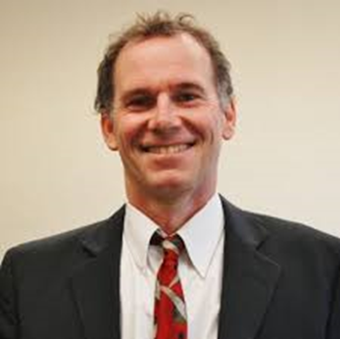
The Way of the Humanist
Illuminating the path from suicide to Wellness
John Sommers-Flanagan, Ph.D.
Professor of Counseling
University of Montana
For free resources, Go to: https://johnsommersflanagan.com/

Slide 2
Gratitude
To Amanda Evans and Victoria Kress of the Association for Humanistic Counselors
To ACA
To life and this moment

Slide 3
In the Beginning
Existentialists, Counseling, and Psychology all spent far too much time and energy (100+ years) mostly studying: What’s WRONG with YOU?
  Psychopathology and mental disorders, OCD, ADHD, ODD, PTSD, etc.
  Freud: “Neurotic misery” to “common unhappiness”
  Help people become more aware of deficiencies and then usually fail in their efforts to fix them

Slide 4
In the Beginning - 2
A Sample from Irvin Yalom:
“I do not like to work with patients who are in love. Perhaps it is because of envy—I, too, crave enchantment. Perhaps it is because love and psychotherapy are fundamentally incompatible. The good therapist fights darkness and seeks illumination, while romantic love is sustained by mystery and crumbles upon inspection. I hate to be love’s executioner” (p. 15)

Slide 5
Myers 1967-2000 Study
Articles About
Articles About
Depression: 54,040
Anxiety: 41,416
Anger: 5,584
Overall Ratio: 21/1 – Why?
How could this be?
Life Satisfaction: 2,582
Happiness: 1,710
Joy: 415

Slide 6
Words (were originally magic)!
Why the preoccupation with suffering and misery?
Constructed privilege and oppression precedes us
  "It is not I who make a meaning for myself, but it is the meaning that was already there, pre-existing, waiting for me ... waiting for that turn of history ... I am a potentiality of something" (from, Black Skin, White Masks, Frantz Fanon, 1952/1967, p. 135)

Slide 7
Words (were originally magic)!
Why the preoccupation with suffering and misery?
Reality and mortality impinge on living
“We are in a world from which there is no escape. None of us will get out alive. Once this fact is recognized and accepted, there is no reason to be afraid of life or death, what I call existential twins. You cannot have one without the other. That is why I often talk about existential courage. It takes courage to live. Death is a given, since people die whether they want to or not” Clemmont Vontress (2014)

Slide 8

our brains seem built to ruminate on negatives
And our well-constructed cultural obsession with happiness makes it worse

Slide 9


















Slide 10
The Dialectics
Suffering
Happiness
Death (and COVID)
Isolation (and COVID)
Meaninglessness
Freedom (and its burdens)
Gratitude
Other people matter: Acts of Kindness
Acts of Meaning or Inspiration
Three Good Things – Mental choosing

Slide 11
The Hope Dialectic
We focus on hope
We get hopelessness
What gives you hope?
What do you look forward to doing?
Who makes your life feel meaningful?
When are you happiest?
I’ve tried everything
Nothing
I am a failure . . . defective . . . unlovable . . . and irrelevant
This is stupid

Slide 12

The Chase Video Clip
Who’s the most validating?
Who’s the most toxic?
1:16:30 – 1:20:00
1:21:45 – 1:24:14

Slide 13

Dealing with irritability
Being irritable
Being pleasant
Resonate with, validate, accept, and sometimes even amplify the irritability
Watch for the emergence of pleasantness, nurture it, and sometimes, create space for (practicing) it (e.g., let’s take 5 min to focus in on how you can express yourself toward others in ways that are kind, pleasant, and pleasing)

Slide 14


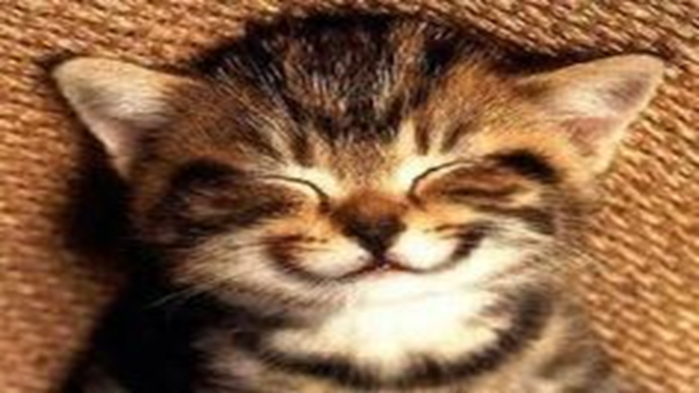
Embracing Happiness
Starting shallow – With behaviors
Happy distractions☺☺, power poses, and movement!

Slide 15

Embracing Happiness – 2
Focusing on cognition . . . and non-binaries
Witness something inspiring

Slide 16
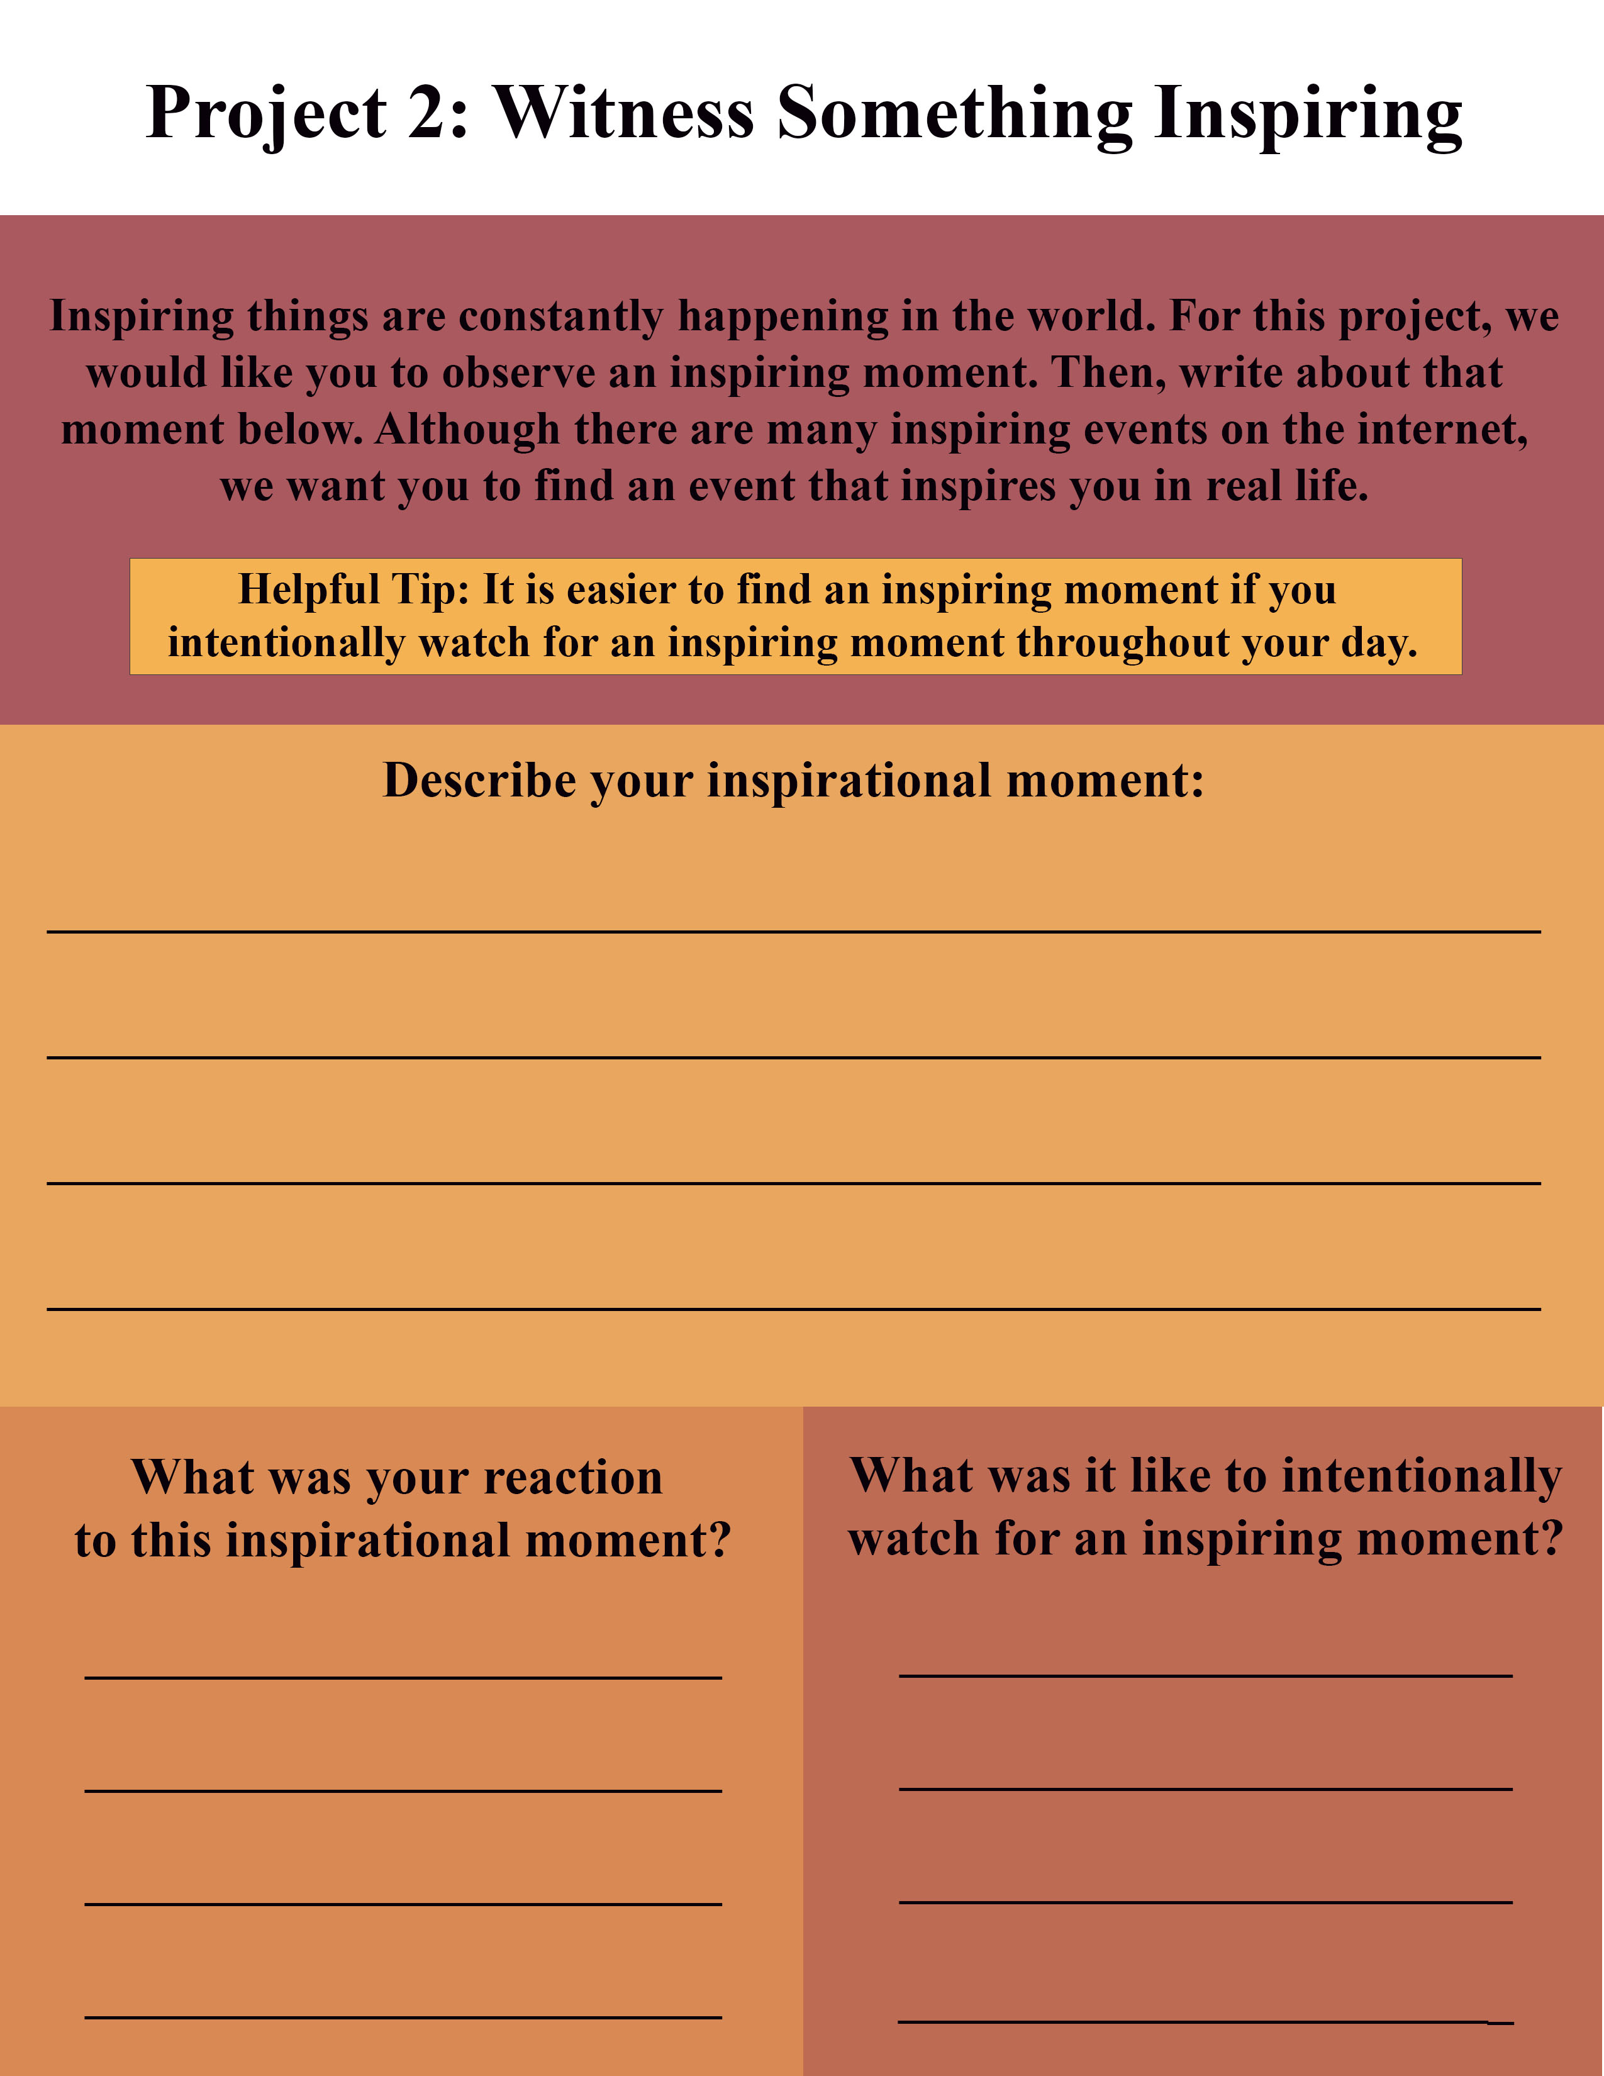
Your Assignment
Now . . .

Slide 17

Embracing Happiness – 3
Staying Cognitive
Do you ponder your existential happiness?
Or do you ruminate on past problems and future stressors?
Or something else?

Slide 18
Embracing Happiness – 3
Three Good Things: Seligman’s signature technique
  Before you go to sleep (or right now)
  Write down (or think about) three good things that happened during the day (or last 24 hours)
  Then track down in your mind “Why” those things happened
  Seligman: After a week, you’ll want to keep doing it (JSF: Maybe)

Slide 19

Demonstration
A Volunteer – Three Good Things
Report three good things that happened during the day (or last 24 hours) . . . As you think of these three things, notice your thoughts and feelings
  What happens when. . . Spoiling
  Not remarkable [coffee; dog walk; talked to old friend]
  What it took (why): Self-awareness, initiative, set aside time

Slide 20

Embracing Happiness – 4
The Attention Tug-of-War

Slide 21
Attention Training and Control
Attention control (aka mindfulness) ALWAYS FAILS; this failure is another natural obstacle to eudaimonic happiness
But Harvard study (n = 2,000+) paying attention to what you’re doing increases happiness ratings (JKZ)
The amazing brain – Now

Slide 22
Pretend Activity
Everyone
Two minutes
Begin at 1 and mentally count your “out” breaths
If you lose track, start back at 1
Be mindfully non-judgmental of losing track and/or make it spiritual

Slide 23
Mindfulness Knowledge and Tricks
The mind is a yapping dog – Give it a bone – Mantra
Balance how much you care about being mindful with NOT CARING AT ALL about being mindful
Extend your outbreath (or use a soothing object) to engage the parasympathetic nervous system (and be less mentally jumpy)
Practice. But remember, practice DOES NOT make perfect

Slide 24
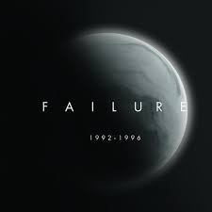
The Big Take-Home Message
Mindfulness is about accepting failure . . .
We always fail to achieve perfect mindfulness
We accept that and value the process
It’s NOT about ACHIEVING mindfulness or relaxation
It’s about the EXPERIENCE of the process of taking time to not try too hard to achieve mindfulness

Slide 25

Embracing Happiness – 5
Back to Gratitude
Like existentialism, we can do spiritual or secular gratitude

Slide 26
Adverts for gratitude
Do you want to increase optimism, improve life satisfaction, be healthier, and exercise more?
Weave intentional gratitude into your life

Slide 27
Gratitude Homework
Toward whom do you want to express gratitude?
Write a postcard or letter or email or text or IM of gratitude to a person you value
Even better: Tell the person directly
Results?? Not about the response.

Slide 28
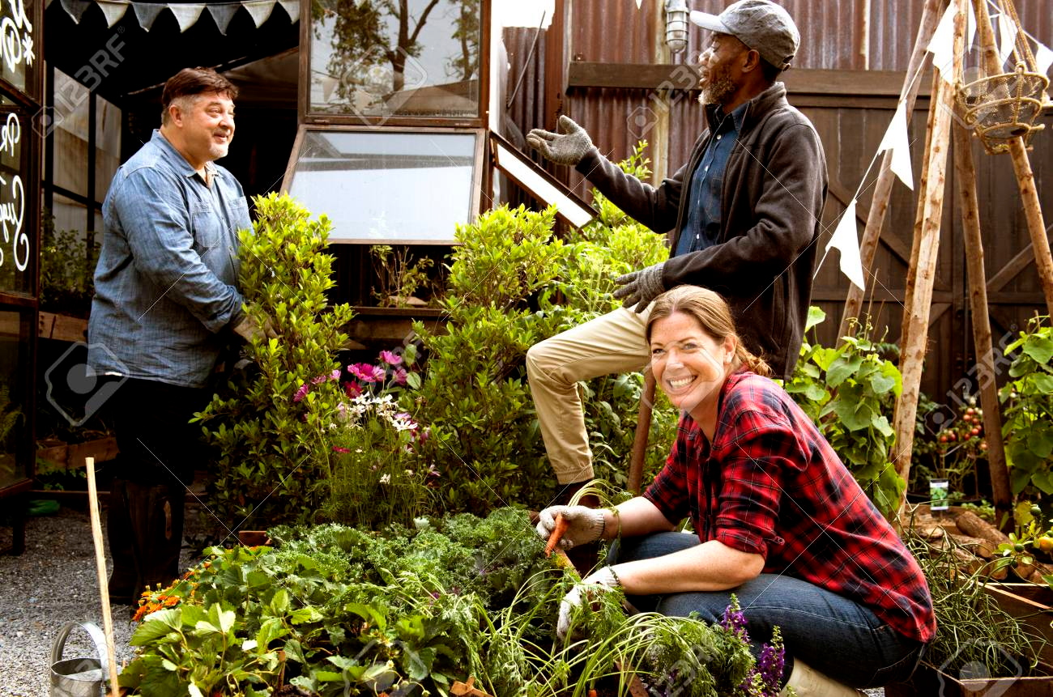
In the End . . .
We’re talking about eudaimonic happiness that involves living well physically, psychologically, socially, spiritually, emotionally, and more. The secret to happiness is no secret . . .
Eudaimonic happiness requires effort

Slide 29
One Last Positive Distraction
Life is hard
We all experience common unhappiness and wonder about ourselves
Emotions are a pain☺
Sometimes, we need distractions
  What songs help you feel your feelings?
  What songs help boost your mood? [JSF and 9th grade basketball]

Slide 30
Stunning Conclusions
The brain, our culture, existentialism, the news . . . are all built to track negativity (and outrage)
Remember dialectics: Side with the affect, come emotionally alongside depression, misery, and suffering AND then watch for openings to move toward wellness
Well-being (eudaimonic happiness) requires at least awareness, intention, effort, reminders, and persistence

Slide 31
Resources
For more homework ideas, just do an internet search: Sommers-Flanagan + Happiness Homework
University of Pennsylvania Positive Psychology Center: https://ppc.sas.upenn.edu/
Greater Good Magazine: https://greatergood.berkeley.edu/
Positive Psychology: https://positivepsychology.com/
The Montana Happiness Project: https://montanahappinessproject.com/

