Slide 1
John.sf@mso.umt.edu
Johnsommersflanagan.com
Love Skills . . .
with John and Rita Sommers-Flanagan

Slide 2
Opening Story
The Orange Street Bridge
36+ years later

Slide 3
Today’s Learning Objectives
Broadly: To discuss how it might be easier to fall in love than it is to stay in love, which is why learning a few love skills is a good idea
Define (sort of) romantic love
Identify 6 predictors of divorce (J. Gottman)
Describe 6 skills for fending off the predictors of divorce (J. Gottman, S. Johnson, and the Jungians)

Slide 4
What We Will Need
Engagement and Participation
Openness to Learning
Commitment to Respect for Different Perspectives

Slide 5
Love Defined: The Book of Love
In honor of Dr. Nichols’s 2021 syllabus and song quotations, we offer this one.
“The book of love is long and boring, and written very long ago.”
Stephin Merritt (Peter Gabriel)

Slide 6
Romantic Love Includes
Passion/Eros
Compassion
Commitment
Communication
Investment
And your experiences?

Slide 7
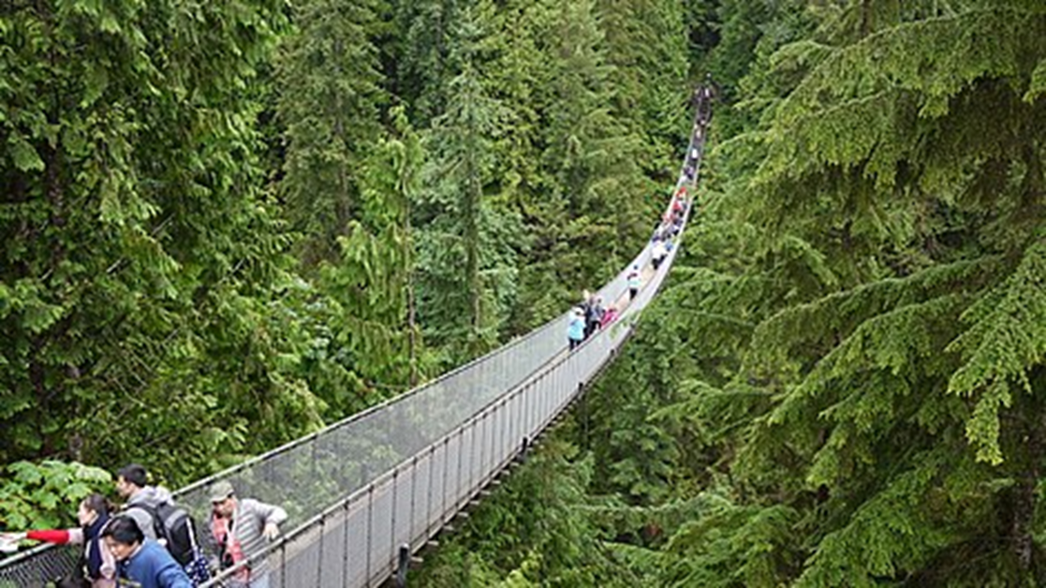
The Bridge Study
Males found female “confederates” more attractive and were more likely to call them when they met them on a suspension bridge.

Slide 8
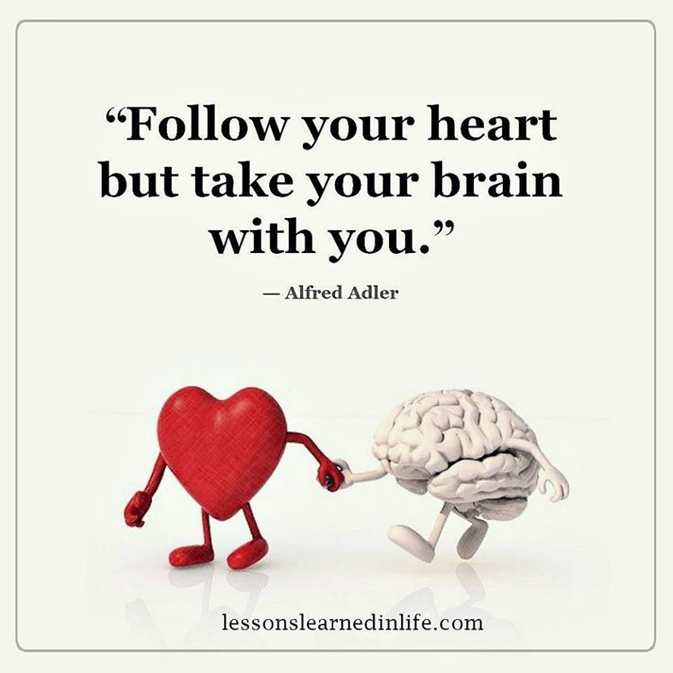
Alfred Adler on Love
Love often starts with physical and emotional passion . . .
Although the physical and emotional passion is fun and enhances relational bonding, love requires more.

Slide 9
Predictor #1: The Harsh Start-up
When partners attack each other with harsh opening statements, less good things happen
What’s a soft start-up?
  I like it when you . . .
  How can we . . .
  What do you think would . . .
What would Adler say?

Slide 10
More Alfred Adler on Love
“An incalculable amount of tension and useless effort would be spared in this world if we realized that cooperation and love can never be won by force.” (A. Adler, 1931, p. 132).
Adler is a fan of the soft start-up.

Slide 11
Predictor #2: The Four Horsemen
Criticism – More global than a specific complaint (Why are you so forgetful? Why don’t you care about my feelings?).
Contempt – Roll your eyes and curl your lip in disgust . . . And see how that works out.
Defensiveness – Victimizing yourself to reverse blame. This involves NOT listening, and defending yourself or counter-attacking.
Stonewalling – Shutting down, turning away, walking out.

Slide 12
Fixing the Four Horsemen - 1
Criticism: Complain about specific behaviors with I statements tied to emotional bids: “I like it when you . . .” “I feel when ___, because ____.”
Contempt: Deal with small things before they deepen and bitterness grows. Culture of appreciation. Gratitude for positive actions.

Slide 13
Fixing the Four Horsemen - 2
Defensiveness: Listen first. Take responsibility. Accept partner’s perspective. Remember, your partner is on your team
Stonewalling: Physiological self-soothing. If you need a break, call time-out; later you can return for a constructive discussion

Slide 14
More Adler
“When applied to love and marriage, it is to pay greater attention to the other person than to oneself, to live so as to make life for one's partner easier and more pleasant.”

Slide 15
Predictor #3: Flooding
Flooding happens when your partner’s negativity becomes overwhelming. You may feel desperate. You may feel very bad about yourself. You may feel the urge to strike back below the belt.
Solutions: Hit pause; self-soothe; visualize your partner at his/her/their best

Slide 16
Predictor #4: Body Language
Turning away and fleeing the scene feels natural and protective. (100 beats/minute; no longer rational)
You’ll need structure, tools, and support to face a situation that has held chronic criticism and flooding.
Counseling may be especially helpful.

Slide 17
Predictor #5: Failed Repair
When you try and fail (even through silliness) to manage conflict and negativity, then you end up feeling discouraged. (Who wants to hug?)
Shifting thinking is important; don’t just turn up the volume, change the channel or modality of communication; you will need small successes to gain traction. Forgiveness.
https://www.gottman.com/blog/r-is-for-repair/

Slide 18
Adler on a Bad Marriage Formula
“There are too many people in our society who take and have great expectations, and too few who give. It seems that too much of human kind is caught in a love and marriage formula that states: Because I love you, you must obey me!”

Slide 19
Predictor #6: Bad Memories
When there has been chronic negativity, couples often “re-write” the past.
Early courtship questions (aka the romantic history).
Mutual savoring from positive psych (do now)
Mutually enjoyable time and activities are essential to shift the mood and remember the positive. Create them!

Slide 20
The Big(gest) Solution
Although rekindling passion is great, more important is for couples to engage in behaviors that strengthen friendship.
Ask: How would I (should I) treat my best friend in this situation?

Slide 21
Adler – One Last Time
“Each partner must be more interested in the other than in himself. This is the only basis on which love and marriage can be successful.” (Ansbacher & Ansbacher, 1956, p. 432)

Slide 22
Conclusions
What did you find interesting about this presentation?
What would you like to remember??

