Slide 1
Being Seen, Being Heard
Strategies for Working with Adolescents in the Age of Tik Tok
John Sommers-Flanagan
University of Montana
Chinwé U. Williams
Owner, Meaningful Solutions Counseling
***********

Slide 2


Introductions
John introduces Chinwé
Chinwé introduces John
Who are you? –
Our intersectional and multiple identities

Slide 3



Adolescents: The Challenge
Chinwé stories
John stories
Your stories

Slide 4

Principles
Being seen and heard: Use validation, radical acceptance, radical respect, and radical interest (reframing tough kids and empathically “siding with the affect, not the behavior”)
Be transparent (genuine) and non-threatening
Use counter-conditioning
Offer collaboration

Slide 5
Six Strategies
Conversation sparklers (Bauman, 2013)
The APS and Wishes and goals (S-F & S-F, 1997)
Social media profiling (Davis, 2013)
Three good things – and the Tik Tok challenge (Lyubomirsky, 2007)
Circle of trust (Keller, 2005)
Mindful vision casting (Himelstein, 2016)

Slide 6

Conversation Sparklers
How Was Your Day?
•
Notes:
How was school today?
Good.
What did you do?
Not much.
Sound familiar?

Slide 7

Conversation Sparklers…
Keep questions open-ended. “How”, “why,” and opinion-based questions work well.
Avoid asking the same questions, session after session.
Have a range of questions across different topics: personal experiences; likes/dislikes family life; dreams; hobbies, aliens

Slide 8
The APS and Wishes and Goals
Using an authentic purpose statement
TJ Clip – Opening
  We are in the room for a reason
  Make it transparent
  Speak your purpose openly
  Speak it as an opening AND whenever the need manifests
  Watch clip here: https://www.youtube.com/watch?v=noE2wMMNLY4

Slide 9
Wishes and Goals
Claire Clip – Three wishes
  Listen for goals under the wishes
  Watch clip here: https://www.youtube.com/watch?v=rHHrMC8t6vY

Slide 10

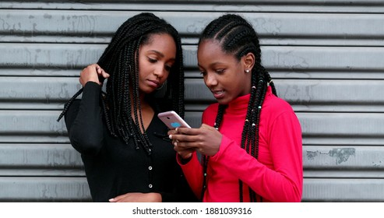
Social Media Profiling
Notes:
describe how they see themselves and how they believe other people see them. You can customize the prompts on the template to target individual clients’ treatment goals. This technique provides a venue for the adolescent to engage with the counselor and share the adolescent’s perceptions of self, fears about how others may see the adolescent, and dreams or hope about who the adolescent wants to be potentially without as much discomfort

Slide 11

Social Media Profiling
How do you see yourself?
How do you believe other people see you?
What are some of your fears about how others may perceive you?
What do you wish they saw in you that social accounts don’t show?
Can social media have a positive and negative influence?
How can you use social media in a way that doesn't cause additional stress?
Notes:
describe how they see themselves and how they believe other people see them. You can customize the prompts on the template to target individual clients’ treatment goals. This technique provides a venue for the adolescent to engage with the counselor and share the adolescent’s perceptions of self, fears about how others may see the adolescent, and dreams or hope about who the adolescent wants to be potentially without as much discomfort.
Can social media have positive and negative influences?
If you don’t use social media, can it still affect your mental health?
Can elicit a discussion about highlight reels and social currency. This really resonated with my clients, as they often reported they often deleted pics and posts that didn’t get enough likes or felt the need to constantly check how many likes they get.
My clients who shared that they had actually deleted certain social media apps, talked about how they felt better. Others report that they just unfollow accounts that make them feel bad about themselves. Some shared fears--said they could never delete apps or unfollow people for fear of being left out or making others upset.

Slide 12
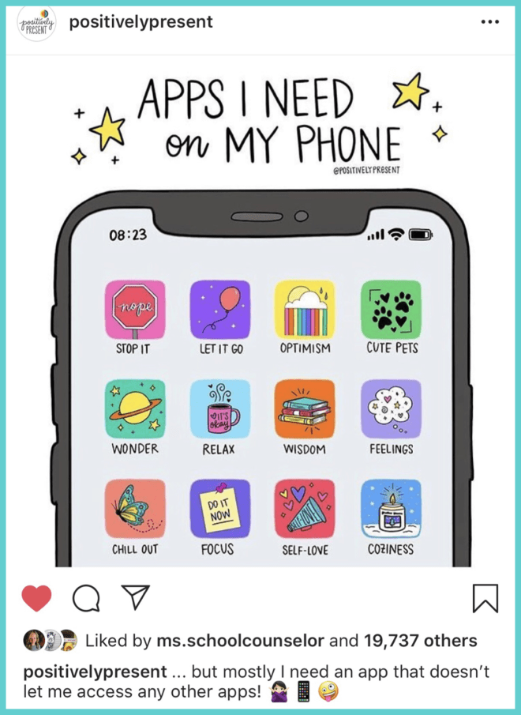
Positively Present
Notes:
One of my favorite accounts to follow is Positively Present by Artist Dani DiPirro She’s an artist who posts encouraging, inspiration, and funny illustrations that I always find myself saving. She created an illustration of “apps I need on my phone,”

Slide 13
Three Good Things and the Tik Tok Challenge
Seligman’s evidence-based happiness technique
Ask the question
Pull out the underlying values, personality traits, etc.
Make the Tik Tok challenge

Slide 14

Old Three Good Things vs. . .

Slide 15
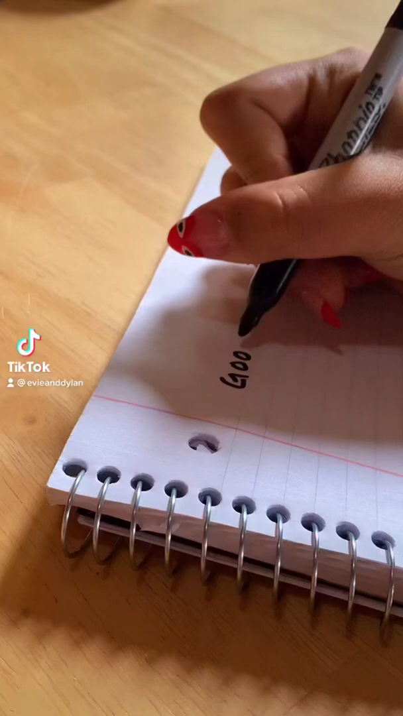
New Three Good
Things on
Tik Tok

Slide 16

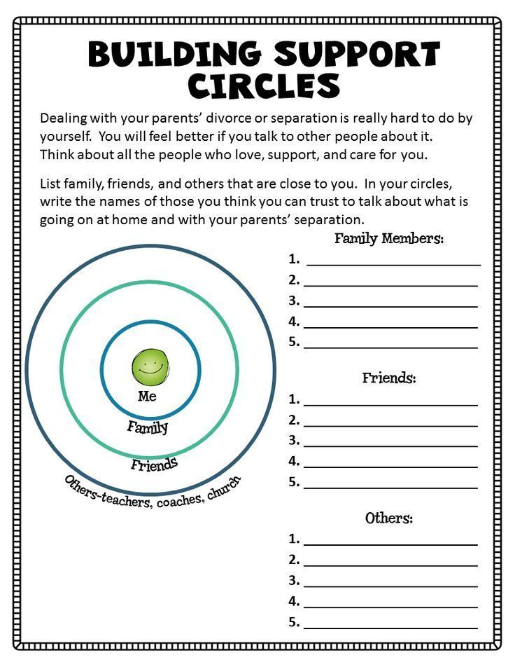
Circle of Trust
Add info here
Notes:
No family is perfect. There will be differences. Even arguments.
Family relationships don’t always happen biologically. Sometimes it happen in other forms.
Circle of Trust: This activity is on the topic of trust, and who the adolescent feels they can trust in their lives. This activity challenges adolescents to explore and identify people they can trust, the qualities those trustworthy people possess, and how they feel when they can trust that person. The activity challenges the teens in the following ways: to acknowledge that trusting someone is not easy; to perform a self-analysis on themselves and their family; to describe how they see their relationship with their family members and loved ones; and to discover ways to build trust and respect within their family.
Paparazzi — Many teens follow celebrity news, and one of the primary ways celebrity lives are documented is with paparazzi photos. In this activity, the teen is instructed to be their own paparazzi, taking pics of the most important people in their life.

Slide 17

Cultural Humility & Therapeutic Alliance
Microaggressions have an adverse effect on the therapy process and outcomes (Owen et al, 2011)
When alliance is strong, adverse effects were mediated (Owen et al, 2015)
Higher ratings of therapist’s cultural humility were associated with positive ratings of the working alliance and client’s perceived improvement in therapy.
Repair is essential. How?
  Increase cultural awareness
  Initiate cultural conversations (Day-Vines et al, 2007)
  Display humility and admit mistakes
  Check in regularly
Notes:
Client's can experience micro-aggressions regardless of counselors race or ethnicity.
In other words, when heapist maintans storng rapprt, microagressions have less of an impact
Rupture is a breakdown in the therapeutic relationship
In my practice, intake process, firsts session, I invite conversations. I create a space where cultural factors and world events ca be broached
Use client satisfaction surveys
I ask teens to send an email others text if there's something on their remind they'd like for me to bring up during next session. Works really well with introverted contemplative clients. Nit just but other therapeutic content. I don’t respond.

Slide 18

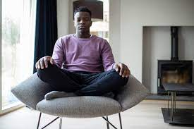
Mindful Vision-Casting
Have your teen close eyes or soften their gaze.
Attend to each breath as it comes and goes.
Notice how chest and abdomen contracts and expands.
I invite you to think about yourself 10 years into the future. Think of yourself as a huge success.
What does that mean to you?
Where are you waking up every morning? What type of job do you have? Hobbies? Do you have family?
Look around and really experience this.
How do you feel?
When comfortable, slowly open your eyes.
Notes:
Developing the vision: What does success look like?
Counselor can help teens develop a vision for the future (especially when it comes to success) through a mindfulness meditation
use the following script (and if not, these prompts can be used conversationally as well):Have your teen close their eyes or softly gaze at their lap or straight ahead and pay attention to their breathing.
Have your teen simply pay attention to each breath as it comes and goes.
Ask your teen to notice how their body is feeling and breathe through it. Let your teen know that if they are anxious, it’s just a feeling and it will pass.
Encourage your teen to separate themselves from their emotions. Tell your child to pay attention to their chest and abdomen, how they contract and expand. Ask them to pay attention to how their breath feels on their nostrils, breathing in and out.
Ask your teen to breathe without judgment and without trying to change the rhythm of their breath.
Where are you waking up every morning? In a house? An apartment? What type of job do you have? Do you have family?

Slide 19
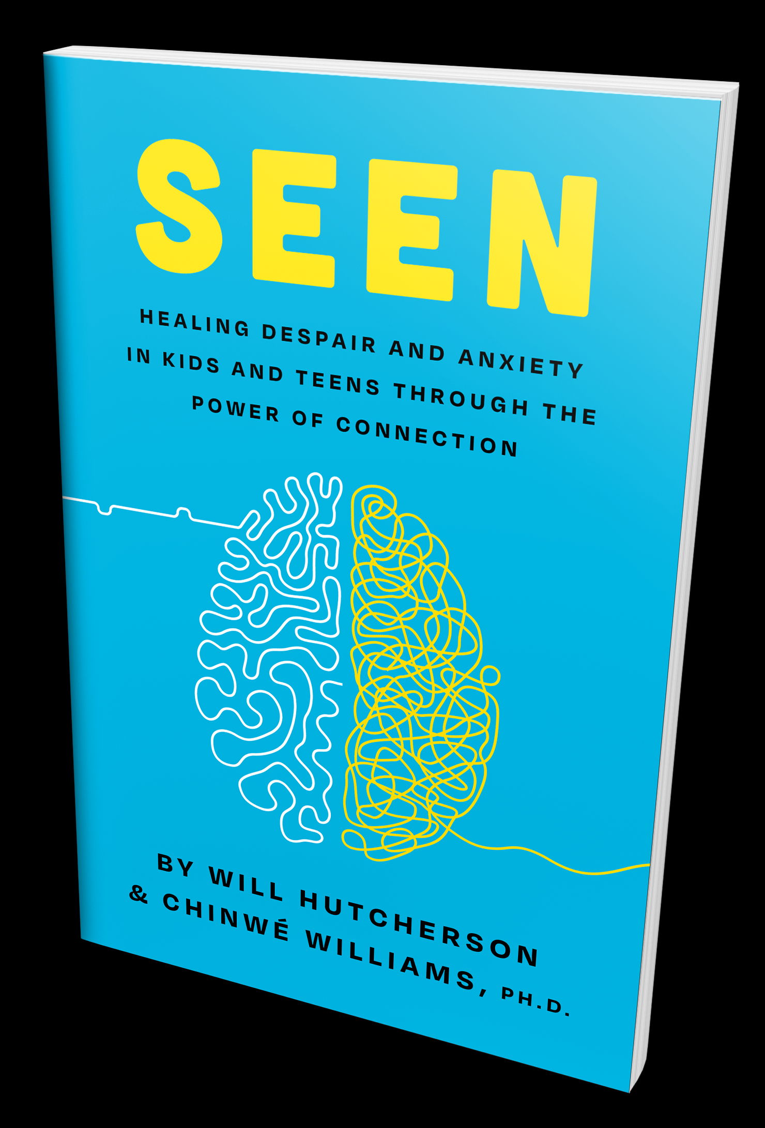

Resources
Seen by Hutchenson and Williams
Tough Kids, Cool Counseling by John and Rita S-F

Slide 20
Resources
For Chinwé: https://meaningfulsolutionscounseling.com/ and https://orangebooks.com/tribe-leaders/seen/
For John: https://montanahappinessproject.com/ and https://johnsommersflanagan.com/

