Slide 1
Happiness and Well-Being
LW49 – Stakeholder Gathering
October 21, 2019
John Sommers-Flanagan, Ph.D.
University of Montana – Department of Counseling
Sponsored by Big Sky Youth Empowerment Program (BYEP)
john.sf@mso.umt.edu or for Info: https://johnsommersflanagan.com/

Slide 2
Introductions
John SF
University of Montana
Blogging at johnsommersflanagan.com
And you . . . ?

Slide 3





Let’s Talk
Happiness

Slide 4
Background
Suicide assessment
Happiness is fragile
The Instagram/Facebook effect
Well-being

Slide 5


Slide 6
Roads to Well-Being
Emotional
Cognitive or mental
Social or interpersonal
Physical
Spiritual and cultural
Behavioral

Slide 7
Why is it So Hard?
Ironically, for many of us, our natural inclination is to nearly always do the opposite of what will create well-being

Slide 8
Life Dimension | Suicide | Well-being
Emotional | Excruciating and unremitting distress | Emotional expression; separate from self
Cognitive/Mental | Hopelessness; impaired problem-solving | Creative problem-solving; accurate, helpful thoughts
Social/Interpersonal | Thwarted belonging and perceived burden | Social belonging and feeling useful
Physical | Agitation; pain; poor physical health; addiction | Exercise, breathing, physical self-soothing
Spiritual/Cultural | Meaninglessness; spiritual isolation | Living with meaning
Behavioral | Behaviors with suicidal intent | Safety planning and positive actions

Slide 9
The Emotional
Roads to Well-Being
The Pennebaker study
½ are writing about trivia
½ are writing about thoughts and deeper emotions
Outcomes: Fewer medical visits; better immune functioning; happier

Slide 10
The Opposite of
Emotional Wellness
In the emotional dimension, there’s a tendency to choke off emotional expression . . . and avoid thinking about trauma . . . rather than actively exploring emotional pain and making meaning around it

Slide 11
Cognitive Roads to Well-Being
Your thoughts influence your physical and emotional well-being
Cherries
What’s good about you?

Slide 12
Cognitive Strategies
Mindfulness meditation
CBT on views of self, others, future
Creative problem-solving
Savoring

Slide 13
Savoring
What is savoring?
Deliberate effort to extend and expand positive experiences
  Track and review fun (one funny thing from today)
  Track and review meaning (one meaning ful thing from today)
  Create, discuss, time travel

Slide 14
The Opposite of Savoring
We often dampen or spoil good experiences, while savoring or chewing on our mistakes
Anybody ever get stuck chewing on the negative or spoiling the positives?
We lean toward distractions, rather than mindful acceptance of what is

Slide 15
Social Roads to Well-Being
Old theory from Alfred Adler
Belongingness
Socially useful
These two social factors reduce suicidality (Joiner, 2005)

Slide 16
Social Roads to Unhappiness
An internal revenge philosophy
Many internal factors (anxiety, inhibition, self-consciousness) stop us from stepping up and being useful

Slide 17
Physical Roads to Well-Being
The DATE Study (Depression in adolescence treated with exercise)
  But how do we get them to breathe and stretch (exercise!)
Gentle, Loving, and Consenting Touch
  But we need to be careful here

Slide 18
Spiritual/Cultural
Roads to Well-Being
Active pursuit of meaning
  But it’s so easy to watch television and play on Instagram
Regular involvement in spiritual, religious, or social justice groups
  But staying home can feel good in the moment

Slide 19
Activity: Gratitude
Write a postcard or letter or email or text or IM of gratitude to a person you value
Even better: Tell the person directly
Results?? Not about the response.
Visualize . . . Who do you tell . . . in this room?

Slide 20

Stunning Conclusion
Well-being requires intention, effort, and reminders

Slide 21
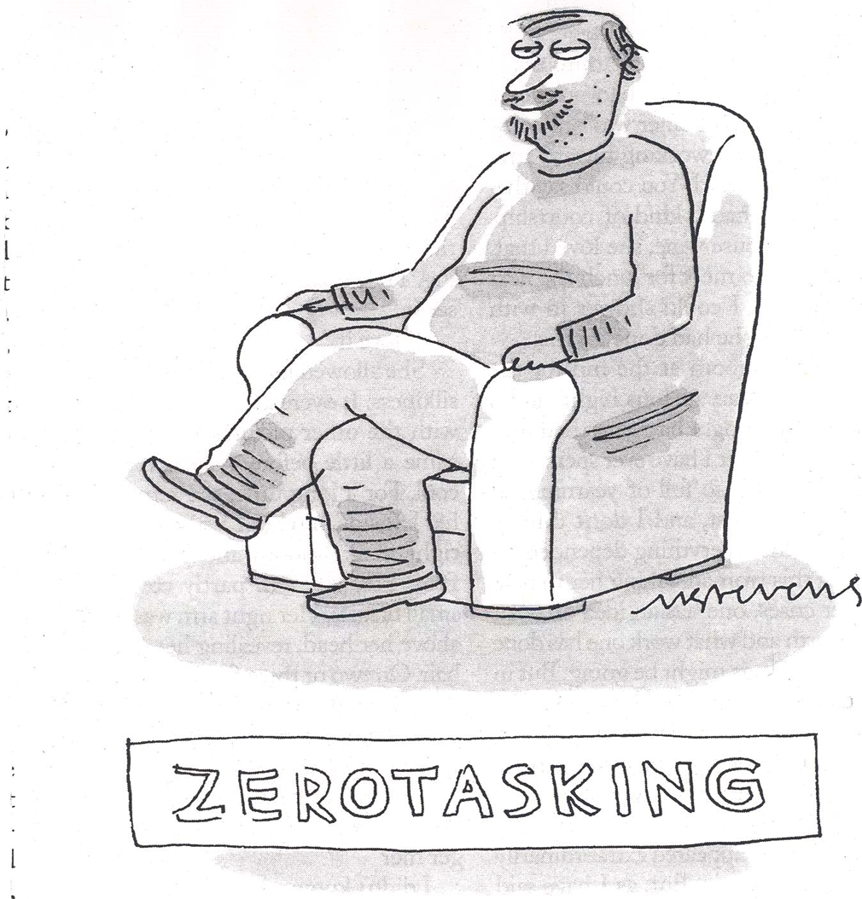
Questions???

