Slide 1
Burning Out, Burning Up, or
Just Singed
Coping with Stress and Living Well
John Sommers-Flanagan, Ph.D.
University of Montana – Department of Counselor Education
john.sf@mso.umt.edu

Slide 2
Introductions
John SF
University of Montana
Blogging at johnsommersflanagan.com
And you . . . ?

Slide 3
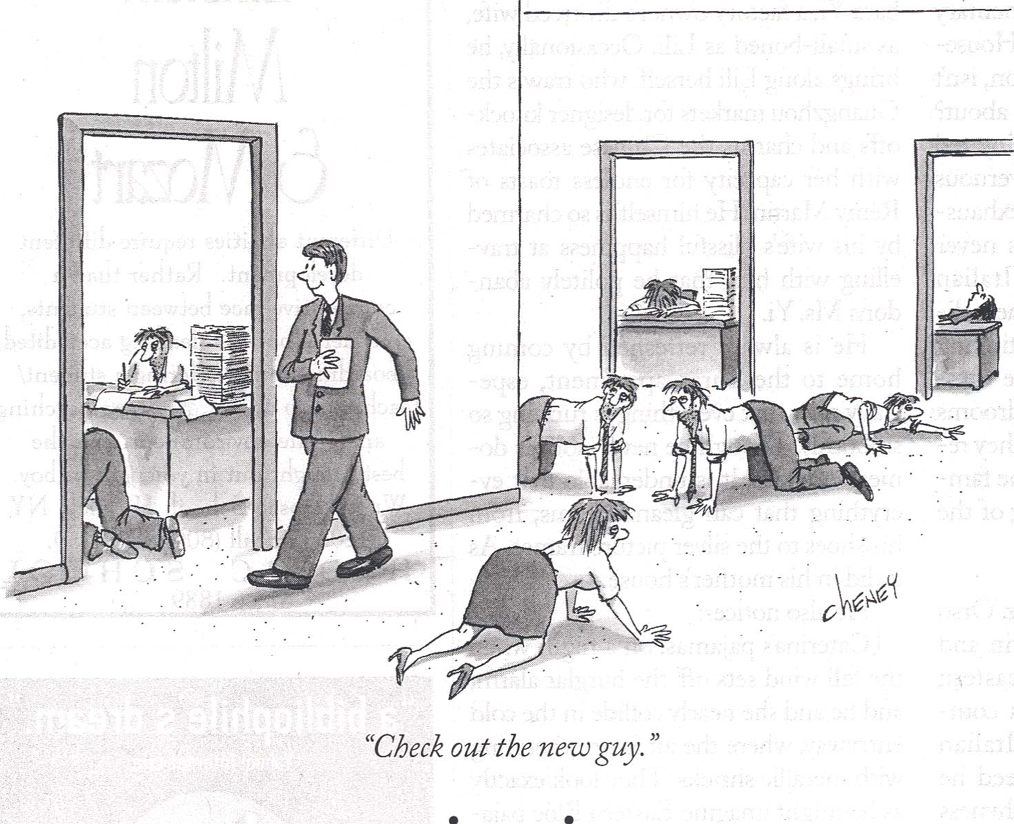
The Plan: Let’s Talk about Work and Stress and Burnout and other fun things like that

Slide 4
Introductions II
None Of Us Are Getting Out Of Here Alive...
“... So please stop treating yourself like an afterthought. Eat the delicious food. Walk in the sunshine. Jump in the ocean. Say the truth you’re carrying in your heart like hidden treasure. Be silly. Be kind. Be weird. There’s no time for anything else.” - Nanea Hoffman

Slide 5
The Plan
[Seriously this time]
We will discuss
  What is stress?
  What is burnout?
  What causes stress and burnout?
  Activities/solutions to stress and burnout
  Stunning conclusions

Slide 6
Our Ground Rules
Be open to learning
Communicate respectfully
Engage in experiential activities to whatever extent you’re comfortable [*ignore me as needed]
Take care of yourself and have as much fun as we can while we learn together

Slide 7
Opening Story and Goals
Full disclosure**
Warning: There is profanity in this story
“One perfect SFBT hour”

Slide 8
Definitions – Merriam-Webster
Stress: “A physical, chemical, or emotional factor [or force] that causes bodily or mental tension and may be a factor in disease [or distress] causation.”
Burnout: “Exhaustion of physical or emotional strength or motivation usually as a result of prolonged stress or frustration”
Burnout often includes (a) emotional exhaustion, (b) depersonalization, and (c) no sense of personal accomplishment (meaning)

Slide 9
What Causes Stress (and burnout)?
Short answer: Pretty much anything☺
The Holmes and Rahe Scale
Marriage
New Job or promotion
New family member
Winning the lottery
Others? [Theoretically, death of spouse is ranked as #1 stressor]

Slide 10
PHC and Stress and Burnout
Working at PHC involves:
  Interpersonal intensity
  Multitasking
  Suicide prevention and intervention
  Trauma support, child abuse reporting, etc.
  Dealing with people – Supervisors, Administrators, Patients, and Co-workers who are not always perfectly pleasant and supportive

Slide 11
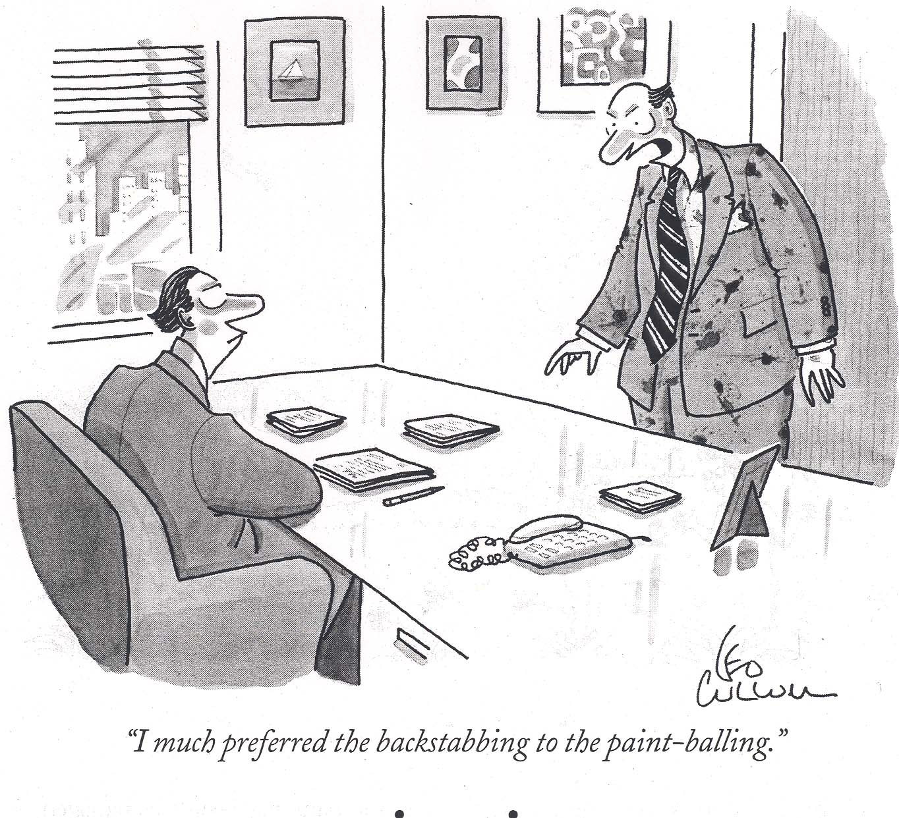

Slide 12
Activity #1: Self-Awareness
Exploring YOUR Stress Response
Get ready to TALK
Sixty seconds

Slide 13
Activity #1: Debriefing
  Where did you feel the stress in your body?
  What thoughts were popping in and around your brain?
  What emotions did you feel?
  What desired ACTIONS could you feel in yourself?
  It’s good to know yourself and your usual stress response

Slide 14
Activity #2: the Natural Solution+
Breathing and awareness
  We all breathe and can strive to maximize the physiological and neurological benefits of breathing
  Notice your thoughts
  Notice your body, the temperature, smells, sounds
  Notice the room and the view from inside yourself
  Notice your friends

Slide 15
Activity #2: Debriefing
  What gets in the way? [Yapping dog]+
  What helps? [knowing what gets in the way]+
  Herbert Benson’s (1975) big four: Comfortable position, quiet place, mental device, and passive attitude

Slide 16
Intellectualizing Together
 | Preparation | Coping | Self-Reinforcement
Physical | Exercise | Breathing | Latte
Mental/Cognitive | Mental practice (planning) | Guiding self-talk | The best-friend whisper
Emotional | Know thyself | Let the emotion be there | Donuts☺
Social | Coaching/Support | Your team (posse) | High fives all around
Cultural | Sweat lodge | Ancestor strength | Humor and laughter
Spiritual | Prayer | Prayer | Prayer

Slide 17
Activity #3: Words were originally Magic
Milk, Milk, Milk
Think of all the qualities associated with the word milk
Repeat word for 45 seconds [Together]
Reflect

Slide 18
Milk, Milk, Milk – Research
Masuda et al., 2009
Two studies – UGs generated a negative self-referential thought
Rated the thought on discomfort and believability
They said the word repeatedly out loud for: 1, 3, 10, 20, or 30 seconds.
They rated the emotional discomfort and believability of the word again.

Slide 19
Research Results
Emotional discomfort of the word went down within the 3 – 10 seconds
Believability took longer, about 20 – 30 seconds.
Emotional discomfort and believability may be different constructs.

Slide 20
Activity #3: application
Pick a word that causes you stress
All together now . . .
Implications: How do you get away from the WORDS?

Slide 21
Activity #4: Gratitude
Writing a postcard/letter/email/text/IM of gratitude to a meaningful person
When? How often? Results??
Now: Visualize . . . Who do you tell . . . in this room?

Slide 22
Activity #5: distraction
This is the simplest approach of all . . . EXAMPLES
What’s needed is the ability to pull back from the moment and get mental and emotional distance
You have to want to do it

Slide 23
Stress Solutions at work: creating rituals
  No shop talk at lunch
  Transition to the person you are at home
  Your transition song(s)
  Message to a friend/partner; prayer; mindfulness meditation
  Going on a run; yoga

Slide 24
Homework Activities
Intentionally develop your stress management repertoire [Research tip: Having a variety of SM activities is more effective]
Identify something new [from today] that you will try to do this year to manage your stress
Express gratitude to someone at work . . . every day

Slide 25
Stunning Conclusion
We cannot “solve” stress and burnout
But we can manage it constructively through physical, mental, emotional, social, cultural, and spiritual methods

Slide 26
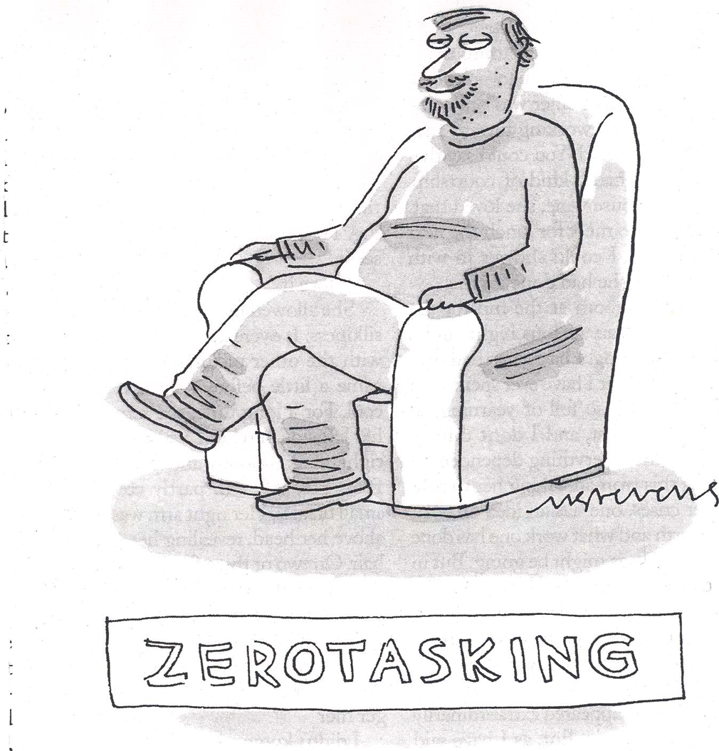
Questions???

