Slide 1
Peaceful Pathways to Stress Management for School Counselors:
Mainstream and Cultural Perspectives
John Sommers-Flanagan, Ph.D.
Salena Beaumont Hill, M.A.
University of Montana – Department of Counselor Education

Slide 2
Introductions*
Salena
John

Slide 3
Today’s Plan
A morning with a information and experiences that help us expand our:
  Stress-related self-awareness
  Knowledge and understanding of the many dimensions of human stress and the stress response
  Application of many* distinct and overlapping approaches to stress management, self-care, and neurobiological behavioral regulation

Slide 4
Our Ground Rules
Be open to learning
Communicate respectfully
Engage in experiential activities to whatever extent you are comfortable [*ignore us as needed]
Take care of yourself and have as much fun as we can while we learn together

Slide 5
Opening Story
Full disclosure**
Warning: There is profanity in this story
“One perfect SFBT hour”

Slide 6
Opening Thoughts
School counseling involves:
  Interpersonal intensity
  Multitasking
  Suicide prevention and intervention
  Trauma support
  Parents☺
  Teachers☺☺
  Administrators☺☺☺

Slide 7
Opening Thoughts II
Survey: Your school counseling frustrations?
“If you don’t know your hot buttons you’re destined to get them pushed”
The definition of burnout: “A state of fatigue or frustration brought about by devotion to a cause, way of life or relationship that failed to produce the expected reward”

Slide 8
Self-Awareness I: Centering
Breathing and awareness [Ways to think about this]
  Notice your thoughts
  Notice your body
  Notice what you want, your impulses
  Notice the temperature, smells, sounds
  Notice the room and the view from inside yourself
  Welcome each other

Slide 9
Self-Awareness II*
Debrief on centering
  What gets in the way? [Yapping dog]+
  What helps? [knowing what gets in the way]+

Slide 10
Self-Awareness III
Exploring YOUR Stress Response
Get ready to TALK
Sixty seconds

Slide 11
Self-Awareness IIIA
Debriefing
  Where did you feel the stress in your body?
  What thoughts were popping in and around your brain?
  What emotions did you feel?
  What IMPULSES or desired ACTIONS could you feel in yourself?

Slide 12
Self-Awareness IIib*
Debriefing
  Stress genogram
  Know thyself!
  And cope with your stress based on your self knowledge
  “Stress accumulates; opportunity ameliorates” (Garbarino + ACES)
  Intergenerational stress and trauma (ACES)

Slide 13
Intellectualizing Together
 | Preparation | Coping | Self-Reinforcement
Physical | Exercise | Breathing | Latte
Mental/Cognitive | Mental practice (planning) | Guiding self-talk | Mocha
Emotional | Know thyself | Let the emotion be there | Donuts
Social | Coaching/Support | Your team (posse) | High fives all around
Cultural | Sweat lodge | Ancestor strength | Humor and laughter
Spiritual | Prayer | Prayer | Prayer

Slide 14
Activity: The Natural Solution
What happened in your body?
What happened in your brain?
What about this experience “worked” for you?
What didn’t work so much?
Why does it work for some people, but not for others
Which category of strategy did we use?

Slide 15
Words were originally Magic
Milk, Milk, Milk
Think of all the qualities associated with the word milk
Repeat word for 45 seconds [Together]
Reflect

Slide 16
Milk, Milk, Milk – Research
Masuda et al., 2009
Two studies – UGs generated a negative self-referential thought
Rated the thought on discomfort and believability
They said the word repeatedly out loud for: 1, 3, 10, 20, or 30 seconds.
They rated the emotional discomfort and believability of the word again.

Slide 17
Research Results
Emotional discomfort of the word went down within the 3 – 10 seconds
Believability took longer, about 20 – 30 seconds.
Emotional discomfort and believability may be different constructs.

Slide 18
application
Pick a word that causes you stress
All together now . . .
Results?? [Preparation; Coping; Self-Reinforcement]
Implications: How do you get away from the WORDS?

Slide 19
Activity: creating rituals
  No shop talk at lunch
  Transition to the person you are at home
  Your transition song(s)
  Message to a friend/partner; prayer; mindfulness meditation
  Going on a run; yoga
  Table talk
  What’s so hard about these simple rituals that we know are good?

Slide 20
Acceptance and Commitment Therapy (Act)*
  Acceptance vs. problem-solving
  The Serenity Prayer
  ACT, mindful acceptance, and the Brain
  Insula exercises
    John and Selena Demo

Slide 21
Group activity: The behavioral plan
Student One-Liners
What student comments (including nonverbal behaviors) really get under your skin?
How do you deal with these?
Could you improve on your response to these one-liners?
How?

Slide 22
Activity: Gratitude
Writing a postcard/letter/email/text/IM of gratitude to a meaningful person
When?
How often?
Results??
Now: Visualize . . . Who do you tell . . . in this room?

Slide 23
Break Time
Take that GRATITUDE and spread it around during break
Louis Armstrong or Just Breathe

Slide 24
Activity: The one method
There is only ONE method for anxiety/stress reduction
Let’s do it now . . .
As the SLEEP SOLUTION

Slide 25
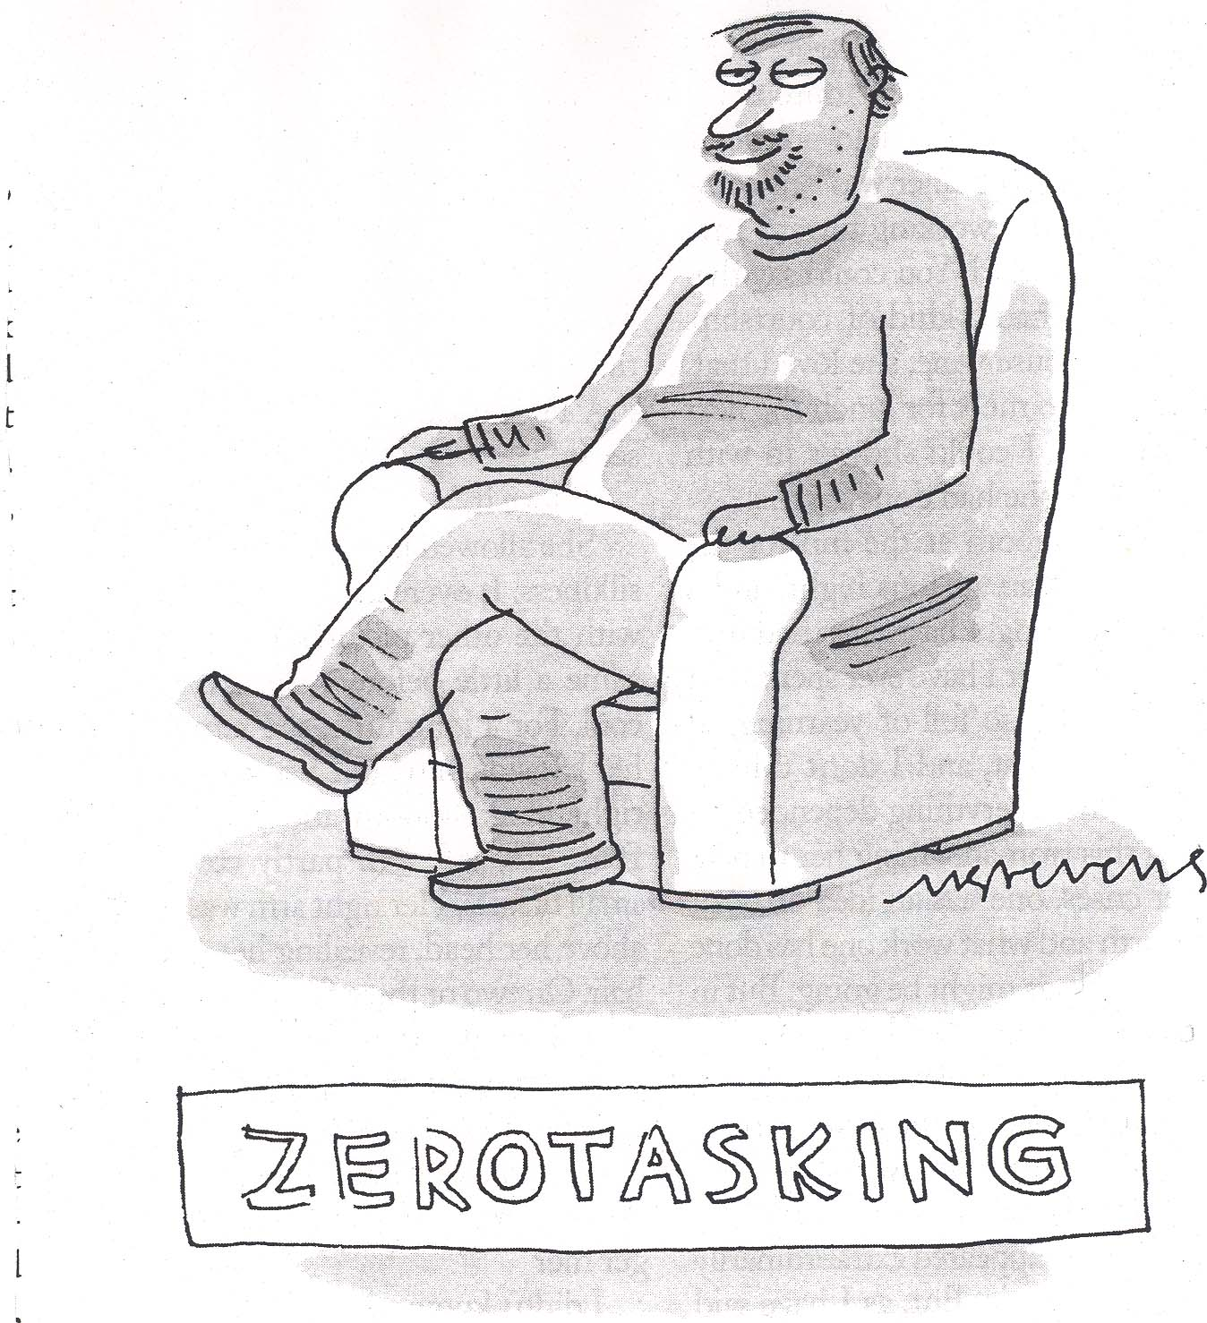

Slide 26
debrief: The one method
What worked or didn’t work for you?
What is theoretical principle is this approach based on?
What strategy and category did we employ?
Could this fit for all the strategies and categories?

Slide 27
Activity: storytelling
Salena
John
Others

Slide 28
Activity: Letter to your child
Opt in or opt out
Non-dominant hand-writing

Slide 29
Activity: distraction
This is the simplest approach of all . . . EXAMPLES
What’s needed to do it is the ability to pull back from the moment and get distance
You have to want to do it

Slide 30
Closing Activity
Get with a partner/table
Share your favorite stress management activities
If you can, identify something new [from today] that you will try to do this year to manage your stress

